Slide 1

Deal Manthan
Team GenerationX
By
Abinaya Sampath
Ankur Gupta
Ayush Mittal
Deven Pawar

Slide 2
What is Deal Manthan ?
Deal Manthan is a web crawler that helps to find the seller who gives the best deal for a product
Three main functionalities are
Collecting product information from specific categories of interest.
Collecting product prices from all categories on a retailer site.
Option to share your individual search on social media

Slide 3
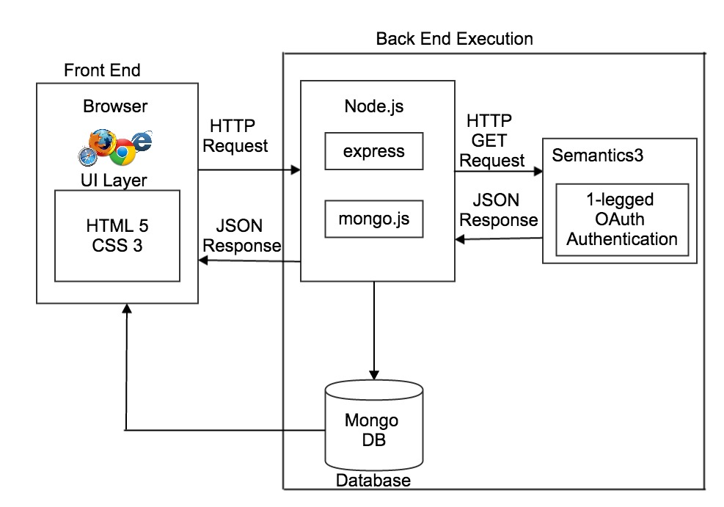
High Level Architecture

Slide 4
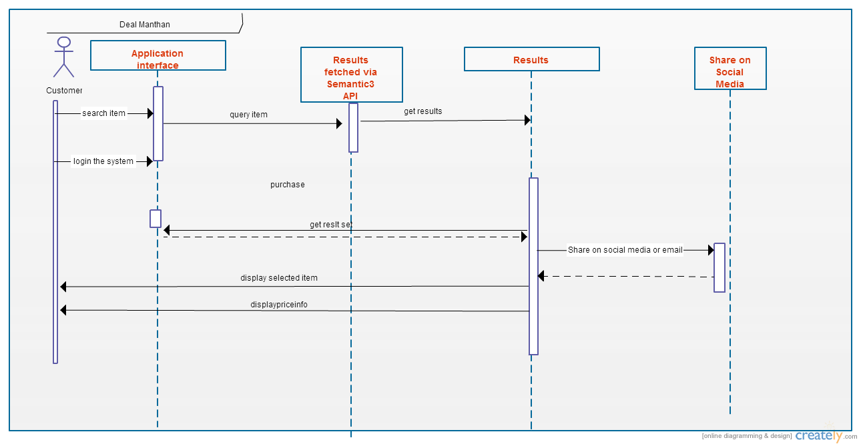
Sequence Diagram

Slide 5






Technology Stack

Slide 6

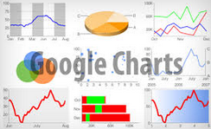
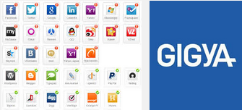


Technology Stack (cont'd)

Slide 7
Semantics3
It allows us to access the data about many different products and prices
The request sent is an HTTP GET request
The response is in the form of JSON
JSON data is parsed to display the necessary information
The products listed are sorted in the order of price

Slide 8
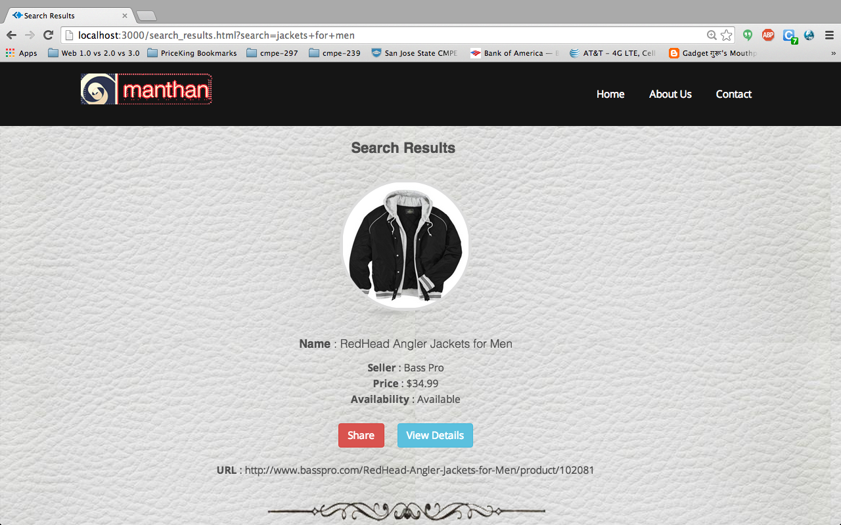
Search
The user can enter the product to be searched and the list of products is updated dynamically

Slide 9
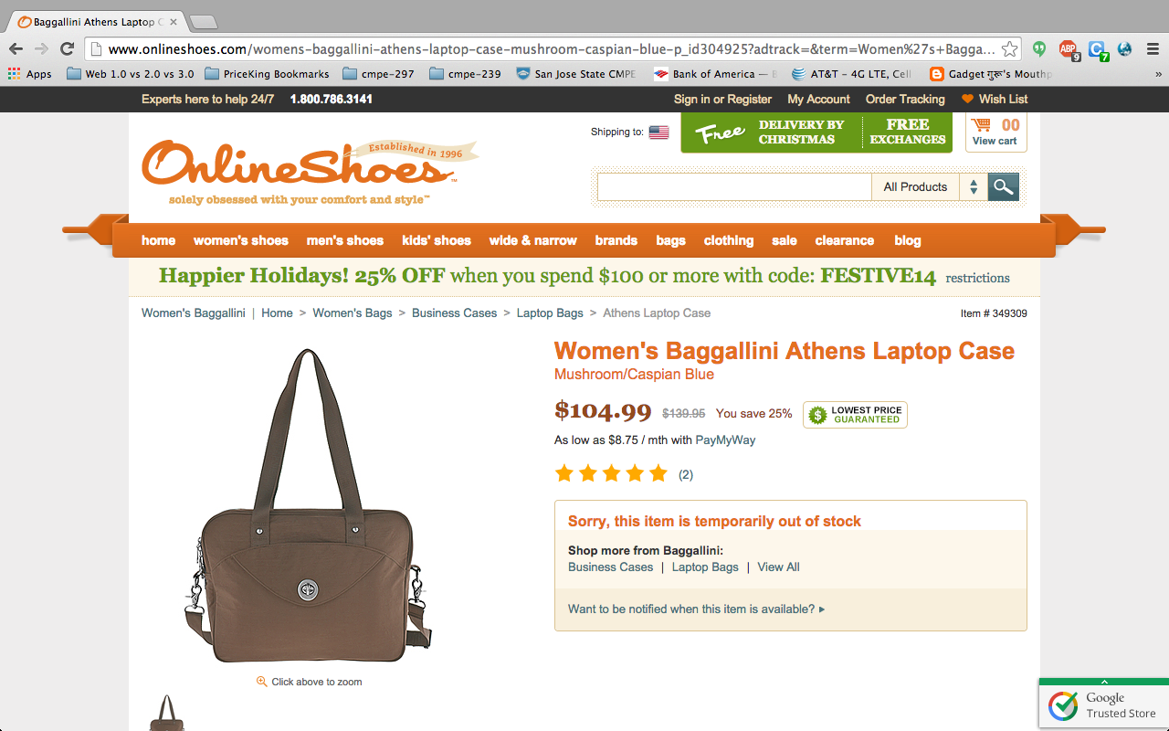
Product Page:
Go to the actual Product Page for full specs

Slide 10
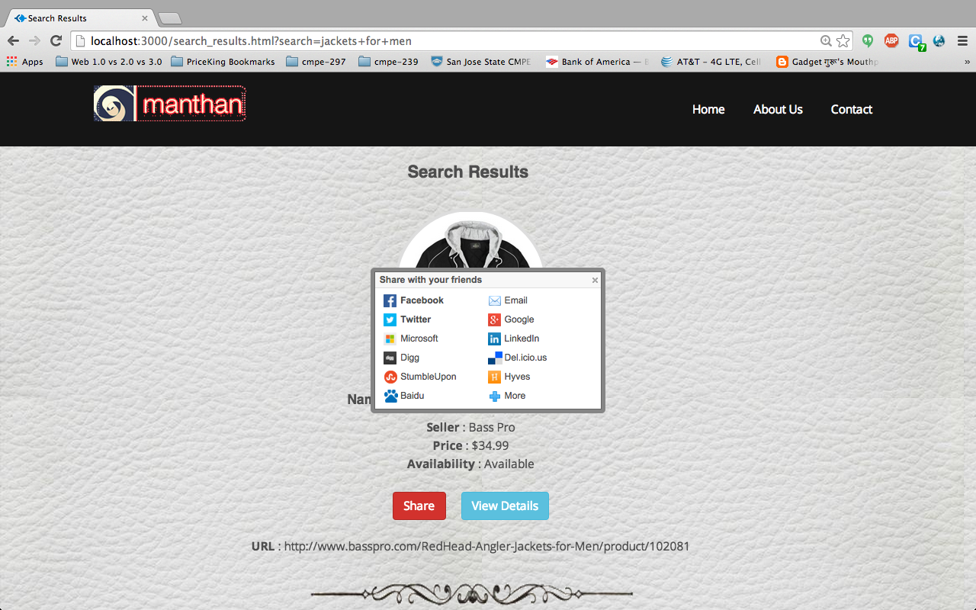
Share
User can share their favorite deal to others via social media

Slide 11
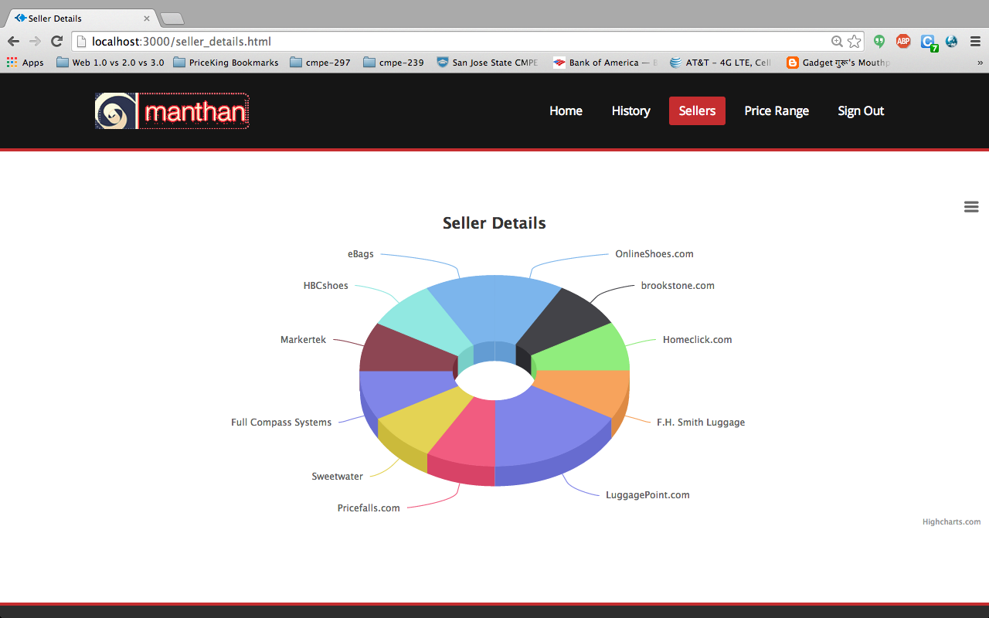
Seller’s Info:
Information about various sellers through Highcharts

Slide 12
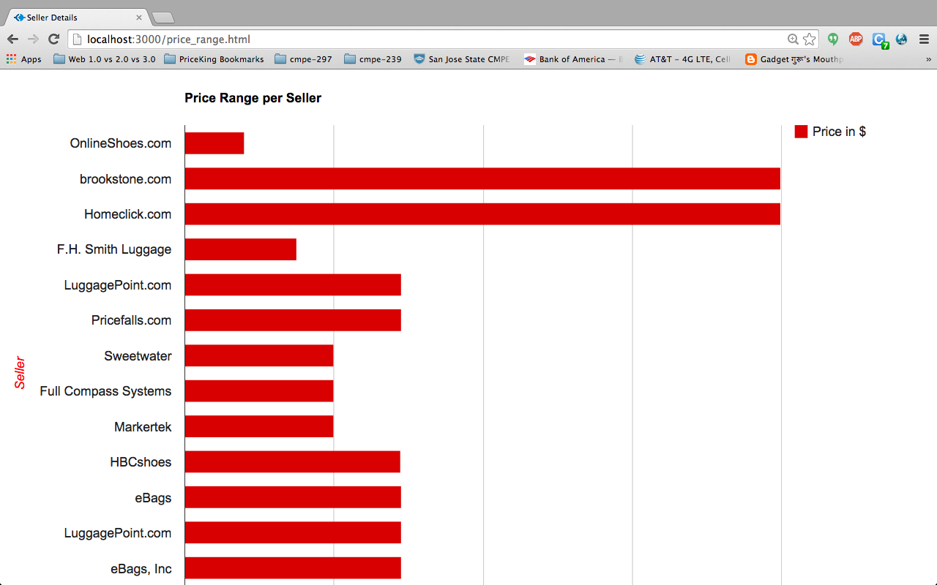
Price Range:
View price range for a particular product from various sellers through Google Bar Charts.

Slide 13
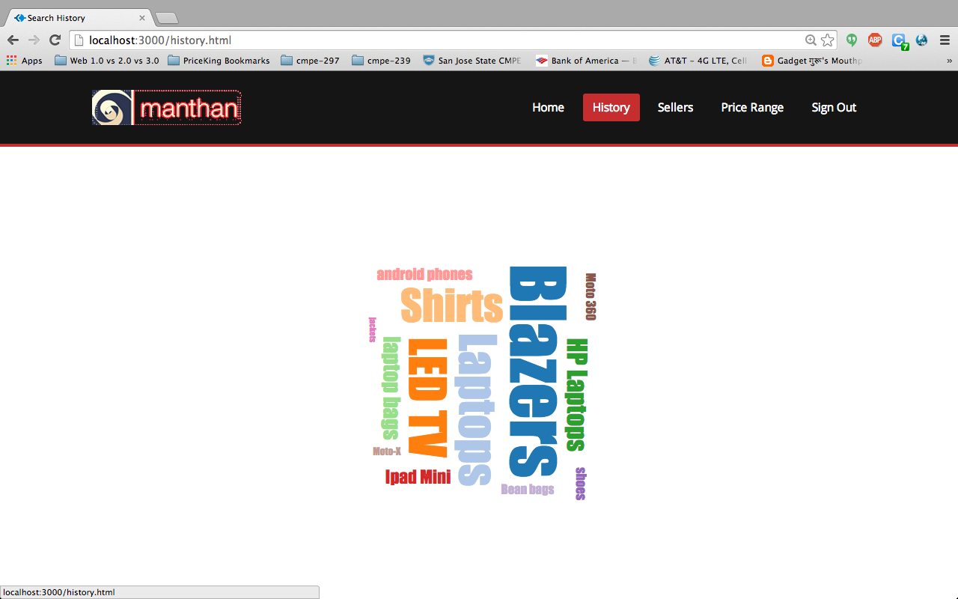
Search History
Display user’s search history through Word Cloud using D3.js

Slide 14
Testing
User Interface Testing
Each feature in the webpage is tested
Functional Testing
All the functionalities like search, share, user history are tested with appropriate test cases
Cross Browser Testing
Functionality and UI features are tested in all browsers

Slide 15
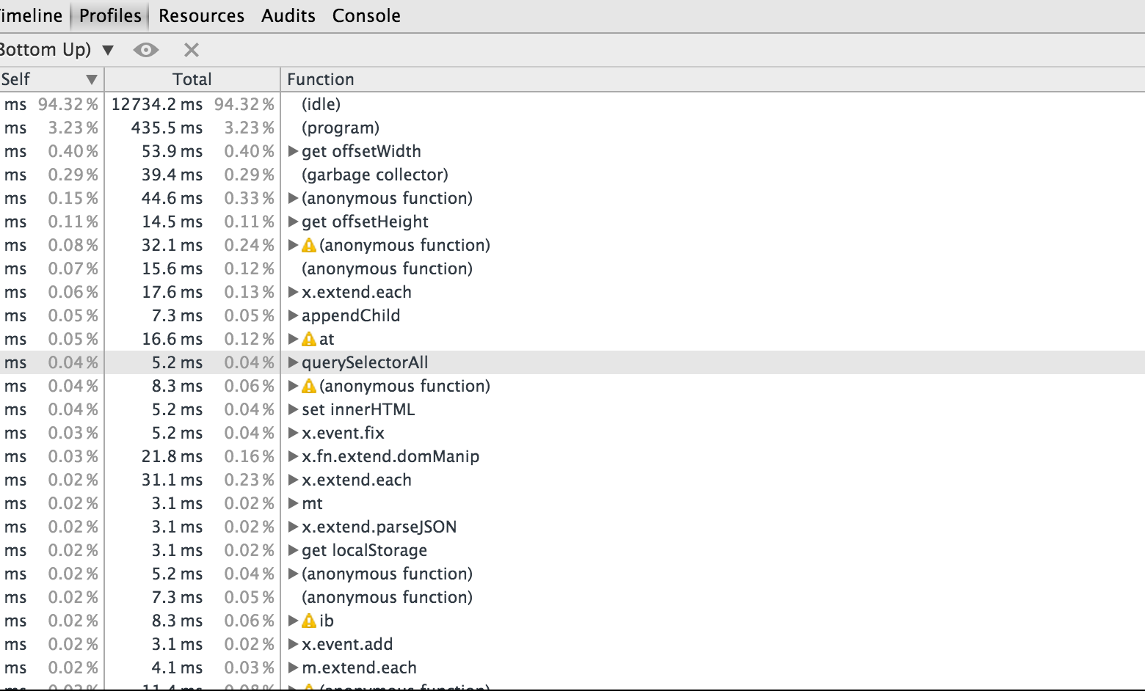
Profiling

Slide 16
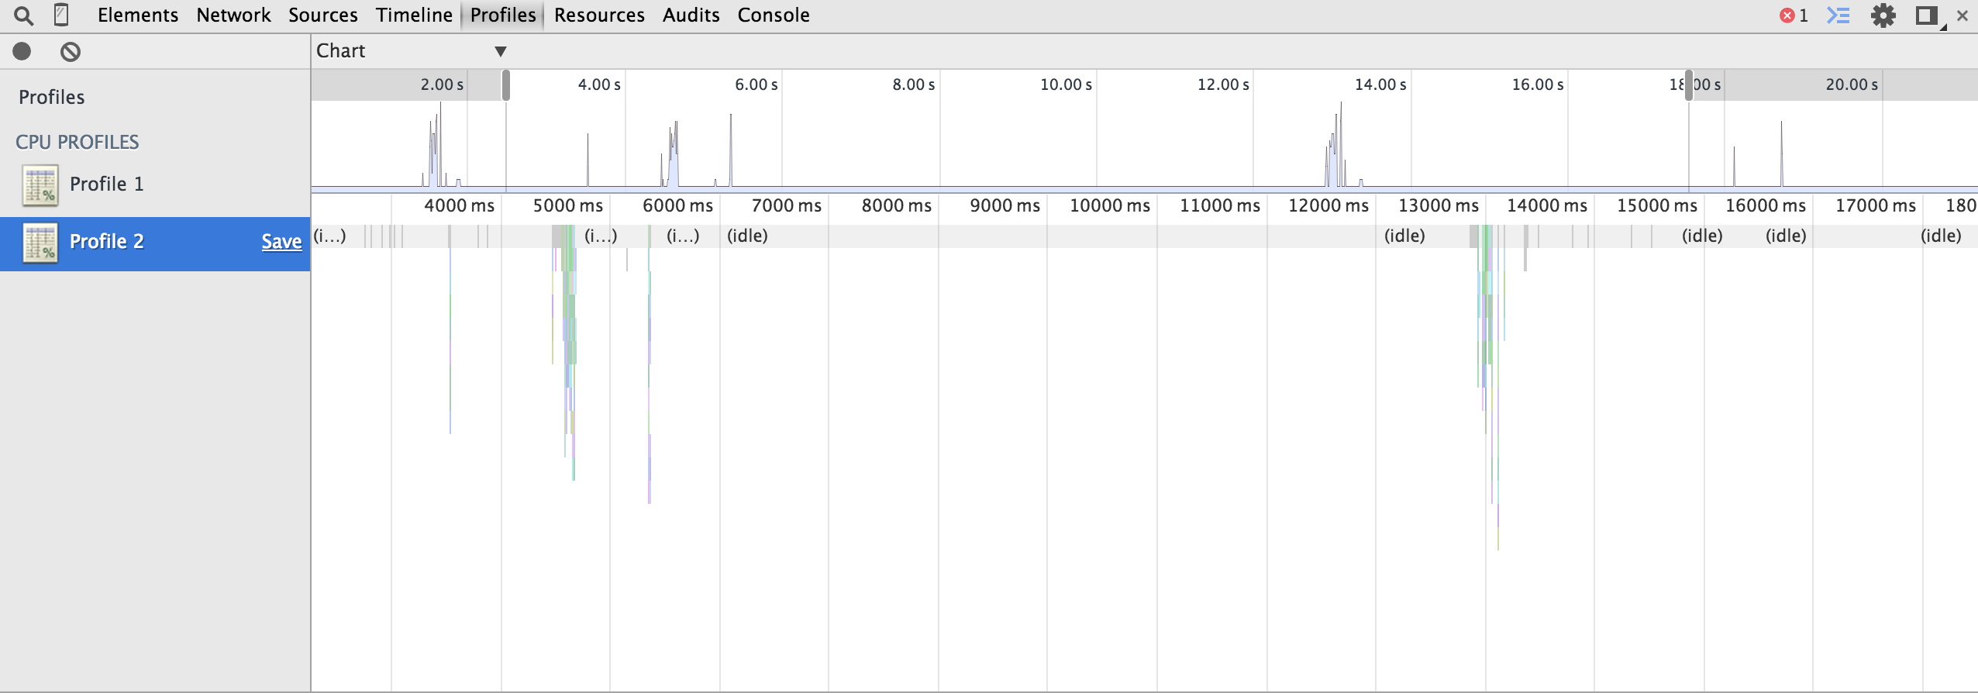
Profiling

Slide 17
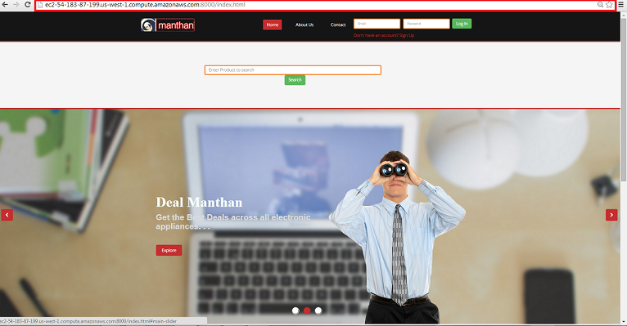
Deployed on Cloud- Amazon Web Services
http://ec2-54-183-87-199.us-west-1.compute.amazonaws.com:8000/index.html

Slide 18
Thank you!!!

