Slide 1
MET CS 777 · BIG DATA ANALYTICS · TERM PROJECT
Can the news tell us where violence is coming?
Forecasting spikes in violent conflict for 118 countries, one to four weeks ahead, from a free feed of the world's news.
Deven Shah · Boston University MET · August 2026
Notes:
Opening line: this project asks whether the news, read automatically at scale, gives any warning before violence escalates. Everything here comes from free public data.

Slide 2
THE PROBLEM
Decisions get made before violence peaks, not after
Aid agencies have to pre-position supplies somewhere, weeks in advance.
1
The tools that exist move too slowly
Standard conflict-risk indices refresh quarterly or once a year, and they are built from slow indicators: GDP per capita, regime type, past wars.
Peacekeeping missions have to decide where patrols go next month.
2
Newsrooms and analysts have to pick which country gets attention this week.
They explain why a country is fragile. They cannot tell you which week the fragility turns into events.
3
So the question is not "which countries are dangerous?" It is "which countries are about to get worse than they usually are?"
Notes:
Frame the audience-neutral point first: the constraint is timing, not information. Two or three weeks of notice changes what is operationally possible.

Slide 3
THE DATA
GDELT: a machine that reads the world's news, all day
A public project scans news coverage worldwide and turns every reported incident (a protest, a raid, a border clash, a peace talk) into one row of a table: who did what to whom, roughly where, and when.
The catch, stated up front
GDELT counts news reports, not verified incidents.
So it measures reporting about the world rather than the world itself. Coverage rises when a country becomes newsworthy for any reason: an election, a summit, a visiting correspondent.
15 min
65+
9.1M
A new batch of events, around the clock
Languages of news coverage read
Events used, after cleaning
This comes back in the limitations. It is the biggest caveat on everything that follows.
Free to download · 96 files per day · 61 columns per event · February 2015 to today
Notes:
Keep this slide non-technical. The one thing the audience must retain is that this is a record of coverage, which is both why it is fast and why it is imperfect.

Slide 4
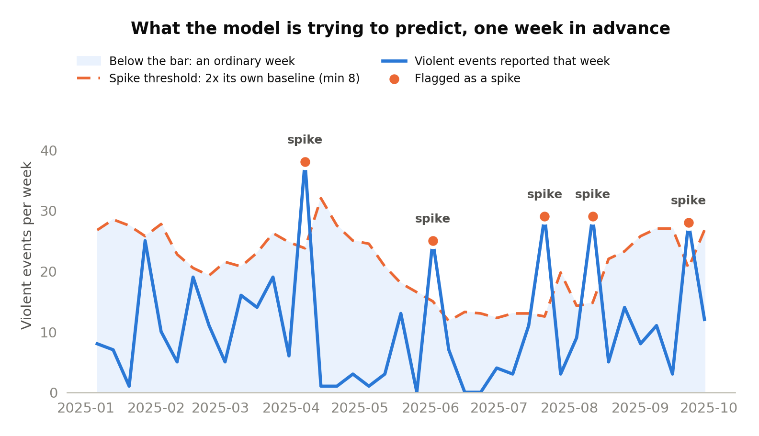
THE TARGET
"A spike" means unusual for that country
Why relative, not absolute
Absolute counts are dominated by a handful of chronically violent countries. A model trained on those would just learn a fixed ranking and look impressive while telling nobody anything new.
Escalation is the useful question.
Flagged when the violent-event count is at least twice its own trailing eight-week average, and at least eight events. The floor stops small numbers from faking a crisis.
Notes:
This is the slide to slow down on. If the audience understands the spike definition, every result later makes sense. Note the 8.89% base rate follows from this definition.

Slide 5
WHY THIS IS A BIG-DATA PROBLEM
Huge at the front, small at the back
7,472
9.1M
15,930
42
raw files downloaded
events scanned in Spark
country-week rows out
features per row
12 minutes
59 seconds
to scan and aggregate the raw events in Spark. This is the only stage that genuinely needs a cluster to grow.
to train and evaluate every model at all four horizons, because the table is sized by the calendar, not by the feed.
Sizing a cluster for this workload means sizing it for one distributed scan and nothing else.
Notes:
The lopsidedness is the interesting engineering point: 12 minutes of distributed I/O feeding 59 seconds of modelling on 16,000 rows.

Slide 6
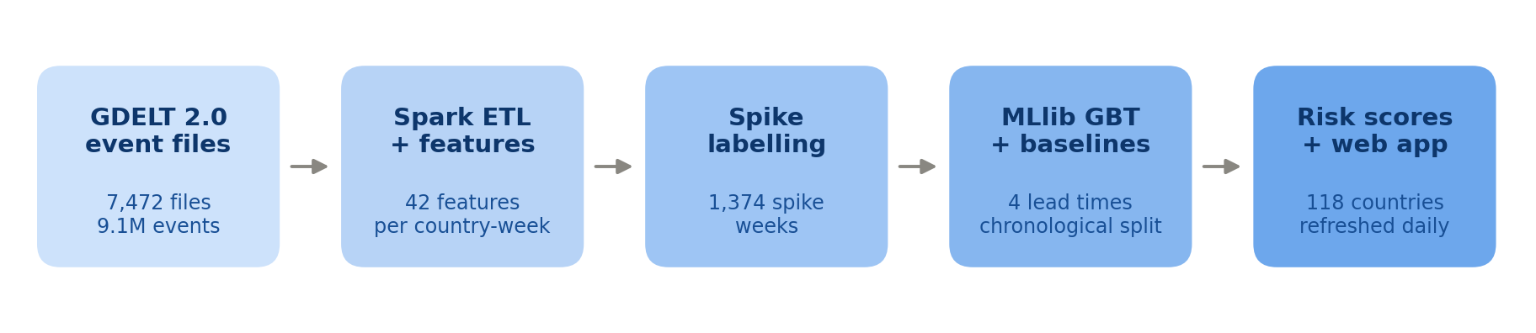
HOW IT WORKS
Five stages, one command
Download
Aggregate
Label
Train
Serve
Keeps 11 of 61 columns and resumes where it stopped.
Events become one row per country per week, in Spark.
Flag the weeks that jumped past 2x their own baseline.
Boosted trees plus two baselines, four horizons.
Score the latest week; a web app shows the board.
Everything runs on a laptop with a local Spark session. The same code scales by adding executors to the aggregation step.
Notes:
Mention that the web app imports the same functions the CLI uses, so there is no duplicated pipeline logic.

Slide 7
MAKING IT A REAL FORECAST
Three rules that stop the model cheating
1
2
3
No peeking forward
Train on the past, test on the future
Never report accuracy
Every rolling average and lag looks strictly backwards. A row for this week contains nothing that was not knowable by the end of this week.
The first 75% of weeks train; the rest are the test. A gap sits between them so no training label reaches across the boundary.
Only 9% of country-weeks are spikes, so predicting "nothing will happen" every time is 91% accurate and completely useless.
Enforced in the window definition, not by memory.
A random split would let the model interpolate instead of forecast.
The base rate is the number every result gets compared against.
These are the choices that decide whether the numbers on the next slides mean anything at all.
Notes:
If someone asks the sharpest possible question about this project, it will be about leakage. This slide is the answer.

Slide 8
THE MODELS
One candidate, two baselines chosen to be hard
Gradient-Boosted Trees
The candidate. Hundreds of small decision trees, each correcting the last. Good at messy tabular data on wildly different scales, and it reports which features it used.
80 trees · depth 4 · Spark MLlib
Logistic regression
Tests whether the complexity is earning its keep. If a straight-line model matches the ensemble, the ensemble is not adding much.
standardised features · L2
"Assume next week looks like this week"
The rule of thumb, with no parameters and no training. Conflict is bursty, so this is genuinely hard to beat, and beating it is the minimum evidence of foresight.
the real floor
All three are scored on exactly the same held-out weeks.
Notes:
Emphasise that the persistence baseline is not a straw man. Beating it is the whole test of whether the model sees build-up rather than the present.

Slide 9
HOW TO KEEP SCORE
Only 9 weeks in 100 are spikes.
That single fact decides which numbers are worth reporting.
0.090
PR-AUC
1 in 10
What pure guessing scores. Every result gets compared to this line.
One number for the whole trade-off between catching spikes and crying wolf.
The alert budget. If only one quiet week in ten may raise an alarm, how many real spikes do we catch?
Notes:
This is the bridge slide into results. Anyone who takes away only the 0.090 floor will be able to read every chart that follows.

Slide 10
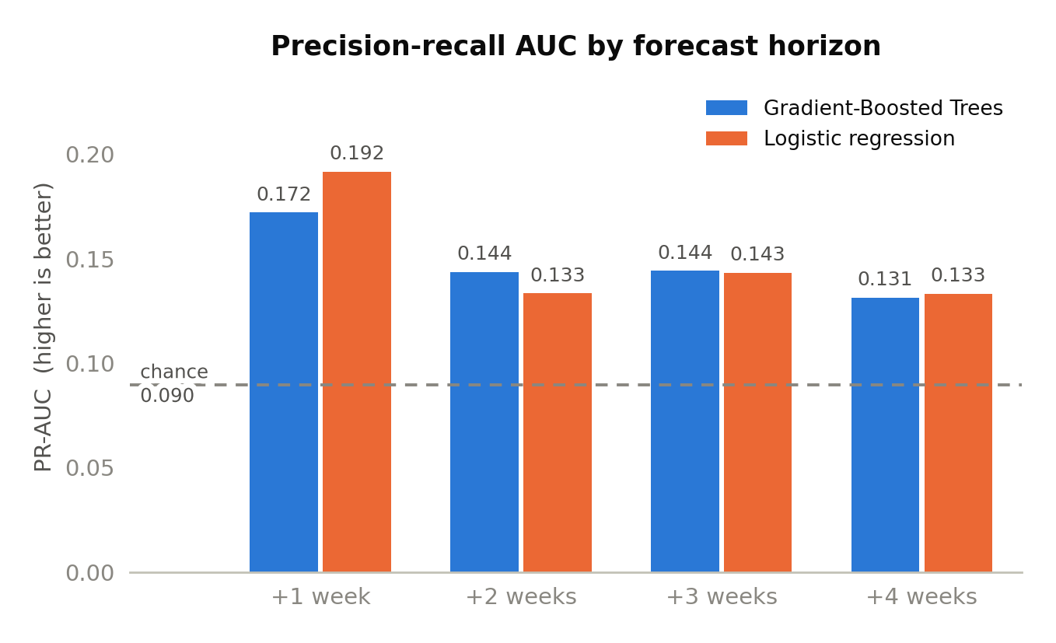
RESULT 1
There is a real signal, and it fades with distance
Roughly twice as good as guessing
0.172 one week out, against a 0.090 floor: a 1.9x lift.
Decays smoothly to 0.131 by four weeks.
So the useful horizon is one to two weeks, not a month.
Straight-line model edges it at +1 week. More on that shortly.
PR-AUC summarises the whole precision/recall trade-off in one number. Chance level equals the share of weeks that are spikes.
Notes:
Do not oversell. A 1.9x lift on a rare event is real and modest. The decay pattern is exactly what a genuine short-lived signal should look like.

Slide 11
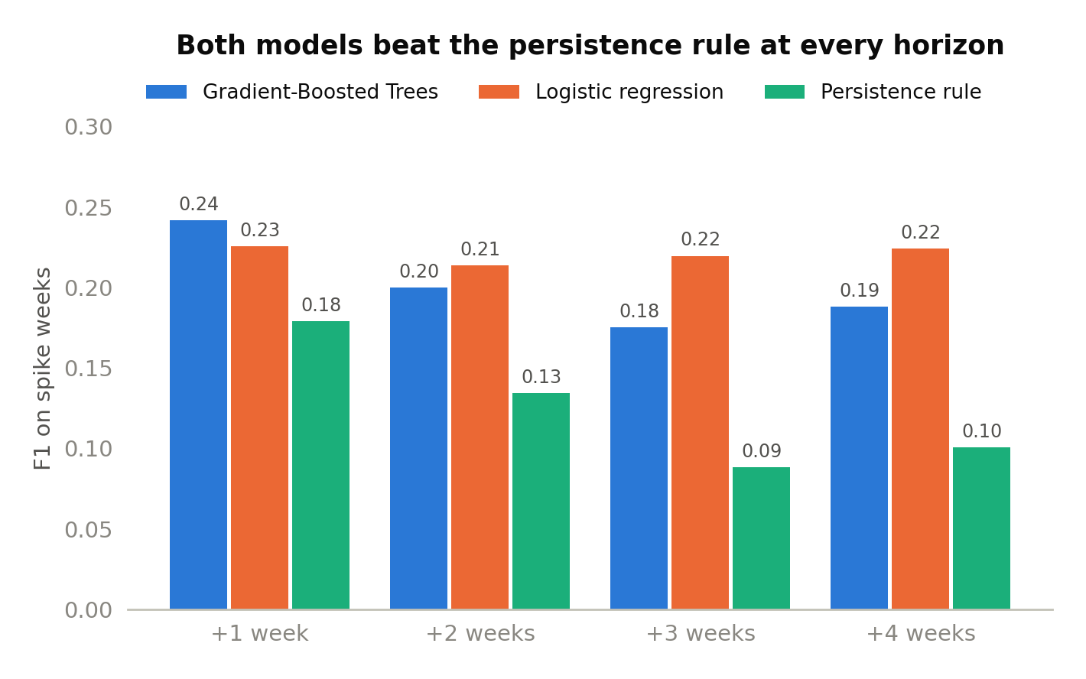
RESULT 2
It beats the rule of thumb at every horizon
The most trustworthy finding here
Better than "assume next week looks like this week" at every horizon.
The margin widens: 35% better at one week, 99% at three.
The rule of thumb collapses with distance; the model does not.
That gap is the evidence it learned about build-up, not just inertia.
F1 balances catching real spikes against crying wolf. Higher is better; the persistence rule is the no-model floor.
Notes:
The widening margin matters more than the level. Persistence decays fast because knowing a country is spiking now says little about three weeks out.

Slide 12
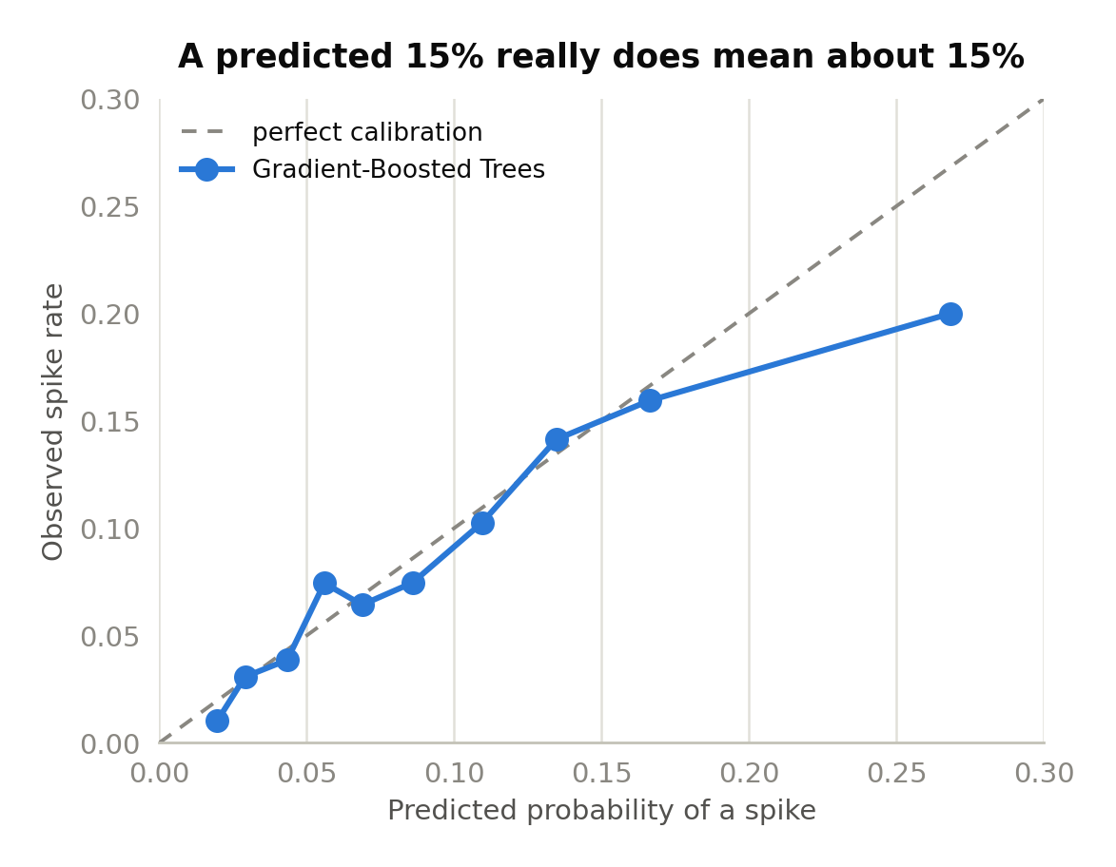
RESULT 3
When it says 15%, it means about 15%
The probabilities are honest
Across nine of ten confidence bands, predicted and observed rates track closely.
The most confident band overshoots: 0.268 predicted against 0.200 observed.
Nothing in the training optimises for this. It came out clean anyway.
It matters because a calibrated score can be compared across countries and thresholded to your own risk appetite.
Each point is one tenth of the test weeks, grouped by how confident the model was. On the dashed line, the forecast is exactly right on average.
Notes:
For a non-technical audience this is the most important property: the number means something, so a user can choose their own cut-off rather than trusting a ranking.

Slide 13
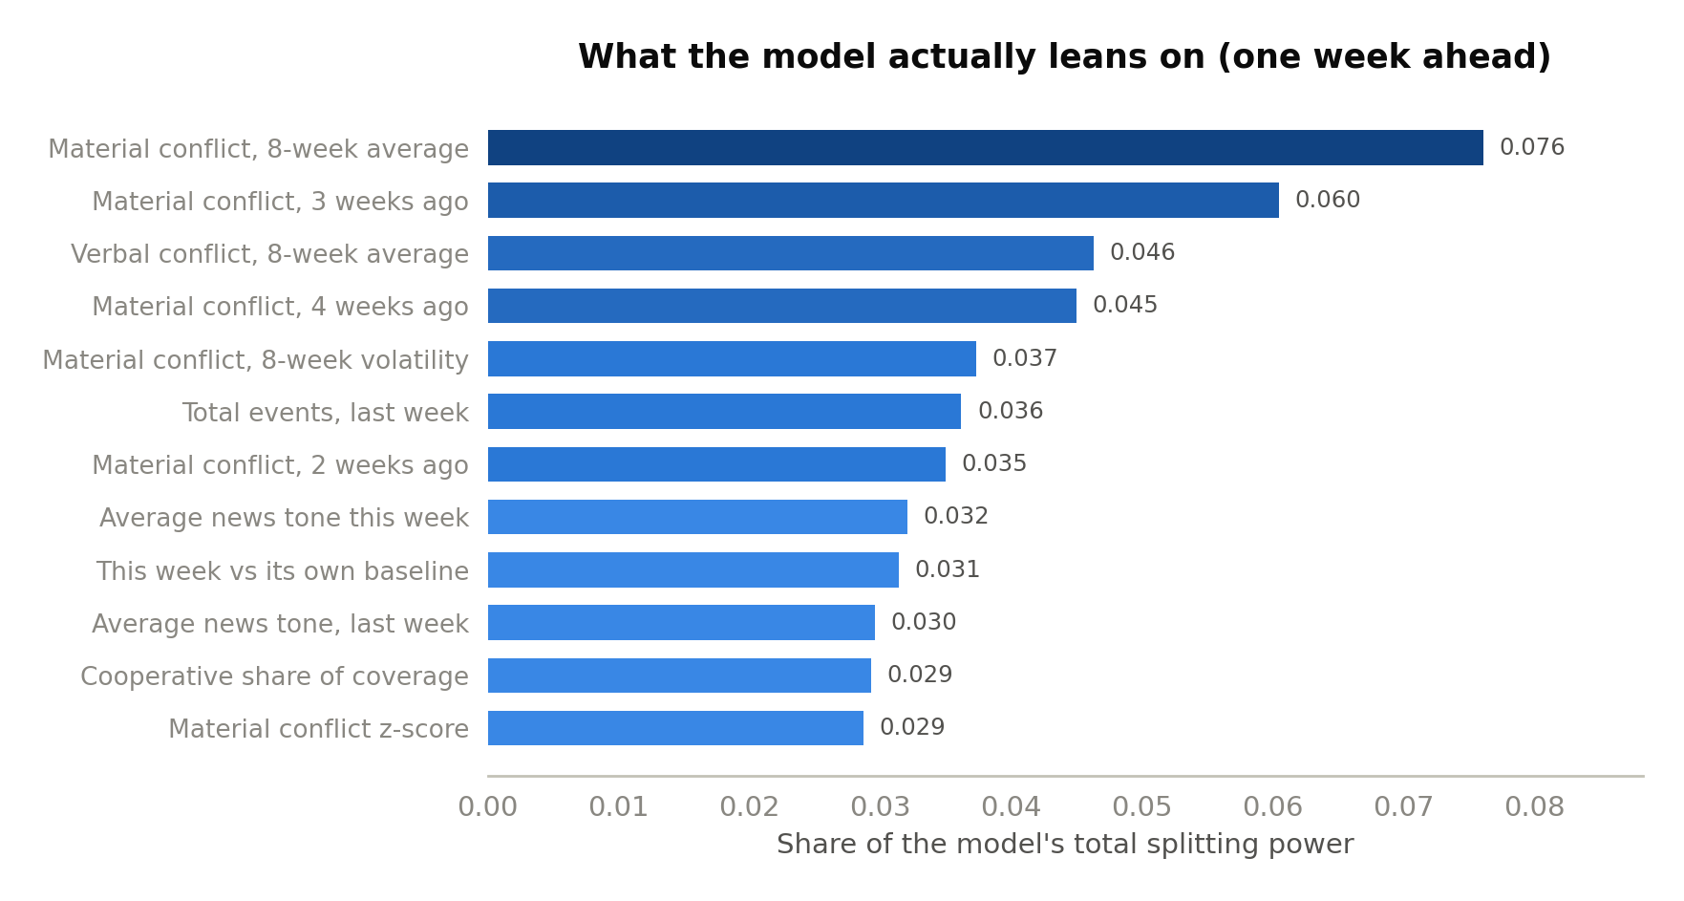
RESULT 4
Hostile words help, but less than hoped
The escalation ladder, partly confirmed
The hypothesis: threats and protests come before violence.
Verbal conflict does rank third: real, and it survives at every horizon.
But a country's own recent violence dominates the top of the list.
Honest verdict: most of what is predictable here is momentum, with verbal friction adding a genuine second increment.
Importance is how much each feature contributed to the model's decisions. No single feature carries more than 7.6 percent.
Notes:
Report the weaker version of the original hypothesis rather than the version proposed. No single feature carries more than 7.6% of the importance.

Slide 14
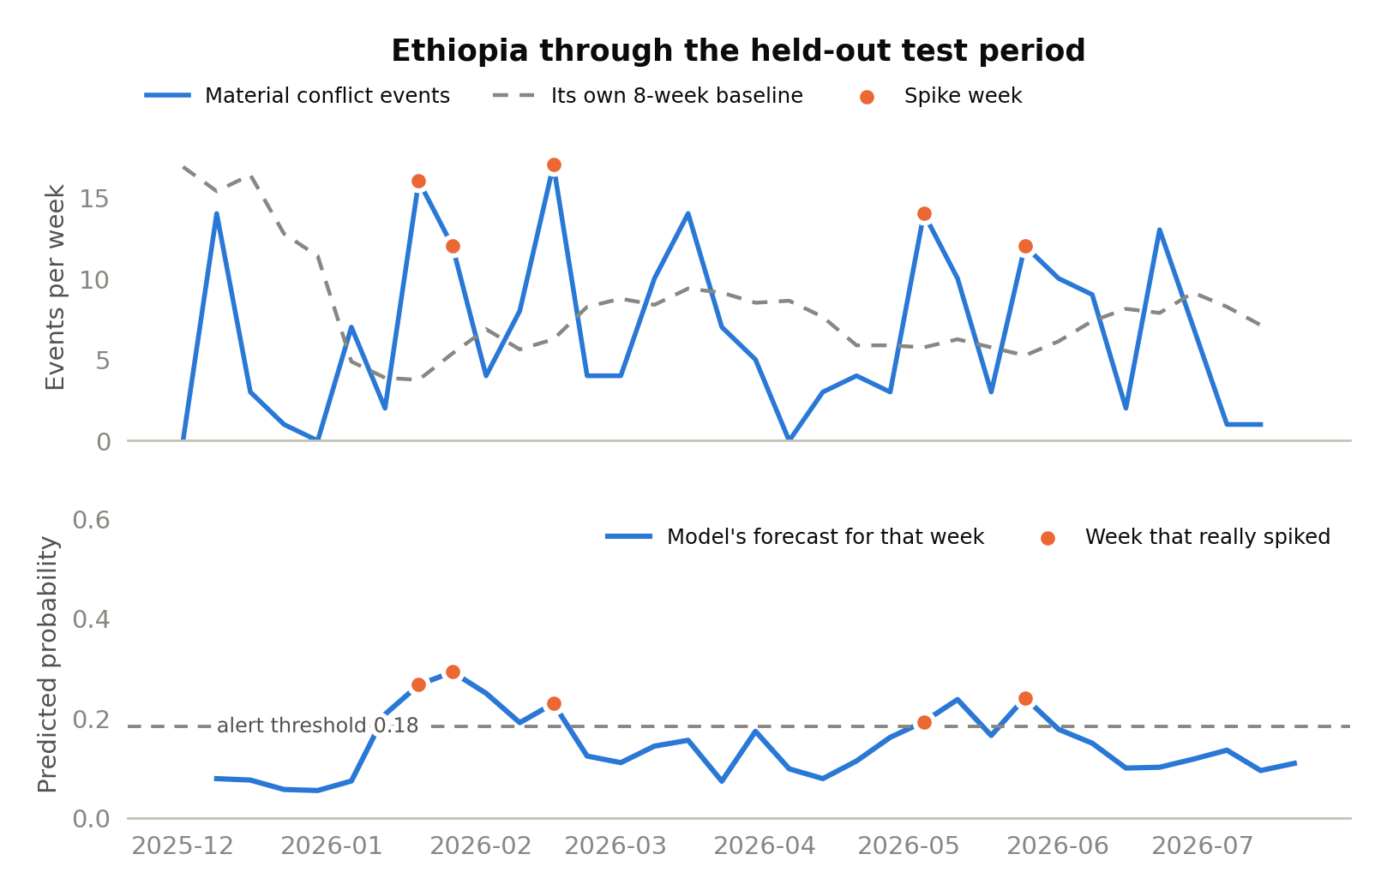
ONE COUNTRY, UP CLOSE
Ethiopia through the weeks the model had never seen
What it looks like when it works
Top: violent events each week against the country's own baseline; dots are real spikes.
Bottom: the forecast made a week earlier for that same week.
The forecast rises into the winter cluster, falls through the quiet spring, lifts again before May and June.
Ethiopia is the best case in the test set, not a typical one. The spread slide is the honest counterweight.
Notes:
Ranked Ethiopia's spike weeks above its quiet weeks with an AUC of 0.957. Say clearly that this is the best case, and that the spread slide follows.

Slide 15

LIVE DEMO
The pipeline, running
What the recording walks through
1
The risk board: all 118 countries, ranked, four horizons each
2
A single country's history with its spike weeks marked
3
The evaluation page: PR-AUC, calibration, feature importances
4
Hitting refresh: download, rebuild, retrain, rescore, live in the console
Notes:
VIDEO GOES HERE: PowerPoint > Insert > Video > This Device, then size it to the dashed frame and delete the dashed rectangle and play button behind it. If the recording is not ready, run the app locally at 127.0.0.1:5001 and walk the same four steps live. Keep it to about two minutes.

Slide 16
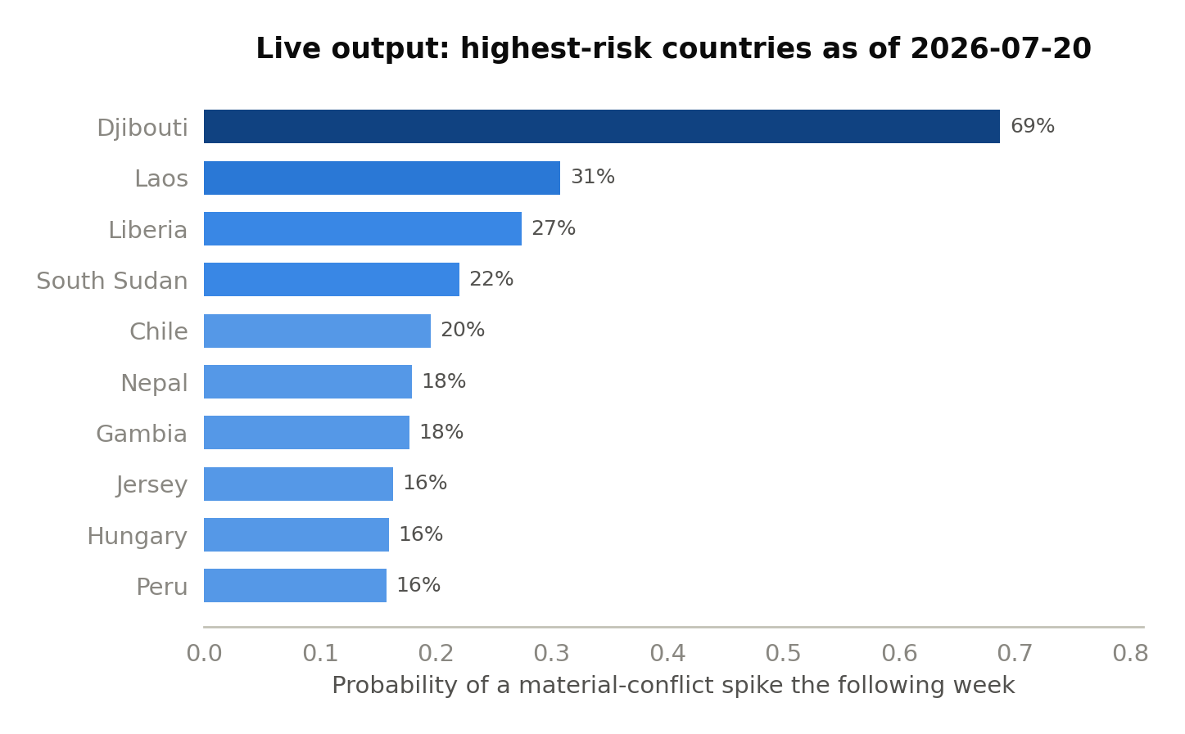
WHAT THE DEMO SHOWS
The output: every country, scored every week
As of the week of 20 July 2026
Highest one-week risk: Djibouti at 0.69, then South Sudan at 0.33 and Laos at 0.31.
Djibouti is instructive and a bit deflating. It was already spiking, so the model largely re-expressed the present.
That overlap with the rule of thumb is strongest at the one-week horizon, which is exactly what the feature importances predicted.
Every country is rescored whenever the pipeline refreshes; the board below is what the web application renders.
Notes:
Being honest about Djibouti is better than presenting it as a catch. It illustrates the short-horizon model's overlap with persistence.

Slide 17
WHAT IT CAN AND CANNOT DO
The same result, translated into alerts
Over the 33 test weeks, at an alert budget of one false alarm per ten quiet country-weeks:
442
87
349
1 in 5
alerts raised
were real spikes
spikes actually happened
alerts were right
Good for
Not good for
Reordering a watchlist a human will read anyway. One in five beats the one in eleven you get reading countries in arbitrary order, and the scores are calibrated, so you know where to stop.
Anything automatic with a cost attached. Four alerts in five are wrong, so this must never trigger a decision on its own. It is a triage aid, not an alarm.
Notes:
This is the slide that makes the project credible. Translating PR-AUC into 442 alerts and 87 hits is what a non-technical audience actually needs.

Slide 18
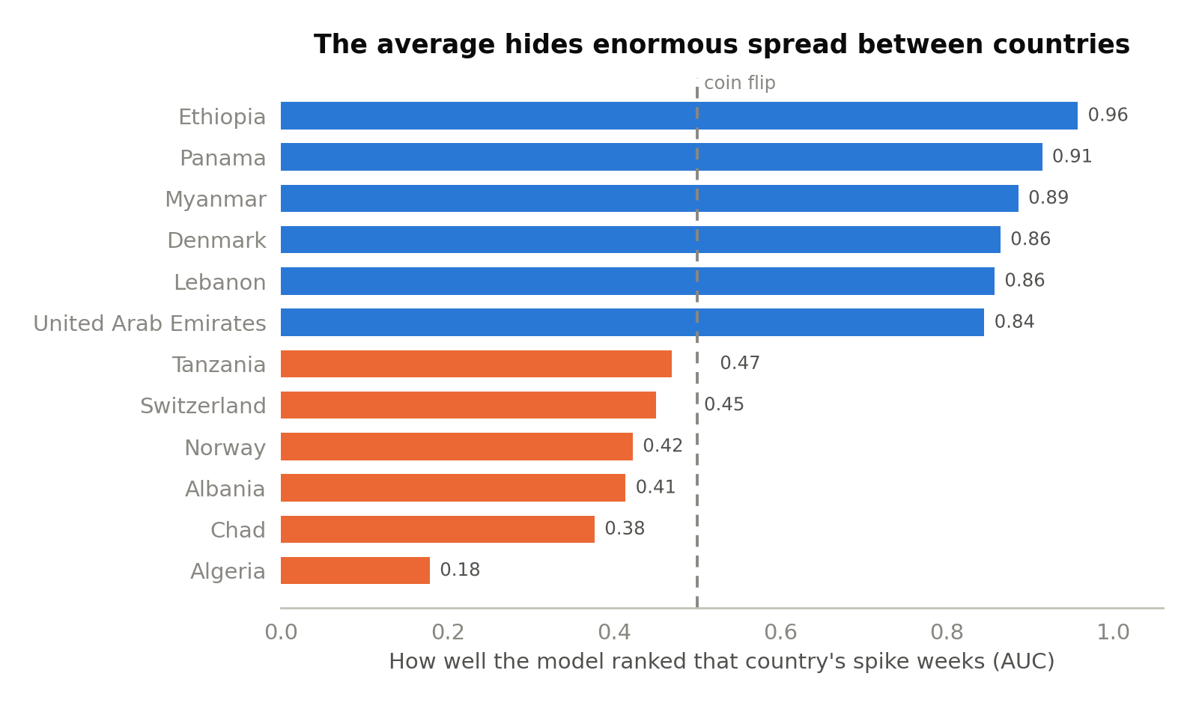
WHERE IT FALLS SHORT
Three things worth stating plainly
It measures coverage, not violence
A spike in coded events can be a spike in attention. No human-coded conflict dataset was used for validation, which is the first thing to fix.
The average describes nobody
Per-country performance runs from 0.96 down to 0.18. 37 of 44 countries beat a coin flip; the rest do not.
One split, ~349 positives
Enough to show the signal exists, not enough for tight confidence intervals. Walk-forward validation is the obvious next step.
Also honest: logistic regression matches the ensemble on average precision. The boosted model's advantage is confined to the high-confidence end, which happens to be the end you operate at.
Notes:
Volunteering the logistic-regression result is stronger than waiting to be asked. At a matched alert budget the boosted model still leads at three of four horizons.

Slide 19
WHAT COMES NEXT
Ordered by what would settle the questions fastest
Check it against reality
Compare the labels with a human-coded conflict dataset such as ACLED or UCDP. This decides how much of the signal is escalation rather than news attention.
1
Validate over many windows
Roll the train/test cutoff forward repeatedly instead of splitting once, and report uncertainty rather than point estimates.
2
Let it see who, not just where
Add actor-level features so the model can watch escalation between specific pairs of states, invisible to it today.
3
Try a model that reads sequences
Give a sequence model the weekly series directly and see whether the ceiling reached here belongs to the data or to the hand-built lags.
4
The pipeline was built so each of these is an addition rather than a rewrite. That was the point of building it as a pipeline.
Notes:
Ordered by how much each would change confidence in the result, not by how hard it is. External validation comes first.

Slide 20
THE TAKEAWAY
Free news data really does give you a week or two of warning.
It is a signal about reporting rather than about the world, it is modest in size, and it is worth having anyway, for deciding what to read first rather than for raising alarms.
1.9x
every
1 in 5
better than guessing
horizon beats the rule of thumb
alerts are real
Deven Shah · MET CS 777 · Code, data documentation and the web app are in the project repository
Notes:
Close on the honest version: real signal, about reporting, modest, useful for triage. Then take questions.

