Slide 1
MEETUP STREAM ANALYSIS
TEAM MEMBERS:
DEVENDRA RAJU
RAJAT NAGPAL
Krishna Bhanushali
UTSAV KANSARA

Slide 2
INTRODUCTION
The project goal:
Work input data in form stream.
Storage of Stream Data.
Analysis of Stream Data.
Persistence of analyzed results.
Exposing web services for CRUD operations on results.
Visualization of results.

Slide 3
Problem Domain
Meetup.com is a social website for attending social events offline.
People can RSVP i.e accept/deny a meeting by clicking the Yes/No button on each page up.
Every minute lot of data is generated since
Meetup API can be used to gather all the RSVP data.
A simple web application that gathers the data and perform analysis.

Slide 4
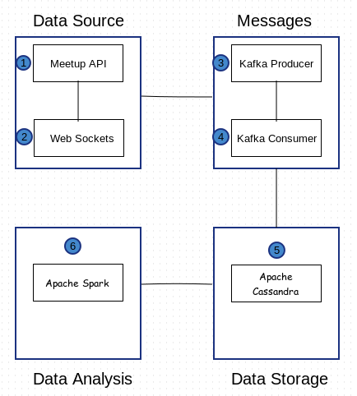
ARCHITECTURE

Slide 5
ARCHITECTURE COMPONENTS
DATA SOURCE
Meetup.com provides all the data through its API
Two kind of API’s available:
- REST based
- Websockets Stream
Python Program which would use the Websockets API and gather the data from Meetup
Json is the data format.

Slide 6
KAFKA & ZOOKEEPER – MESSAGE PASSING
KAFKA
A high-throughput, distributed publish-subscribe
messaging system.
Kafka Producer:
The object which would pass the data as messages.
Kafka Consumer
The object which would consume the data as messages.
Topic
Message Queue between the producer and consumer.

Slide 7
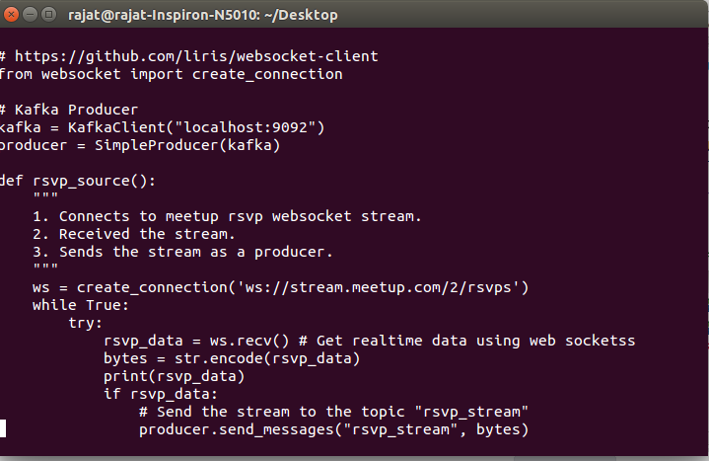
PRODUCER CODE

Slide 8
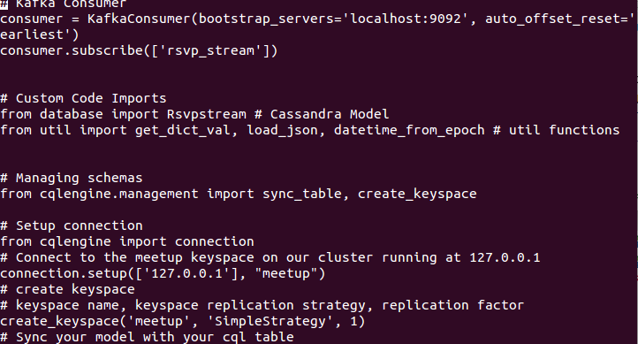
CONSUMER CODE

Slide 9
DATA STORAGE - CASSANDRA
What is Apache Cassandra?
open source
distributed and decentralized/distributed storage system (database).
Used for managing very large amounts of structured data spread out across the world.
It provides highly available service with no single point of failure.

Slide 10
DATA STORAGE - CASSANDRA
CREATE TABLE rsvpstream ( rsvp_id int PRIMARY KEY, event_name text, event_time timestamp, event_url text, group_city text, group_country text, group_id int, group_lat int, group_lon int, group_name text, group_state text, group_topic_names text, guests int, member_id int, member_name text, response text, rsvp_last_modified_time timestamp, venue_id int, venue_lat decimal, venue_lon decimal, venue_name text, visibility text ) WITH bloom_filter_fp_chance=0.010000 AND caching='KEYS_ONLY' AND comment='' AND dclocal_read_repair_chance=0.000000 AND gc_grace_seconds=864000 AND read_repair_chance=0.100000 AND replicate_on_write='true' AND populate_io_cache_on_flush='false' AND compaction={'class': 'SizeTieredCompactionStrategy'} AND compression={'sstable_compression': 'SnappyCompressor'};
Create TABLE CountryUserCount (
countryId PrimaryKey int,
countryName varchar,
UserCount int)

Slide 11
DATA STORAGE – CASSANDRA (Continued)
A python program which gets the data from the kafka producer and stores it in Cassandra.
KeySapce = meetup
Input Table = rsvpstream
Results Table = UserCountryCount
= UserCitiesCount
= EventInterest
= GuestUsersCount

Slide 12
Web-services
//List of Count of No. of Users based on Country Id
@RequestMapping(value="/CountryUser/{id}", method = RequestMethod.GET) CountryUser findByIdc(@PathVariable("id") int countryUserId) { return countryUserService.getCountryUser(countryUserId); } //Count of No. of Users based on Country Id
@RequestMapping(value="/CountryUser", method = RequestMethod.GET) List<CountryUser> findAll() { List<CountryUser> cs= countryUserService.getAllCountryUser();

Slide 13
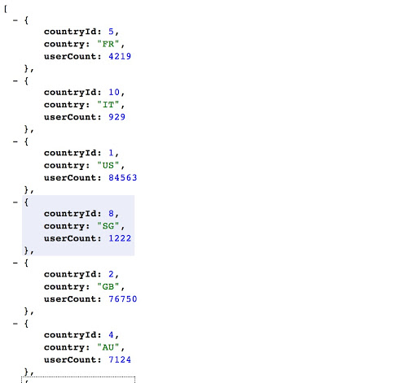
Visualization Data

Slide 14
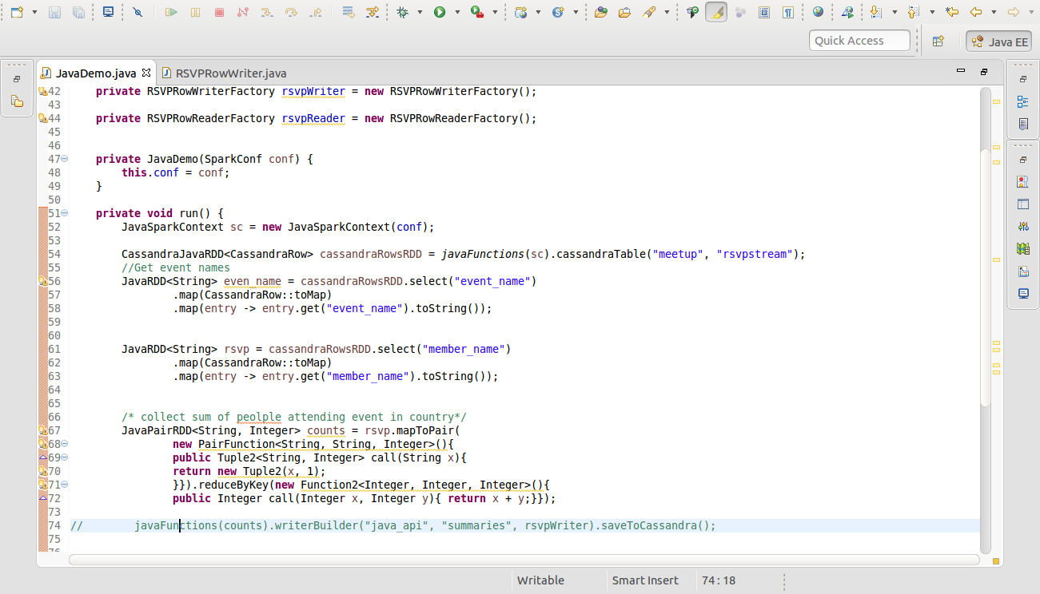
DATA ANALYSIS-SPARK

Slide 15
Visual Representation
Analysis done using spark is visualized in form of graphs
APIs will be exposed by spring boot app
Technology stack : chart.js, must.js, bootstrap

Slide 16
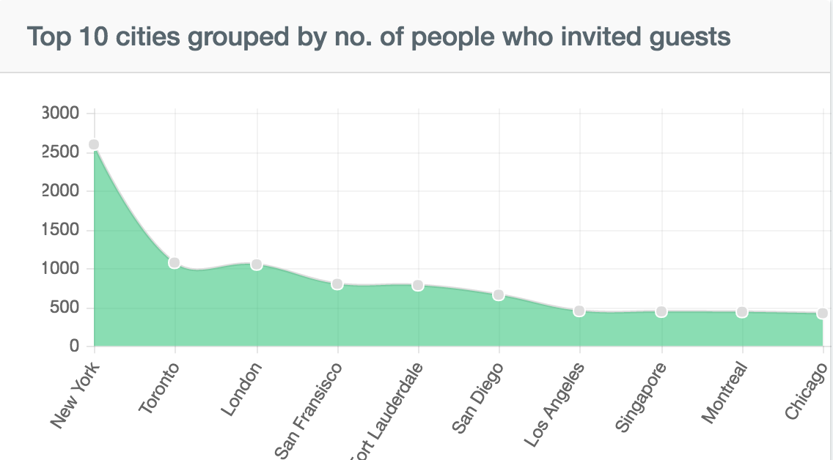
Visual Representation

Slide 17
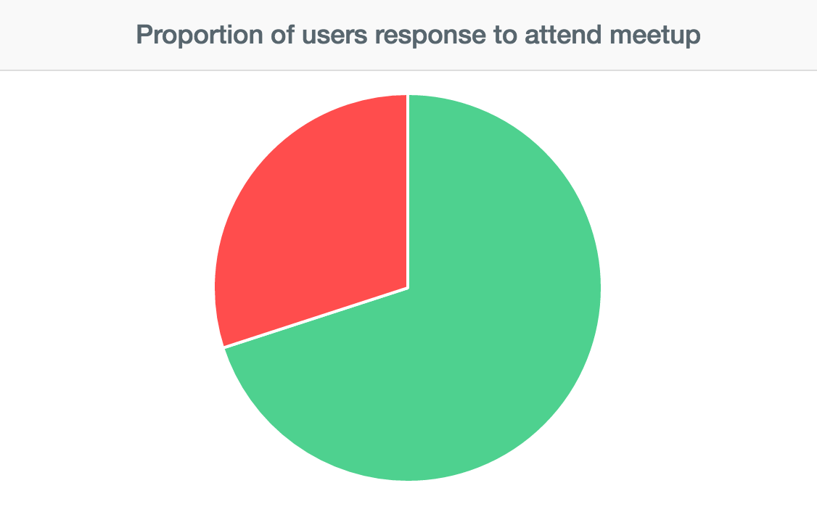
Visual Representation

Slide 18
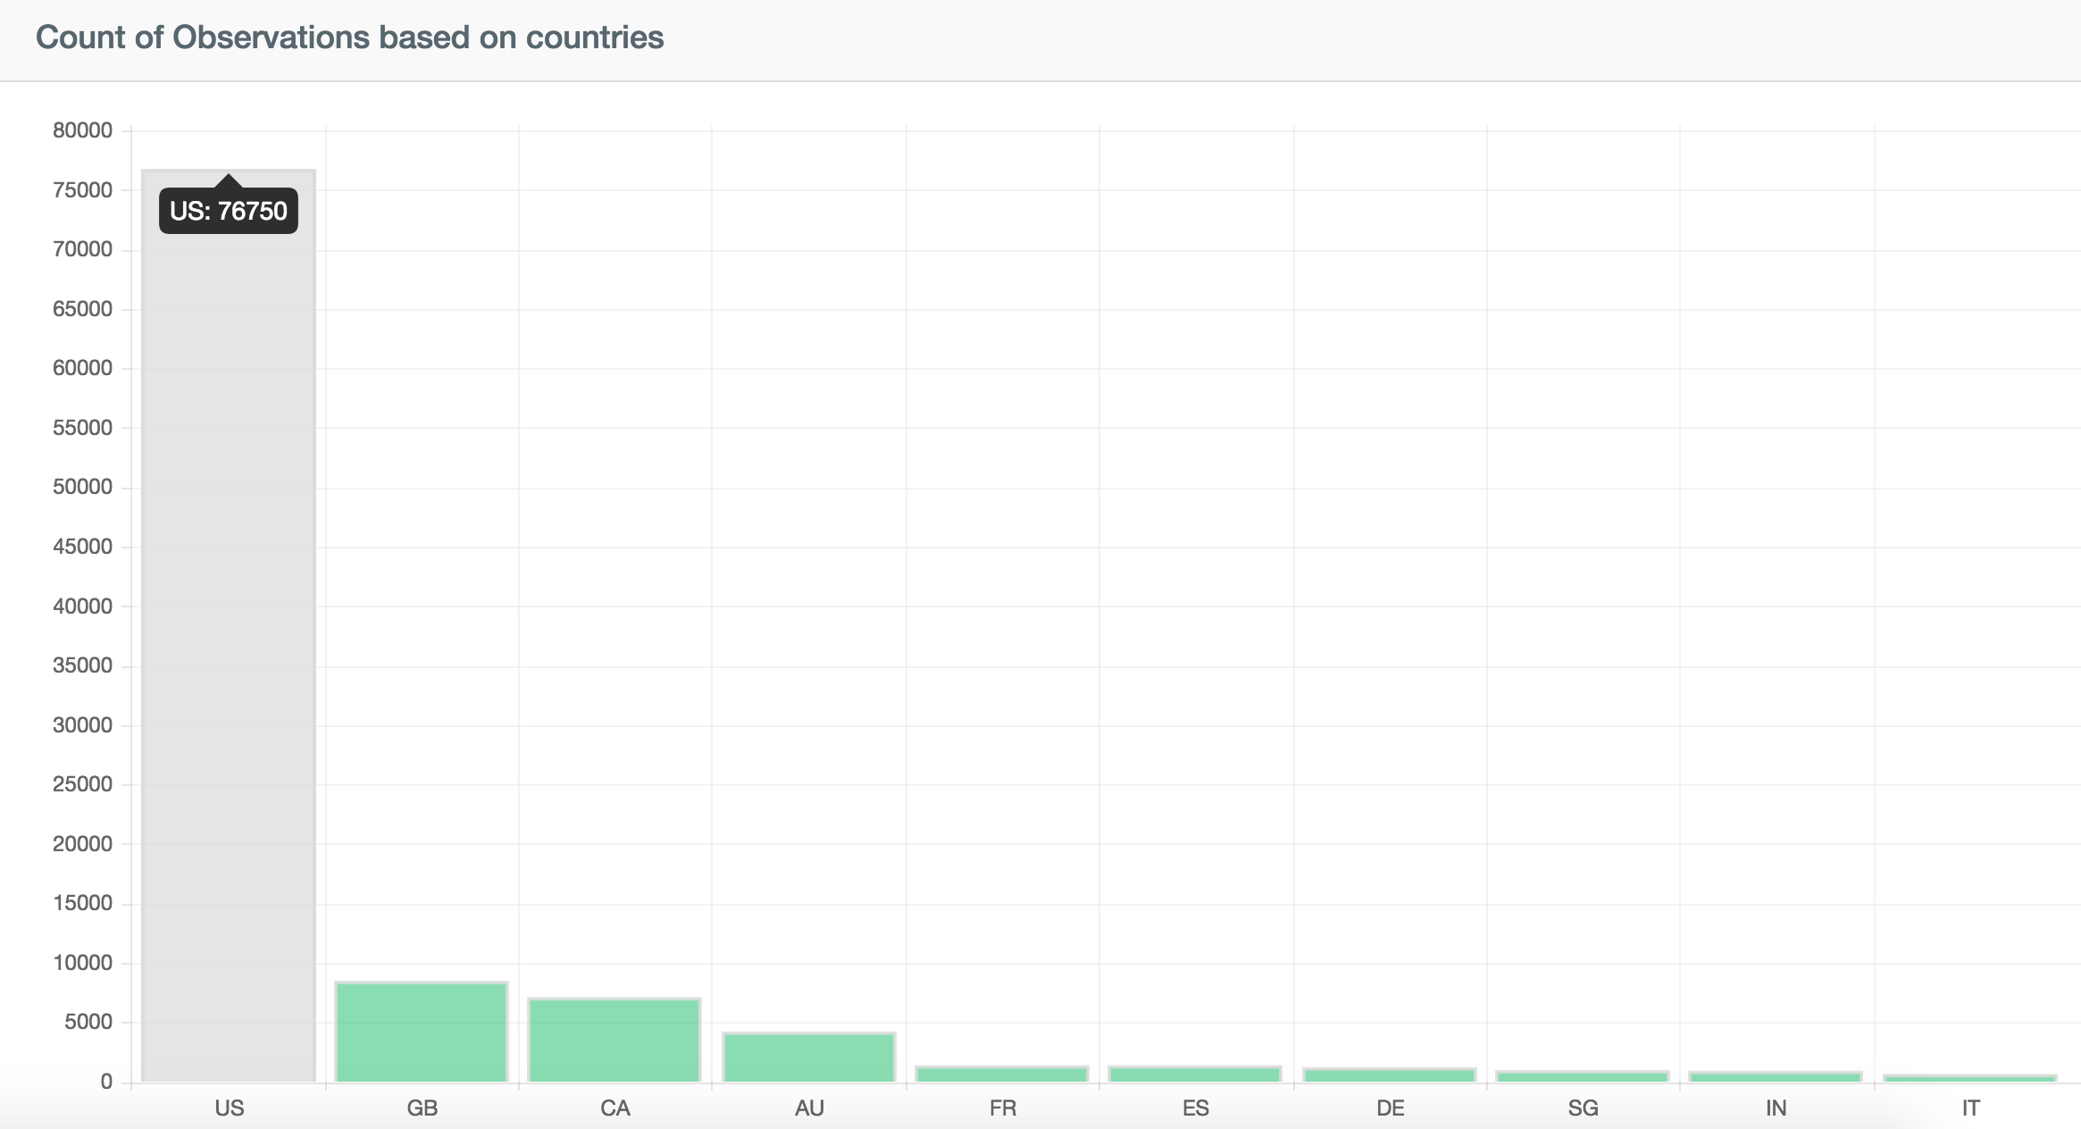
Visual Representation

Slide 19
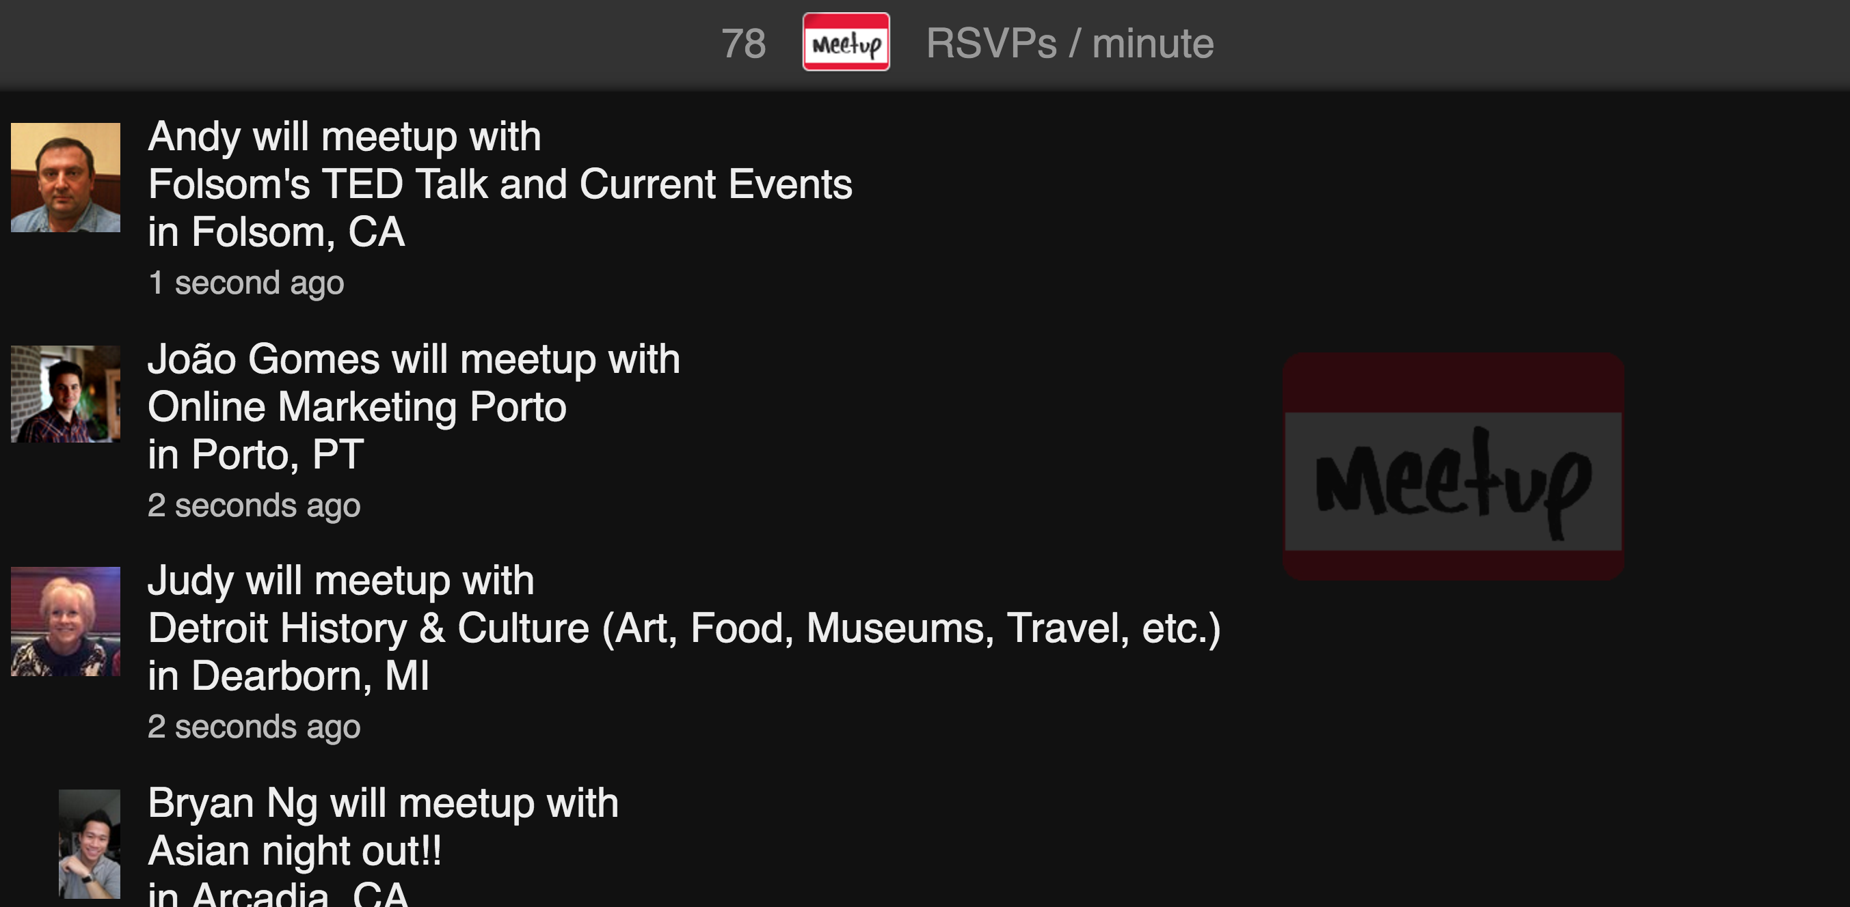
Visual Representation

