Slide 1
13forge
AI trading fails when ideas become orders too fast.
One hallucinated strike or missed risk check can send real capital to the broker.
LLM thesis
>
Unsafe trade
x
Broker order
PROBLEM
Notes:
Open with the judge-facing risk. Autonomous trading agents are becoming easier to build, but the hard part is not generating an idea. The hard part is proving that a bad idea cannot quietly become a broker order.

Slide 2
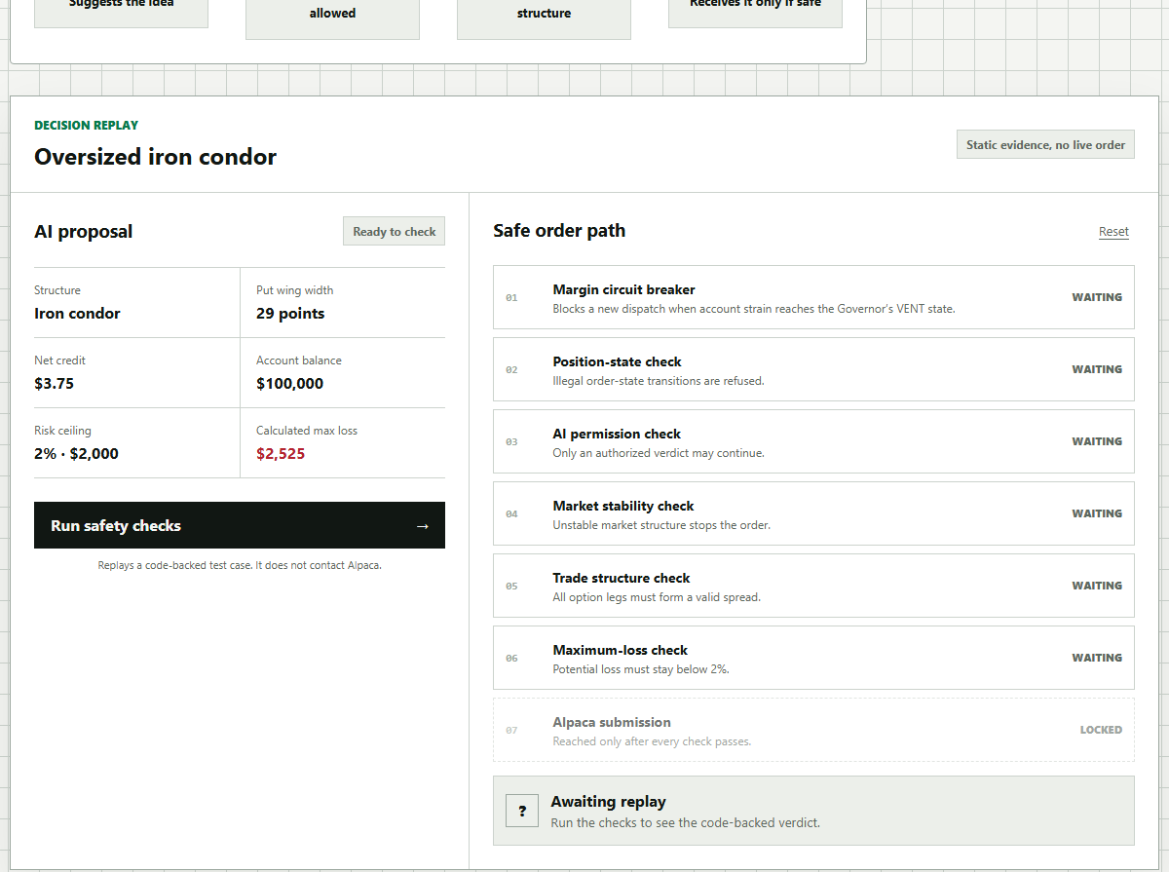
13forge
13forge makes AI ask for permission.
The model proposes a bounded thesis. Rust rebuilds, checks, and records the result.
1
AI thesis
2
Rust airlock
3
Receipt
Idea only
Seven checks
Refuse by default
A real product, not a slide-only concept.
Notes:
Position the product as a control layer, not a prediction app. 13forge lets the AI contribute the thesis, then moves execution authority into a deterministic Rust airlock that reconstructs, checks, and records the result.

Slide 3
13forge
The order path is a deterministic airlock.
Verified gates run before Alpaca is reached.
01
>
02
>
03
>
04
>
05
>
06
>
07
Governor
Position
Oracle
Market
Geometry
Max loss
Alpaca
Built from ChainQuote data
Alpaca mleg via stdin
forge-gate: no_std + unsafe-denied
Notes:
Make the technical difference clear. The model is upstream of execution, not inside the final order-writing step. The live path checks governor state, position-state, oracle verdict, market purity, leg geometry, and max-loss before the Alpaca boundary.

Slide 4
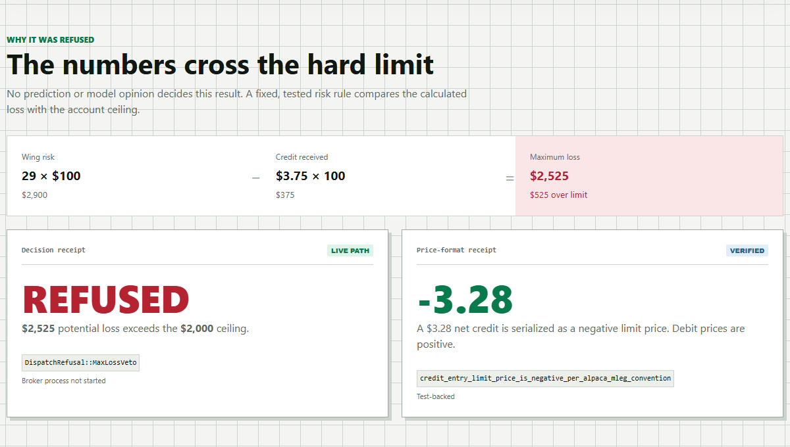
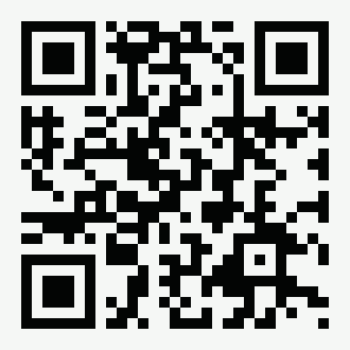
13forge
The proof is refusal.
The public portal shows the actual refused result.
$2,525
$2,000
REFUSED
max loss
ceiling
no broker call
WATCH THE PROOF
youtu.be/IrLmPIXukyo
Controlled agency for AI trading.
Notes:
Close with evidence, not a thank-you slide. The public demo gives judges a simple artifact to remember: an unsafe options idea is evaluated, refused, and kept away from Alpaca. The winning message is controlled agency.

