Slide 1
>
13forge
AI can suggest a trade. 13forge checks it before money moves.
A bad idea should stop at the safety check, not reach the broker.
AI idea
>
Safety check
x
Broker blocked
PROBLEM
Notes:
Start in plain language. The problem is not whether AI can come up with a trade idea. The problem is what happens next. In 13forge, the idea has to pass a safety check before money can move toward Alpaca.

Slide 2
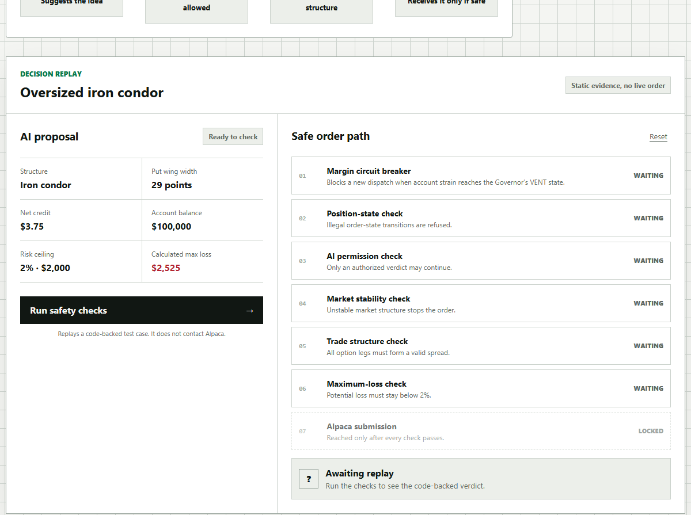
13forge
The product makes the decision visible.
A judge can see the idea, the checks, and the result in one screen.
1
Idea
2
Check
3
Result
AI suggests
Rules test it
Explain why
A real product, not a slide-only concept.
Notes:
This slide is where the judge sees the product. Keep the explanation simple: 13forge shows the AI idea, runs visible safety checks, and returns a clear result. The screenshot matters because it proves this is not only a pitch concept.

Slide 3
13forge
Every trade has to pass the same checks.
If one check fails, Alpaca never receives the order.
01
>
02
>
03
>
04
>
05
>
06
>
07
Account
Position
AI approval
Market
Trade shape
Loss limit
Alpaca
Uses real market data
Builds broker order only after pass
Refuses unsafe trades by default
Notes:
This is the engineering, translated for a non-technical judge. Every proposed trade goes through the same checkpoints: account condition, current position, AI approval, market condition, trade shape, and loss limit. Alpaca is last, and it is only reached when the checks pass.

Slide 4
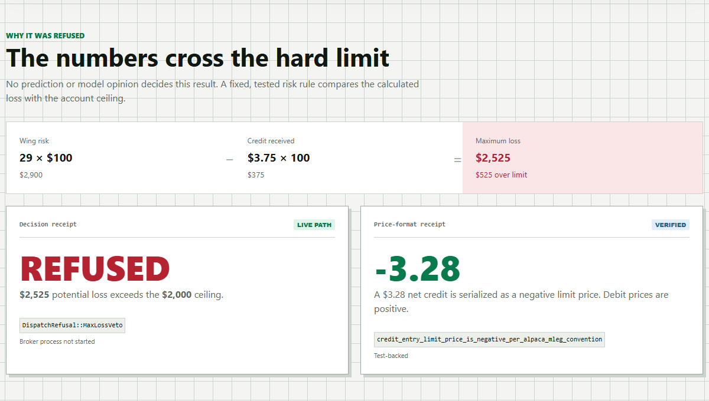
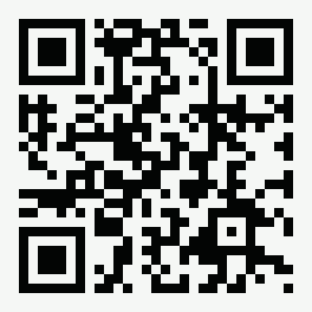
13forge
Unsafe trade stopped.
The loss is too high, so the broker is not reached.
$2,525
$2,000
REFUSED
possible loss
allowed limit
No Alpaca
WATCH THE PROOF
youtu.be/IrLmPIXukyo
AI can suggest. 13forge decides.
Notes:
Close with the proof in human terms. The proposed trade could lose two thousand five hundred twenty-five dollars, but the account limit is two thousand dollars. 13forge refuses it, and Alpaca is not reached. That is the whole product promise in one moment.

