Slide 1
Combating Data Imbalances in Federated Semi-supervised Learning with Dual Regulators
Authors: Sikai Bai, Shuaicheng Li, Weiming Zhuang, Jie Zhang, Kunlin Yang, Jun Hou, Shuai Zhang, Shuai Yi, Junyu Gao.

Slide 2
Introduction
Federated Semi-Supervised Learning (FSSL):
A branch of Federated Learning (FL) where a small amount of labeled data and abundant unlabeled data exist on decentralized clients.
Federated Learning: Machine learning paradigm where multiple clients collaboratively train a model without sharing raw data, preserving privacy.
Challenges:
External imbalance: Differences in data distributions between clients (e.g., some clients may only have a subset of the classes).
Internal imbalance: Labeled and unlabeled data within a client are drawn from different distributions.
Notes:
Define Federated Learning as a decentralized machine learning approach that ensures privacy by training local models without sharing raw data.
Introduce Semi-Supervised Learning: a method to improve performance with minimal labeled data by leveraging unlabeled data.
Highlight two major challenges in FSSL:
External imbalance: Clients have varying distributions of data (e.g., some clients may lack certain classes).
Internal imbalance: Labeled data on a client differs in distribution from its unlabeled data.
Emphasize that existing methods assume ideal conditions (IID data) and fail under these imbalances.
Introduce FedDure, which solves these challenges with adaptive regulators for both global and local adjustments.

Slide 3
Introduction
Existing Methods:
Rely on IID assumptions (Independent and Identically Distributed data).
Perform poorly in real-world non-IID settings.
Proposed Solution:
FedDure: A framework with two adaptive regulators that addresses both external and internal imbalances.

Slide 4
Related Work
Federated Learning: A distributed learning paradigm where client devices train models locally and share updates with a central server.
Problem: Statistical heterogeneity (non-IID data across clients) leads to client drift, where global and local models diverge.
Semi-Supervised Learning (SSL):
Utilizes both labeled and unlabeled data for training:
Pseudo-labeling: Assigns artificial labels to unlabeled data (Lee et al., 2013).
Consistency regularization: Ensures consistent predictions under input perturbations (Tarvainen and Valpola, 2017).
Notes:
Briefly cover Federated Learning and the issue of statistical heterogeneity that causes client drift (divergence of local and global models).
Explain the key methods in Semi-Supervised Learning:
Pseudo-labeling: Generates artificial labels for unlabeled data.
Consistency regularization: Enforces consistent predictions across perturbations.
Describe how FSSL blends FL and SSL, focusing on decentralized environments.
Point out that previous methods (e.g., FedMatch) only address external imbalances but ignore the internal distribution mismatches between labeled and unlabeled data.

Slide 5
Related Work
Federated Semi-Supervised Learning (FSSL):
Combines FL and SSL principles.
Categories:
Labels-at-Server: Labeled data centralized at the server.
Labels-at-Clients: Each client has some labeled data.
Labels-at-Partial-Clients: Only a subset of clients have labeled data.
Gaps: Prior methods (e.g., FedMatch) ignore intra-client imbalances.

Slide 6
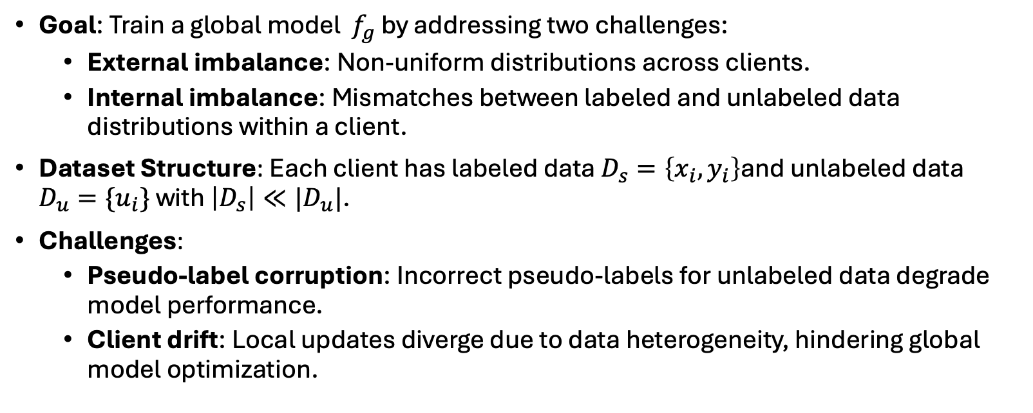
Problem Definition
Goal: Train a global model $f_{g}$ by addressing two challenges:
External imbalance: Non-uniform distributions across clients.
Internal imbalance: Mismatches between labeled and unlabeled data distributions within a client.
Dataset Structure: Each client has labeled data $D_{s}=\left\{x_{i}, y_{i}\right\}$and unlabeled data $D_{u}=\{u_{i}\}$ with $\left|D_{s}\right|≪|D_{u}|$.
Challenges:
Pseudo-label corruption: Incorrect pseudo-labels for unlabeled data degrade model performance.
Client drift: Local updates diverge due to data heterogeneity, hindering global model optimization.
Notes:
Define the goal of FedDure: train a global model that works effectively despite data imbalances.
Explain External Imbalance: Differences in data distributions across clients lead to inconsistent local training and client drift.
Explain Internal Imbalance: Differences in labeled vs. unlabeled data distributions within a client cause pseudo-label errors.
Highlight that traditional methods suffer from pseudo-label corruption, leading to degraded performance when mismatched data distributions exist.

Slide 7
Proposed Framework
FedDure Overview: A novel FSSL framework designed to handle imbalances using dual regulators:
Coarse-grained regulator (C-reg):
Tracks overall learning performance on labeled data.
Provides feedback to mitigate pseudo-labeling errors.
Uses global server parameters to reduce client drift.
Fine-grained regulator (F-reg):
Assigns weights to individual unlabeled samples.
Adapts dynamically to each client's unique data distribution.
Optimization Process:
Formulated as a bi-level optimization:
Alternating updates for C-reg, F-reg, and the local model.
Local updates incorporate feedback from both regulators to ensure robustness.
Notes:
KEY DEFINTION! In the context of Federated Semi-Supervised Learning (FSSL), a regulator is a mechanism or module designed to guide and adjust the training process of local models on decentralized clients. Regulators dynamically control how labeled and unlabeled data influence model updates, ensuring more robust and balanced learning, especially in the presence of imbalanced or heterogeneous data.
Introduce FedDure, emphasizing its dual-regulator approach:
C-reg:
Tracks overall learning performance on labeled data.
Provides feedback to correct pseudo-label errors and mitigate internal imbalance.
Uses global server parameters to address client drift.
F-reg:
Dynamically assigns weights to individual unlabeled data points based on their relevance to the model's performance.
Tailored for each client’s data distribution.
Explain the bi-level optimization strategy:
Alternates updates between regulators and the local model.
Regulators guide the local training process to ensure robust and balanced updates.

Slide 8
Experimental Setup
Datasets:CIFAR-10: A 10-class image dataset with 60,000 examples.
Fashion-MNIST: A dataset of clothing categories with 70,000 grayscale images.
CINIC-10: An extended dataset with 270,000 images, offering a more realistic distribution than CIFAR-10.
Data Settings:
(IID, IID): Labeled and unlabeled data are IID.
(IID, DIR): Labeled data is IID; unlabeled data is non-IID.
(DIR, DIR): Both labeled and unlabeled data are non-IID.
Implementation:
Local models use ResNet-9; F-reg employs a multi-layer perceptron (MLP).
Optimization with Adam; batch size: 10.
Baselines:
FedAvg, FedProx, and FedMatch combined with SSL methods (Fixmatch, UDA).
Notes:
Describe the datasets used:
CIFAR-10: A standard benchmark for image classification with 10 classes.
Fashion-MNIST: A dataset of grayscale clothing images.
CINIC-10: A larger, more realistic dataset for robust testing.
Explain the three data settings:
(IID, IID): Ideal case; labeled and unlabeled data are IID.
(IID, DIR): Labeled data is IID; unlabeled data is non-IID, simulating real-world imbalance.
(DIR, DIR): Both labeled and unlabeled data are non-IID, representing the most challenging scenario.
Highlight implementation details, such as using ResNet-9 for local models and an MLP for F-reg.
Mention that baselines include FedAvg, FedProx, and FedMatch combined with SSL methods like Fixmatch and UDA.

Slide 9
Results
Performance Comparison: FedDure achieves significant improvements over baselines:
11%-12% increase in accuracy in the challenging (DIR, DIR) setting.
Effectively mitigates the negative impact of internal and external imbalances.
Robustness:
Maintains high accuracy across varying data settings, labeled data ratios, and number of clients.
Outperforms FedMatch by over 15% on CIFAR-10 in some cases.
Scalability:
Adapts to increasing numbers of clients without significant performance loss.
Key Findings:
Existing FSSL methods degrade significantly under (DIR, DIR), while FedDure maintains superior performance.
Notes:
Emphasize the performance gains of FedDure:
Outperforms all baselines, particularly in the challenging (DIR, DIR) setting.
Achieves an 11%-12% accuracy improvement on CIFAR-10 and CINIC-10.
Highlight robustness:
FedDure consistently maintains performance across varying amounts of labeled data and different client counts.
Other methods degrade significantly under non-IID conditions.
Discuss scalability:
FedDure performs well even with a large number of clients, while others plateau or degrade.
Reinforce the advantage of dual regulators in handling both internal and external imbalances effectively.

Slide 10
Conclusion
Contributions:
Introduced a practical FSSL scenario addressing both external and internal imbalances.
Developed dual regulators (C-reg, F-reg) for adaptive and robust local model updates.
Achieved state-of-the-art performance across multiple benchmarks.
Implications:
Demonstrates the importance of tailored strategies for decentralized learning under real-world conditions.
Future Directions:
Extend FedDure to handle larger and more diverse datasets.
Explore adaptive noise mechanisms to further enhance performance.

Slide 11
References
Bai, S., Li, S., Zhuang, W., et al. "Combating Data Imbalances in Federated Semi-supervised Learning with Dual Regulators." AAAI-24.
Lee, D.-H., et al. (2013). "Pseudo-label: The simple and efficient semi-supervised learning method for deep neural networks." ICML.
Tarvainen, A., & Valpola, H. (2017). "Mean teachers are better role models: Weight-averaged consistency targets improve semi-supervised deep learning results." NeurIPS.
McMahan, B., et al. (2017). "Communication-efficient learning of deep networks from decentralized data." AISTATS.
Sohn, K., et al. (2020). "Fixmatch: Simplifying semi-supervised learning with consistency and confidence." NeurIPS.
Jeong, W., et al. (2021). "Federated semi-supervised learning with inter-client consistency & disjoint learning.”
Karimireddy, S. P., et al. (2020). "Scaffold: Stochastic controlled averaging for federated learning." ICML.

