Slide 1
Embedded Lua Workflow Techniques with LEJIT
Dylan Everingham
Mentor: Christine Sweeney
08/25/2016
Notes:
Content Slide Notes
“UNCLASSIFIED” marking of slides is not a security requirement and may be deleted from the Slide Master (View › Master › Slide Master). In general, slides should be marked “UNCLASSIFIED” if there is potential for confusion or misinterpretation of something that could be deemed classified. For guidance on marking slides containing classified and unclassified controlled information, see the Protecting Information Web site at http://int.lanl.gov/security/protectinfo/.

Slide 2
Contents
Motivation / Definitions
Usage
Performance
What’s next

Slide 3
Motivation
How will next generation codes be structured?
Problem: workflow for configuring input data and parameters for complex codes could be more flexible and dynamic

Slide 4
Motivation
How will next generation codes be structured?
Problem: workflow for configuring input data and parameters for complex codes could be more flexible and dynamic
Proposal: Use an embedded language such as Lua to enable configurable parameters and new function callbacks to be added without recompiling entire application or submodules

Slide 5
What is an Embedded Language?
A language with a lightweight compiler which can be easily integrated with code written in a system language such as C/C++/FORTRAN
Code written in system language can call scripts and functions written in the embedded language, which are JIT compiled at runtime
JIT compilation: compilation performed at run time as opposed to ahead of time (AOT)

Slide 6
What I Have Done So Far
Created LEJIT (Lua Easy Just-In-Time library)
LEJIT is a package for C/C++ codes which allows for easy management of configurable parameters and function callbacks through a generated Lua config file
Developers register variables/function pointers as configurable
An easily readable config file is created in which users can modify parameter values/add Lua code to callbacks
Developers can read configurable values out of config file at
Experimented with jitting code that calls C routines using LuaJIT FFI and in situ visualization using Torch
Initial performance testing

Slide 7
Why Bother?
Pros
Allows modification of code and complex changes to program behavior without recompilation (Torch math/plotting/notebook lib available)
Provides users with an easy way to modify inputs / behavior
Provides developers with an easy way to specify and limit which parts of the model should be configurable
Cons
Some performance penalties compared to straight C/C++/FORTRAN due to file parsing / Jitting
Requires LuaJIT compiler be included as project dependency (but it’s lightweight)
Slowdown in certain niche circumstances

Slide 8
Example Use Cases
Reconfigure in situ/postprocessing analysis/vis without recompilation
Redefine aspects of model behavior without recompilation (ex mesh subset selection logic)
Change which values program dumps even at runtime (useful for provenance and debugging)

Slide 9
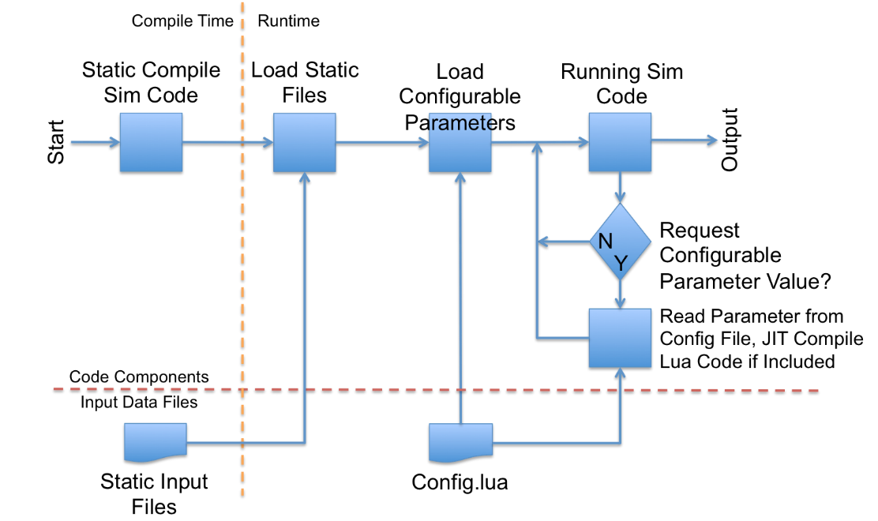
A Closer Look at Each Component
/* In model.cpp */
int static_data[100];
parse(“static_inputfile.dat”,
static_data);

Slide 10
A Closer Look at Each Component
/* In model.cpp */
#include “Lejit.hpp”
/* Declare parameters and give them default values */
int config_param = 5;
std::function<void(int)> config_callback = [](int x) {};
/* Create new LEJITReader */
LEJITReader *lr = new LEJITReader(“config.lua”);
/* Register configurable params with the LEJITReader */
lr->registerParam(“config_param”, config_param);
lr->registerParam(“config_callback”, config_callback);
/* Create config file (does nothing and returns false if
file already exists) */
if(! lr->writeConfigFile()) {
/* If file already exists, get values of configurable
parameters from it */
lr->readParam(“config_param”, config_param);
lr->readParam(“config_callback”, config_callback);
}
/* Now we can use the int and the function pointer */

Slide 11
A Closer Look at Each Component
-- In config.lua
config_param = 5
config_callback = function (arg0)
-- Add a Lua function definition
-- here to override the default
-- behavior. For example:
print(arg0)
end

Slide 12
A Closer Look at Each Component
/* In model.cpp */
/* Can use the int */
some_function(config_param);
/* Can use the callback */
config_callback(42);
/* Can reload from config file at any time */
if (someCondition) {
lr->readParam(“config_callback”,
config_callback);
}

Slide 13
Performance Overview
Important points:
There is overhead associated with both Jitting and calling Lua function from C
However, LuaJIT is very fast, even faster than C++ in certain test cases
So slowdown is a function of JIT time, Lua C API overhead and the speed of LuaJIT in a certain problem
Penalty to executable size for inclusion of LEJIT is small
1KB on disk / 2MB in memory difference for benchmarks
Bottom line: minimize calls to configurable callbacks in nested loops and you’ll be fine

Slide 14
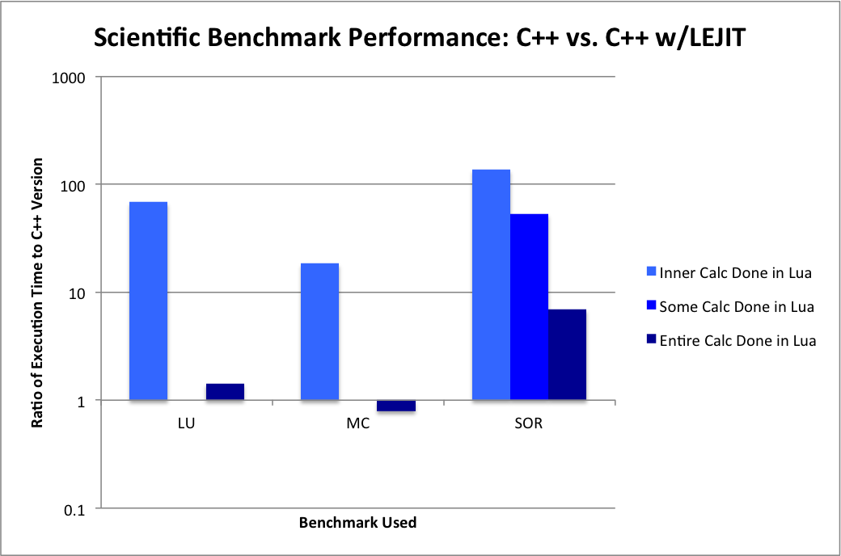
Performance: Scientific Benchmarks C++ vs. Lejit
Tests done on Mac mini using clang++ for C++

Slide 15
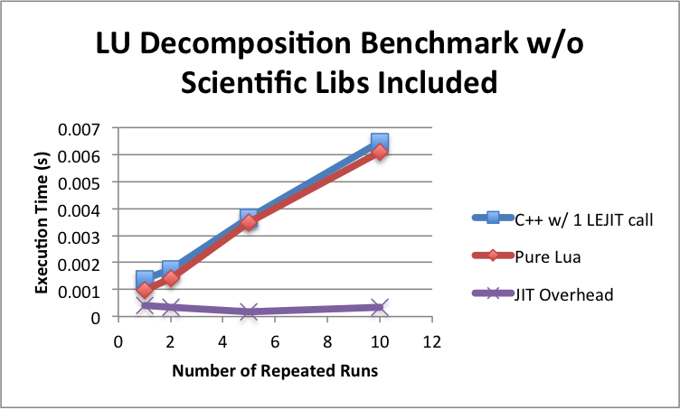
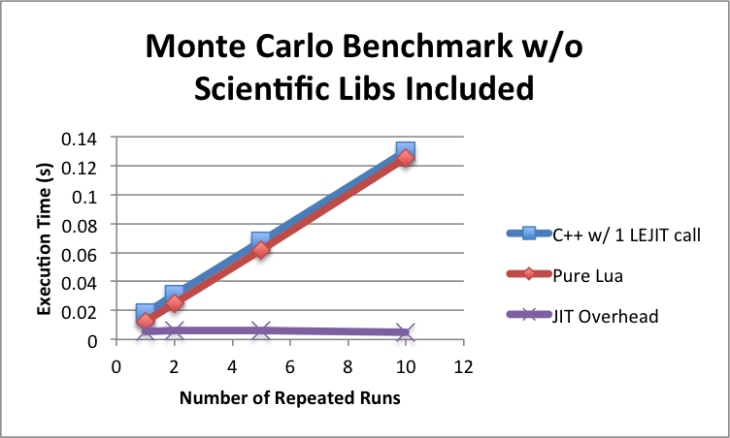
Performance: Cost of Jitting
Overhead for JIT compiling callback is one time cost of about ~0.5ms

Slide 16
Performance: Cost of Jitting
JIT overhead increases to ~5ms if including Lua torch or gnuplot libraries (10ms for both). With LEJIT you can choose whether to include these libraries or not.

Slide 17
Performance: In Situ Visualization
There is a significant performance cost depending on the complexity of the analysis added
For example, ~300x slowdown for plotting in each iteration of Monte Carlo benchmark
However, cost scales with how often you are plotting
For example, plot only once every 10 iterations and for a ~30x slowdown
Also a flat 10ms penalty for JIT compilation (inclusion of both torch and gnuplot libraries)
Still, extremely flexible and easy to set up (only ~3 lines for Monte Carlo)

Slide 18
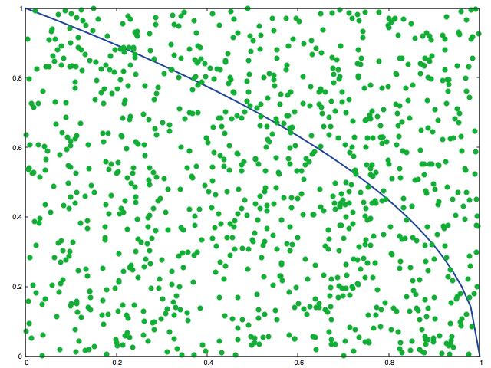
Example of In Situ Visualization
Plot generated with gnuplot/torch during run of Monte Carlo benchmark showing randomly generated points being used to find the value of pi

Slide 19
What’s Next?
Continued performance benchmarking
Cost imposed by Lua C API
Cost of in situ visualization
Comparison of different interfaces
Use of LEJIT with a large code (VPIC)

Slide 20
Thank You!
I’ve had a great summer at LANL, and hope to keep in contact and return someday.
See you around!

