Slide 1
MULTITHREADING
By
Manishkumar R Solanki
Sr. Lecturer (Information Technology)
SBMP

Slide 2
Learning Outcomes
Create multiple user defined threads
Apply the methods isAlive() and join()
Achieve synchronization between threads
Observe the Producer – Consumer problem

Slide 3
Choosing an Approach for thread creation
The class which extends Thread, overrides only one method run()
Classes should be extended only when they are being enhanced or modified in some way. We do not do this while extending Thread class. So, we should simply implement Runnable.
Another Reason: We can extend at most one class in Java so Runnable will help us here to achieve for thread execution.

Slide 4
Creation of multiple threads
// Create multiple threads.
class NewThread implements Runnable {
String name; // name of thread
Thread t;
NewThread(String threadname) {
name = threadname;
t = new Thread(this, name);
System.out.println("New thread: " + t);
t.start(); // Start the thread
}
// This is the entry point for thread.
public void run() {
try {
for(int i = 5; i > 0; i--) {
System.out.println(name + ": " + i);
Thread.sleep(1000);
}
} catch (InterruptedException e) {
System.out.println(name + "Interrupted");
}
System.out.println(name + " exiting.");
} }

Slide 5
Creation of multiple threads
class MultiThreadDemo
{
public static void main(String args[]) {
new NewThread("One"); // start threads
new NewThread("Two");
new NewThread("Three");
try {
// wait for other threads to end
Thread.sleep(10000);
} catch (InterruptedException e) {
System.out.println("Main thread Interrupted");
}
System.out.println("Main thread exiting.");
}
}

Slide 6
Creation of multiple threads
class MultiThreadDemo
{
public static void main(String args[]) {
new NewThread("One"); // start threads
new NewThread("Two");
new NewThread("Three");
try {
// wait for other threads to end
Thread.sleep(10000);
} catch (InterruptedException e) {
System.out.println("Main thread Interrupted");
}
System.out.println("Main thread exiting.");
}
}

Slide 7
The output from this program
New thread: Thread[One,5,main]
New thread: Thread[Two,5,main]
New thread: Thread[Three,5,main]
One: 5
Two: 5
Three: 5
One: 4
Two: 4
Three: 4
One: 3
Three: 3
Two: 3
One: 2
Three: 2
Two: 2
One: 1
Three: 1
Two: 1
One exiting.
Two exiting.
Three exiting.
Main thread exiting.

Slide 8
Using isAlive( ) and join( )
The main tread should be the last to finish, this is accomplished by calling sleep( ) within main( ) with a long enough delay.
How can one thread know when another thread has ended?
Two ways exist to determine whether a thread has finished.
First, you can call isAlive( ) on the thread.
This method is defined by Thread, and its general form is shown here:
final boolean isAlive( )
The isAlive( ) method returns true if the thread upon which it is called is still running. It returns false otherwise.
The method that will be used to wait for a thread to finish is called join( )
final void join( ) throws InterruptedException
This method waits until the thread on which it is called terminates. Its name comes from the concept of the calling thread waiting until the specified thread joins it.
Additional forms of join( ) allow you to specify a maximum amount of time that you want to wait for the specified thread to terminate.

Slide 9
Using isAlive( ) and join( )
class DemoJoin
{
public static void main(String args[]) {
NewThread ob1 = new NewThread("One");
NewThread ob2 = new NewThread("Two");
NewThread ob3 = new NewThread("Three");
// checking status of threads
System.out.println("Thread One is alive: “ + ob1.t.isAlive());
System.out.println("Thread Two is alive: “ + ob2.t.isAlive());
System.out.println("Thread Three is alive: “ + ob3.t.isAlive());

Slide 10
Using isAlive( ) and join( )
// wait for threads to finish
try {
System.out.println("Waiting for threads to finish.");
ob1.t.join();
ob2.t.join();
ob3.t.join();
} catch (InterruptedException e) {
System.out.println("Main thread Interrupted");
}
// checking status of threads again
System.out.println("Thread One is alive: “ + ob1.t.isAlive());
System.out.println("Thread Two is alive: “ + ob2.t.isAlive());
System.out.println("Thread Three is alive: “ + ob3.t.isAlive());
System.out.println("Main thread exiting.");
}
}

Slide 11
The output from this program
New thread: Thread[One,5,main]
New thread: Thread[Two,5,main]
New thread: Thread[Three,5,main]
Thread One is alive: true
Thread Two is alive: true
Thread Three is alive: true
Waiting for threads to finish.
One: 5
Two: 5
Three: 5
One: 4
Two: 4
Three: 4

Slide 12
The output from this program
One: 3
Two: 3
Three: 3
One: 2
Two: 2
Three: 2
One: 1
Two: 1
Three: 1
Two exiting.
Three exiting.
One exiting.
Thread One is alive: false
Thread Two is alive: false
Thread Three is alive: false
Main thread exiting.

Slide 13
Thread Priorities
Thread priorities are used by the thread scheduler to decide when each thread should be allowed to run.
higher-priority threads get more CPU time than lower-priority threads.
A higher-priority thread can also preempt a lower-priority one. For instance, when a lower-priority thread is running and a higher-priority thread resumes (from sleeping or waiting on I/O, for example), it will preempt the lower priority thread.
To set a thread’s priority, use the setPriority( ) method, which is a member of Thread.
final void setPriority(int level)
level specifies the new priority setting for the calling thread. The value of level must be
within the range MIN_PRIORITY and MAX_PRIORITY. Currently, these values are 1 and 10, respectively. To return a thread to default priority, specify NORM_PRIORITY, which is currently 5.
You can obtain the current priority setting by calling the getPriority( ) method of Thread, shown here:
final int getPriority( )

Slide 14
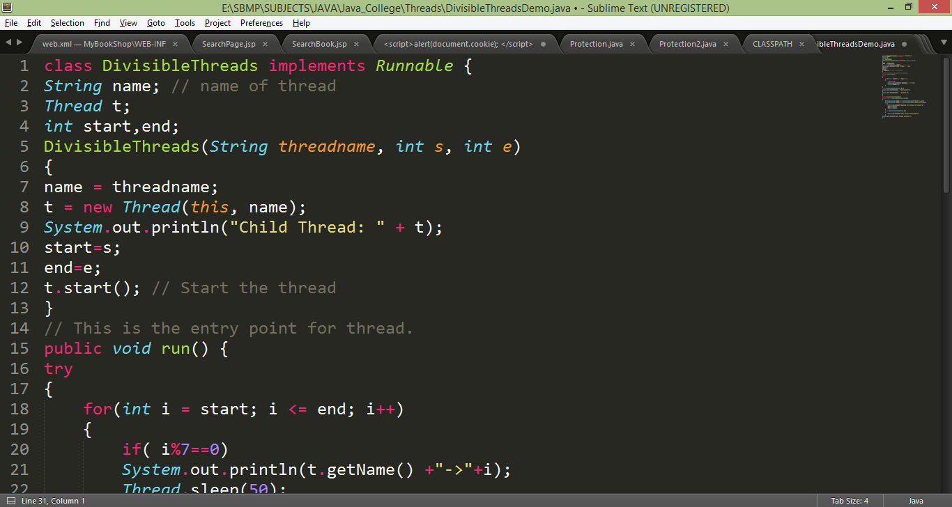
Real World Example
Create two threads to find out numbers which are divisible by 7 between 1 to 200 numbers. Each thread should look after 100 numbers in the given range.

Slide 15
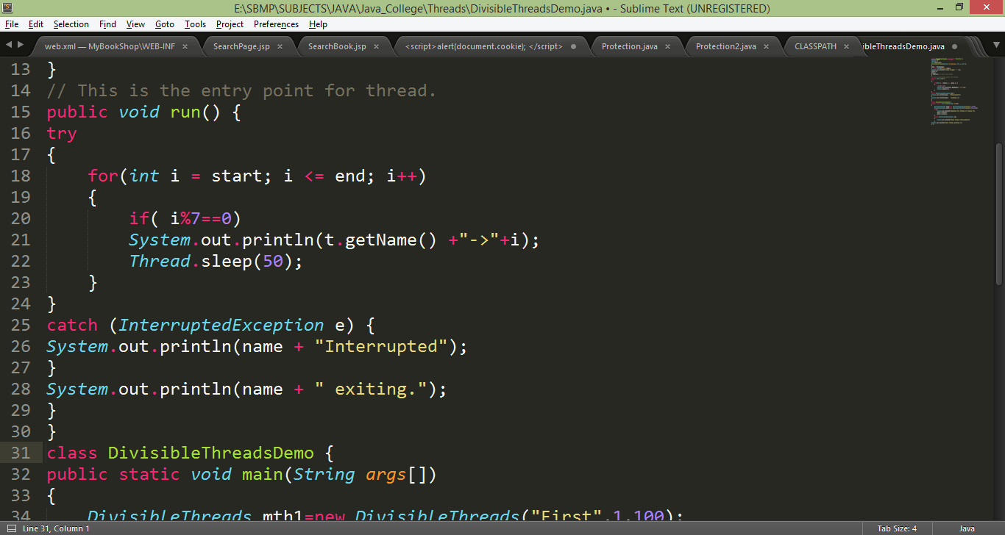
Real World Example

Slide 16
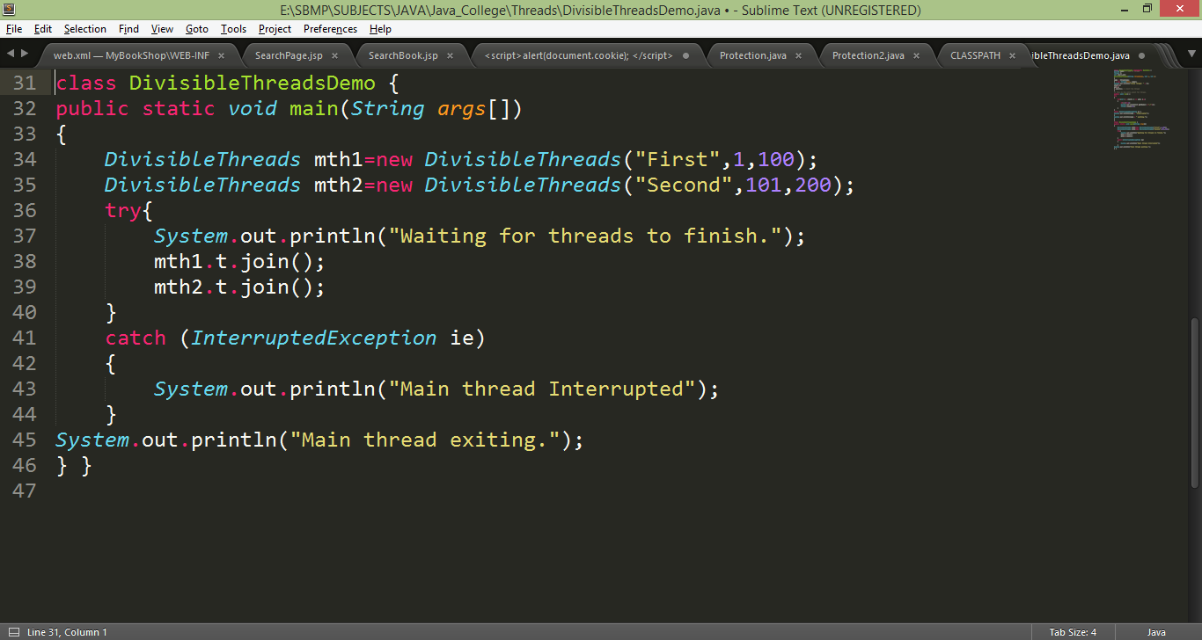
Real World Example

Slide 17
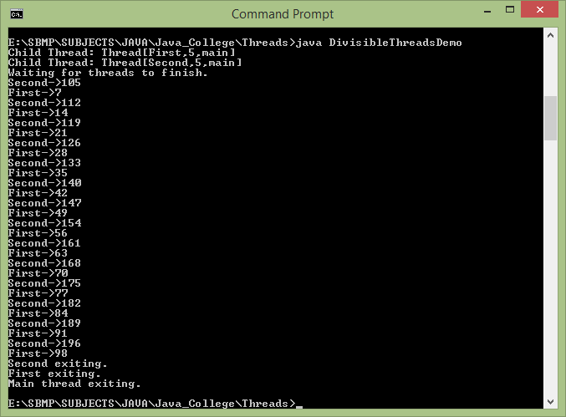
Real World Example

Slide 18
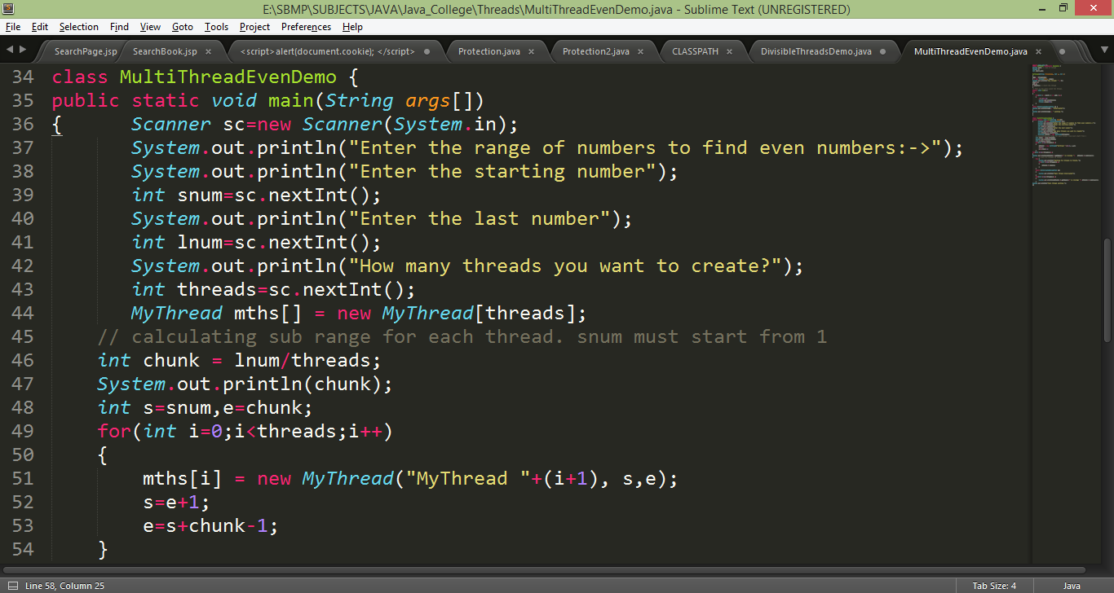
Real World Example
Write an interactive multithreaded Java program to find even numbers from the given range of numbers. The program should ask the user about range and number of threads to be created.

Slide 19
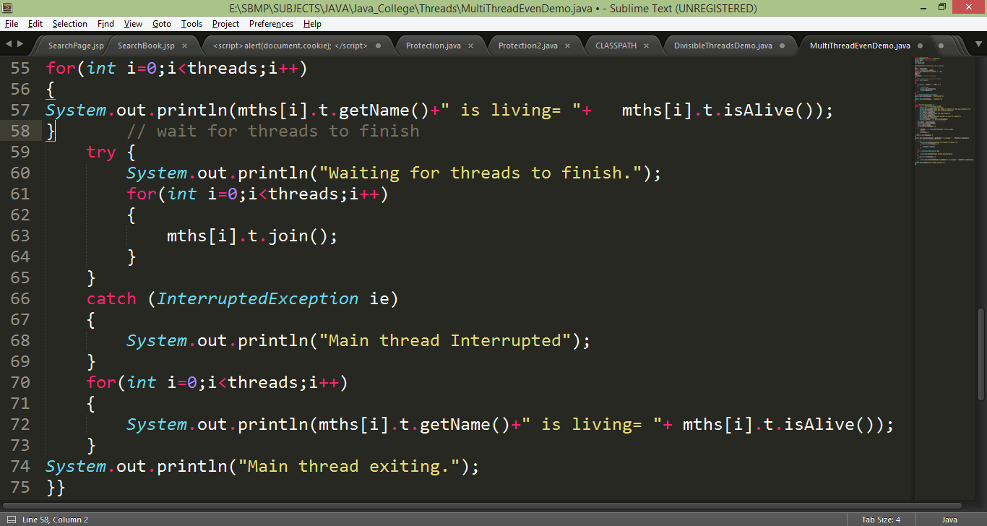
Real World Example

Slide 20
Real World Example
Note: If range is in between i.e. 10 to 100
Then,
chunk = (lnum – snum) / threads;
// Outside the loop
s=snum;
e= s+chunk
// Inside the loop
s=e+1;
e= s+chunk-1;

Slide 21
Thread Synchronization
When two or more threads need access to a shared resource, they need some way to ensure that the resource will be used by only one thread at a time. The process by which this is achieved is called synchronization.
Key to synchronization is the concept of the monitor (also called a semaphore).
A monitor is an object that is used as a mutually exclusive lock, or mutex.
Only one thread can own a monitor at a given time. When a thread acquires a lock, it is said to have entered the monitor.
All other threads attempting to enter the locked monitor will be suspended until the first thread exits the monitor. These other threads are said to be waiting for the monitor.
A thread that owns a monitor can reenter the same monitor if it so desires

Slide 22
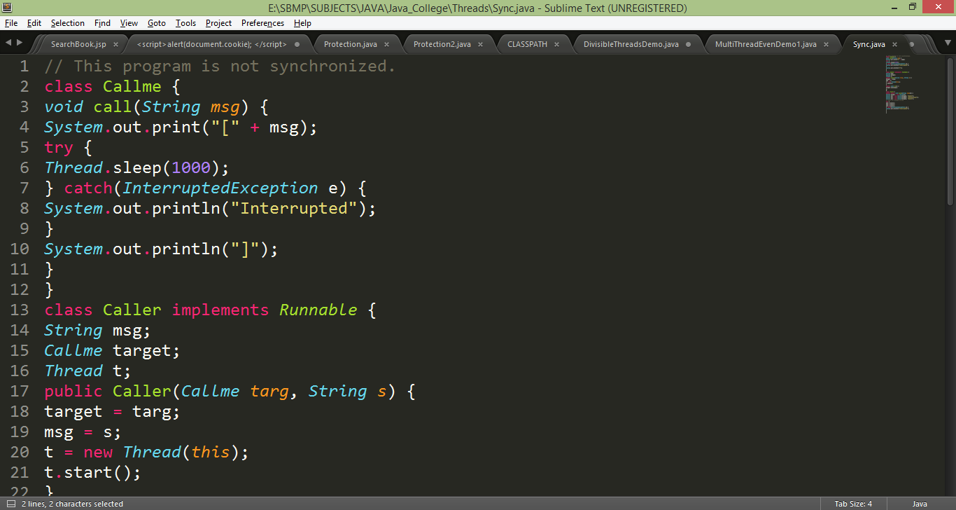
Thread Synchronization

Slide 23
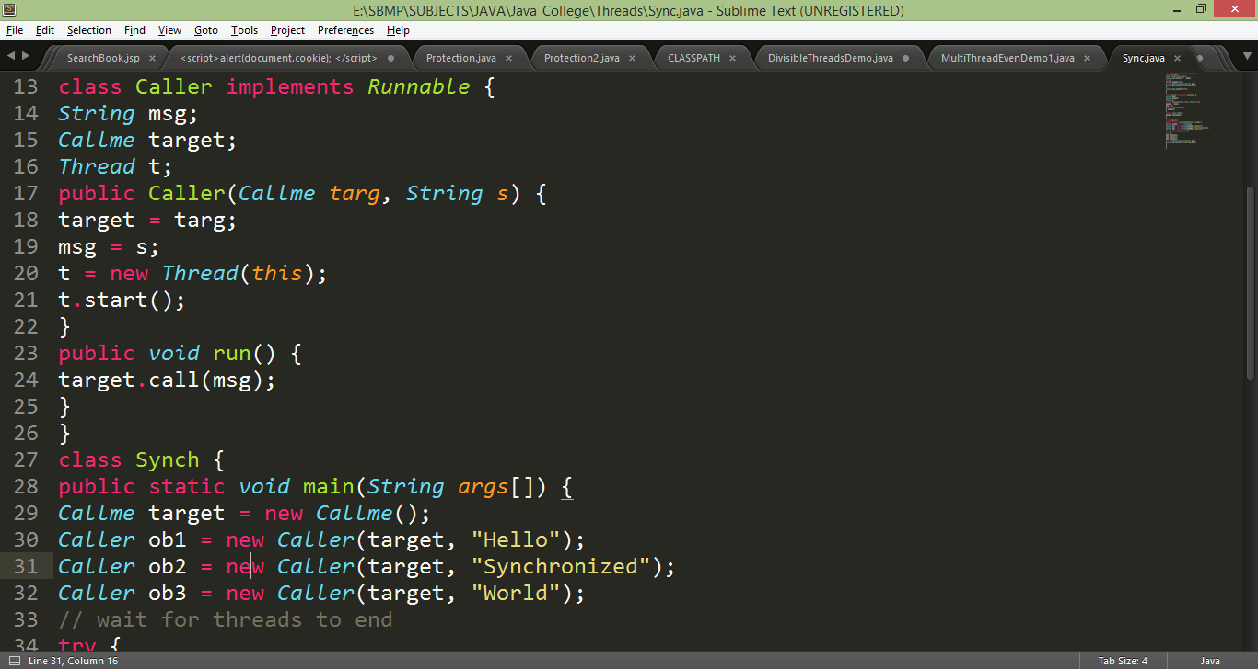
Thread Synchronization

Slide 24
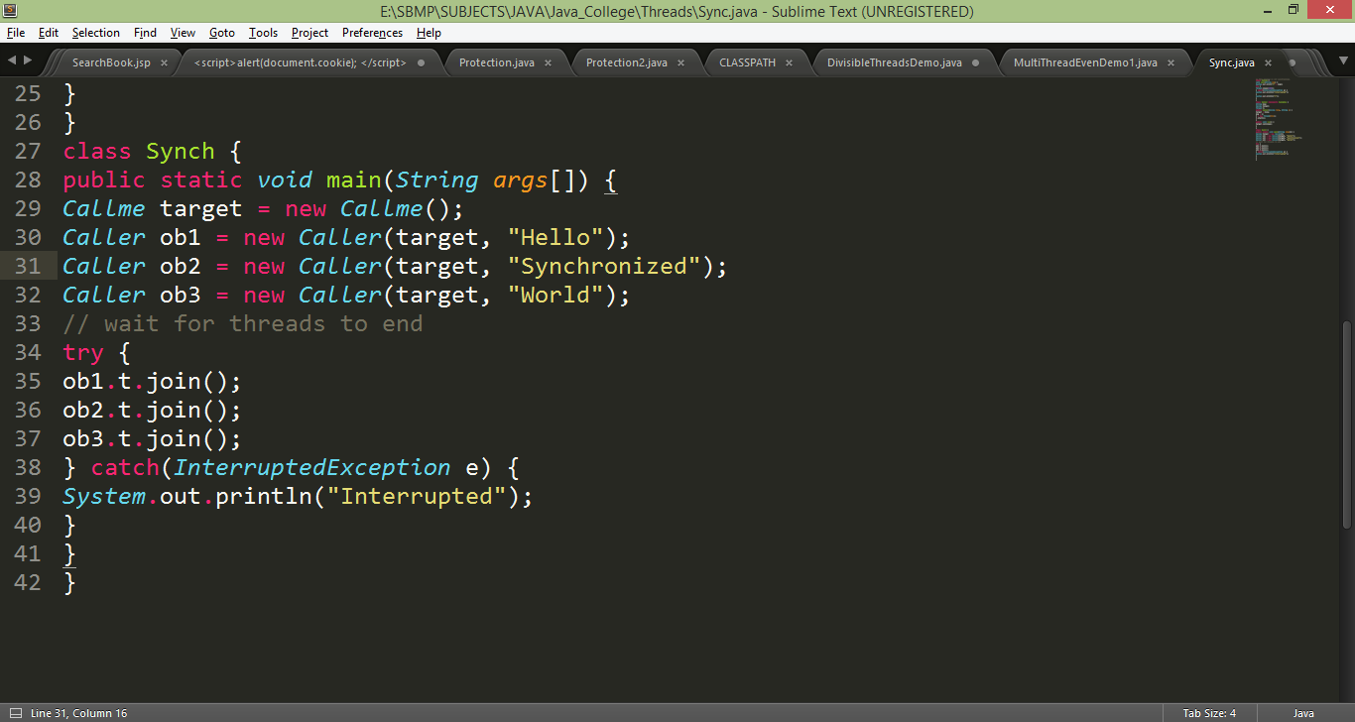
Thread Synchronization

Slide 25
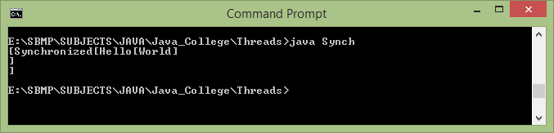
Thread Synchronization

Slide 26
Thread Synchronization
To fix the preceding program, you must serialize access to call( ).
That is, you must restrict its access to only one thread at a time.
To do this, you simply need to precede call( )’s definition with the keyword synchronized, as shown here:
class Callme {
synchronized void call(String msg) {
The output of the program is as follows:
[Hello]
[Synchronized]
[World]
Once a thread enters any synchronized method on an instance, no other thread can enter any other synchronized method on the same instance.

Slide 27
Thread Synchronization
Creating synchronized methods within classes that you create is an easy and effective solution to achieve synchronization
But it is not applicable in all cases
Imagine that you want to synchronize access to objects of a class that was not designed for multithreaded access. That is, the class does not use synchronized methods.
Further, this class was not created by you, but by a third party, and you do not have access to the source code.
Thus, you can’t add synchronized to the appropriate methods within the class. How can access to an object of this class be synchronized?
The solution to this problem is quite easy: You simply put calls to the methods defined by this class inside a synchronized block.
synchronized(object) {
// statements to be synchronized
}

Slide 28
Thread Synchronization
The program code should be written as follows:
// synchronize calls to call()
public void run()
{
synchronized(target) { // synchronized block
target.call(msg);
}
}

Slide 29
Interthread Communication
The preceding examples unconditionally blocked other threads from asynchronous access to certain methods. This use of the implicit monitors in Java objects is powerful, but you can achieve a more subtle level of control through interprocess communication.
Producer Consumer Problem: One thread is producing some
data and another is consuming it. To make the problem more interesting, suppose that the producer has to wait until the consumer is finished before it generates more data.
In a polling system, the consumer would waste many CPU cycles while it waited for the producer to produce. Once the producer was finished, it would start polling, wasting more CPU cycles waiting for the consumer to finish, and so on. Clearly, this situation is undesirable.

Slide 30
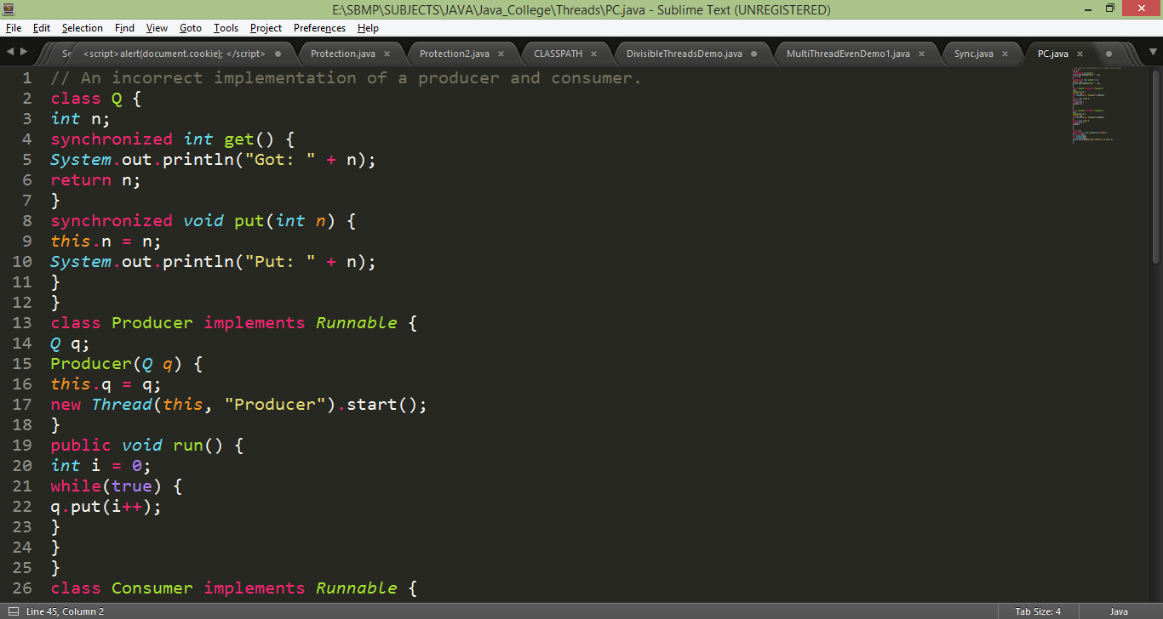
Producer Consumer Problem with only Synchronization

Slide 31
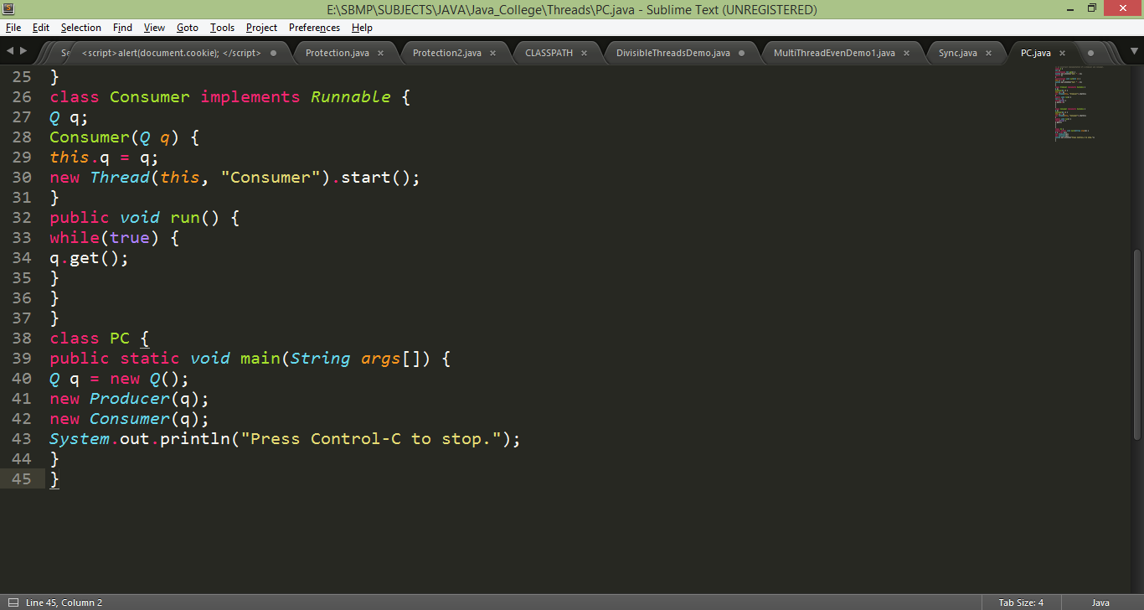
Producer Consumer Problem with only Synchronization

Slide 32
Producer Consumer Problem with only Synchronization
Output
Put: 1
Got: 1
Got: 1
Got: 1
Got: 1
Got: 1
Put: 2
Put: 3
Put: 4
Put: 5
Put: 6
Put: 7
Got: 7

Slide 33
Interthread Communication
To avoid polling, Java includes an elegant inter process communication mechanism via the wait( ), notify( ), and notifyAll( ) methods.
These methods are implemented as final methods in Object, so all classes have them. All three methods can be called only from within a synchronized context.
wait( ) tells the calling thread to give up the monitor and go to sleep until some other thread enters the same monitor and calls notify( ).
notify( ) wakes up a thread that called wait( ) on the same object.
notifyAll( ) wakes up all the threads that called wait( ) on the same object. One of the threads will be granted access.
These methods are declared within Object, as shown here:
final void wait( ) throws InterruptedException
final void notify( )
final void notifyAll( ).

Slide 34
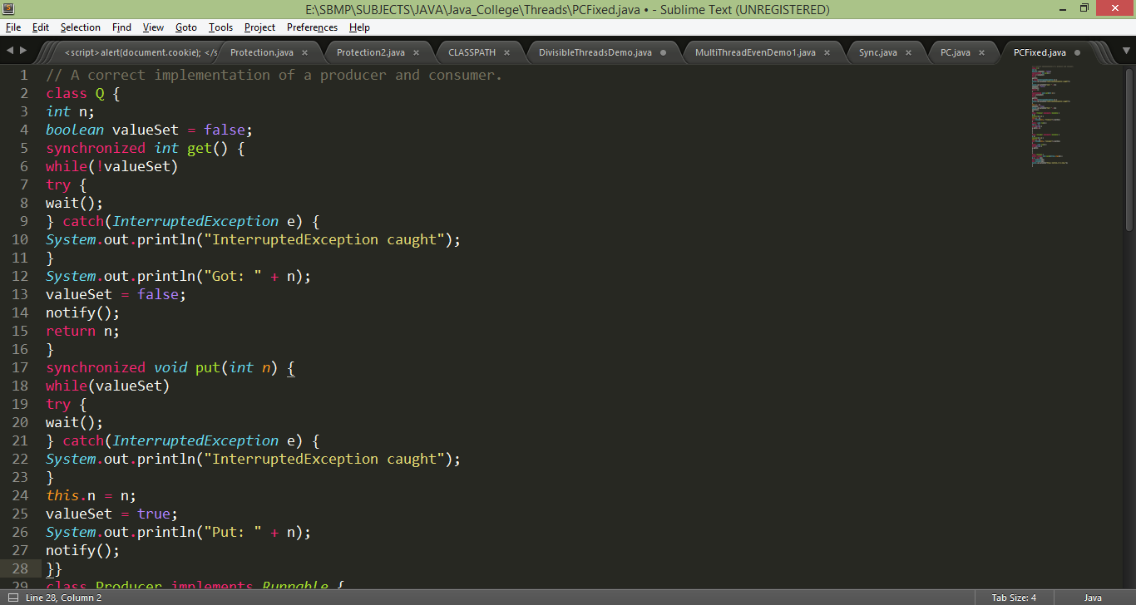
Producer Consumer Problem with only Synchronization

Slide 35
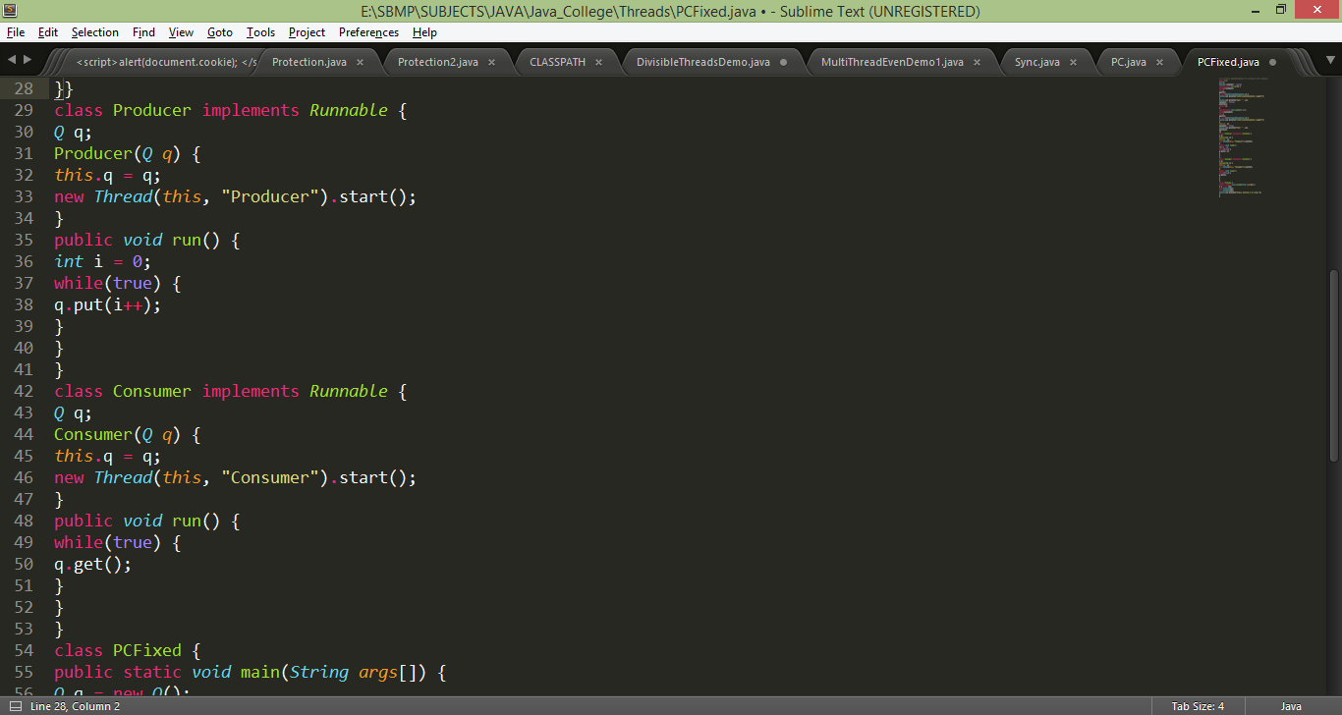
Producer Consumer Problem with only Synchronization

Slide 36
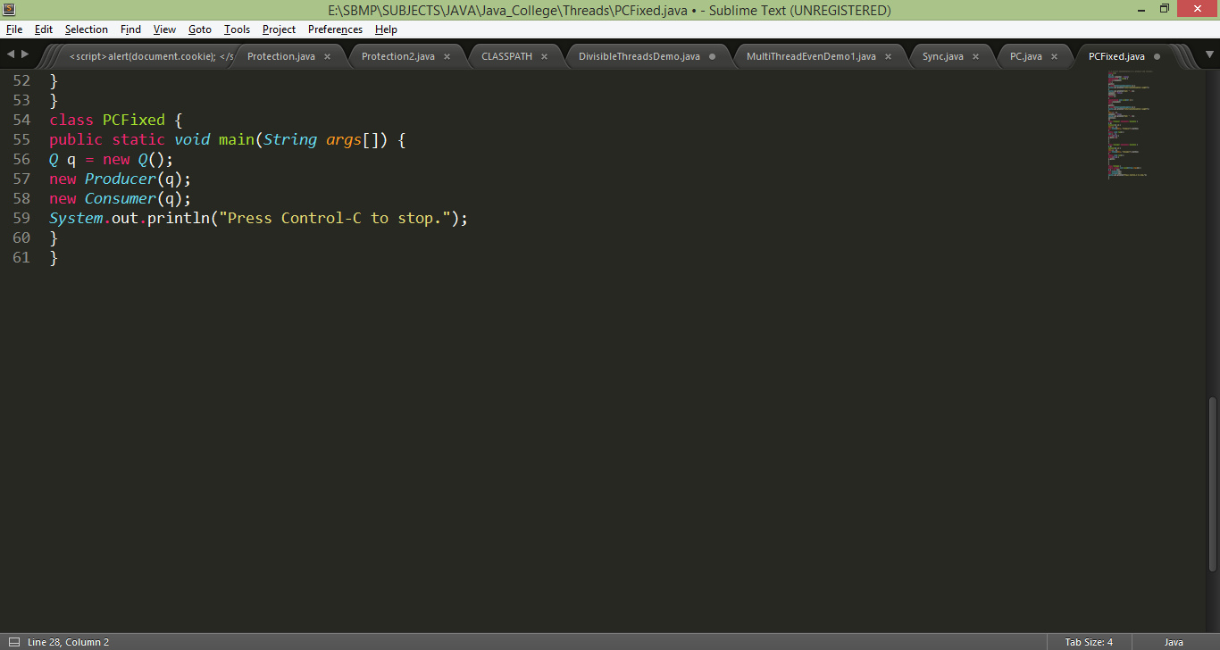
Producer Consumer Problem with only Synchronization

Slide 37
References:
Java The Complete Reference,TMH

