Slide 1
BFS CAPSTONE PROJECT
By
Devesh Pandey
Ritesh Gupta

Slide 2
Objective
CredX is a leading credit card provider that gets thousands of credit card applications every year. But in the past few years, it has experienced an increase in credit loss. The CEO believes that the best strategy to mitigate credit risk is to acquire the right customers.
In this project, our task is to help CredX identify the right customers using predictive models. Using past data of the bank’s applicants, we need to determine the factors affecting credit risk, create strategies to mitigate the acquisition risk and assess the financial benefit of your project.

Slide 3
Steps performed
Understand the main problem and drafted the initial steps.
Understand the dataset provided (both Demographic and Credit Bureau) and analyze both dataset.
Perform data cleaning on both the data sets, handling null values.
Perform EDA on each data set separately and explain the outcome of EDA.
Work of Evidence (WoE) and Information Value (IV) analysis and preparing WoE transformed dataset.
Take Demographic data-set and perform WoE transformation and also obtain significant variables based on IV.
Merge Demographic data-set with Credit Bureau dataset and do WoE transformation and get significant variables, called Master dataframe
Perform basic EDA on Merged/Master dataset.

Slide 4
Steps performed…contd
Use both the original clean data-set and WoE transformed data set of demographics separately to prepare data models. For this bi-logit problem model preparation, begin with simple models like Logistic Regression model with RFE and step by step move on to relatively complex models like Logistic Regression with Regularization, Decision Tree, Random Forest etc. Following steps needs to be considered in each model building process :
Initially the dataset needs to be divided into Test and Train dataset.
There is a class imbalance in the dataset. This needs to be handled using balanced class during each model preparation.
Cross Validation needs to be done for each model.
Additional validation of data should be done on the dataset on the rejected applications (performance tag null) ignored for model building.
Hyperparameters for each type of models need to be optimized properly using GridSearch and model coming with optimized parameter should be chosen.

Slide 5
Methodology
Start
Understanding problem statement
Data understanding
Understanding features
Data cleaning
EDA
Perform EDA
Analyze important features
WOE IV Analysis
Compare features
Compare with WOE/IV and EDA
Prepare model
Get a clean dataset to prepare model
Perform WOE / IV Analysis
Logistic regression
Use logistic regression to start modeling
Decision Tree Classifier
Use the decision tree classifier modeling method
RandomForest Model
Use RandomForest model
Evaluate models
Compare model performance
Compare features
Application Scorecard
Build Application Scorecard of each applicant
Submit results
Display financial benefit

Slide 6
Data understanding
There are two data sets in this project: Demographic and Credit bureau data.
Demographic/application data: This is obtained from the information provided by the applicants at the time of credit card application. It contains customer-level information on age, gender, income, marital status, etc.
Credit bureau data: This is taken from the credit bureau and contains variables such as 'number of times 30 DPD or worse in last 3/6/12 months', 'outstanding balance', 'number of trades', etc.
Both files contain a performance tag, which indicates whether the applicant has gone 90 days past due (DPD) or worse in the past 12 months (i.e. defaulted) after getting a credit card.
In some cases, it is observed that all the variables in the credit bureau data are zero and credit card utilization is missing. These represent cases in which there is a no-hit in the credit bureau. The cases with missing credit card utilization are also observed. These are the cases in which the applicant does not have any other credit card.

Slide 7
Data understanding and fixing
Variable | Explaination
Age | One customer had negative age (age was -3). 19 customers had age as 0. 45 customers had age less than 18 (assuming a person with age less than 18 is not eligible for applying the card). The age for all the above record was set as 18. For example Demo_dt['Age'][Demo_dt['Age']<=18]=Demo_dt['Age'].mean()

Slide 8
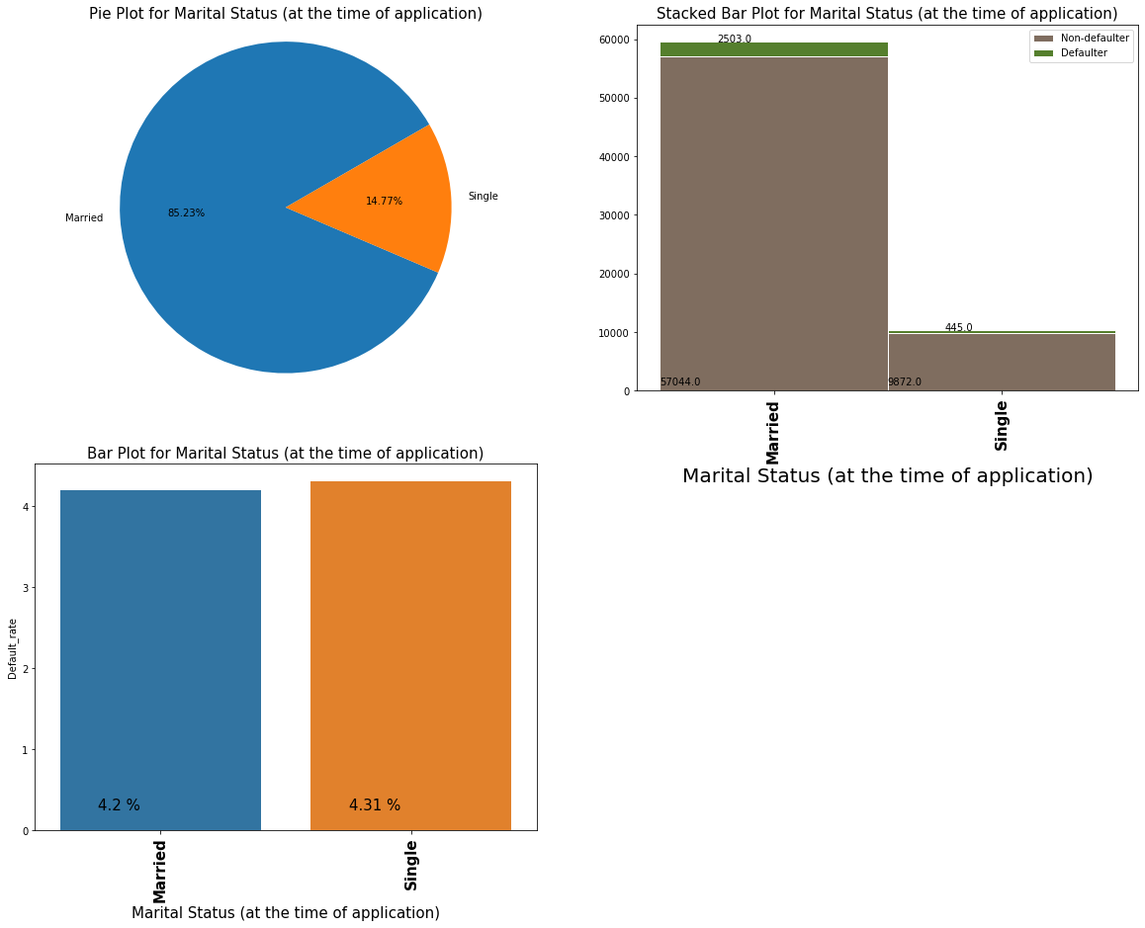
EDA
Marital Status – Singles seem to have higher default rate.

Slide 9
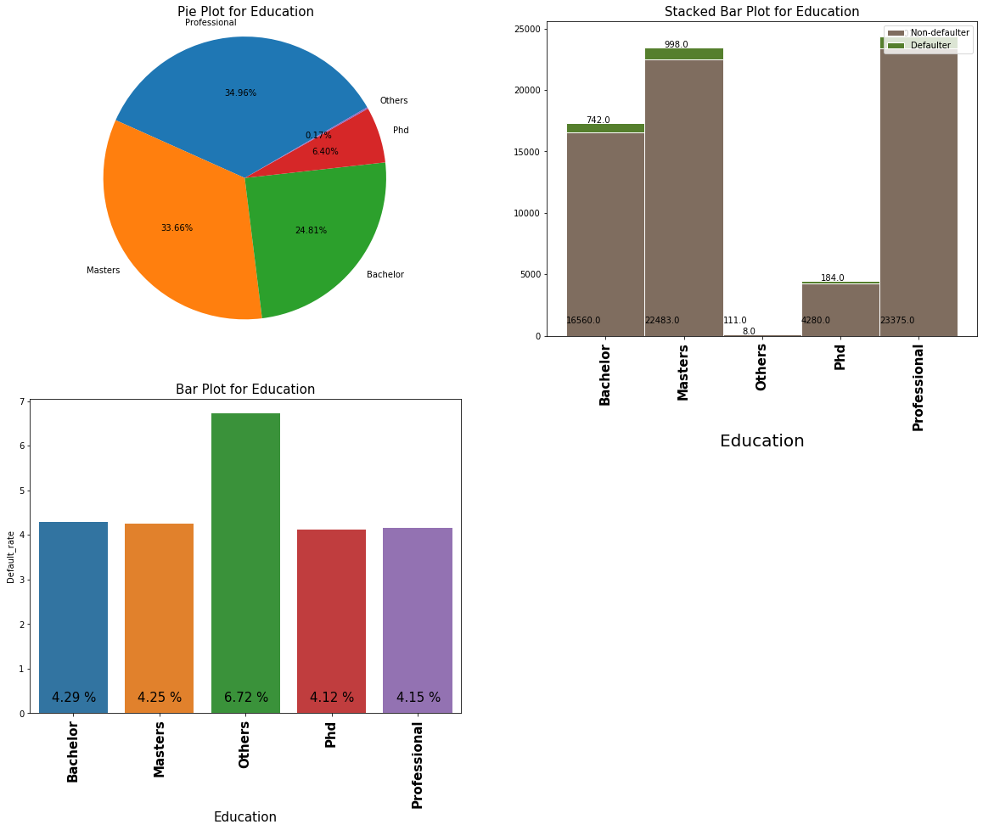
EDA…contd
Education – Others type have higher default rate

Slide 10
EDA and WOE/IV Analysis
Following predictor variables were obtained as part of EDA and WoE Analysis for Credit Bureau data
(top five based on IV values).
Avgas_CC_Utilization_12_months
Trades_opened_last_12_months
PL_Trades_opened_last_12_months
Inquiries_last_12_months
No of times 30 DPD or worse in last 12 months

Slide 11
Model Evaluation Steps
Basis of Evaluation To Get Optimal Model for each type:
The objective of the model is to optimize Sensitivity / Recall .
Confusion matrix prepared for each model.
Sensitivity, specificity, accuracy curve for Logistic Regression models.
AUC-ROC curve for the Logistic Regression models using cut-off values for each model.
Plots showing optimized values for Regularization hyperparameter.
Use of GridSearchCV and plotting its results for all models.
Within each model type evaluation using GridSerach based on recall values should be done to get models with optimized hyperparameters.
For evaluation among models, the dataset for rejected applications (with performance tag missing), which were assumed as potentially defaulters should be considered for evaluations. Ideally, the output for all these applications should be defaulters.

Slide 12
Application Scorecard Calculation
Scorecard Evaluation variables and formulae :
target_score = 400
target_odds = 10
pts_double_odds = 20
factor = pts_double_odds / log10(2)
offset = target_score - factor × log10(target_odds)
scorecard['logit’] = ∑ (β×WoE) + α
(where β — logistic regression coefficient and α — logistic regression intercept)
Finally, scorecard['score'] = offset - factor × scorecard['logit']

Slide 13
Financial Risk in current operation
Total number of applications = 71295
Credit Card given to applicants = 69870
Customers that made Credit Loss = 2948
Assumptions on unit Applications :
Acquisition Cost + Credit Report Cost –100 INR
Calling Cost – 10 calls avg × 10p = 1 INR
Operations {Agents + Infra + Others) = 1000 INR approx.
Credit Default = Rs 48,000 average
For every customer defaulted we are at a risk of loosing 50,000 INR (48k + 2k) on an average (assuming 50K is average credit line used by defaulter)
Total Credit Loss for all customers = 50000 × 2948
= 150 Million INR (approx.)

Slide 14
Financial benefit of the model
The model giving a recall of 63% which means it is preventing 63% of losses.
Potential Loss prevented with using model = 0.63 × 150 Million INR
= 93 Million INR
Loss after prevention = 150 – 93Million INR
= 57 Million INR
The Credit loss after applying the model has slashed to 37% compared to the Original Credit loss, which did not include using any model.
Saving the amount paid to Underwriters for Credit application approval is added advantage.
Important Note : There will be a tradeoff between the increase in approval rate and credit loss – increase of one will lead to increase of other. With this model the approval rate is bound to be less business to the bank and so will be the profits of the bank. However, profits are very small in margins (5-7%) as compare to the Principal amount in Credit Line. Hence percentage would be very small overall the Credit Line amount.

Slide 15
Thank you

