Slide 1


SHEmove
TITLE
Team Eclipse
Project Name: SHEmove
(Women’s Safety platform)
Team name: Eclipse
Institution: Uttarakhand Technical University
Team Members: Devesh Rawat(Leader)
Pranjal Arya
Deepika
Jyoti Negi
HackCBS 9.0
1

Slide 2


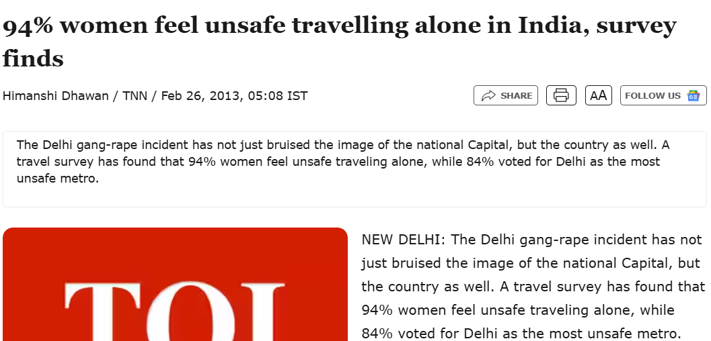
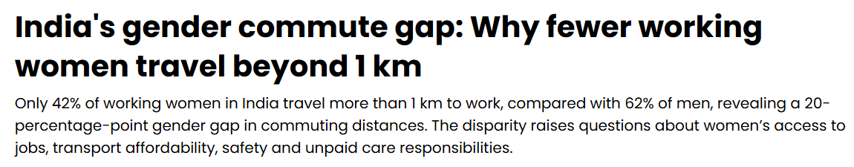
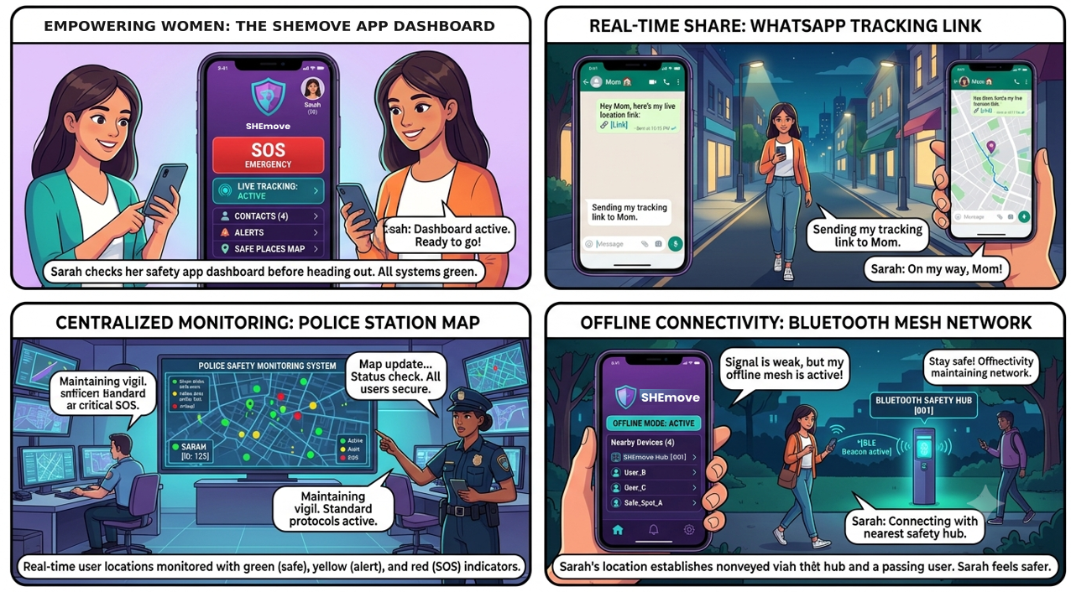

IDEA OVERVIEW
SHEmove
Team Eclipse
Problem
Our Solution
Women's safety is fragmented, reactive, and disconnected.
One crime against women every 41 sec is registered as of 2025 data, yet existing systems still depend on victims actively seeking help.
An integrated proactive women safety platform that connects women, emergency responders, and authorities through real-time SOS alerts, live location tracking, and intelligent incident management.
1
2
Unique Selling Point
Dual-PIN Convert Distress Authentication
3
Regular PIN:
Normal authentication and app access.
Duress PIN:
Covert emergency activation and location sharing.
HackCBS 9.0
2

Slide 3

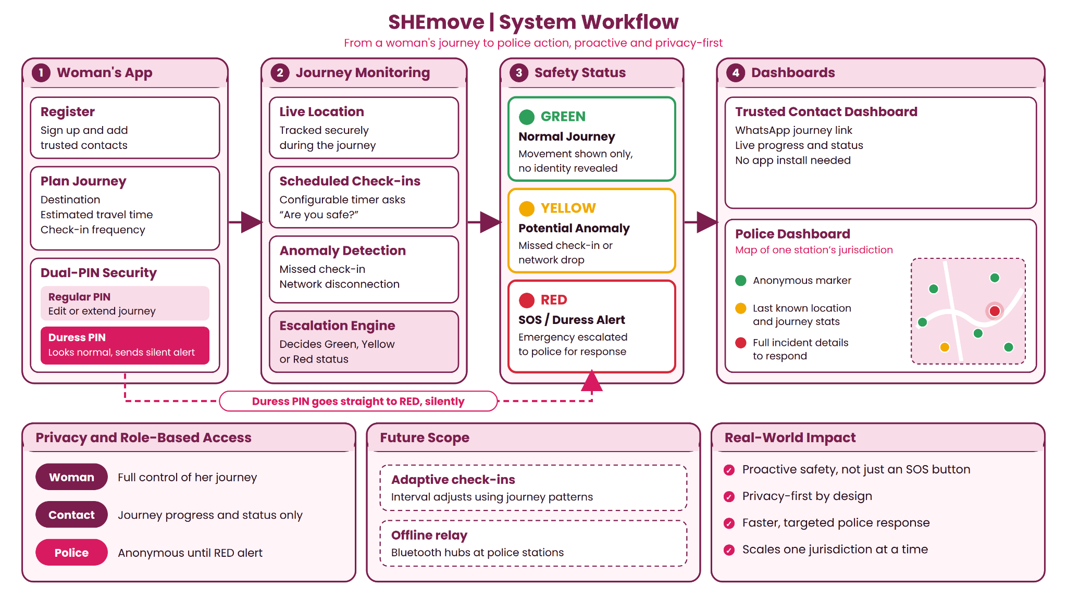














TECHNICAL APPROACH
SHEmove
Team Eclipse
System Architecture and Workflow
Tech Stack
HackCBS 9.0
3

Slide 4
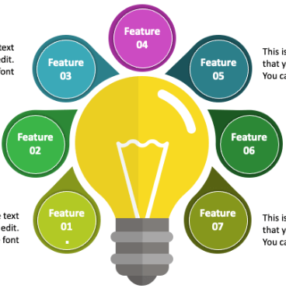
FEATURES OF PROJECT
SHEmove
Team Eclipse
Silent SOS Trigger:
Discreetly activate emergency protocols without alerting the aggressor.
Dual-PIN Authentication:
Separate regular and duress PINs for normal access and covert SOS activation.
Live Location Tracking:
Share real-time GPS coordinates with trusted emergency contacts.
Smart Threat Detection:
Detect potential distress through contextual audio and sensor signals.
Emergency Escalation:
Automatically notify predefined contacts during distress situations.
Evidence Capture:
Securely capture and preserve relevant audio evidence during emergencies.
Safe Route Navigation:
Identify safer routes and highlight nearby emergency assistance points.
HackCBS 9.0
4

Slide 5









BUSINESS MODEL
SHEmove
Team Eclipse
• 70.9 Cr Female Population
• 2.07 Cr Female Higher-Education Enrolments
• 2.19 Million Active Companies
• 45,473 Colleges
Key Partners
• 2-PIN Authentication System
• 99.5% Target Platform Uptime
• 4,41,534 Registered Crimes Against Women (2024)
• 1,210 Cases Registered Daily
• 2 Authentication Modes
• 1 Covert Emergency Trigger
• 1:1 Institutional Onboarding
Customer
Segment
• State Police & Emergency Response Agencies
• 1,168 Universities
• 45,473 Colleges
• 2.19 Million Active Companies
• ₹7,712.85 Cr Nirbhaya Fund allocation
Key Activates
Value Prepositive
Customer Relationship
• 1 Unified Safety Platform
• 3 Revenue Channels
• 2.19 Million Active Companies Potential
• 2 Major App Stores
Key Resources
Channels
• ₹30/User/Month — Proposed SaaS Cost Basis
• Cloud & Infrastructure Costs
• Deployment & Maintenance Costs
Revenue Streams
Cost Structure
• ₹49–99/Month — B2C Subscription
• ₹99–149/Month — Family Plan
• Annual Government Licensing & AMC
HackCBS 9.0
5

Slide 6
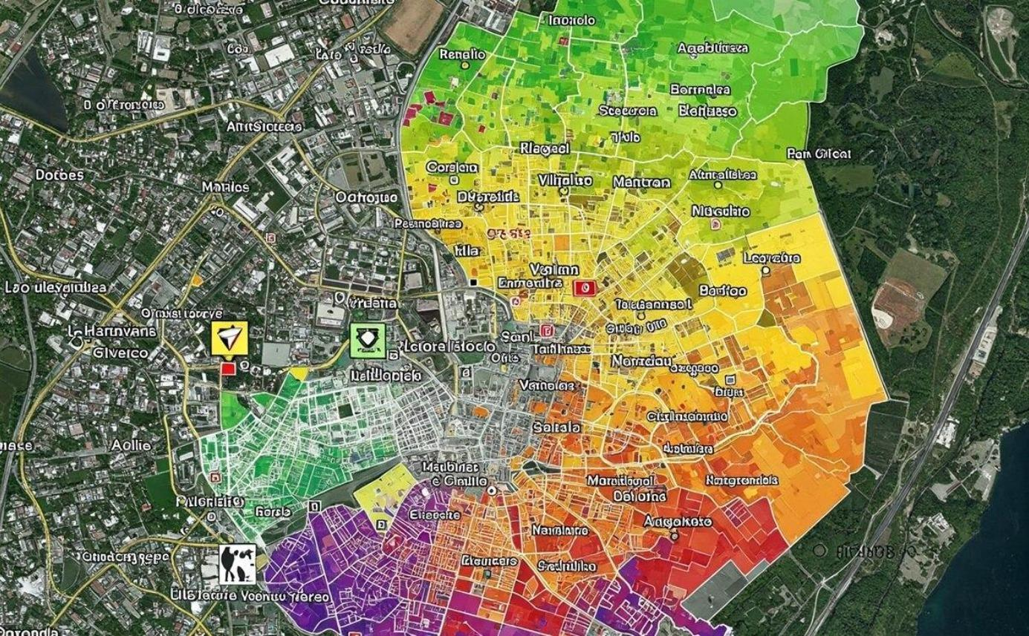
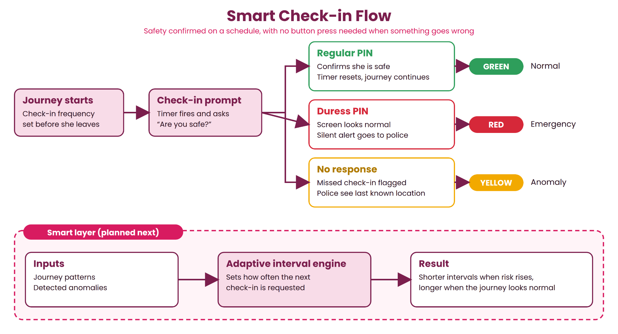
AI ENGINEERING
SHEmove
Team Eclipse
Community-Driven Safety Heatmap
Smart Check-in
1. User Feedback: Women anonymously report areas where they feel unsafe.
2. Data Aggregation: Reports are grouped by geographical location.
3. Risk Mapping: Areas receive color-coded safety indicators based on feedback volume, recency and consistency.
4. Safer Navigation: Users can view safety zones and choose alternative routes.
1. Journey Initiation: User enters destination and starts journey.
2. AI-Based ETA: Predicts arrival time using traffic, distance and route conditions.
3. Smart Check-in: Schedules adaptive safety check-ins.
4. Deviation Detection: Flags unexpected delays or route deviations.
5. Safety Escalation: Prompts confirmation and triggers emergency escalation if needed.
HackCBS 9.0
6

Slide 7


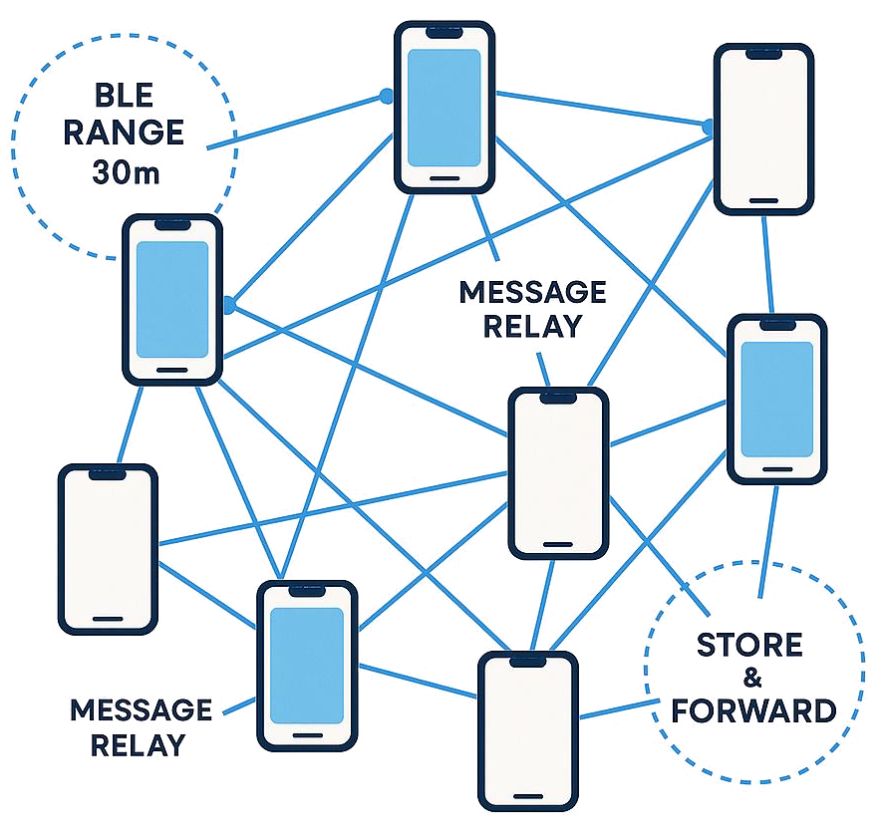
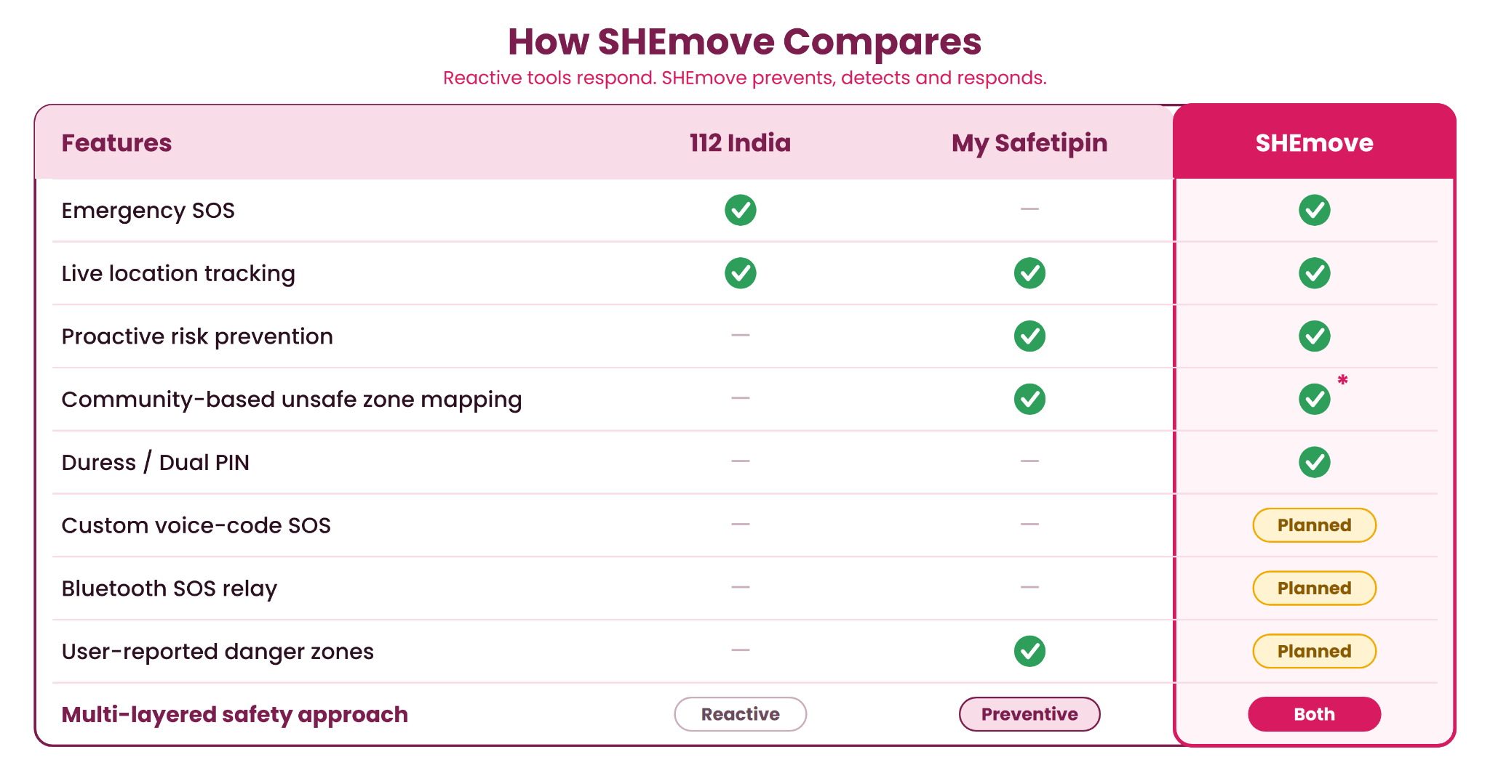
FUTURE INNOVATION
SHEmove
Team Eclipse
Bluetooth Mesh Hopping:
Enables nearby participating devices to relay emergency signals through Bluetooth when conventional internet connectivity is unavailable, extending distress communication beyond a single device's range.
Voice-Code Activation
Uses personalized, predefined keywords
(e.g. "Charlie") to trigger a covert SOS,
allowing hands-free emergency activation
without touching the phone.
6
HackCBS 9.0
7

Slide 8

SHEmove
Team Eclipse
"To every woman who has ever shared her location just to feel safe; we hope one day you won't have to."
~Team Eclipse
6
HackCBS 9.0
8

