Slide 1
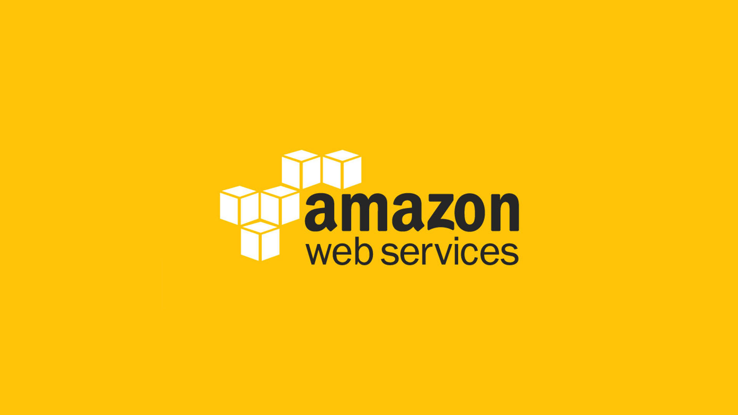

Slide 2
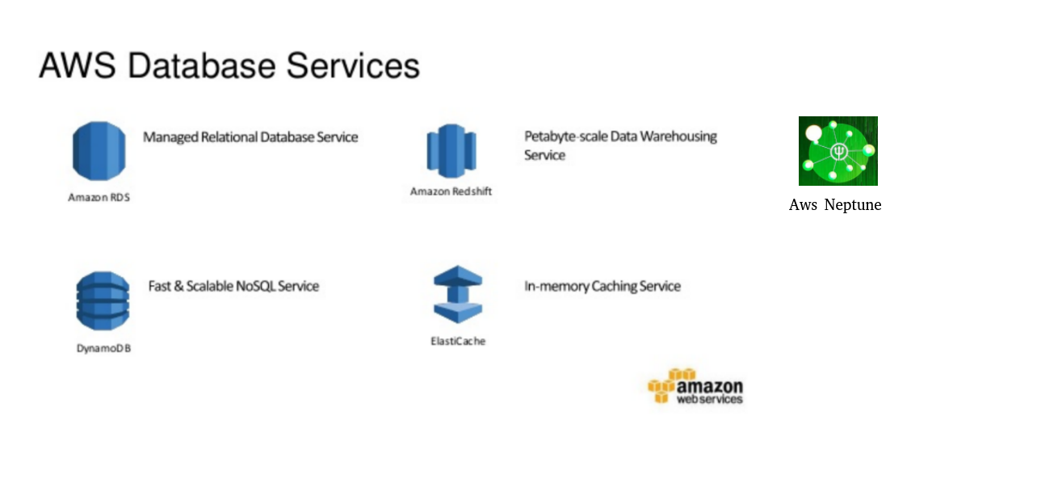

Slide 3
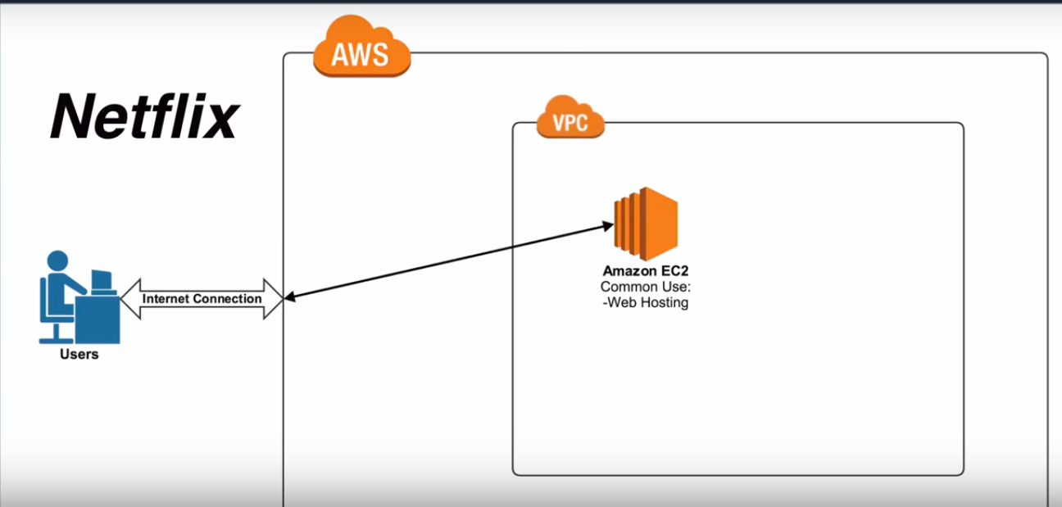

Slide 4
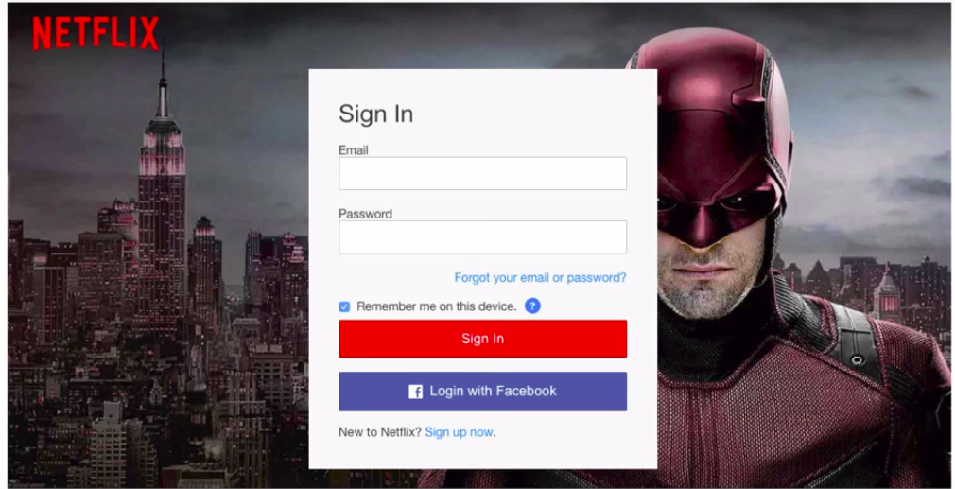

Slide 5
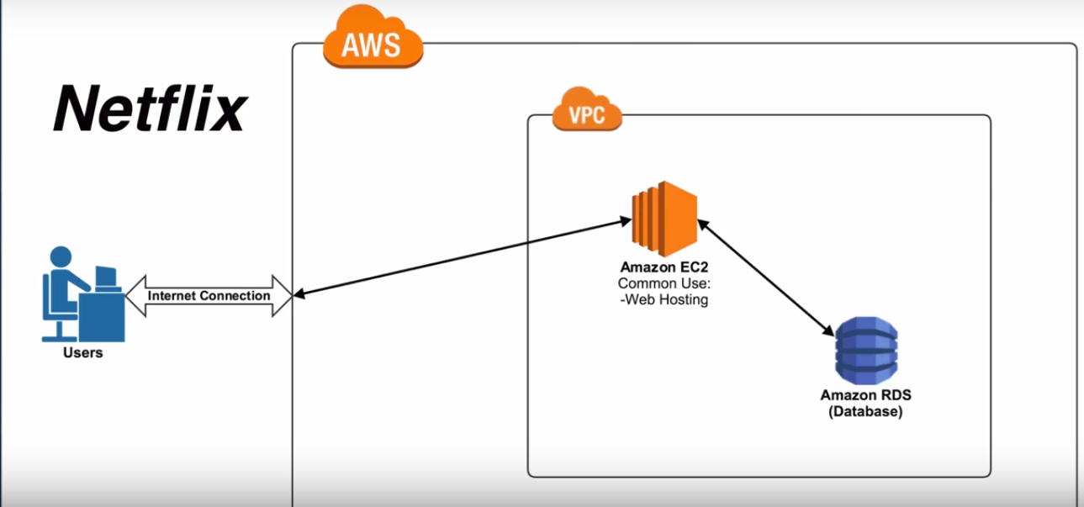

Slide 6
Amazon Relational Database Service
Easy to set up
Easy to Operate
Cost-efficient
Resizable capacity
Managing time-consuming database administration tasks

Slide 7
Used for OLTP(Online Transactional processing ) system ex: bookmyshow.
Launched in region.
Single and Multi -AZ options.
Read Replica supported accross regions (Aurora, MySQL).
Snapshots are stored in S3.
Lives inside VPC, security groups applicable.
Security – DB user based ex: scott tiger in SQL

Slide 8
Amazon DynamoDB
No SQL DB
Fully Managed, can only mention the speed on which you are going to access data.
Used in DB which require milli-second read latency.
Launched in a region
Data is stored in muliple AZ by Default, data which you put in one Dynamo DB table gets replicated in all other AZ’s.
No need to take backup.
Doesn’t live in VPC.
Security: IAM based

Slide 9
Amazon Redshift
Used for OLAP(Online Analytical Processing) systems.
Launched in a region.
Can spread accross Az but it’s not like RDS multi-AZ where data gets replicated.
Snapshots(Backups) are stored in S3
Lives inside VPC, security groups applicable.
Security-DB user based.

Slide 10
Cloud SQL
Pros
Fully managed
SQL
Flexible
Automatic Software Patching
Encryption at rest and transit
Replication across multiple zone by default

