Slide 1


Synopsis Presentation on UNIVERSAL AI AUTO-FILL ASSISTANT
Guided By: Presented By:
Prof. Mayank Bhatt
Pushpraj Singhal (0827IT231107)
Samyak Choudhary (0827IT231117)
Vinay Kumar Patel (0827IT231145)
Devesh Talreja (0827IT243D03)

Slide 2
Contents
Introduction
1.1 Problem Context(Real world Scenario)
1.2 Motivation & Need
Literature Survey
2.1Research paper
2.2 Problem Statement
Proposed Solution Overview
Objectives
Contributions
Theoretical Analysis
6.1 Block Diagram
6.2 Hardware / Software Requirements
Applications
References

Slide 3
1. Introduction
In today's digital world, users interact with many online platforms daily. Most of these platforms require users to fill forms with the same personal information repeatedly. This repetitive process wastes time and reduces productivity.
Real-World Scenarios
• Job Seekers: ~15 hours/week spent filling applications repeatedly • Doctors: Manual patient forms lead to errors and burnout • Students: Re-enter personal data for visas, registrations, banking
Global Impact • Manual form filling wastes 47 billion hours every year

Slide 4
Why Current Solutions Fail
🔐 Password Managers • Fill login fields only • Cloud storage raises privacy concerns
📱 Google Autofill • Around 23% app incompatibility
🌐 Browser Extensions • Work only in browsers • Fail inside native mobile applications
🚨 The Core Gap
No existing solution provides all three:
• Universal compatibility across applications • Intelligent field recognition using AI • Complete privacy through on-device processing

Slide 5
2. Literature Survey
Year | Authors | Title | Key Finding
2024 | Fu et al | Understanding Mobile GUI: From Pixel-Words to Screen Sentences | Proposed a pixel-based UI understanding framework that extracts text and visual components from screenshots to understand mobile interfaces for automation tasks
2023 | Chen et al | Deep Learning for Mobile Form Field Classification | 94% accuracy in field prediction using CNNs on UI hierarchies
2023 | Song et al. | VisionTasker: Mobile Task Automation Using Vision-Based UI Understanding | Developed a framework that combines UI vision analysis and AI planning to automate tasks on mobile apps by interpreting screen content
2022 | Rodriguez &Kumar | Accessibility-Based Text Injection in Android Applications | Demonstrated bypassing from restrictions via accessibility APIs
2021 | Patel et al | On-Device NLP for Context-Aware Form Filling | Lightweight BERT models for field understanding

Slide 6
2.2 Problem Statement
Develop a privacy-first Android autofill system achieving:
Metric | Target
Application Compatibility | ≥98% of Android apps (including restricted apps)
Field Recognition Accuracy | ≥95% across diverse form layouts
Supported Field Types | 50+ form field categories
Form Filling Time | ≤2 seconds
Privacy | 100% on-device processing (no cloud transmission)
OCR Accuracy | ≥90% extraction from physical documents
Battery Consumption | ≤3% increase during active use

Slide 7
3. Proposed Solution Overview
Stage 1 – Profile Creation • Create user profiles (Personal / Work / Student) • Data entered manually or via OCR scan
⬇
Stage 2 – Screen Analysis • Accessibility service detects form fields • ML model performs field classification
⬇
Stage 3 – Smart Profile Selection • System analyzes app context • Automatically selects correct profile
⬇
Stage 4 – Dual-Mode Filling • Standard Mode: Android Autofill framework • Force-Fill Mode: AI bubble for restricted apps
⬇
Result: Complete form filling in < 2 seconds

Slide 8
4. Objectives
Build a smart autofill system that can automatically fill forms in most Android apps (including restricted apps) with high compatibility and fast performance.
Develop a lightweight machine learning model that can identify different types of form fields (50+ types) with high accuracy to improve automatic form filling.
Ensure secure user data management by using encrypted storage, biometric authentication, and an OCR scanner to extract information from documents like ID cards and business cards.

Slide 9
5. Contributions
Technical Contributions:
Hybrid Filling Architecture: First dual-mode system (Standard + Force-Fill)
Lightweight ML Model: 12MB size, 50ms inference, 95% accuracy
Context-Aware Selection: Auto profile switching based on app
Privacy Architecture: Zero data transmission
Academic Contributions:
Compatibility study across 200+ Android apps
Dataset of 10,000+ labeled form fields
UX Contributions:
Zero-learning floating bubble interface
Transparent privacy controls

Slide 10
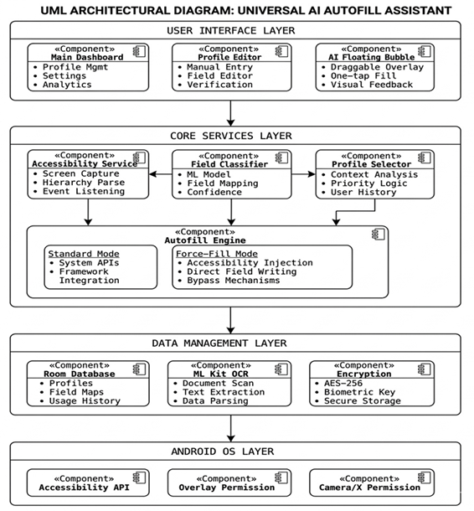
6. Theoretical Analysis
6.1 Block Diagram
UNIVERSAL AI AUTO-FILL ASSISTANT

Slide 11
6.2 Hardware / Software Requirements
Software Requirements:
Kotlin, Jetpack Compose
Room DB + SQLCipher (Encryption)
Android Accessibility
Android 8.0+ (API 26)
Hardware Requirements:
2GB RAM minimum
50MB storage minimum
Camera

Slide 12
7. Applications
Employment: LinkedIn, Naukri, company portals
E-commerce: Amazon, Flipkart checkout
Healthcare: Patient registration, telemedicine
Education: College apps, course registration
Finance: Bank accounts, loan applications
Government: Visa forms, tax filing
Travel: Flight, hotel bookings
Accessibility: Assistive tech for motor challenges

Slide 13
GitHub Link
Pushpraj Singhal : https://github.com/pushprajsinghal
Samyak Choudhary : https://github.com/Upriser99
Vinay Kumar Patel : https://github.com/Vinaypatel24
Devesh Talreja : https://github.com/devesh-talreja

Slide 14
8. REFERENCES
[1] Chen, L., Zhang, Y., & Wang, H. (2023). "Deep Learning for Mobile Form Field
Classification." Proceedings of the 2023 ACM International Joint Conference on Pervasive and
Ubiquitous Computing, 234-245.
[2] Rodriguez, M., & Kumar, A. (2022). "Accessibility-Based Text Injection in Android
Applications." IEEE Transactions on Mobile Computing, 21(4), 1289-1302.
[3] Patel, R., Singh, P., & Gupta, N. (2021). "On-Device NLP for Context-Aware Form
Filling." Conference on Neural Information Processing Systems (NeurIPS) 2021, 4567-4578.
[4] Bernstein, M., & Lieberman, H. (2018). "Human-Computer Interaction in Form Completion: A
Quantitative Analysis of Productivity Loss." MIT CSAIL Technical Report, MIT-CSAIL-TR-
2018-012.
[5] Google Research. (2023). "ML Kit: On-Device Machine Learning for Mobile
Developers." Google AI Blog.

Slide 15
Thank You
Thank you for your time and attention. Questions are welcome.
Queries ?

