Slide 1

Exploring the Limits of Transfer Learning with a Unified Text-to-Text Transformer
Devesh Santosh Todarwal : 2017B4A80518P

Slide 2
Authors
Colin Raffel - University of North Carolina at Chapel Hill
Noam Shazeer - Research Scientists at Google LLC, Mountain View, CA, USA
Adam Roberts - Research Scientists at Google LLC, Mountain View, CA, USA
Katherine Lee - Google research, Brain
Sharan Narang - Research Scientists at Google LLC, Mountain View, CA, USA
Michael Matena - Research Scientists at Google LLC, Mountain View, CA, USA
Yanqi Zhou : Google Inc. - Research Scientists at Google LLC, Mountain View, CA, USA
Wei Li - Research Scientists at Google LLC, Mountain View, CA, USA
Peter J. Liu : Google research, Brain

Slide 3
Research paper - Aim
To measure general language learning abilities of the T5 model.
Study performance on a diverse set of benchmarks, including machine translation, question answering, abstractive summarization, and text classification.
Measure performance on the GLUE and SuperGLUE text classification meta-benchmarks; CNN/Daily Mail abstractive summarization; SQuAD question answering; and WMT English to German, French, and Romanian translation.

Slide 4
Research paper - Methodology
Choosing out the model configuration amongst various options available namely : Baseline, Baseline 1-T, T5
Deciding on the model architecture : Encoder only, decoder only or Encoder - decoder model
Pre training the small/base T5 model
Fine tuning the pretrained model for different tasks
Benchmark Testing the Developed Model on State of The Art Metrics.

Slide 5
Research paper - Final Outcome
The T-5 Base model was found to yield much better performance in comparison to the baseline setup.
Text to Text transformation : We found the text-totext framework obtained comparable performance to task-specific architectures.
Architecture : The encoder-decoder model was found to work better than encoder only and decoder only models. Although it used twice the number of parameters, the computational cost was similar.

Slide 6
Research paper - Final Outcome Continued
The basic approach of updating all of a pre-trained model’s parameters during fine-tuning outperformed methods that are designed to update fewer parameters,
Training a smaller model on more data was often outperformed by training a larger model for fewer steps.
Demonstrated that an ensemble of models can provide substantially better results than a single model.

Slide 7
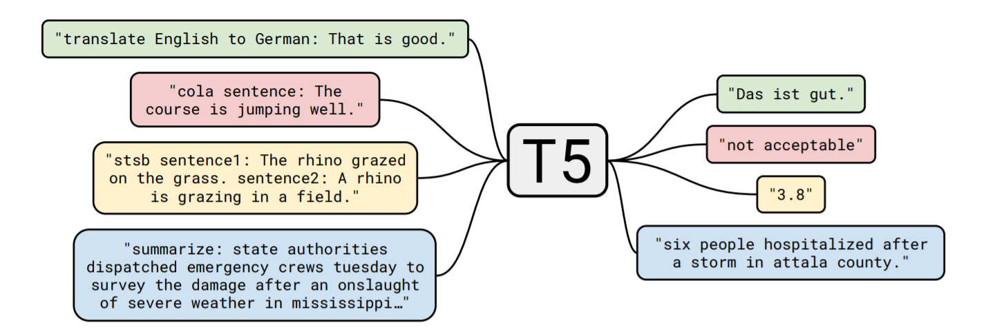
Background Concepts
Diagram of our Text-to-Text Transformer : Text to text conversion is the emphasis, as a result same model, loss function, hyperparameters, etc. across our diverse set of tasks.

Slide 8
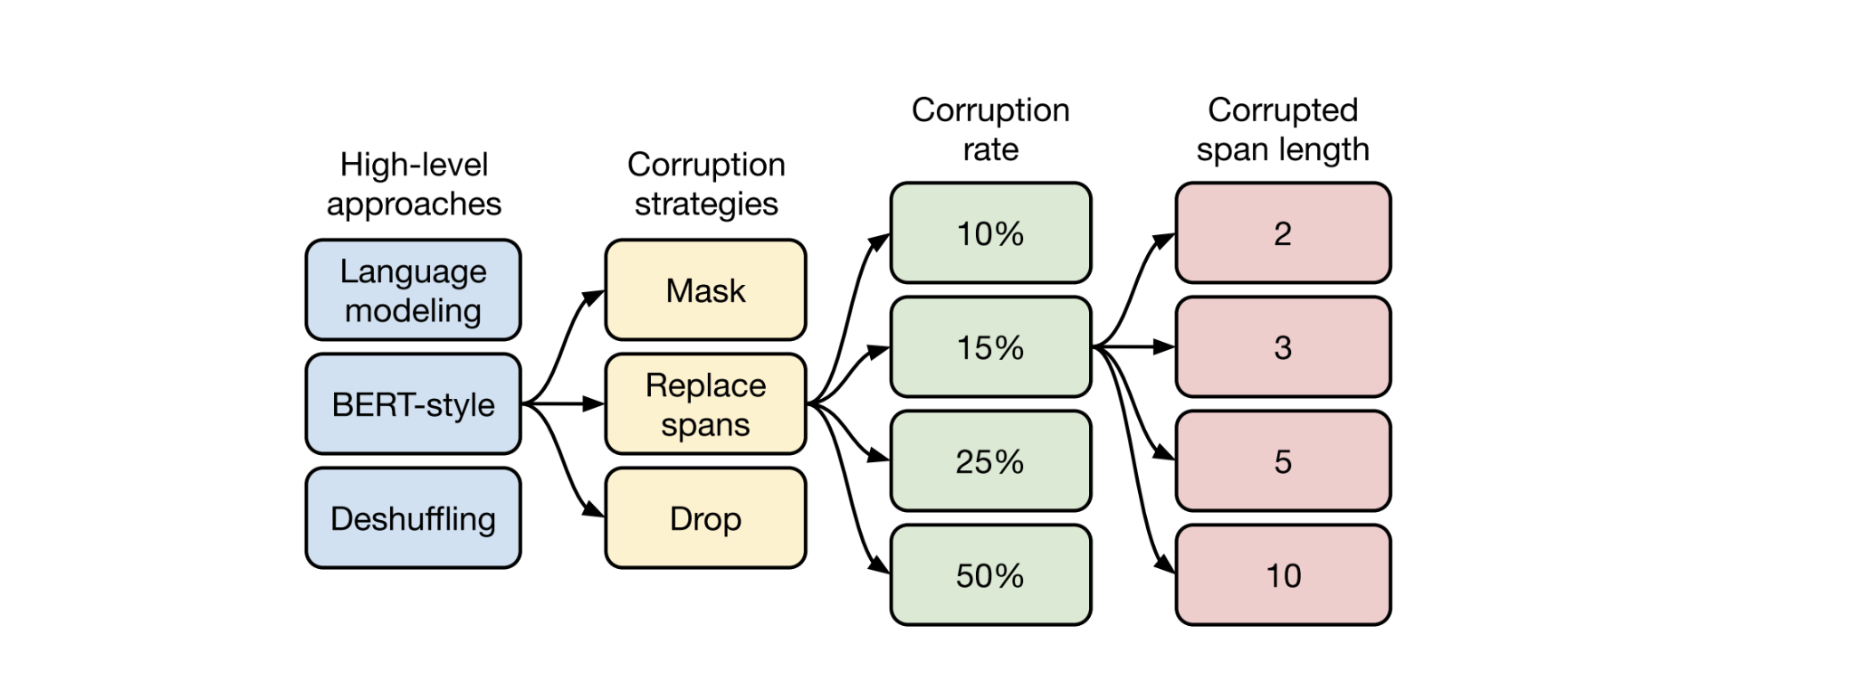
Background Concepts

Slide 9
Diversification of Developed Model
The T5 has been developed in variants of the parameter size in order to enable convenient training and a choice between the accuracy of the training and time taken to train a model. The various T5 models developed are -
Small - with 60 million parameters
Base - with 220 million parameters
Large - with 770 million parameters
Large 3B - with 3 billion parameters and
Large 11B - 11 billion parameters
Respectively.
We use the Small Model for the purpose of our assignment.

Slide 10
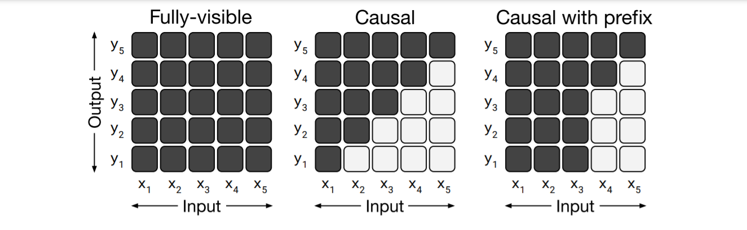
Background Concepts
Matrices representing different attention mask patterns.

Slide 11
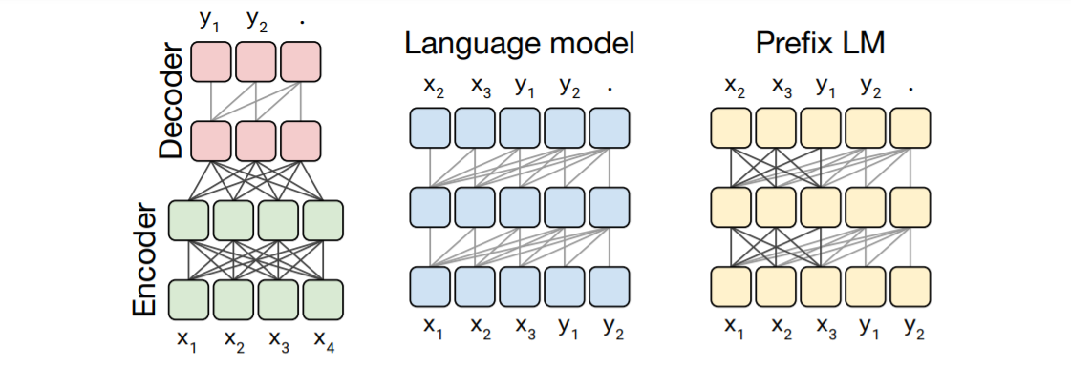
Background Concepts
The Transformer architecture variants that were taken into consideration. In this diagram, blocks represent elements of a sequence and lines represent attention visibility.

Slide 12
Dataset Details
For The Overall Assignment
Our tasks were divided into three major categories - Binary Classification, Multilabel Classification and Question Generation.
Given the highly sophisticated resources required for training the T5 Model, very few implementations of training/fine tuning the model on any datasets are available.
Hence, we chose to finetune the model on custom databases, the details of which are mentioned in the following sliders.

Slide 13
Dataset Details
The following are the tasks that we performed as a part of the paper and the corresponding datasets to them.
Question Generation | Amazon Review Dataset (2018)
Binary Classification | Yelp Review Polarity Dataset
Multilabel Classification | Toxic Comments Dataset - Kaggle

Slide 14
Dataset Details
For Question Generation Task
We have used the Amazon Review Data (2018) dataset which contains product metadata, reviews, descriptions of the various products on Amazon and question-answer pairs related to those products.
The total data is divided across 30 different shopping categories ranging from appliances to luxury beauty. Out of these 30 categories, we have considered three categories which include appliances, beauty products and art,crafts and sewing.
The total data corresponding to the original dataset is 24 GB and we have used 2GB out of it.

Slide 15
Dataset Details
For Binary Classification Task
Large Yelp Review Dataset. This is a dataset for binary sentiment classification. We are provided with a set of 560,000 highly polar yelp reviews for training, and 38,000 for testing.
The Yelp reviews polarity dataset is constructed by considering stars 1 and 2 negative, and 3 and 4 positive.
For each polarity 280,000 training samples and 19,000 testing samples are take randomly. In total there are 560,000 training samples and 38,000 testing samples. Negative polarity is class 1, and positive class 2.

Slide 16
Dataset Details
For Multilabel Classification Task
We are provided with a large number of Wikipedia comments which have been labeled by human raters for toxic behavior.
The types of toxicity are: Toxic, severe_toxic, obscene, threat, insult, identity_hate
Our objective was to train the T5 model to predict the probability of each type of toxicity for each comment and based on the obtained probabilities, the model would tag the sentence with one or more of the above listed tags.
The data had over 10,000 statements but not all of them were necessarily tagged with the toxicity tags.

Slide 17
Allotted Tasks
Finetune the t5 small/base model on Multilabel Classification on any appropriate dataset of your choice.
Finetune the t5 small/base model on Binary Classification and Question Generation on any appropriate dataset of your choice
Plot the loss curve and accuracy curve of fine-tuning with respect to epochs
Calculate the F1 score and Precision for the fine-tuned model on Binary Classification task
Train the t5-small/base model as mentioned according to the paper (This was later omitted due to unavailability of an extremely high end TPU)

Slide 18
Progress - Allotted Tasks
We were successfully able to finetune the t5 small/base model on the following tasks and dataset pairs:
- Multilabel Classification - Toxic Comment Classification Dataset by Kaggle.
- Binary Classification - Yelp Polarity Review Dataset
- Question Generation - Amazon Review Dataset
The loss curves and accuracy curves of fine-tuning with respect to the training steps were successfully plotted and stored.
The F1 score, Precision and Recall were calculated for the fine-tuned model on the Binary Classification task as well as the Multilabel Classification task.

Slide 19
Implementation details - Overview
Pre-processing: We have preprocessed the data using the Pandas library in Python and given the fact that T5 is a Text-To-Text Transformer, our objective was to ensure that both input and output data was correctly formatted as text else the model would run into an error.
Model: The Simple Transformers library is used to create the model architecture and for all training and evaluation which is based on the globally acclaimed Transformers library developed by the Huggingface team.
Plotting: The Weights and Biases library is used to generate all the plots that have been shown in this presentation. This was chosen over the traditional matplotlib as wandb library also provided an in-depth analysis of usage of system resources.

Slide 20
Implementation details - Installation and setup
Requires Python 3+ and pip3 to be installed
The project has been developed in the interactive IPython Notebooks in order to give the user a clear intuition of what they are working with.
All the dependencies of the model have been stated clearly in the respective task-wise developed Jupyter Notebooks. Additionally a requirement.txt file is also provided.
To install the simpletransformers library (which forms a key component of this implementation) use the following command:
pip install simpletransformers
For more details, refer the README.md provided in the code

Slide 21
Implementation details - Code Format
The assignment has been systematically broken down in terms of the tasks that were needed to be completed. Each task a has a separate .ipynb file that implements the following operation
Download the datasets and model weights using shell scripts or inline links
Pre-process the data
Train the model
Plot graphs
Evaluate metrics on a model checkpoint
Predict Class of/Generate Question on the evaluation data.

Slide 22
Pseudo Code - Preprocessing - Classification Tasks
binary_train_df = pd.read_csv(prefix + 'train.csv', header=None)
binary_train_df.head()
binary_eval_df = pd.read_csv(prefix + 'test.csv', header=None)
binary_eval_df.head()
binary_train_df[0] = (binary_train_df[0] == 2).astype(int)
binary_eval_df[0] = (binary_eval_df[0] == 2).astype(int)
binary_train_df = pd.DataFrame({
'prefix': ["binary classification" for i in range(len(binary_train_df))],
'input_text': binary_train_df[1].str.replace('\n', ' '),
'target_text': binary_train_df[0].astype(str),
})
#final structure of the dataframe
binary_eval_df = pd.DataFrame({
'prefix': ["binary classification" for i in range(len(binary_eval_df))],
'input_text': binary_eval_df[1].str.replace('\n', ' '),
'target_text': binary_eval_df[0].astype(str),
})
print(binary_eval_df.head())

Slide 23
Pseudo Code - Training - Classification Tasks
"fp16": False,
"save_steps": -1,
"save_eval_checkpoints": False,
"save_model_every_epoch": False,
"reprocess_input_data": True,
"overwrite_output_dir": True,
"wandb_project": "T5 - Binary Classification”
}
model = T5Model("t5", "t5-base", args=model_args)
model.train_model(train_df, eval_data=eval_df)
model_args = {
"max_seq_length": 196,
"train_batch_size": 16,
"eval_batch_size": 64,
"num_train_epochs": 1,
"evaluate_during_training": True,
"evaluate_during_training_steps": 15000,
"evaluate_during_training_verbose": True,
"use_multiprocessing": False,

Slide 24
Pseudo Code - Testing T5 Model - Classification
wget -i meta_links.txt
wget -i qa_links.txt
mv meta_All_Beauty.json.gz meta_Beauty.json.gz
# Load the trained model
model = T5Model("t5", "outputs", args=model_args)
# Load the evaluation data
df = pd.read_csv("data/eval.tsv", sep="\t").astype(str)
# Prepare the data for testing
to_predict = [
prefix + ": " + str(input_text)
for prefix, input_text in zip(df["prefix"].tolist(), df["input_text"].tolist())]
truth = df["target_text"].tolist()
tasks = df["prefix"].tolist()
# Get the model predictions
preds = model.predict(to_predict)
for task, truth_value, pred in zip(tasks, truth, preds):
output_dict[task]["truth"].append(truth_value)
output_dict[task]["preds"].append(pred)
task_truth = [int(t) for t in output_dict[task]["truth"]]
task_preds = [int(p) for p in output_dict[task]["preds"]]
results_dict[task] = {
"F1 Score": f1_score(task_truth, task_preds),
“Precision”: precision_score(task_truth, task_pred)
"Accuracy Score": accuracy_score(task_truth, task_preds),}
print(f"Scores for {task}:")
print(f"F1 score: {results_dict[task]['F1 Score']}")
print(f"Accuracy Score: {results_dict[task]['Accuracy Score']}")
print()

Slide 25
Pseudo Code Part II - Preprocessing - Question Generation
for category in tqdm(categories):
if not os.path.isfile(f"data/{category.split('.')[0]}.tsv"):
try:
df1 = getDF(f'data/qa_{category}')
df2 = getDF(f'data/meta_{category}')
df = pd.merge(df1, df2, on="asin", how="left")
df = df[["question", "answer", "description"]]
df = df.dropna()
df = df.drop_duplicates(subset="answer")
print(df.head())
df.to_csv(f"data/{category.split('.')[0]}.tsv", "\t")
except:
pass
df = pd.concat((pd.read_csv(f"data/{f}", sep="\t") for f in os.listdir("data") if f.endswith(".tsv")))
df = df[["question", "description"]]
df["description"] = df["description"].apply(lambda x: x[2:-2])
df.columns = ["target_text", "input_text"]
df["prefix"] = "ask_question"
df.to_csv(f"data/data_all.tsv", "\t")
train_df, eval_df = train_test_split(df, test_size=0.05)
train_df.to_csv("data/train_df.tsv", "\t")
df = pd.concat((pd.read_csv(f"data/{f}", sep="\t") for f in os.listdir("data") if f.endswith(".tsv")))
df = df[["question", "description"]]
df["description"] = df["description"].apply(lambda x: x[2:-2])
df.columns = ["target_text", "input_text"]
df["prefix"] = "ask_question"
df.to_csv(f"data/data_all.tsv", "\t")
train_df, eval_df = train_test_split(df, test_size=0.05)
train_df.to_csv("data/train_df.tsv", "\t")
eval_df.to_csv("data/eval_df.tsv", "\t")

Slide 26
Pseudo Code Part II - Training and Evaluation
import pandas as pd
from simpletransformers.t5 import T5Model
train_df = pd.read_csv("data/train_df.tsv", sep="\t").astype(str)
eval_df = pd.read_csv("data/eval_df.tsv", sep="\t").astype(str)
model_args = {
"reprocess_input_data": True,
"overwrite_output_dir": True,
"max_seq_length": 128,
"train_batch_size": 8,
"num_train_epochs": 1,
"save_eval_checkpoints": True,
"save_steps": -1
"use_multiprocessing": False,
"evaluate_during_training": True,
"evaluate_during_training_steps": 15000,
"evaluate_during_training_verbose": True,
"fp16": False,
"wandb_project": "Question Generation with T5",
}
model = T5Model("t5", "t5-large", args=model_args)
model.train_model(train_df, eval_data=eval_df)

Slide 27
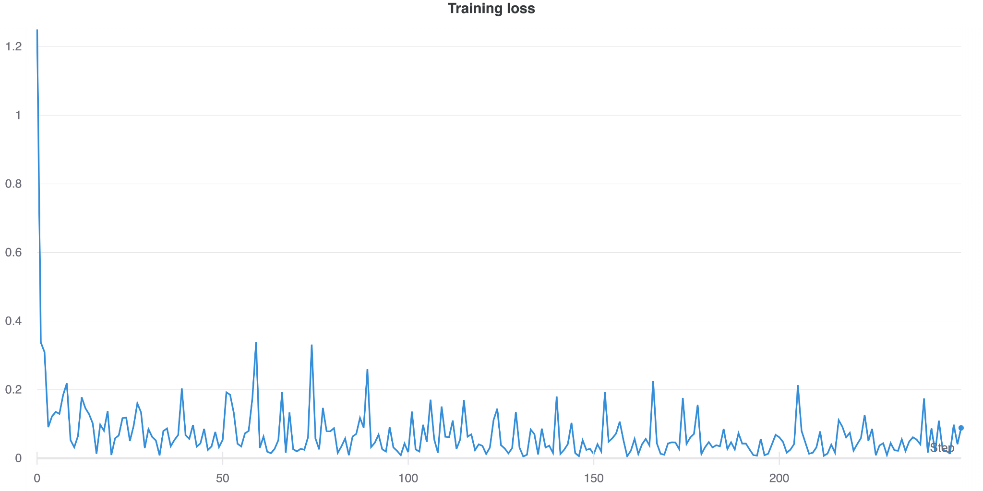
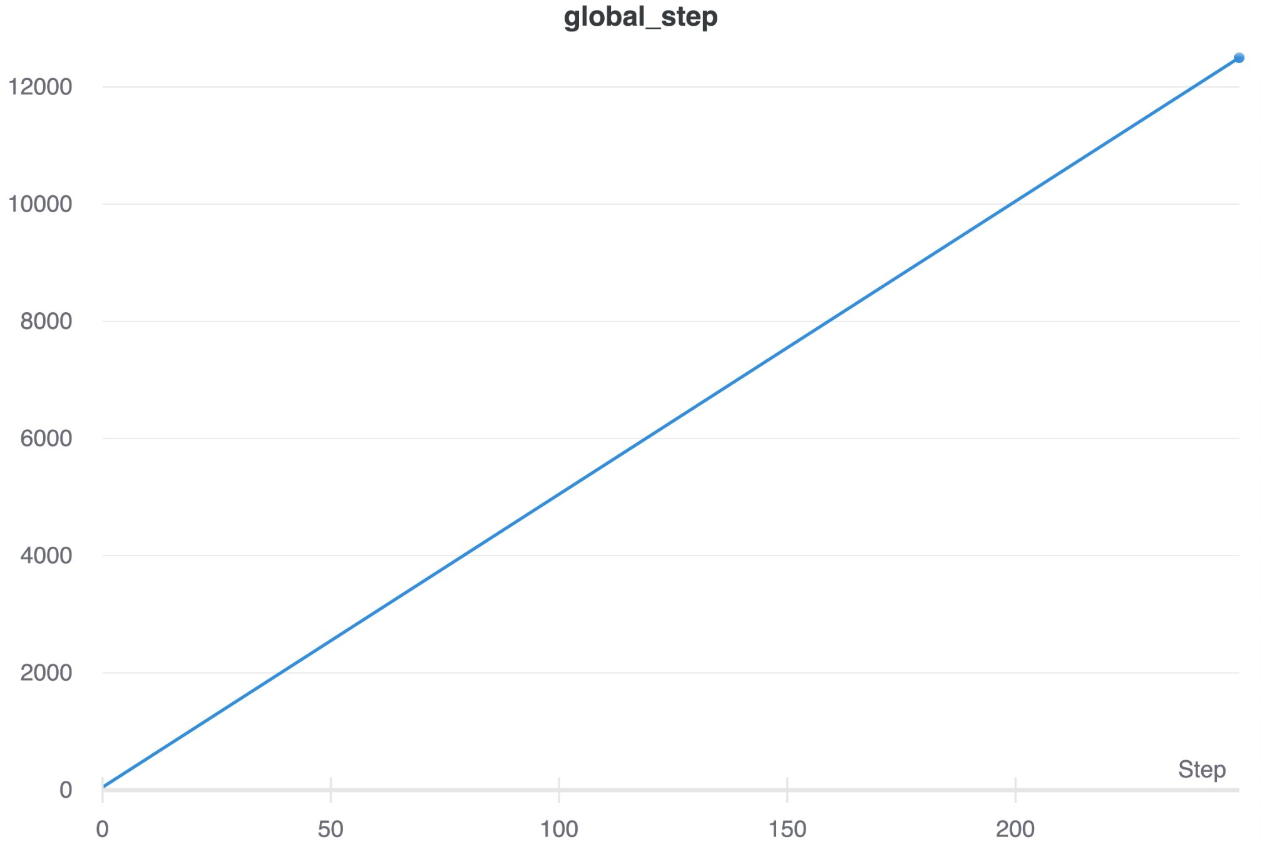
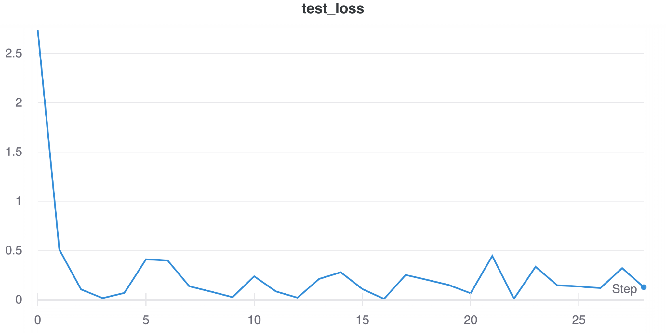
Results and Discussions
For Binary Classification Task
The T5 small model is trained on 280,000 samples and over just a single epoch of training achieves a consistent loss of less than almost 0.1%.
The extremely low loss on test further establishes that the model hasn’t overfit on the training data and these results with just a single epoch of training truly put T5 at par with the SOTA binary text classifiers (which are mostly based on BERT)

Slide 28
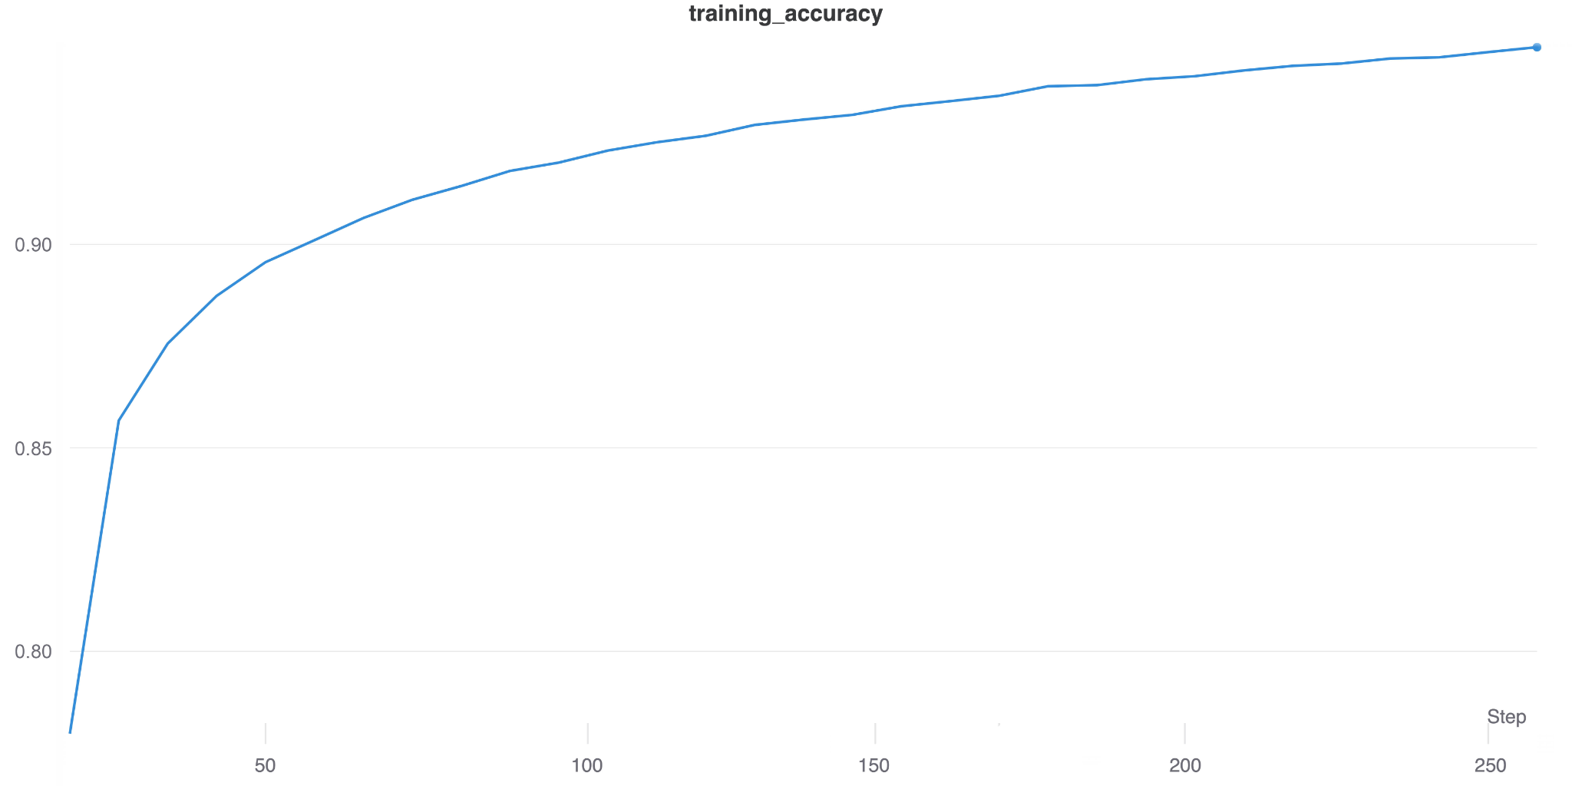
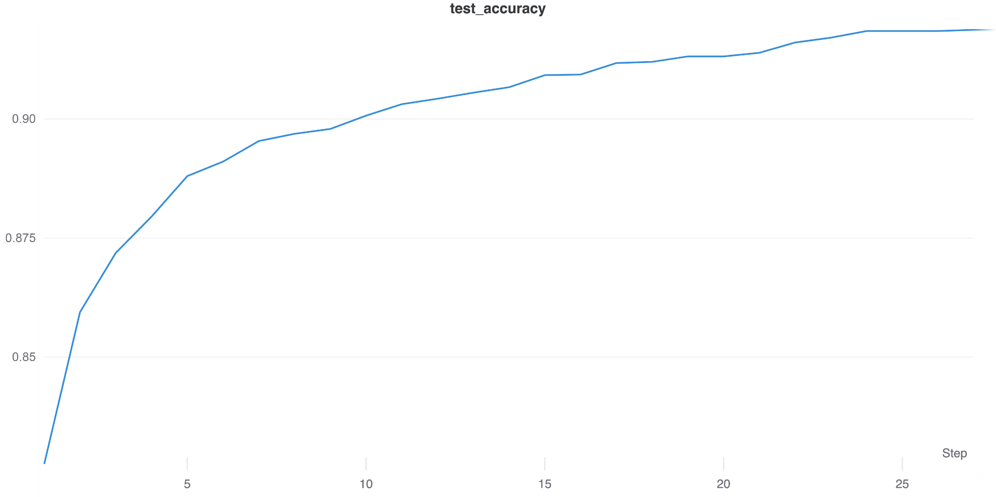
Results and Discussions
For Binary Classification Task
"F1 Score": 0.9281883584041857,
"Accuracy Score": 0.9268418402,
"Precision": 0.9289770564184022,
"Recall": 0.92688358404
The model performs well on the binary classification tasks. The final accuracy is less in comparison to the SOTA binary classifiers but this can be overcome by using the more sophisticated models and a longer training time.

Slide 29
Example - Binary Classification
Sample 1
Review - Contrary to other reviews, I have zero complaints about the service or the prices. I have been getting tire service here for the past 5 years now, and compared to my experience with places like Pep Boys, these guys are experienced and know what they're doing. Also, this is one place that I do not feel like I am being taken advantage of, just because of my gender. Other auto mechanics have been notorious for capitalizing on my ignorance of cars, and have sucked my bank account dry. But here, my service and road coverage has all been well explained - and let up to me to decide. \nAnd they just renovated the waiting room. It looks a lot better than it did in previous years.
Prediction - 1 (Positive Review)

Slide 30
Example - Binary Classification
Sample 2
Review - Last summer I had an appointment to get new tires and had to wait a super long time. I also went in this week for them to fix a minor problem with a tire they put on. They \"fixed\" it for free, and the very next morning I had the same issue. I called to complain, and the \"manager\" didn't even apologize!!! So frustrated. Never going back. They seem overpriced, too.
Prediction - 0 (Negative Review)

Slide 31
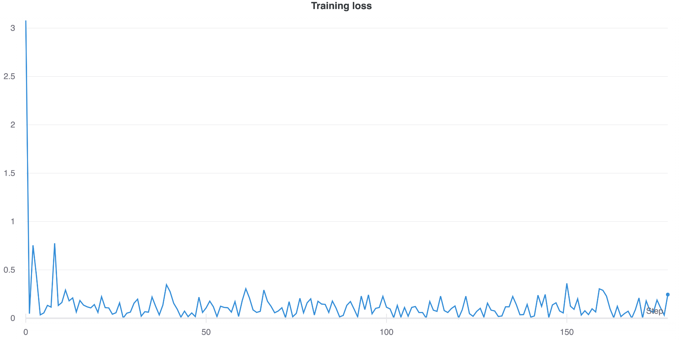
Results and Discussions
For Multilabel Classification Task
Owing to the extreme ambiguity of the multilabel classification task, we chose to go forth with the weighted implementation of the F1, Recall and Precision Scores.
In this, we took the arithmetic mean of the individual scores of the various classes and even though the metric isn’t completely reliable, it is the recommended method in case of multilabel classification.
The model performed extremely well for just a single epoch with around 9000 steps and the results suggest that the T5-base and T5-large model would outperform the T5-small model and give even better results.
"multilabel classification":
"F1 Score": 0.9080054384800154,
"Exact matches": 0.9085725028199022,
"Precision": 0.9085989470177637,
"Recall": 0.9085725028199022

Slide 32
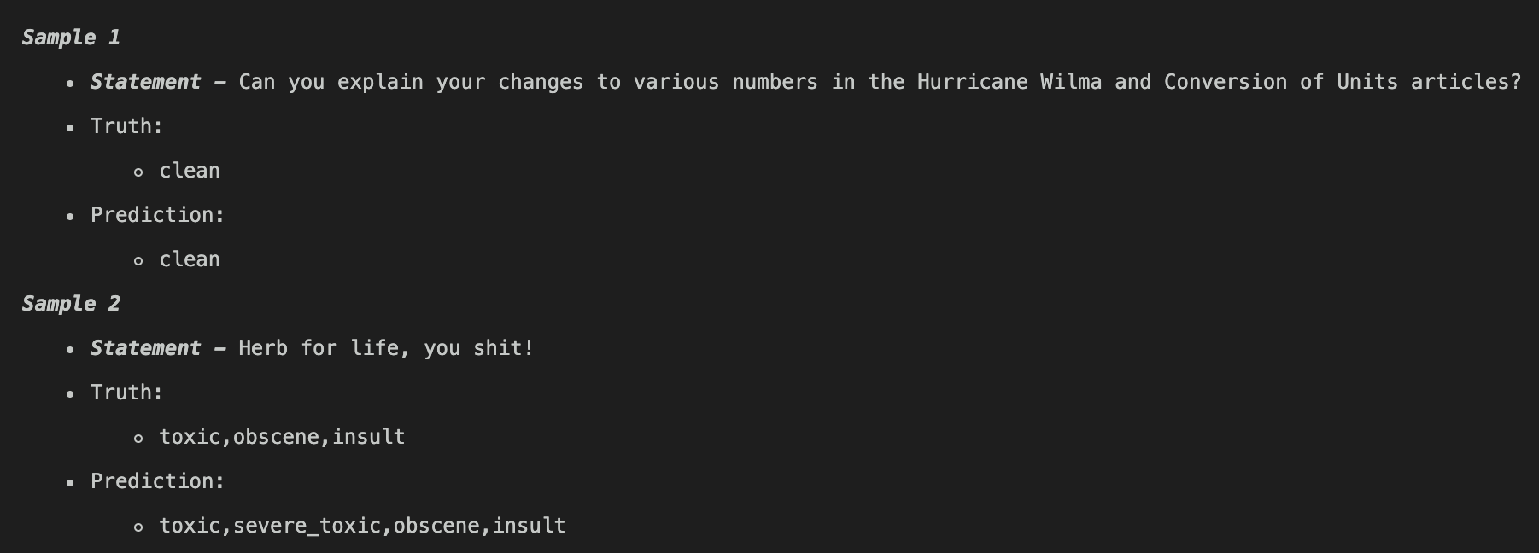
Example - Multilabel Classification

Slide 33
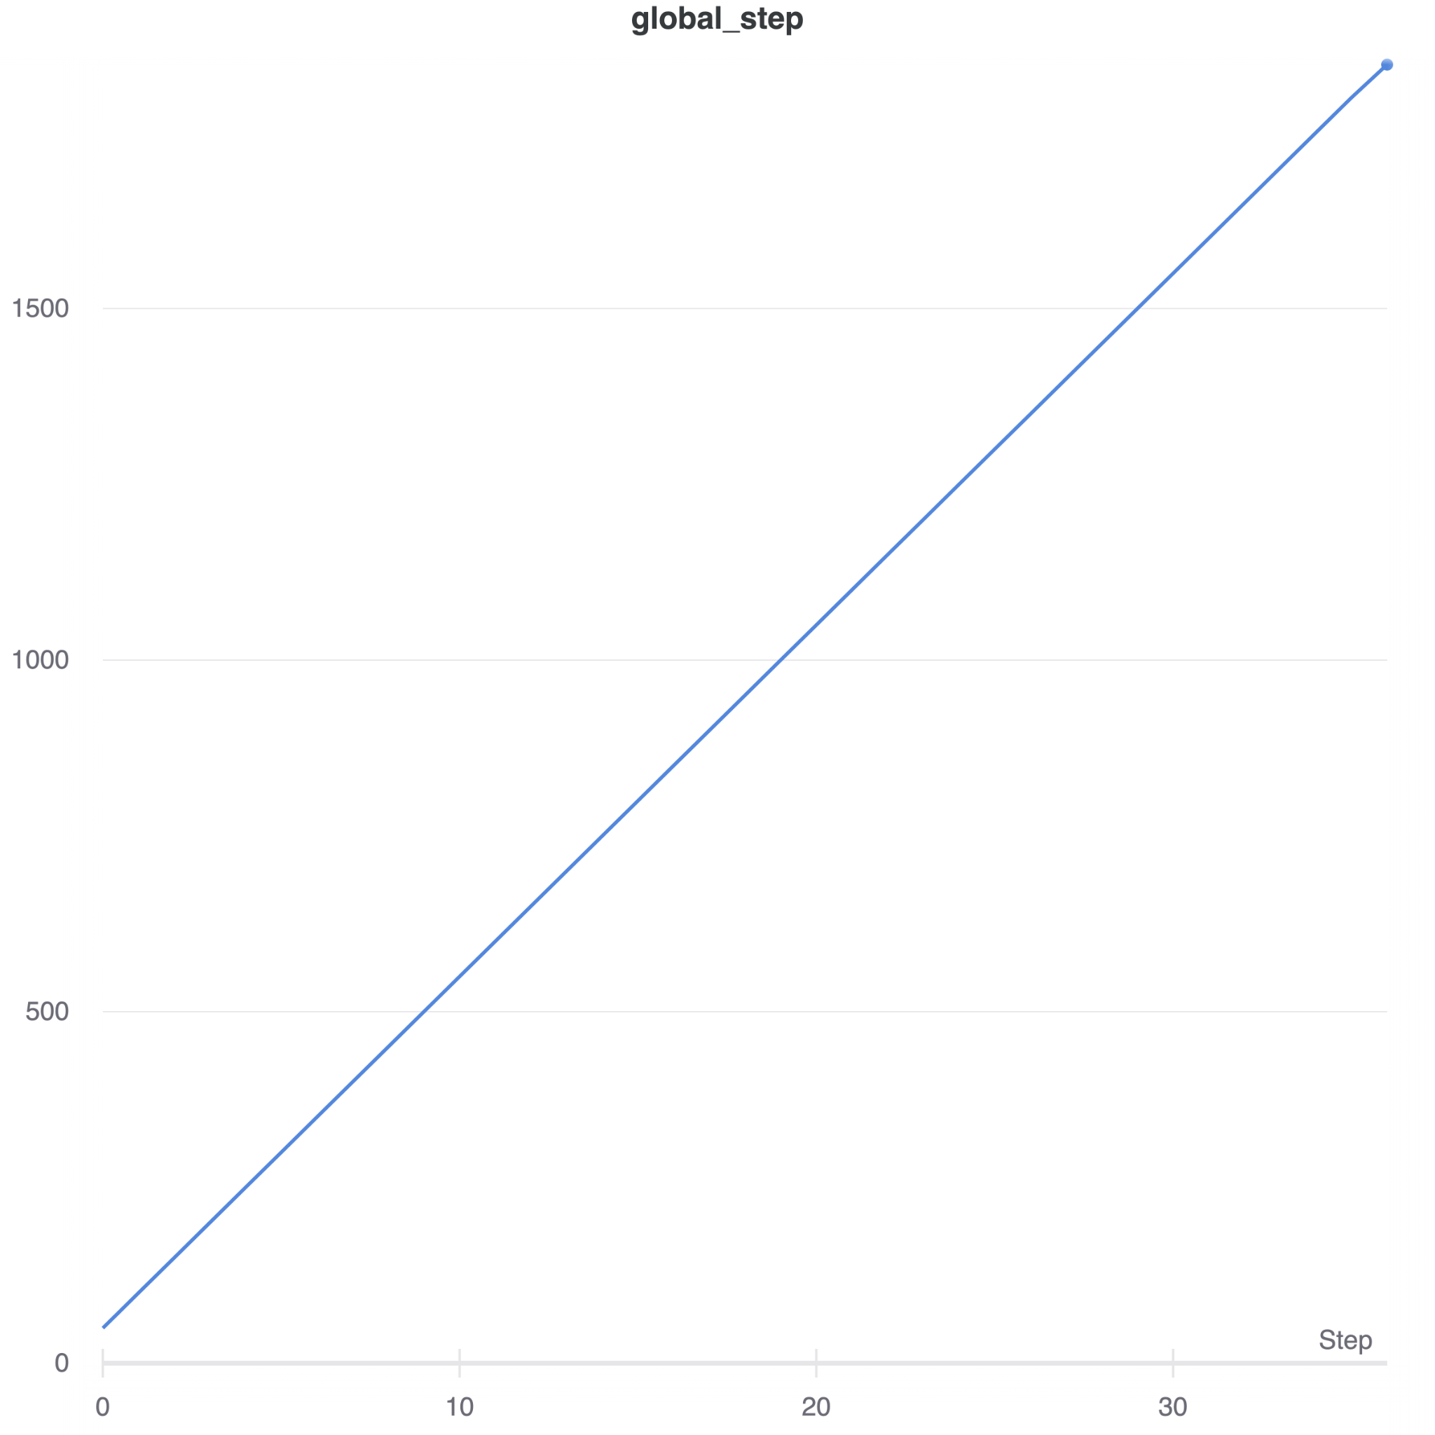
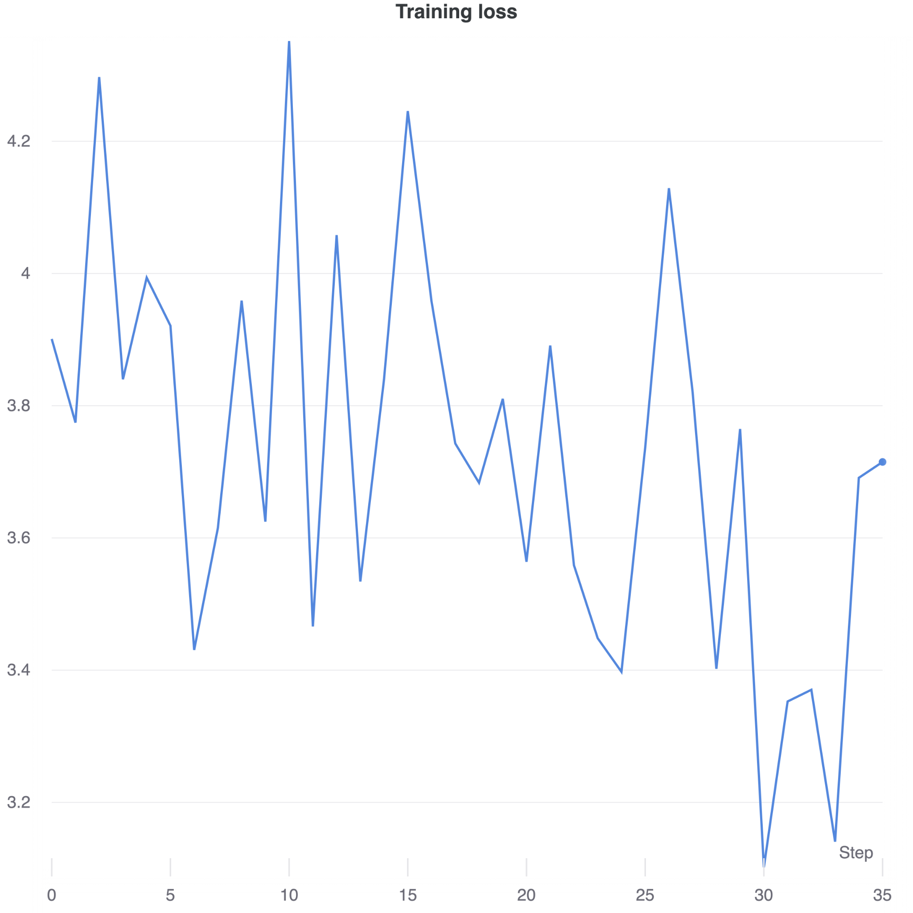
Results and Discussions
For Question Generation Task
Loss Interpretation

Slide 34
Evaluating The Generated Results
For Question Generation Task
Evaluating a language generation model is a little more complicated than evaluating something like a classification model.
This is because there is no right answer you can compare against like you could with a classification model.
The evaluation dataset contains descriptions and the questions that people have asked about those products, but that doesn’t mean that those are the only right questions you can ask.
Therefore, one of the best ways to evaluate a language generation model is to generate text and have it evaluated by an actual person (or several people).
Faced with this obstacle of evaluating generating text, we deep dived into the developments in decoding algorithms over the past few years that have led to models capable of generating quite realistic text sequences. (Decoding algorithms are used to generate text)
Hence to proceed with the evaluation of the model, we first generate the needed data.

Slide 35
Evaluating The Generated Results
For Question Generation Task
Eg of Decoding Algorithm:
Greedy search — Selects the word with the highest probability as the next word at each timestep. The T5 paper uses this algorithm for short sequence generation
Beam search — Tracks the n most likely hypotheses (based on word probability) at each timestep and finally chooses the hypothesis with the highest overall probability.
Top-K sampling — Randomly samples a word from the K most likely next words at each time step. The number of possible words to choose from at each step is fixed.
Top-p sampling — Samples a word from the smallest possible set of words whose cumulative probability (sum of probabilities for each word) exceeds the probability p at each timestep.
We will be using a combination of both Top-K and Top-p sampling techniques to generate questions with our T5 model. This strategy typically leads to more natural-looking text.

Slide 36
Evaluating The Generated Results
For Question Generation Task
Eg of Decoding Algorithm:
Greedy search — Selects the word with the highest probability as the next word at each timestep. The T5 paper uses this algorithm for short sequence generation
Beam search — Tracks the n most likely hypotheses (based on word probability) at each timestep and finally chooses the hypothesis with the highest overall probability.
Top-K sampling — Randomly samples a word from the K most likely next words at each time step. The number of possible words to choose from at each step is fixed.
Top-p sampling — Samples a word from the smallest possible set of words whose cumulative probability (sum of probabilities for each word) exceeds the probability p at each timestep.
We will be using a combination of both Top-K and Top-p sampling techniques to generate questions with our T5 model. This strategy typically leads to more natural-looking text.

Slide 37
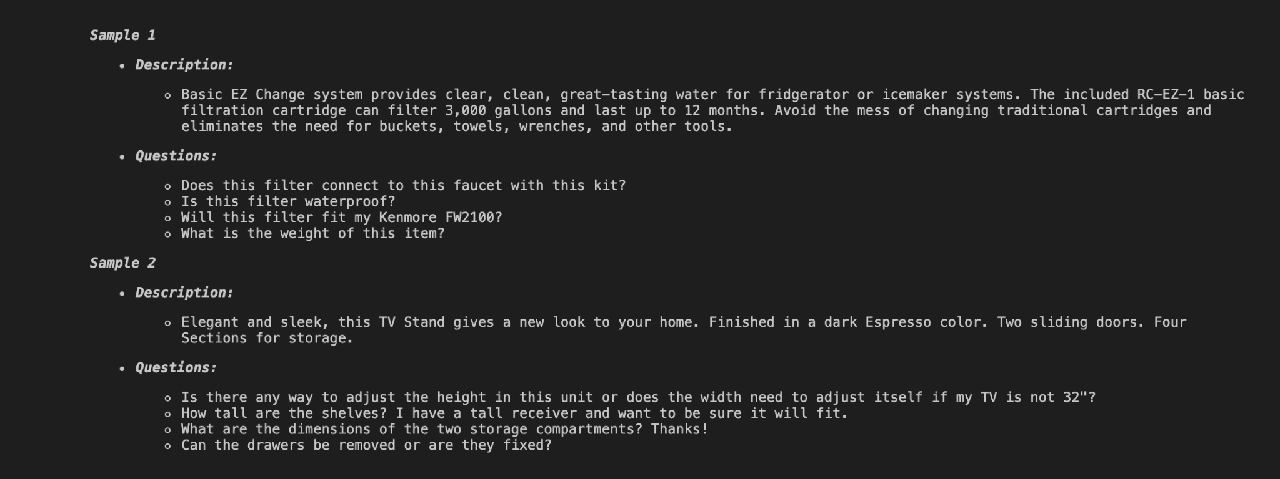
Evaluating The Generated Results
For Question Generation Task

Slide 38
Evaluating The Generated Results
For Question Generation Task
Description:
Elegant and sleek, this TV Stand a new look to your home. Finished in a dark Espresso color. Two sliding doors. Four Sections for storage.
Questions:
Is there any way to adjust the height in this unit or does the width need to adjust itself if my TV is not 32"?
How tall are the shelves? I have a tall receiver and want to be sure it will fit.
What are the dimensions of the two storage compartments? Thanks!
Can the drawers be removed or are they fixed?

Slide 39
Evaluating The Generated Results
For Question Generation Task
Description:
Basic EZ Change system provides clear, clean, great-tasting water for refrigerator or icemaker systems. The included RC-EZ-1 basic filtration cartridge can filter 3,000 gallons and last up to 12 months. Avoid the mess of changing traditional cartridges and eliminates the need for buckets, towels, wrenches, and other tools.
Questions:
Does this filter connect to this faucet with this kit?
Is this filter waterproof?
Will this filter fit my Kenmore FW2100?
What is the weight of this item?

Slide 40

Answers

Slide 41
Results - Comparison
Task | Model type | Epochs | Train Accuracy | Train Loss | Train Precision | Train F1 Score | Test Accuracy | Test Loss | Test Precision | Test F1 score
Binary Classification | T5-Small | 1 (257 Steps) | 0.93974 | 0.10034 | 0.91734 | 0.90763 | 0.92684 | 0.18327 | 0.92898 | 0.92818
Multilabel Classification | T5-Small | 1 (200 Steps) | 0.89732 | 0.19565 | 0.92468 | 0.88743 | 0.90857 | 0.09889 | 0.90859 | 0.90803
A summary of the data obtained from fine tuning on the classification tasks.

Slide 42
Final Say On Results
The context in which the T5 model is set and the way it has been trained with an exceptionally high number of parallelised GPUs made the task of fine tuning the data on the author’s chosen dataset much more challenging, which made comparing accuracies a distant dream.
The paper which has been originally trained on the C4 dataset has outdone most of the BERT like models which are developed to specialise in a single task and as such, transfer learning using a transformer holds promise for the future.
While we were not able to compare to the author’s results, we did compile a repository fine tuning the model on a completely new set of datasets.
The required tasks were completed and the predicted and generated outputs’ accuracy suggest an overwhelming potential in the learning of text transformers.

Slide 43
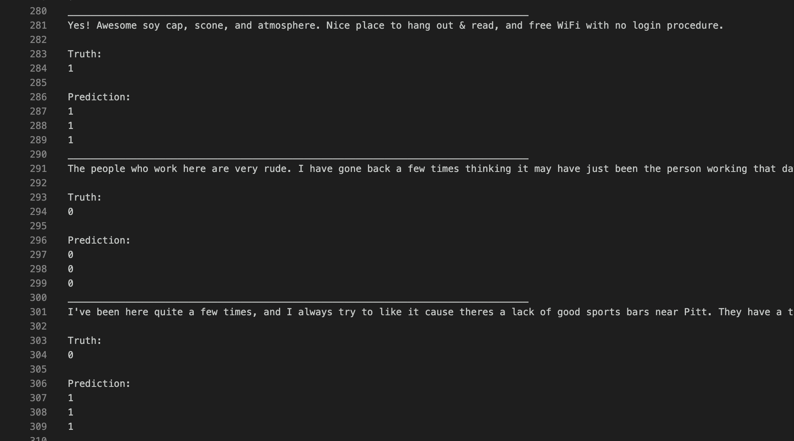
Example - Binary Classification - Generated Output
Note:
0 - Negative Review
1 - Positive Review

Slide 44
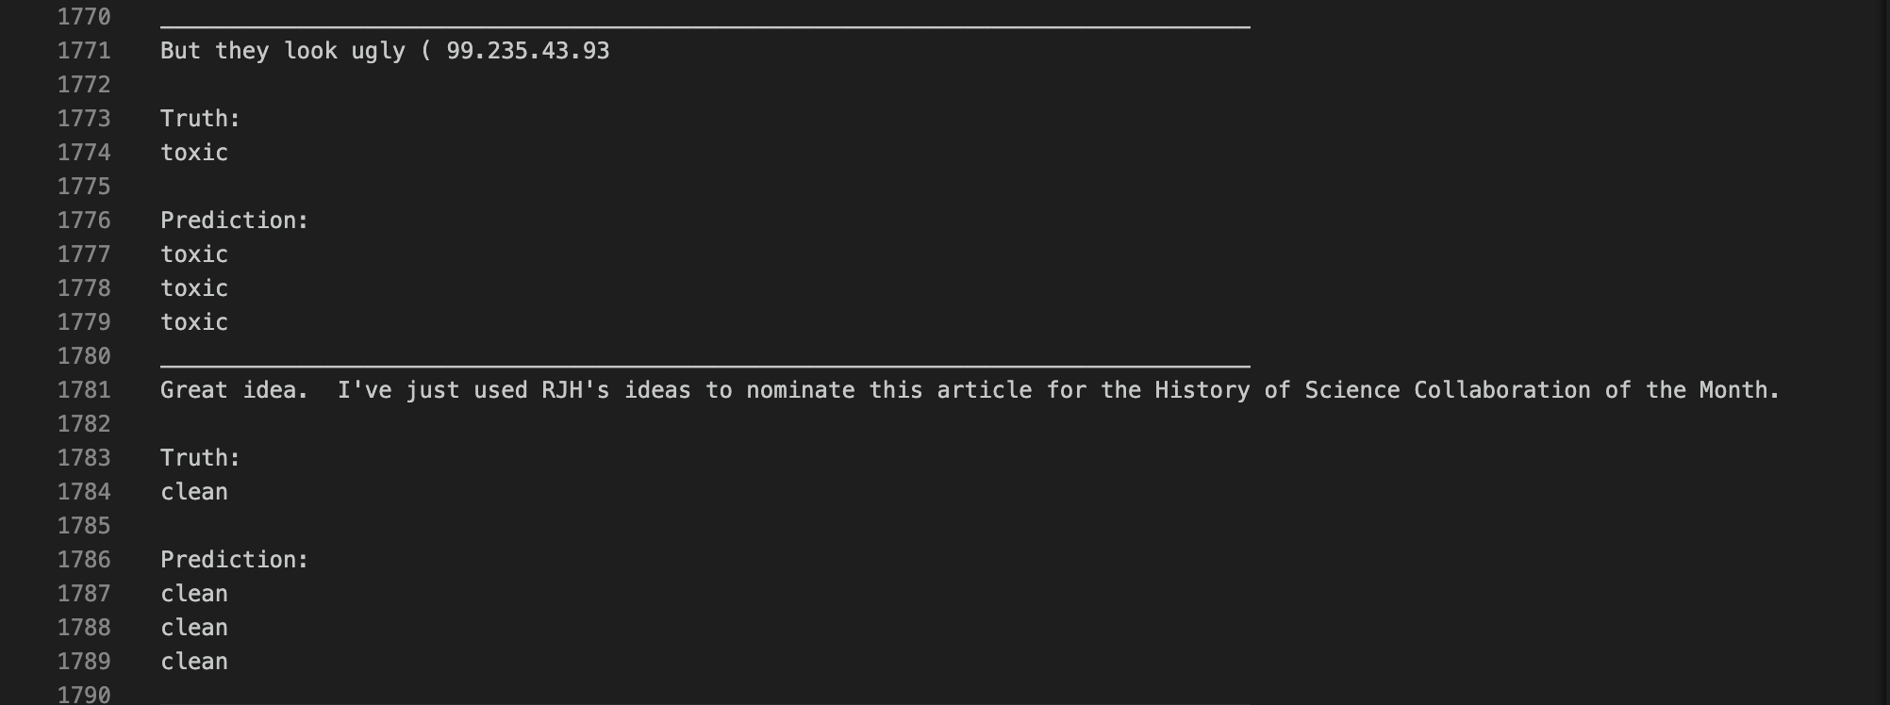
Example - Multilabel Classification

Slide 45
Challenges faced
Difficult to implement the entire code as it is because of the memory issues in Google Colab. The original model is very big with huge number of parameters, what we implemented was a small/base model.
Training the model took a lot of time (~12 hours for 1 epoch for base model on Google Colab).
The immense training time and high functioning GPU requirement made it extremely tough to train the code on either Colab or Local Machine. This was overcome by careful segmentation of data and division of every epoch into numerous checkpoints.
Faced issues while setting up the GCP account. Thus, the pre-training task was cancelled.

Slide 46
Challenges Faced
The unavailability of resources compelled us to look for pretrained model and most of the libraries that we thought we could leverage were implemented on older versions of PyTorch and Tensorflow (1.2.0 and 2.0.0) and hence weren’t usable due to the massive change in the codebase over the past year.
Thanks to our assigned Teaching Assistant, we were able to find out about the Huggingface implementation of the T5 Module which we eventually for our used model development.
Due to the online nature of the assignment, the team couldn’t carry out the assignment with complete synchronization, but we are glad we managed to do it.

Slide 47
Future Scope
Can achieve far better performance on most language understanding tasks than the typical NLP
T5 is doing as well as human crowdworkers
Using pre-trained T5 models as a starting point for building systems for language understanding tasks.
Aim to develop Language Agnostic models, i.e models that can perform a given NLP task with good performance regardless of the text’s language.

Slide 48
Experience and Learning Outcome of the Assignment
We learnt how to convert theory to practice and learnt how to apply the concepts we learned in class
We learnt how machine learning models are trained, evaluated, tested and visualized
We learnt about the rapidly developing transformer models and also about how a unified transformer can eliminate the need to train individual BERT-like models.
Working long hours and patiently waiting for the model to be trained was a bit uncomfortable in the start but when the model worked well, the whole endeavour seemed sweet.
Learnt how to use Google Colab effectively and to quickly train deep learning models along with how to interpret our results (referring to the author’s interpretation)

Slide 49
Thank You

