Slide 1

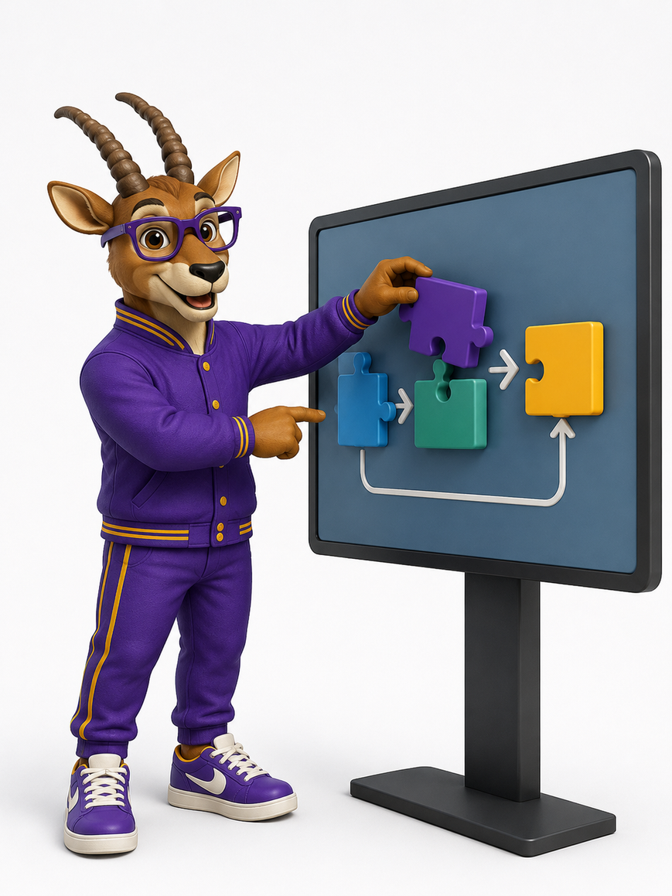
DEPARTMENT OF ARTIFICIAL INTELLIGENCE AND MACHINE LEARNING
AegisDev: AI-Native Software Engineering and Development Environment
Team Members
ADHARSH S (231501006)
MAHESH KUMAR J R (231501092)
DEVESH D (231501034)
Course AD23731 – Foundations of Agentic AI

Slide 2
Problem Statement
1
Problem Definition
Business / Real-World Context
Test–diagnose–fix cycles consume a disproportionate share of engineering time.
Concurrency faults such as race conditions are hard to reproduce and debug.
Existing AI coding tools cover only single-pass code generation.
Suggested fixes are not run against real tests, so they stay unverified.
No approval gates, version history or audit trail for AI-authored changes.
Small & Medium Dev Teams – tight delivery pressure and limited coordination capacity
NexaSoft Technologies – sample company needing an Inventory Management System
Inventory Software – classic defects such as concurrent stock reservation
QA & Maintenance Engineers – recurring defects need reusable fix history
Project Managers & Tech Leads – need delivery visibility and accountability

Slide 3
User and Stakeholder Analysis
2
Target Users
Stakeholder Identification
Stakeholder | Main Need
Client / Business Owner | Working, production-ready software with delivery visibility
Engineering Manager | Access control, role allocation and workload governance
AI System Administrator | Configure LLMs and vector DB; monitor cost and errors
Maintenance Engineer | Fix histories and decision records for recurring defects
Course Faculty | Demonstrable workflow and sound empirical evaluation
Project Managers
Software Developers
QA Engineers
Tech Leads
Engineering Managers
Course Faculty / Evaluators

Slide 4
Proposed System: Analysis Pipeline
3
Transforms a natural-language client brief into a tested, reviewed and traceable software release through a multi-agent workflow.
1
Client Brief Input
2
Requirements + Planning
3
Design + Development
Accepts a natural-language brief and starts the SDLC workflow.
Generates the SRS with acceptance criteria and an ordered task plan.
Proposes architecture, schemas and APIs, then implements the code.
4
QA Execution
5
Debugging + Agentic RAG
6
Reflection + HITL
Runs the real test suite inside an isolated Docker sandbox via MCP.
Diagnoses stack traces, retrieves targeted fixes, proposes a patch.
Bounded repair loop (max 3), six human gates, then docs and release.

Slide 5
Proposed System: Data Sources
4
Indexed technical knowledge and a seeded-defect benchmark support retrieval, debugging and evaluation.
Verified Past-Fix Memory
Technical Documentation
Repository & Standards
ChromaDB Vector Store
Seeded Defect Benchmark
Patches written back only after passing tests and human sign-off.
Python, PyTest, SQLAlchemy and database transaction isolation.
Target repo docs, coding standards and client requirements.
Overlapping chunks with metadata; HNSW dense search.
Inventory Management System bugs, each with a failing test.

Slide 6





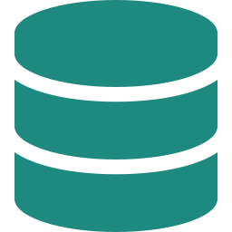
Tools and Technologies Used
5
Layer
Technologies / Tools
1
User Layer
React
TypeScript
Tailwind CSS
2
API & Orchestration
FastAPI (Auth, RBAC)
LangGraph
LangChain
3
Agent Layer
LLM Agents (2 tiers)
MCP Servers
Docker Sandbox
4
Knowledge Layer
ChromaDB
Agentic RAG
HNSW Index
5
HITL Review Layer
Diff Review
Six Approval Gates
Audit Trail
6
Data Layer
PostgreSQL
SQLite
LangGraph Checkpointer

Slide 7
Agents Architecture
6
LANGGRAPH ORCHESTRATOR
Task Routing | Shared State | HITL Interrupts
1 Requirements
2 Planning
3 Design
4 Development
SRS + acceptance criteria
Tasks, sprint plan, effort
Architecture, schema, APIs
Writes code, applies patches
Reflection & Bounded Self-Correction (max 3)
5 QA
6 Debugging
7 Documentation
8 Release
Runs real tests (read-only)
Stack-trace diagnosis + RAG
User and API guides
Build + release checklist
Shared Typed State & Persistent Memory (LangGraph checkpointer + Chroma + PostgreSQL / SQLite)

Slide 8
Agents Responsibilities
7
The proposed system consists of eight specialized agents coordinated by LangGraph.
REQUIREMENTS
PLANNING
DESIGN
DEVELOPMENT
Analyzes the client brief:
Breaks scope into:
Proposes:
Implements:
SRS document
acceptance criteria
ordered subtasks
owner + artifact
effort estimates
system architecture
database schemas
API contracts
source code
approved patches
only agent writing files
QA
DEBUGGING
DOCUMENTATION
RELEASE
Executes:
Diagnoses failures:
Produces:
Prepares:
real test suites
stack traces
cannot modify code
decides retrieval
proposes diff
cannot merge
user guide
API guide
deployment build
release checklist
release package

Slide 9
Agent Workflow and Orchestration
8
Shared typed state + checkpointer
(brief, srs, plan, design, code_files, test_report …)
Debugging
Max 3 repairs, then escalate
No
refine & re-implement
Client
Brief
Require-
ments
Planning
Design
Develop-
ment
QA
Tests
Pass?
Yes
6 HITL gates: Requirements, Plan, Architecture, Code review, Test acceptance, Release
Release
Package
Release
Documen-
tation
Human Test
Gate

Slide 10
Orchestration
9
1
Workflow Sequence
2
Shared Typed State
3
Persistent Data Layer
1. Client Brief
2. Requirements Agent
3. Planning Agent
4. Design Agent
5. Development Agent
6. QA Agent
7. Test Outcome Check
8. Debugging ⇄ Development
9. HITL Approval Gate
10. Documentation Agent
11. Release Agent
brief · srs · plan · design · code_files · test_report · error_trace · iteration · retrieved_context · fix_proposal · docs · release · gate · human_decision · decisions
Requirements and tasks
Designs and code revisions
Test logs and traces
Human approvals
Releases and audit trail
“LangGraph is the orchestration backbone of AegisDev: agents share state, route conditionally, self-correct within a bounded loop, and pause for human approval.”
Conditional Routing
After QA: 0 failures → test gate; cap exceeded → escalate; else → Debugging.
LangGraph StateGraph
Agents are nodes, transitions are edges.

Slide 11

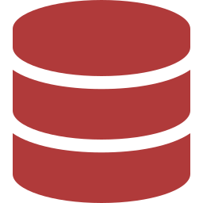

System Architecture: Tiered View
10
1
2
3
4
5
6
User Layer
Orchestration Layer
Agent Layer
Knowledge Layer
Data Layer
Infra Layer
Project manager, developer, QA, tech lead
Natural-language client brief
React web UI
FastAPI + RBAC
LangGraph StateGraph
Checkpoints, conditional routing
1 Requirements
2 Planning
3 Design
4 Development
5 QA
6 Debugging
7 Documentation
8 Release
Agentic RAG
Past fixes
Technical docs
Repo docs, standards
PostgreSQL / SQLite
Artifacts
Test results
Audit logs
MCP servers
Docker sandbox
LLM tiers
Git workspace

Slide 12
Agentic RAG Implementation
11
1
Retrieval Architecture
2
Why Agentic Retrieval?
3
Retrieval Quality Evaluation
Chroma collections
Verified past fixes
Technical docs (Python, PyTest, SQLAlchemy)
Repository docs
Engineering standardsDense HNSW search, metadata filters and a similarity threshold return the most relevant chunks.
On a test failure the Debugging Agent chooses:
Past-fix memory
Technical documentation
No retrievalIt writes a targeted query, checks similarity, and may reformulate or switch collection (max 2 attempts) before falling back.
Benchmark compares:
Baseline 1 — No retrieval
Baseline 2 — Fixed RAG
Proposed — AegisDev
→ Agentic RAG + real tests + human gates
Metrics: Precision@k, Recall@k, MRR, decision accuracy, citation correctness

Slide 13
System Implementation
12
Main Technologies
React + TypeScript
FastAPI
LangGraph
ChromaDB
Docker + MCP
Frontend UI
Backend API
Agent orchestration
Knowledge retrieval
Sandboxed execution
Implementation Flow
Client Brief
Requirements, Plan
Design, Code
QA Tests
Debug + RAG
Docs, Release
Natural-language task
SRS + task plan
Architecture + source
Real test run
Patch with rationale
Package + audit
Functional Prototype
1
2
3
4
5
Accepts a client brief and shows the plan
Coordinates eight specialized agents
Executes real tests in a Docker sandbox
Proposes diffs with retrieved evidence
Stores traces, approvals and release package

Slide 14
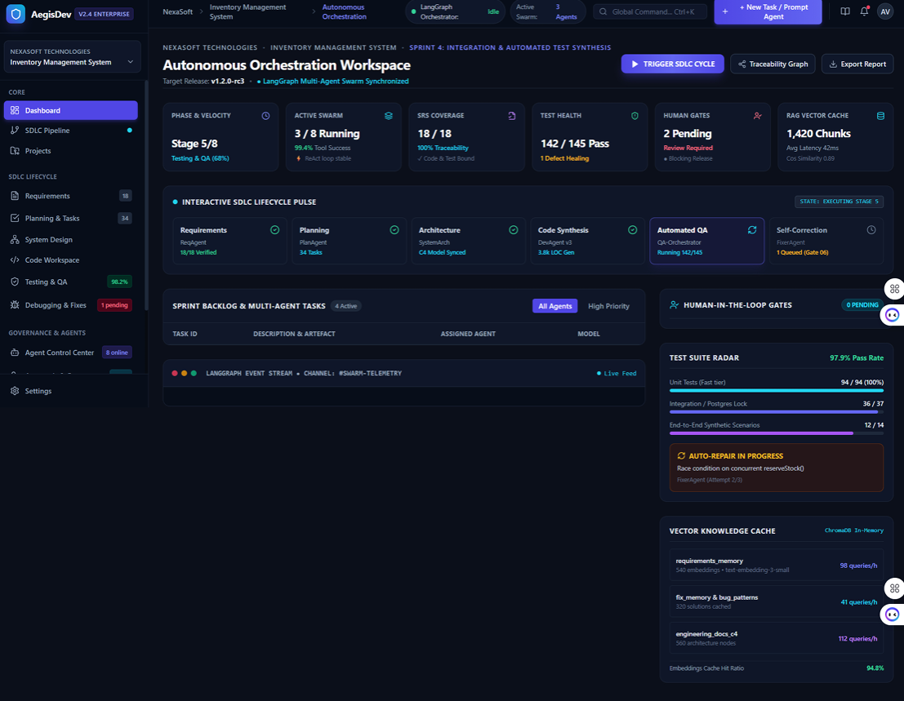
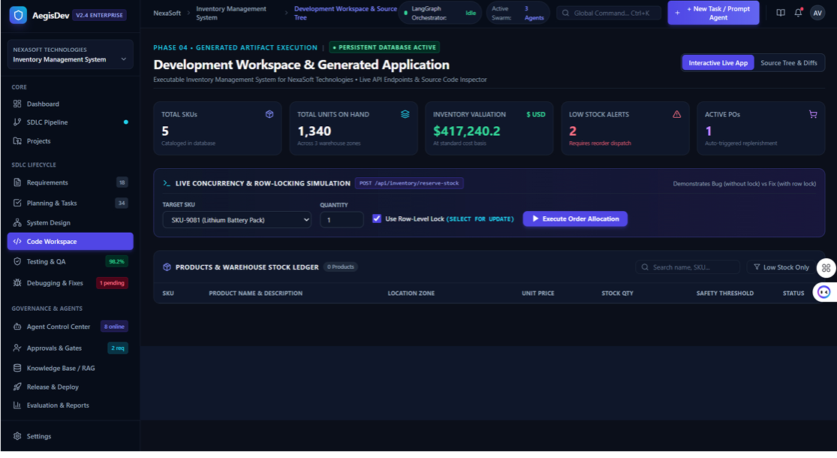
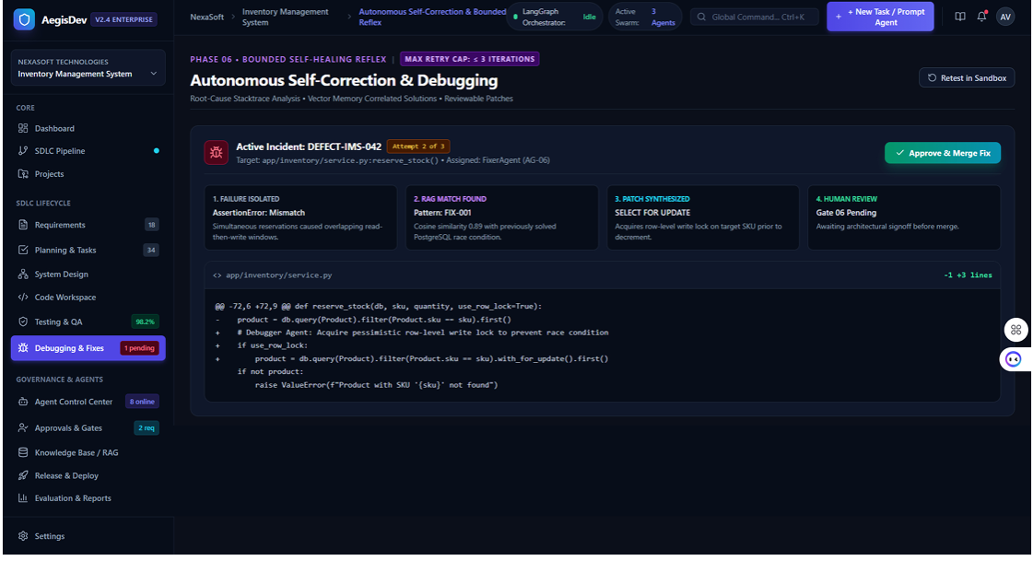
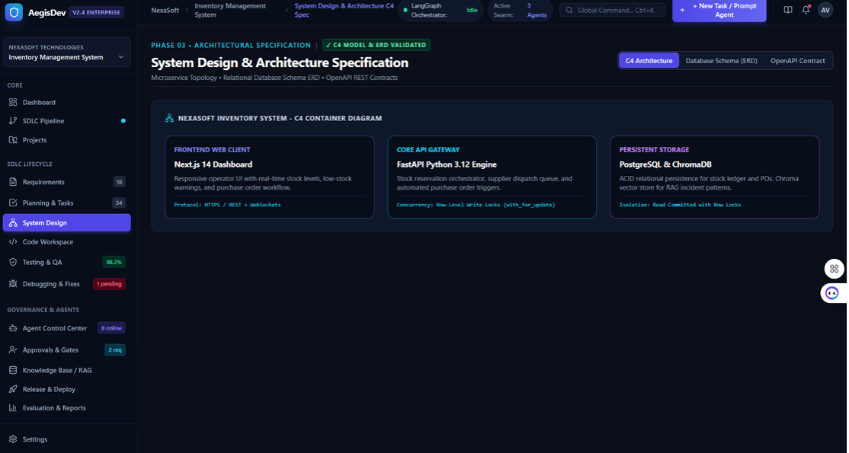
Functional Prototype Screenshots
13
What the prototype shows
Live agent status, test health and HITL gate queue
Row-level locking demo on stock reservation
Auto-repair: failure, RAG match, patch, human review
C4 architecture, database schema and API contracts
Orchestration workspace and HITL gates
Development workspace and concurrency simulation
Self-correction: diff, RAG match, approve
System design: C4, ERD and OpenAPI

Slide 15
Experimental Evaluation
14
We evaluate AegisDev at different stages of the workflow.
Evaluation Areas
Testing Methodology
Key Goal
Area | What We Check
Fix Accuracy | Does the full test suite pass?
Efficiency | Iterations, time, tokens, latency
Reasoning | Root cause and patch quality (1–5)
Retrieval | Relevant chunks and correct citations?
Governance | Escalations and approvals logged?
1. Select a seeded defect
“To verify that the system does not only generate a patch, but proves it with real tests, grounded retrieval and human approval.”
2. Pick config: 3 retrieval × 2 LLM tiers
3. Run in Docker sandbox
4. Record success, iterations, tokens
5. Rate patch on 1–5 rubric
6. Repeat ≥ 3 times and compare
Benchmark Setup
5–8
seeded defects
3
retrieval modes
2
LLM tiers
6
configurations
≥ 3
repeated runs

Slide 16
Performance & Success Metrics
15
Important Metrics
Success Condition
1. Fix Success
2. Retrieval
3. Reasoning
4. Efficiency
5. Governance
Requirements
✓
Does the suite pass after the run?
Precision@k, Recall@k, MRR
1–5 rubric on root cause
Iterations, time, tokens
Escalations and approvals
Design
✓
Code
✓
Verified Results
Tests pass
✓
5/5
0.90 s
≤ 3
6
Debug & fix
✓
baseline unit tests passed
PyTest run time (Python 3.12.7)
repair iterations before escalation
human approval gates
Release
✓
Main Result Success is a tested, reviewed, release-ready fix, not just an AI suggestion. Comparative results are reported only from verified benchmark runs.

Slide 17
Comparison & Innovation
16
Feature | Single-LLM Assistant | AegisDev
Requirement Understanding | ✓ | ✓
Multi-Agent SDLC Coverage | ✗ | ✓
Code Generation | ✓ | ✓
Real Test Execution | ✗ | ✓
Isolated Docker Sandbox | ✗ | ✓
Past-Fix Memory Retrieval | ✗ | ✓
Bounded Self-Correction | ✗ | ✓
Human Approval Gates | ✗ | ✓
Audit Trail & Traceability | ✗ | ✓
Our Innovation
AegisDev connects Requirements → Design → Code → Test → Debug → Review in one bounded, auditable workflow.
Agent-driven retrieval: memory, docs or none
Verified-fix memory: only tested, approved patches
Least-privilege agents: QA tests, Debugging proposes
Benchmark harness: built-in evaluation runner
MCP sandbox: non-root Docker execution

Slide 18
Scalability & Real-World
17
Real-World Applicability
Scalability
AegisDev can support:
AegisDev
Project managers tracking delivery
Developers automating repetitive debugging
QA teams validating acceptance criteria
Maintenance engineers reusing fix history
Teams adopting it without changing roles
Vector Store
Relational Store
Sandboxes
Chroma → pgvector or managed DBs
SQLite → HA PostgreSQL
Queue-based Docker workers
Multi-tenancy and cost-aware model routing

Slide 19
Future Work
18
1. Broader evaluation
2. More languages
3. CI/CD integration
Run standard public benchmarks such as SWE-bench tasks.
Add runtime support for TypeScript, Go and Java.
Connect to pipelines, GitHub pull requests and regression frameworks.
4. Observability
5. Multi-tenant memory
6. More domains
Add tracing through platforms like LangSmith.
Fix memory with workspace isolation, cost-aware routing and prompt caching.
Demonstrate on other subjects, e.g. an Employee Leave Management System.

Slide 20
Conclusion
19
AegisDev shows how Agentic AI can move beyond single-pass code generation toward an accountable software engineering workflow.
The system:
Current Limitations
turns a client brief into an SRS and plan
designs and implements code with 8 agents
runs real tests in an isolated Docker sandbox
retrieves past fixes with agentic RAG
self-corrects within a 3-iteration cap
escalates to humans through 6 approval gates
keeps a complete audit trail
Small benchmark on one application
Limited to Python and FastAPI
Retrieval depends on memory quality
LLM output is non-deterministic
No cloud provisioning or deployment

Slide 21

Thank You
Department of Artificial Intelligence and Machine Learning

