Slide 1
Learning

Slide 2
“O! this learning, what a thing it is”
Shakespeare, The Taming of the Shrew, 1597

Slide 3
What is learning?

Slide 4
A change
that is observable
A change in behavior
How do we learn?

Slide 5
How do we learn?
By Association
Through Reward and Punishment
By Observing others

Slide 6
Classical Conditioning
Pavlov: Experiments with the digestive system
US (food) ----- UR (salivation)
Neutral S (Tone) ------ No response
Neutral S (Tone) + US (food) --------- UR (salivation)
(repeatedly)
CS (Tone)-----------------Conditioned Response(salivation)

Slide 7
Acquisition – the linking of the neutral stimulus to the unconditional stimulus.
Higher order conditioning – a new neutral stimulus may become a new conditioned stimulus by being associated with a previously associated stimulus.
Light + Tone
Light ------ Salivation
Also referred to as second order conditioning
Tends to be weaker than first order conditioning
Field (2006) cartoon characters (ice cream/brussels sprouts)
Olson & Fazio (2001) attitudes to Pokemon characters (positive/neg words)

Slide 8
Extinction – diminished responding that occurs when the CS occurs repeatedly without the US
Spontaneous Recovery – the reappearance of a weakened CR after a pause (suggesting that extinction was suppressing the CR rather than eliminating it)

Slide 9
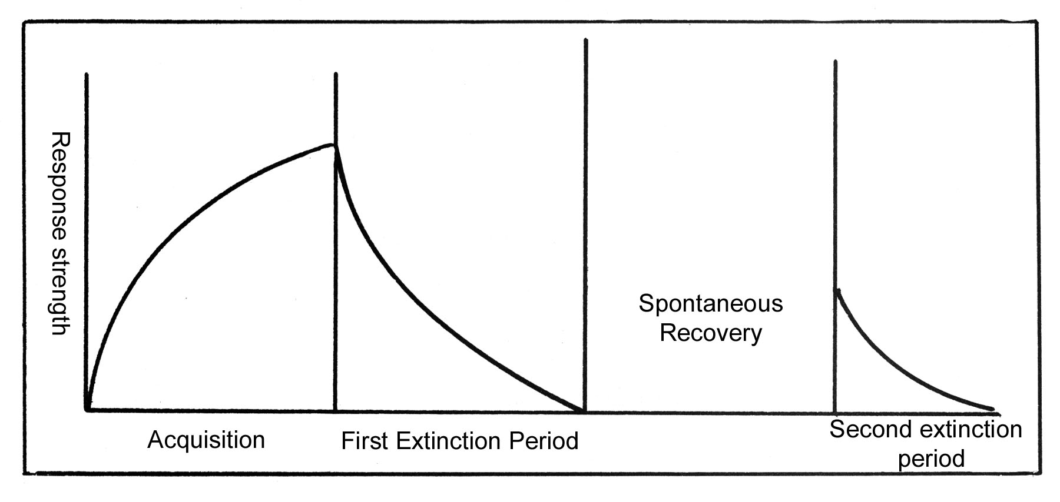
http://www.intropsych.com/ch05_conditioning/extinction_and_spontaneous_recovery.html

Slide 10
Generalization – the tendency for similar stimuli to the conditioned stimulus to elicit similar responses.
Pavlov – different tone also worked
(Pollak et al, 1998 – Abused vs control children response to an angry face)
Discrimination – the learned ability to distinguish between a Cs and a stimuli that may be similar but does not signal a Ucs
(2 tones)

Slide 11
Biological Predispositions:
Are the laws of learning universal ?
Each species’ predispositions prepare it to learn the associations that enhance its survival.
Garcia & Koelling (1966) Taste Aversion associated with sickness among rats (delayed sickness)
Gustavson et al, (1974, 76) coyotes & wolves – poisoned sheep carcasses
Prevented baboons from raiding gardens
Notes:
Chemotherapy eg
Taste aversion is a learned response to eating spoiled or toxic food. When taste aversion takes place, you avoid eating the foods that make you ill. Taste aversion can be so powerful that sometimes you also avoid the foods that you associate with an illness, even if the food did not cause the illness.

Slide 12
Many response can be conditioned to many stimuli in many organisms
Illustration of how learning can be studied objectively.
salivary response measured in term of cubic centimeters of saliva

Slide 13
Applications of Classical Conditioning
Drug Users – the places, the people associated with a high
Immune responses
Watson & Rayner - ‘Little Albert’ 11 month old
white rat with a loud noise
Maxwell House Coffee Break
Notes:
The little albert experiment was a experiment in which a conditional response of fre.r from loud noise was made in 11 month old child

Slide 14
Advertizing
Pair a neutral stimulus (product) with an affective stimulus (UCs) repeatedly
Paint (Brand) + Happy Family ---------- Happiness
Paint Brand ------------------ Happiness
(Attention, Attitude, Purchasing Probability)
Maggi
De Beers Diamonds

Slide 15
“Give me a dozen healthy infants, well-formed, and my own specified world to bring them up in and I'll guarantee to take any one at random and train him to become any type of specialist I might select--doctor, lawyer, artist, merchant-chief, and, yes, even beggarman and thief, regardless of his talents, penchants, tendencies, abilities, vocations, and race of his ancestors.”
John. B. Watson, Behaviorism, 1930

Slide 16
Operant Conditioning
Known also as instrumental conditioning – some action of the learner brings about a change in the environment that makes the action more or less likely to occur in the future.
Reinforcement - consequence
Positive Reinforcement – that follows a response and increases the likelihood that the response will be made again – Reward

Slide 17
Punishment – follows the response and decreases it’s likelihood of occurring.
fines, spanking
Omission of Reinforcement – stop the reinforcement to decrease the likelihood of the behavior occurring.
time out, no TV, no ipad
Negative Reinforcement – a response that terminates an unpleasant consequence (neg reinforcement)
(e.g. noise)

Slide 18
Thorndike - The law of effect principle suggests that responses closely followed by satisfaction will become firmly attached to the situation and therefore more likely to reoccur when the situation is repeated.
Cats in a Puzzle Box
Mazes
Notes:
https://www.youtube.com/watch?v=Vk6H7Ukp6To

Slide 19
B.F. Skinner – Skinner Box
Behavior Shaping – reinforcers gradually guide the animal’s behavior towards a desired behavior –
successive approximations develop complex behaviors
Rats have been taught to sniff out land mines
Dogs that lead the blind

Slide 20
Continuous Reinforcement – every time the response occurs
Partial Reinforcement – intermittent reinforcement (fishing, gambling)

Slide 21
Schedules of Reinforcement
Fixed Ratio Schedules – reinforce behavior after a fixed number of responses
High levels of responding
Variable Ratio Schedule - reinforce behavior after a variable number of responses
High levels of responding
Fixed Interval Schedule - reinforce behavior after a fixed time period
Stop start pattern ( rapid responding near reinforcement)
Variable Interval Schedule - reinforce behavior after a variable time period
Slow steady responding

Slide 22
Latent learning – learning that becomes apparent only when there is some incentive to demonstrate it
Cognition – expectancy

Slide 23
Applications
Breland & Breland - animal training school taught 15,000 animals from 140 species
School - Teaching machines and textbooks that would shape learning in small steps, immediately reinforcing correct responses
Work – reward specific achievable behaviors
“How much richer would the whole world be if the reinforcers in daily life were more effectively contingent on productive work?” Skinner
Sports – reinforce small successes then gradually increase the challenge – golf, baseball

Slide 24
How to use it as a guide
State your goal in measurable terms and announce it
Monitor how often you engage in your desired behavior (log it)
Reinforce the desired behavior
Reduce the rewards gradually

Slide 25
Classical Conditioning Operant Conditioning
Learns association bet events learns assoc bet its behavior and
(over which they have no control) resulting consequences
Response involuntary automatic voluntary

Slide 26
Observational Learning
Modeling - observing and imitating models
Mirror Neurons - Rizzolatti, Parma Italy
macaque monkeys – some neurons in the inferior frontal cortex that responded when the monkey picked up a peanut also responded when the monkey saw a person pick up a peanut

Slide 27
10% of neurons have this mirror property in the inferior frontal cortex and inferior parietal cortex
Turns out humans have mirror neurons too
The human brain has multiple mirror neuron systems that specialize in carrying out and understanding not just the actions of others but their intentions, the social meaning of their behavior and their emotions.
"We are exquisitely social creatures," Dr. Rizzolatti said. "Our survival depends on understanding the actions, intentions and emotions of others.”

Slide 28
“Everyday experiences are also being viewed in a new light. Mirror neurons reveal how children learn, why people respond to certain types of sports, dance, music and art, why watching media violence may be harmful and why many men like pornography.”
"Mirror neurons provide a powerful biological foundation for the evolution of culture,“ Patricia Greenfield.

Slide 29
Bandura – Bobo Doll Experiment
Child watches an
Adult model - behaves aggressively with a Bobo doll – 10 mins - pounds, kicks and throws it around the room
“Sock him in the nose ……. Kick him”
Then child is taken to another room with toys
then told that they need to keep these toys for other children
Then brought back into this room with the Bobo doll

Slide 30
TV violence
Viewing violence
Violent Video Games

Slide 31
Prolonged exposure to violence desensitizes viewers
Implications

