Slide 1
Memory

Slide 2
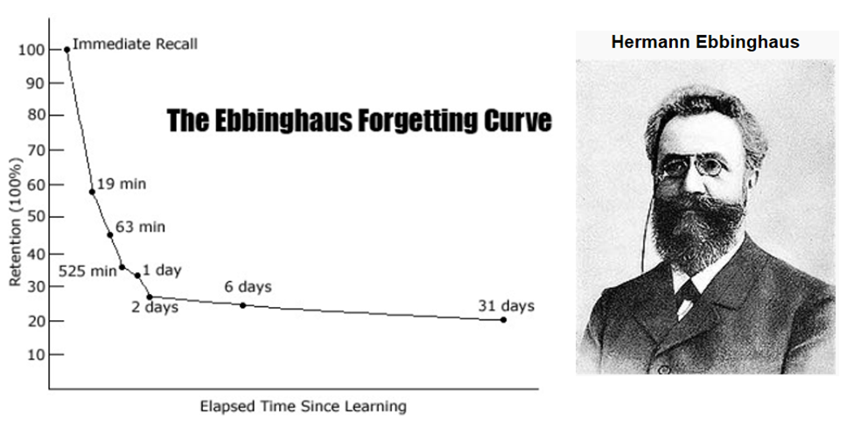
Notes:
More the rehearsal – more the savings in relearning

Slide 3
Serial Position Effect - Primacy effect
Recency effect
When we remember a series then we are able to remember initial and end sequence middle is tough to remember
Savings – learn something and then never rehearse it until it is completely forgotten
then learn it again and compare the learning time

Slide 4
Structuralist Perspective
Proceduralist Perspective
Dynamic Perspective

Slide 5
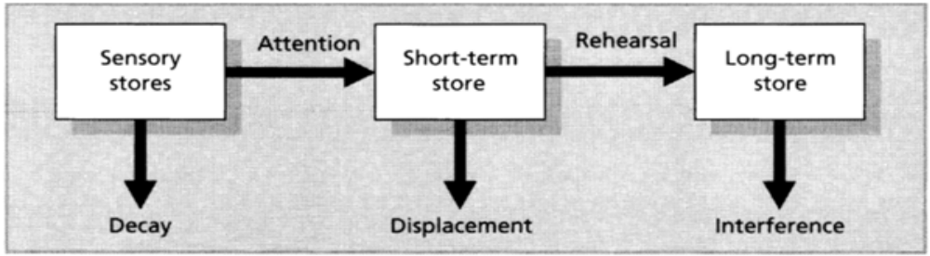
Structure of Memory
Stages in Information Processing:
Encoding
Storage
Retrieval
Memory Stores as explained using Atkinson and Shiffrin’s Modal Model of Memory (see below)
[Source: Eysenck & Keane (2000); p. 169]

Slide 6
38679213

Slide 7
548923168923

Slide 8
Memory Stores
Sensory Store:
Duration: 1-4 seconds; just enough to be perceived.
Iconic (visual) store
Echoic (auditory) store
Short-Term Store:
Duration: for about half a minute; information held longer in STM if rehearsed.
Storage Capacity: “Seven plus or minus two”; the role of chunking
Notes:
Iconic memory 1/20th of a second

Slide 9
Structuralist View
Working Memory
Semantic memory
Episodic Memory
Perceptual Representation
Procedural memory

Slide 10
Working memory – cognitive work is happening
- temporary maintenance and storage
- multiple subsystems – auditory and visuo-spatial
- unlike STM, capacity is based on rehearsal & decay

Slide 11
Semantic memory – knowledge of facts, vocabulary
Episodic memory – memory of events

Slide 12
Perceptual Representation - information about form and structure of objects and words
Procedural memory – memory of how to do things – swim, ride a cycle, play badminton

Slide 13
Proceduralist Perspective
Memory is viewed as a process rather than a store
Craik & Lockhart – Levels of Processing
Encoding Level Example
Structural/Physical Shallow Is the word in caps
Phonemic Intermediate Does it rhyme with
Semantic Deep Is it an e.g of a fruit?

Slide 14
The deeper the processing the better the retention
Rehearsal
- Maintenance rehearsal (mugging)
- Elaborative rehearsal (forming rich associations)

Slide 15
3 dimensions linked to levels/ depth of processing:
Elaboration - rehearsal
Distinctiveness - uniqueness
Self-reference effect - the information is relevant to us.

Slide 16
The Dynamic Perspective
Memory is active and dynamic
memory is constructed
At every retrieval attempt memory is reconstructed based on the old memory and general knowledge

Slide 17
Misinformation Effect
Loftus & Palmer - film of a traffic accident
“How fast were the cars going when they smashed into each other?”
“How fast were the cars going when they hit each other?”
A week later they were asked if they recalled seeing any broken glass at the scene of the accident.
Notes:
These two statements refer to same accident but the people who were asked q1 said the glass broke the old memory is revised based on current knowledge(dynamic)

Slide 18
Visualizing something and actually perceiving something activate similar brain areas (Gonsalves et al., 2004).
Eyewitness Testimony
Source Amnesia
False Memories
Notes:
Amnesia is a deficit in memory caused by brain damage, disease, or psychological trauma. The memory can be either wholly or partially lost due to the extent of damage that was caused

Slide 19
Factors that affect eyewitness testimony
Factor | Effect on accuracy of eyewitness
Post event information | Eyewitness testimony about an event often reflects not only what the witness actually saw, but information that was obtained later.(dynamic
Witness intoxication | Alcohol impairs an eyewitness’s later ability to recall persons and events.
Weapon focus | Presence of weapon impairs an eyewitness’s ability to accurately identify the perpetrator’s face.
Suggestibility | Young children and older adults are more prone than young adults to interviewer suggestion, peer pressure and other social influences.
Disguise | Hampers recognition of perpetrator at line up identification stage.

Slide 20
US Senator John McCain on the Iraq war:
2007(on MSNBC): “When I voted to support this war I knew it was probably going to be long and hard and tough.”
2002(on Larry King): “I believe that the operation will be relatively short (and) that success will be fairly easy.”

Slide 21
Retrieval
Recall – recall information learnt earlier – as to a question on a exam (fill in the blanks )
Recognition – identify items previously learnt - MCQ.
Retrieval cues come from the associations we form when we encode information
Notes:
Retrieval cues are like a small map which we create to remember back the memory

Slide 22
Context Effects - place congruent memory
Mood - mood congruent memory
Notes:
We can remember the things better if we are at the same environment

Slide 23
Neurobiology of Memory
Hippocampus - new memories are formed. Densely packed with neural layers. Connections to the cortex – may lead to memories getting transferred to LTM
Cerebellum - Procedural Memory
Classical Conditioning
Implicit Memories

Slide 24
Forgetting
Encoding Failure – Attention to detail
Storage Decay – Fading
Retrieval Failure – Tip of the tongue phenomenon
Interference – Proactive - earlier information disrupts
Retroactive – later information disrupts
Retroactive interference occurs when learning something new impairs our ability to retrieve information that was learned earlier

Slide 25
Aging - episodic memory is affected not semantic
hippocampus may shrink
Stress – cortisol - hippocampus
Alzheimer’s Disease – beta-amyloid plaques spread over the cortex
Dementia – vascular dementia

Slide 26
Amnesia
Retrograde - events before the incident – brain injury/ stroke
The outcome is retrograde amnesia, a memory disorder that produces an inability to retrieve events that occurred before a given time.
Anterograde – new memories
brain injury, sleeping pills, alcohol
Psychogenic Amnesia – traumatic event (absence of brain injury)

Slide 27
Memory and Studying
Spacing Effect (Cepeda et al. 2006)
Testing Effect (Karpicke & Roediger, 2008)

Slide 28
Encoding
Time Management & Planning
Minimize Distraction – Focused Attention
Taking Good Notes (Concept maps, oulining, summarizing)
Storage
Organizing memory
Spreading out and Consolidated Learning
Retreival
Effective retrieval Cues
Preview, Question, Read, reflect, recite, review
Sleep - memories are consolidated in sleep

