Slide 1
Sleep

Slide 2
Why do we sleep?

Slide 3
U.S. Navy – 14 hours in bed
12 hours
7.5 – 9 hours
Kahneman et al (2004) - 909 working women report on their daily moods

Slide 4
Sleep Deprivation
mood
concentration
memory
appetite
immunity
hormonal functioning

Slide 5
Circadian Rhythm – biological clock activated by light roughly synchronized with the 24 hour cycle of day and night
Bright light activates light sensitive retinal proteins
which signal the suprachiasmatic nucleus
which signals the pineal gland to modulate
melatonin - sleep inducing hormone

Slide 6
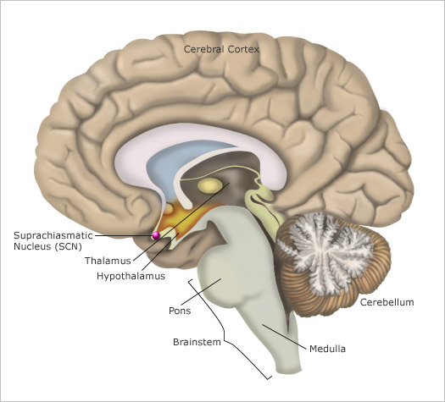

Slide 7
Dement (1999) – sleep deprived participant with eyes taped open to press a button every time a stobe flashed – every 6 seconds
People can have micro sleep ie loose consc. With their eyes open
Notes:
We often become unconscious if we are awake for a long time.We sleep with our eyes open

Slide 8
Stages of sleep
stage 1
stage 2
stage 3
stage 4
REM rapid eye movement – dream time
As the night wears on stage 4 gets briefer and stage 2 and REM gets longer
Notes:
REM have brain waves similar to awake stage

Slide 9
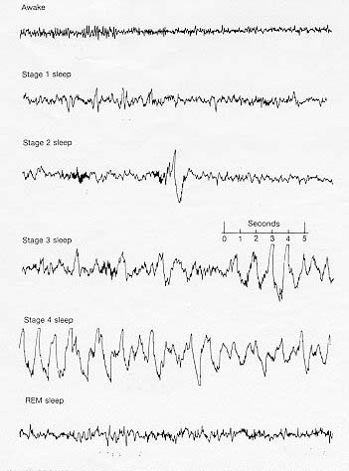
Dement, 1978

Slide 10
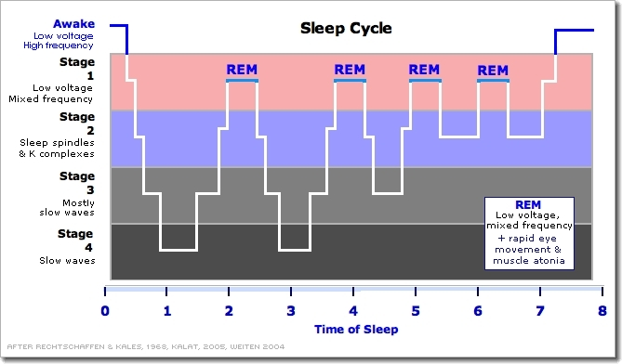

Slide 11
Stage 1 - hypnagogic sensations
Stage 2 – sleep spindles(rapidliy changing)
Stage 3
Stage 4 – delta waves – deep sleep
REM waves appear like awake
Heart rate increases, rapid breathing

Slide 12
Sleep is when all the unsorted stuff comes flying out as from a dustbin upset in a high wind.
William Golding, Pincher Martin

Slide 13
Dreams
- previous day’s experiences
- incorporate sensory stimuli into the dream

Slide 14
Function of Dreams
- file away memories
those with higher grades sleep 25 min more each night (Wolfson & Carskadon, 1998)
- make sense of neural static(sense of random thought)
- provides periodic stimulation to the brain
()provide rest to out brain

Slide 15
Freud psychic safety valve – express otherwise unacceptable feelings
manifest content and latent content
Do the things that you cant do in physical life….(blow up car with rocket launcher)
REM rebound

Slide 16
Sleep talking
Sleep walking - stage 4
Lucid Dreaming
Sleep Paralysis
Notes:
lucid dream is a dream during which the dreamer is aware that they are dreaming. During lucid dreaming, the dreamer may be able to have some control over the dream characters, narrative, and environment.^{[1][2][3][4]}

Slide 17
Age and Sleep Needs
Newborns (0–3 months) 14 to 17 hours^{[73]}
Infants (4–11 months) 12 to 15 hours^{[73]} Toddlers (1–2 years) 11 to 14 hours^{[73]} Preschoolers (3–5 years) 10 to 13 hours^{[73]}
School-age children (6–13 years)9 to 11 hours^{[73]}
Teenagers (14–17 years) 8 to 10 hours^{[73][74]}
Adults 7 to 9 hours^{[73]}
National Sleep Foundation 2015

Slide 18
Sleep Disorders
Insomnia
Exercise regularly – late afternoon
Avoid caffeine after early afternoon
Stick to a regular schedule
Relax with a book using lamp light

Slide 19
Narcolepsy - sleep attacks that last less than 5 minutes, anytime in the day
Sleep Apnea – stop breathing during sleep

Slide 20
Drugs & Consciousness
Psychoactive Drugs – chemicals that change perceptions and moods through their actions at the neural synapses.
Addiction – compulsive craving for a substance despite adverse consequences with physical symptoms associated with withdrawal

Slide 21
Depressants – calm neural activity, slow body functioning
Stimulants – excite neural activity and arouse body function
Hallucinogens – distort perceptions, evoke sensory images in the absence of stimuli

Slide 22
Depressants
Alcohol
disinhibition
slowed neural processing
affects cerebellum(loss in movement
hippocampus ( memory loss)
memory disruption
(Suppresses REM sleep)
reduced self awareness

Slide 23
Barbituates – tranquilizers, mimic alcohol
combined with alcohol - fatal
Opiates – opium and it’s derivatives –morphine and heroin
brain stops producing its own opiates – endorphins when flooded with artificial opiates

Slide 24
Stimulants
Strong stimulants cause increased ht rt, breathing, dilated pupils, reduced appetite, increased energy and confidence
Caffeine – awake, 4-6 hours
Nicotine - acetylcholine, dopamine, epinephrine
Notes:
Caffeine – adenosine antagonist
Nicotine - acetylcholine, dopamine, epinephrine

Slide 25
Methamphetamines – dopamine release – euphoria - reduces baseline dopamine
Cocaine - dopamine, serotonin, norepinephrine
rush and then crash

Slide 26
Hallucinogens
LSD - serotonin, vivid hallucinations
Marijuana – mild hallucinogen
Common Effect across drugs
Continued use leads to diminished effects – tolerance - addiction

Slide 27
Why do some people become addicted?

Slide 28
Biological Influences
Adopted individuals – more susceptible if one or more biological parent has a history
Identical rather than fraternal twins are more similar in alcohol dependence/marijuana use
Researchers have bred mice that prefer alcoholic drinks to water (Thiele et al, 1998)
Researchers have identified genes – animals and humans – predisposed to alcoholism
(NIH, 2006)
Notes:
Adopted
Identical

Slide 29
Psychological and Social influences
Life is meaningless
Stress
Depression
Teen drinking rates influenced by culture
Marijuana Use Romania – 0-1%
Britain, France – 20 -22 %
Peers

Slide 30
Near Death Experience
12 to 40% of those who have come very close to death recall a NDE
bright light in the center of the vision field – tunnel like perspective
Out of body experiences, floating

Slide 31
Oxygen deprivation – increased activity in the visual cortex
Hallucinatory activity of the brain
Cortical activity – flat line
but may not detect sub cortical activity – hippocampus, amygdala

