Slide 1
Emotion

Slide 2
Emotions are psychological responses
that involve
- Conscious experience – cognitive appraisal(thoughts in the head)
- Physiological arousal(heart beat rise and dry mouth)
- Expression (Behavior)

Slide 3
James-Lange Theory
- Physiological arousal
- (then)Interpreted as emotion
() we need physical arousal to experience emotion arousal triggers endocrine gland
Criticism: if injected with adrenalien then emotion is not produced
Cannon-Bard Theory
physiological arousal and emotional experience occur simultaneously
Notes:
Eg: james lange theory when we see lion we start trumbling ie shaking then due to shaking we experience fear …..physical arousal is needed for emotion
Canon bard threpry suggest that phychlogical changes and emotion are different independent process both happen simultaneously eg seeing a lion you began shaking and start to feel fear simultaniously

Slide 4
Two-factor Theory – Schachter & Singer
Physiology
Cognition (perceptions, memories and interpretations)
experience of emotion grows from arousal
need to consciously interpret arousal
Arousal of sympatheic nervous system and then our brain interpretes it…cognition . For example when we witness a car crash even if we are not a victim we still feel our heart rate rising then we access the situation
Notes:
Supproxin
https://www.youtube.com/watch?v=gwfn6ffh-tk

Slide 5
Feeling with the body
Autonomic Nervous System – mobilizes the body for action and then calms it.
Sympathetic Parasympathetic
arousal calming
accelerated ht bt slows
inhibits digestion activates
perspiration dries
Parasympathetic allows you to handle every day task except crisis situaltion calm you down after stress etc
Notes:
Sympathetic neural system is used by our body in time of crisis in life or death situation it gives more oxygenrich blood to hand and legs so that we coud run and save our selves jobs like digestion can be latter …awakining of body

Slide 6
Many emotions have similar physiological responses
Subtle physiological distinctions between emotions
Some tendency for
neg emotions – right hemisphere
positive emotion – left hemisphere
Amydala seat of emotion and cortex concious

Slide 7
25 soldiers severed spinal cords recall emotional experiences before and after surgery (Hohmann, 1966).
Lower spinal cord injuries – lost sensation in the legs
Upper spinal injuries – paralyzed neck below – change in emotion experienced
Not all emotion are in amydala

Slide 8
Cognition and Emotion
Spillover Effect – Schacter & Singer(1962)
epinephrine( adrenalin) injection experiment – college students (male)
Informed, Ignorant, Misinformed, Placebo
euphoric and irritated condition
Eg if we see a lion then our ANS kicks in and tell us that we are experiencing a emotion but what emotion we our expreencing comes out cognitic appraisal (we look in the environment for that)
emotion = cognitive arousal(ANS) and the situation
Maslach – repeated the experiment
did not find the arousal being interpreted as joy in the euphoric condition
We need less time to experience negative emotion
Notes:
https://www.youtube.com/watch?v=_Al3wGg2hp8
euphoric characterized by or feeling intense excitement and happiness.

Slide 9
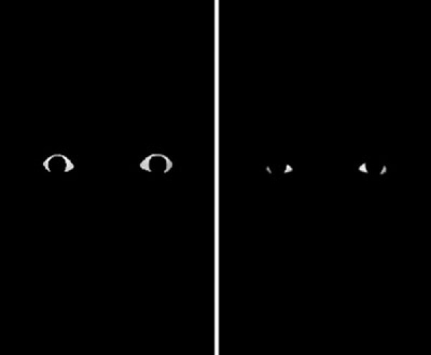

Slide 10
When Emotion precedes Cognition
react automatically sometimes
some emotions take the low road bypass the cortex
pathway runs from eye/ear via thalamus to amygdala
So we experience faster Fear and anger

Slide 11
Whalen et al (2004)
subliminally presented
happy eyes or fearful eyes
We react faster to fear and anger as eye is directly connected to amydala (sight for synthesis of anger and fear)
increased activity in the amygdala after frightened eyes
frightened eyes increasses the amydala activity

Slide 12
Emotion Expression
Do our facial expressions influence our feelings?
Pencil in the lips
Makes people smile
Botox Injections paralyze muscles depresion becomes better

Slide 13
Detecting Emotion
Subtle Expressions
10 sec film clip teacher’s voice/face – teacher liked or admired the student
a tenth of a second glimpse of a face - to make judgments about trustworthiness
Rosenthal & Hall (1979)
2 second scene of a woman’s face
asked whether she was
- criticizing someone for being late or
- talking about her divorce
Notes:
trusworthniness

Slide 14
Gender
Hall - meta-analysis – women are better than men at decoding emotions
- gives them an edge in spotting lies (DePaulo, 1994)
Women more emotionally responsive in positive and negative situations (Grossman & Wood, 1993)
Women are more likely to describe themselves as being empathic
Kring & Gordon (1998) diff in watching a film
Notes:
Physiological measures of ht rt show no diff in empathy

Slide 15
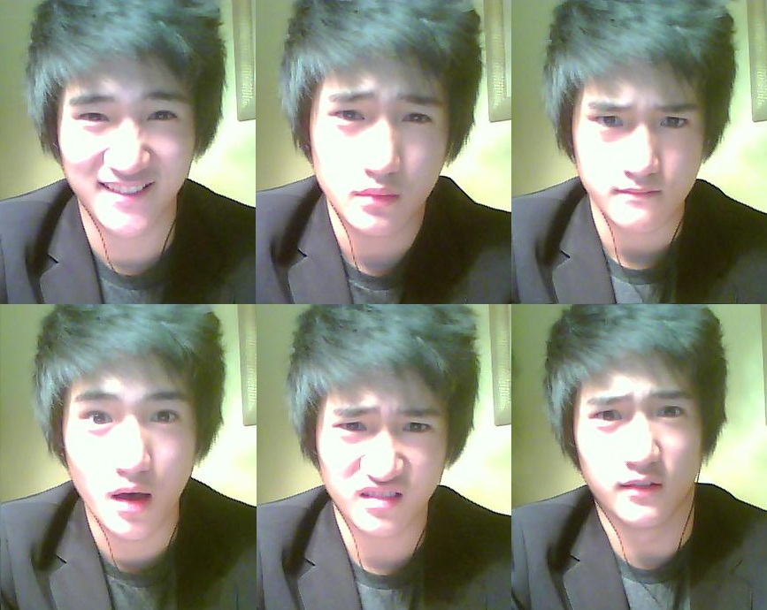
Notes:
Izzard et al

Slide 16
Facial Expression, Emotion and Culture
Darwin believed that human emotional expressions are universal
Current research indicates that about 6 major emotional expressions that are universal
Happiness, surprise, anger, fear, sadness and disgust
Notes:
Survival value – sneer – bared teeth – snarl
Disgust –wrinkle nose – to block odours
Infants
Even in blind children from birth
Shame guilt contempt interest excitement

Slide 17
Ekman & Friesen’s (1971) study with New Guinnea tribes’ people
Slightly enhanced accuracy when judging emotions from their own culture (Elfenbein & Ambady, 2002, 2003) from 182 studies

Slide 18
Fear
Fear is adaptive – protects us from danger
We can lean to ferar a particular thingfrom others specially by out parents
Learning Fear
Little Albert
Monkeys reared in the wild vs lab reared monkeys – fear of snakes (Mineka, 1985)

Slide 19
Physiology of fear
Amygdala – key role in associating emotions with situations
Rabbits & Rats - unable to learn conditioning response if amygdala is damaged (tone with a small shock)
Schacter – blaring horn with a blue slide

Slide 20
Amygdala damage (Adolphs et al,1998)
participants with damaged amygdalas – choose between two faces
Based on approachability & trustworthiness
Compared with control SS – they tended to
choose the more negative faces
Serotonin Reuptake – gene that does not allow serotonin reuptake
serotonin activates the amygdala’s neurons

Slide 21
Anger
Reaction to being treated unjustly.
High temperature, foul odor, pain
Catharsis – emotional release - venting
Out right burst of anger can make you feel ok
Rumination – dwelling on the insult

Slide 22
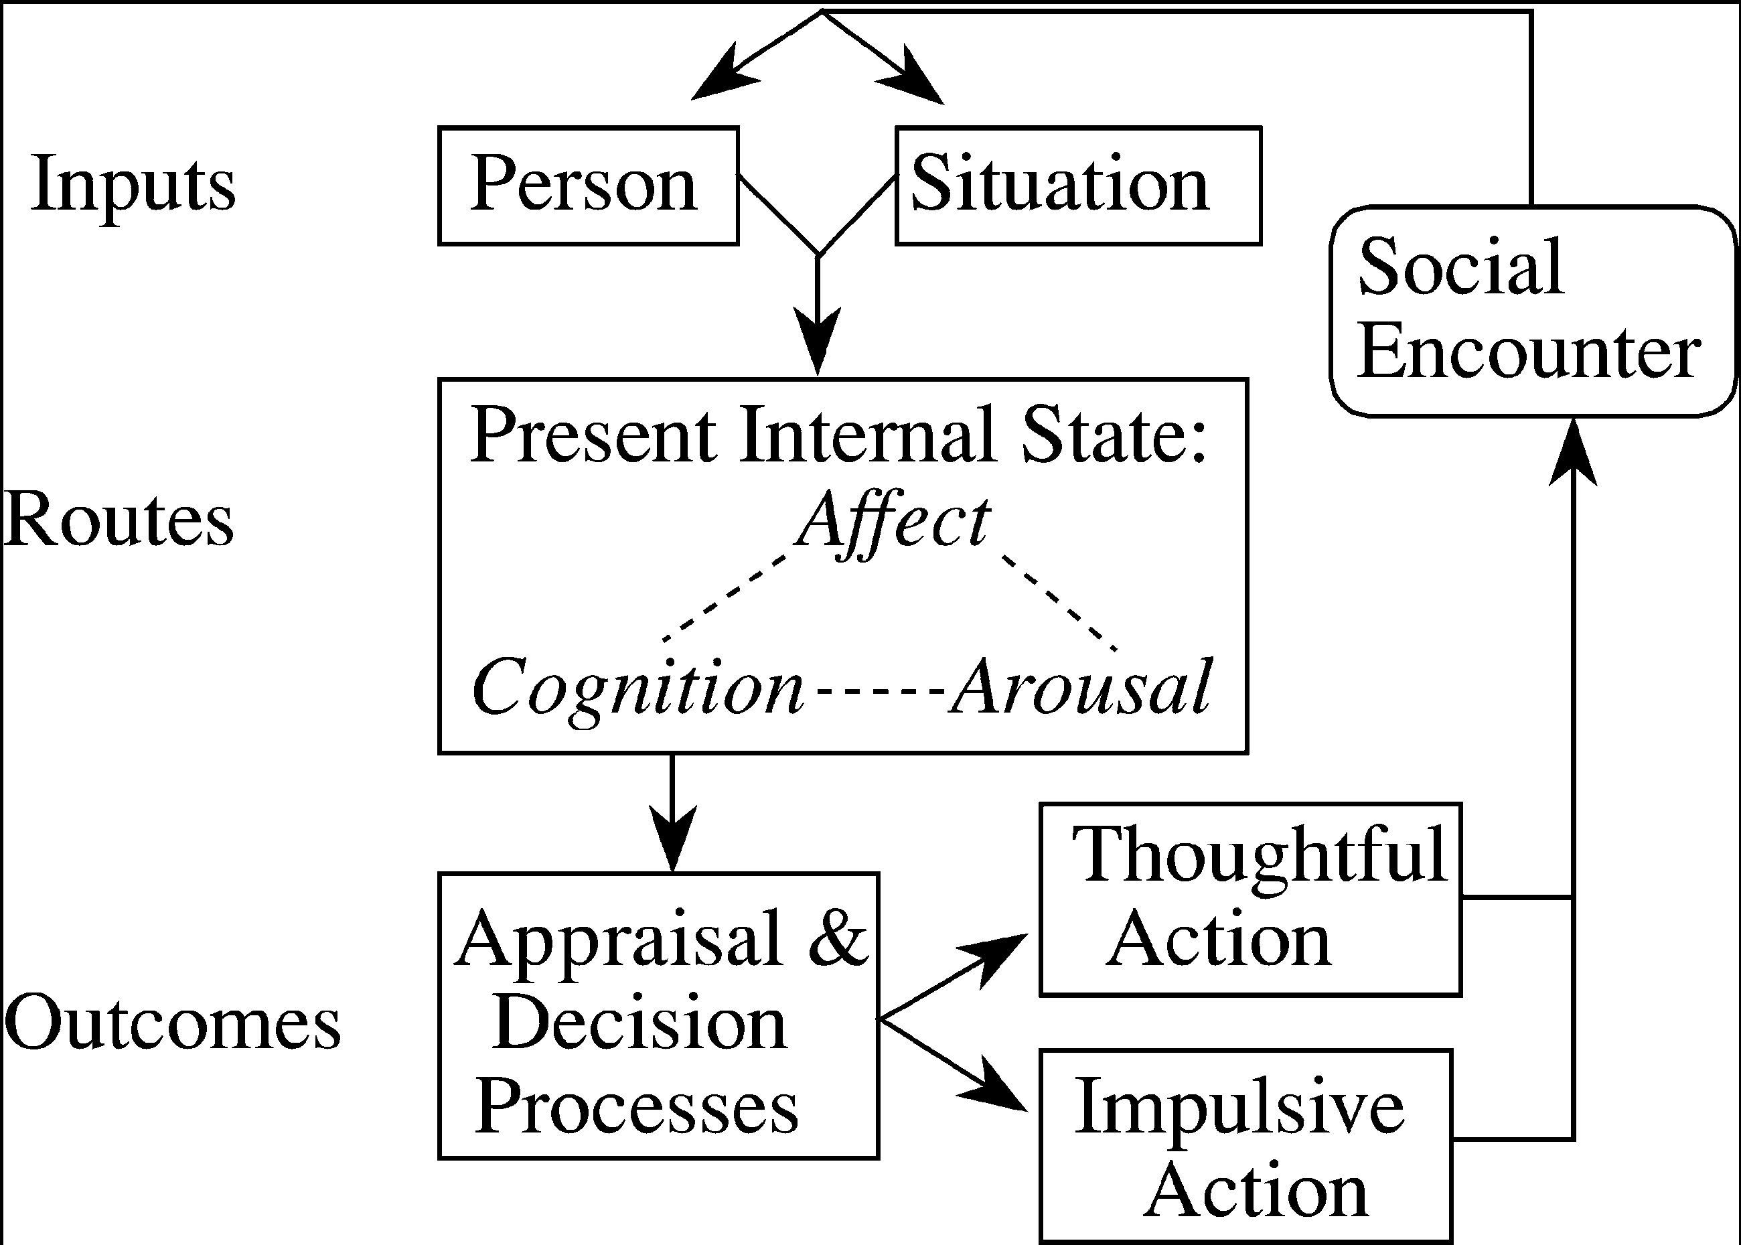
General Aggression Model (Anderson & Bushman)

Slide 23
“Anger will never disappear so long as thoughts of resentment are cherished in the mind” Buddha
Witvliet (2001) – When forgiveness was mentally rehearsed – perspiration, BP, ht rt, facial tension were all lower than when
- grudges were rehearsed.
Controlled expressions of anger are better than outbursts

Slide 24
Happiness
Happiness: Positive emotional state that is subjectively defined by each person
Subjective Well-Being – combination of positive affect and general life satisfaction
Social
Cognitive
Physiological

Slide 25
Fredrickson – Broaden & Build Model
Positive emotions
Broaden Thought –action repertoire
Behave positively towards others
Build resources
Create an upward spiral
Eg when we are in joy we feel more iumpulsive and creative
Positive emotions broadens our mind which can lead to more positive emotions
But people generally tend to overthink their negative emotion
Notes:
https://www.youtube.com/watch?v=7DjkaxXKyE8

Slide 26
The Trajectory of Ups and Downs
Positive emotions tend to rise over the early to middle part of most days and negative emotions towards the end of the day (based on 4500 mood reports)
Watson (2000) Kahneman (2004)
HIV patients
Kidney Dialysis

Slide 27
Positive emotions too are hard to sustain
Wealth
People in rich countries are somewhat happier than poor countries
People with more money are happier, especially in poor countries than those who struggle to manage basic needs (Diener & Biswas –Diener, 2009)
Curve of Diminishing returns

Slide 28
Prior Experience
Adaptation level phenomenon
Other’s Attainment
Upward Comparisons
Downward Comparisons
Twins – about 50% difference in happiness is attributed to heredity (Lykken & Tellegen, 1996, Lucas 2008)

Slide 29
Realize that enduring happiness may not come from financial success
Take control of your time
Act Happy
Seek work and leisure that engage your skills
Exercise
Sleep
Give priority to close relationships
Focus beyond the self
Count your blessings and record your gratitude
Nurture your spiritual self
From Myers The Pursuit of Happiness

