Slide 1
Resilience
TO bounce Back

Slide 2
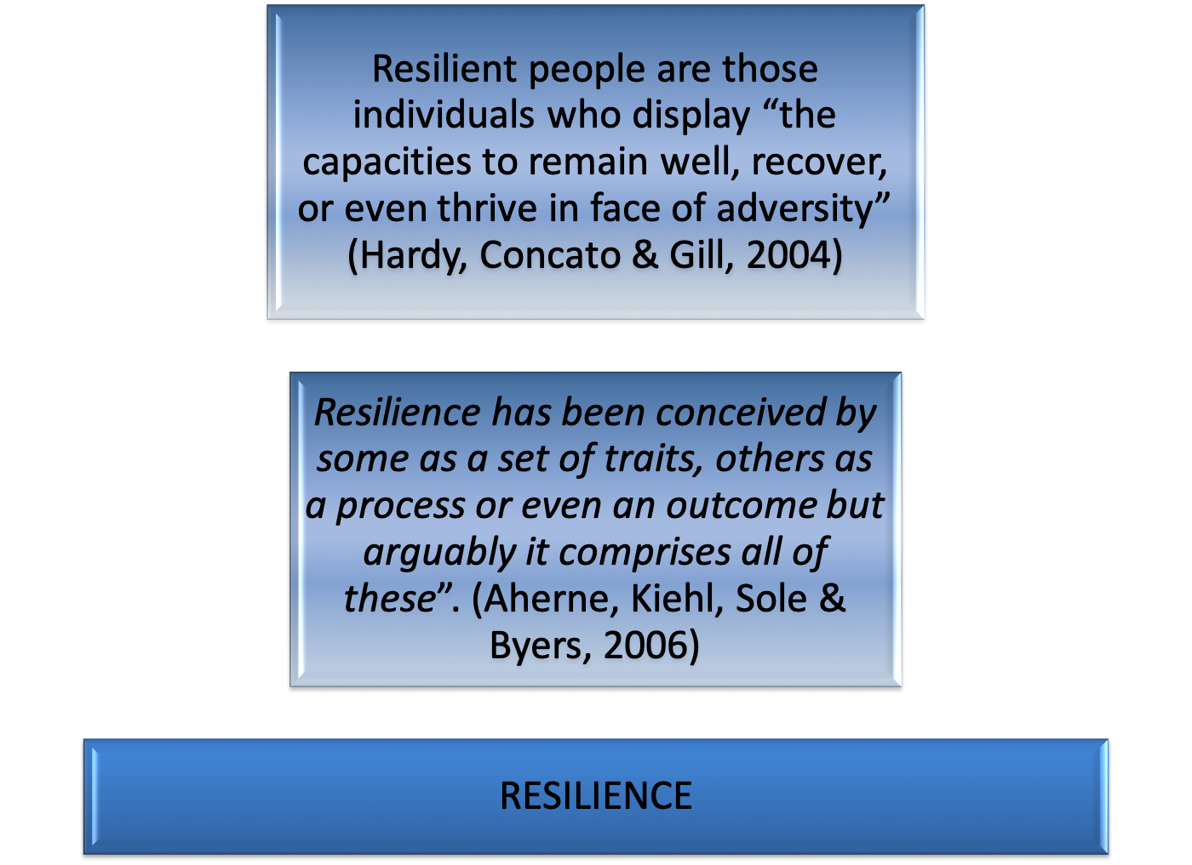

Slide 3
Historical overview
Atypical schizophrenics (Garmezy, 1970)
Children of mothers with schizophrenia (Garmezy, 1974; Masten et al., 1990)
Garmezy’s research program - Project of Competence
The children of mothers with schizophrenia will be normal if their one parent is fine
Emmy Werner’s studies with Children in Hawaii (Werner et al., 1971; Werner & Smith, 1977)

Slide 4
Research identified three clusters of protective factors
protective factors within the individual
protective factors in the family
protective factors in the community
recent research focus - move to understanding underlying protective processes(Luthar,1999)

Slide 5
Resilience
Two judgments are required for a resilient pattern of adaptation:
a. By some criteria, there has been a significant threat to the development of the individual;
b. Despite this threat or risk exposure, the current or eventual adaptation of the individual is satisfactory according to some selected criteria.
These criteria have been utilized to judge positive adaptation:
Absence of pathology
Successes in age-salient developmental tasks,
Subjective well-being
Wright & Masten, 2005

Slide 6
Models of resilience
The earlier models looked at resilience as a personality trait or a stable characteristic. Resilience was identified with having adequate cognitive functioning, problem solving skills and strategies (Werner, 1995).
A popular model looks at resilience as an end result of positive adaptation in situations of exposure to adversity. The model is about resistance and recovery patterns. It is the individual’s ability to put up with challenges and still achieve unexpected positive outcomes called as ‘ordinary magic’( Masten ,2001).
Hunter(1999) emphasizes resilience as a continuum with two poles: less optimum resilience and optimum resilience.

Slide 7
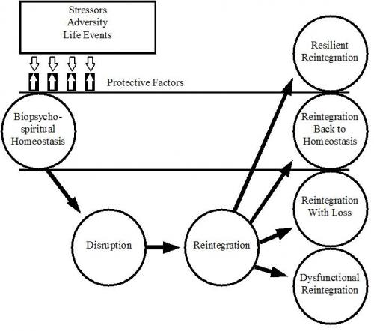
Richardson’s (2002) model suggest resilient reintegration as the off shoot of or an outcome to adversity

Slide 8
Ecological model emphasize resilience as a function of many factors. This model comes up with bidirectional influences from inner self; extending to family and community which influence the person’s behaviour (Harvey et al; 2007)

Slide 9
Adaptive capacities of the child
Social/adaptable temperament
cognitive abilities
Effective emotional and behavioral regulation strategies
Positive view of self
Positive outlook
Faith/sense of meaning in life
Characteristics valued by society and self (talents, humor, appearance) Werner, (1995) ; Masten, (2001)

Slide 10
Availability of resources
Prevalence of resilience was predicted by less income loss, social support, and fewer chronic diseases (Bonanno et al ,2007).
Availability of support systems ensures smooth adaptation (Fox, Cowell &Montgomery, 1994).
Early intervention and psychosocial assistance are crucial protective factors( Punamaki,2001)

Slide 11
Resilience Model
Socio Economic Status
Diagnosis of ID
Cognitive Adaptation
Affect
Coping
Self-Efficacy
RESILIENCE
Awareness
Perception
Child characteristics
Social Support
Contextual Factors
5.10.16
Radhika Mohan Thesis

Slide 12
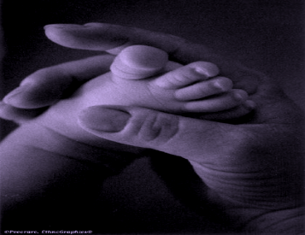
Family factors
Supportive caring parents ,supportive relationship with an adult -Schroon et al,2010)
Mental health of parents (Sack,1994; Papageorgiou (2000)
Family harmony; Secure and stable family
(Macksoud & Aber (1996)
Maternal depression -mother’s emotional well being predicts emotional wellbeing and adaptation in children.
(Cummings & Davies, 1994)

Slide 13
Cultural factors that contributing to resilience are spirituality, traditional activities, traditional languages, and traditional healing ( Fleming and Ledogar; 2008)

Slide 14
ACTION PLAN TO BUILD IN RESILIENCE
Masten & Obradovic´,2008 suggests following ways to build in resilience after trauma .
Focus on positive processes, strengths, recovery and resilience.
Protect and restore the secure base of attachment relationships.
Train first responders about the responses
Support normalizing routines and activities for children.
Support community and cultural practices that support families.
Reduce ongoing exposure to trauma and traumatic reminders
Include experts on human development in disaster response and preparation planning.

Slide 15
Thank You

