Slide 1
IIT Bombay
Page 1
Course Code : EE 611
Department: Electrical Engineering
Instructor Name: Jayanta Mukherjee
Email: jayanta@ee.iitb.ac.in
EE 611 Lecture 1 Jayanta Mukherjee

Slide 2
IIT Bombay
Page 2
Overview of the course
In EE 611 we will study basic passive devices used in
microwave systems
Passive devices are those which do not produce any power
themselves i.e. there is never any gain involved
These include impedance matching networks, couplers, filters,
attenuators, phase shifters etc
Electromagnetic theory combined with Network Theory
Basic parameters used in designs of microwave systems
e.g., S parameters, impedance issues etc.
EE 611 Lecture 1
EE 611 Jayanta Mukherjee Lecture 1
EE 611 Lecture 1 Jayanta Mukherjee

Slide 3
IIT Bombay
Page 3
Pre-Requisites for the course
A Basic circuit course
An introduction to Network theory
Some familiarity with SciLab/MATLAB
EE 611 Lecture 1
EE 611 Jayanta Mukherjee Lecture 1
EE 611 Lecture 1 Jayanta Mukherjee

Slide 4
IIT Bombay
Page 4
References
1. Robert E Collin, Foundation for Microwave Engineering, 2nd Edition, 1992, McGraw-Hill.
2. Davis W Alan, Microwave Semiconductor Circuit Design, Van Nostrand Reinhold, 1984.
3. Peter A. Rizzi, Microwave Engineering, Prentice Hall, New Jersey, 1988.
Other references are handouts to be given as well as reference to journal papers
EE 611 Lecture 1
EE 611 Jayanta Mukherjee Lecture 1
EE 611 Lecture 1 Jayanta Mukherjee

Slide 5
IIT Bombay
Page 5
Microwave Frequencies
Microwave Frequencies typically range from 0.3 to 30 GHz
Frequencies f (GHz) | 0.3 | 3 | 30 | 300
Wavelength λ (free space) | 1 m | 10 cm | 1 cm | 1 mm
EE 611 Lecture 1
EE 611 Jayanta Mukherjee Lecture 1
EE 611 Lecture 1 Jayanta Mukherjee

Slide 6
IIT Bombay
Page 6
Examples of Important Frequency Bands
Radio (AM, Shortwave FM) | 535kHz - 108MHz
TV (VHF-UHF) | 54 - 890 MHz
GPS | 1.5 GHz
AMPS (cellular phone) | 824-894 MHz
PCS (cellular phone) | 1.9 GHz
Microwave Oven | 2.45 GHz
Bluetooth (ISM Band) | 2.4-2.5 GHz
Collision Avoidance | 76-77 GHz
UWB | 3.1 – 10.6 GHz
EE 611 Lecture 1
EE 611 Lecture 1 Jayanta Mukherjee

Slide 7
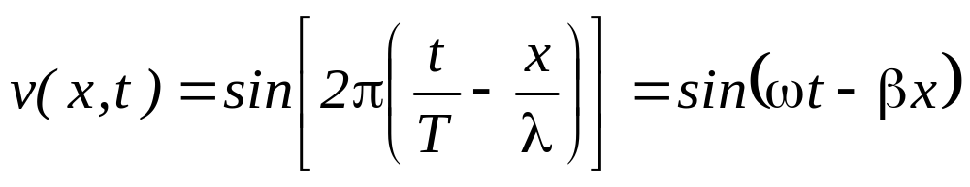
IIT Bombay
Page 7
Waves
Examples of Waves : Sound Waves, Light , Water Waves
It is a Phenomenon
with T the temporal period, λ the spatial period, ω = 2πf the radial
frequency and β=2πλ the wave vector Here v(x,t) could represent
the instantaneous voltage measured across a two wire line
EE 611 Lecture 1
EE 611 Lecture 1 Jayanta Mukherjee

Slide 8
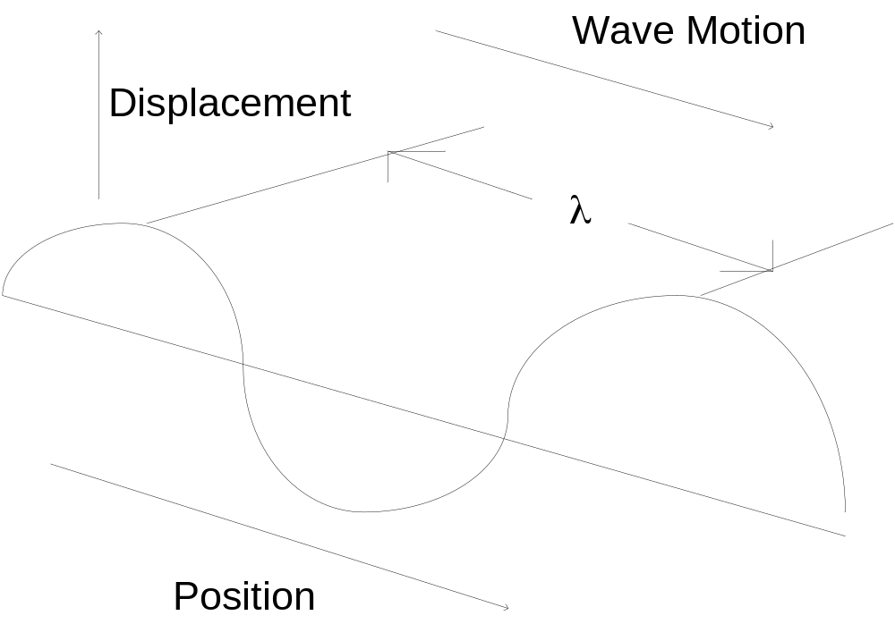
IIT Bombay
Page 8
Waves
EE 611 Lecture 1
EE 611 Lecture 1 Jayanta Mukherjee

Slide 9
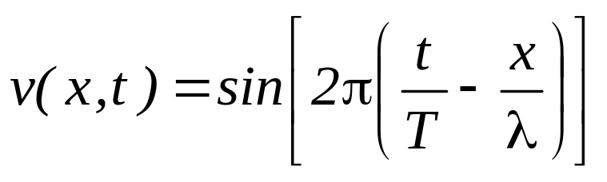
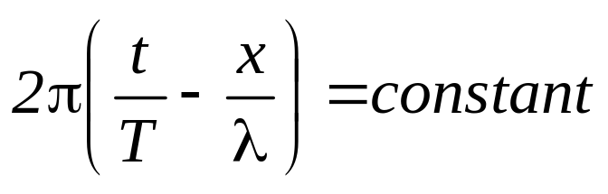
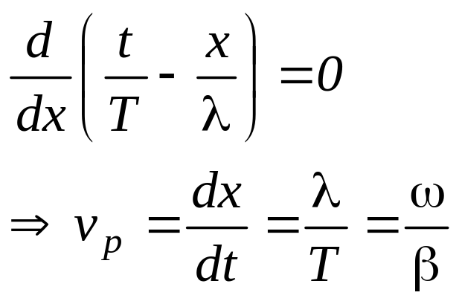
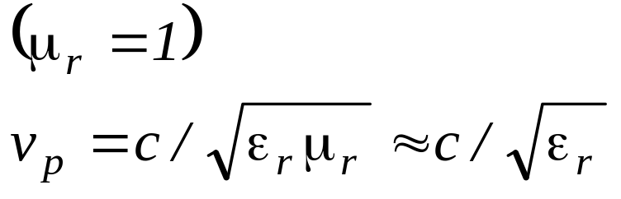
IIT Bombay
Page 9
Phase Velocity
Consider a wave of the form
Wave velocity is obtained by keeping the phase constant
Phase velocity is the speed of
light in the medium considered
or
EE 611 Lecture 1
EE 611 Lecture 1 Jayanta Mukherjee

Slide 10
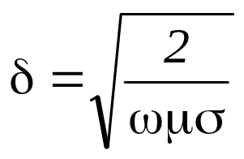
IIT Bombay
Page 10
Wave Effects
Skin Effect – The current is restricted to skin depth
The effect increases with frequency
EE 611 Lecture 1
EE 611 Lecture 1 Jayanta Mukherjee

Slide 11
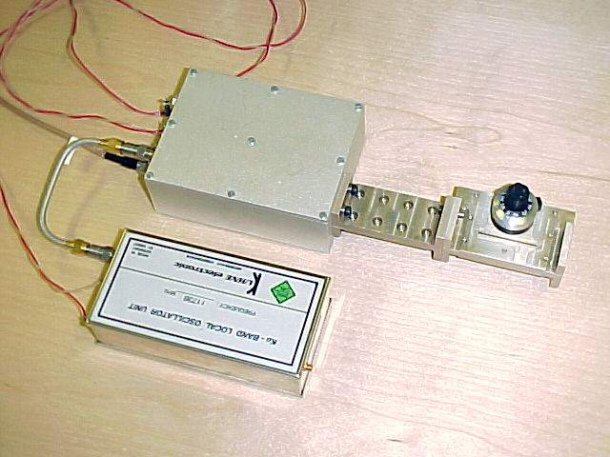
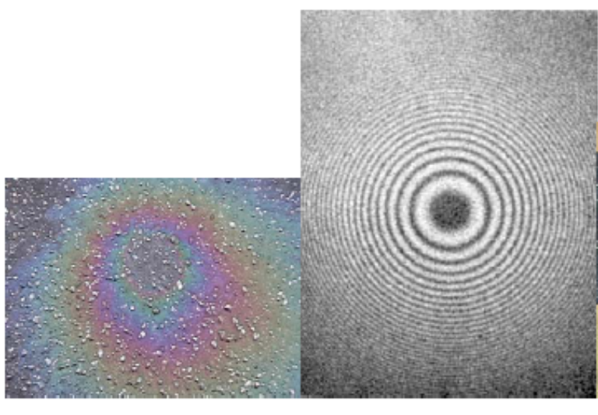
IIT Bombay
Page 11
Wave Effects
EE 611 Lecture 1
EE 611 Lecture 1 Jayanta Mukherjee

Slide 12
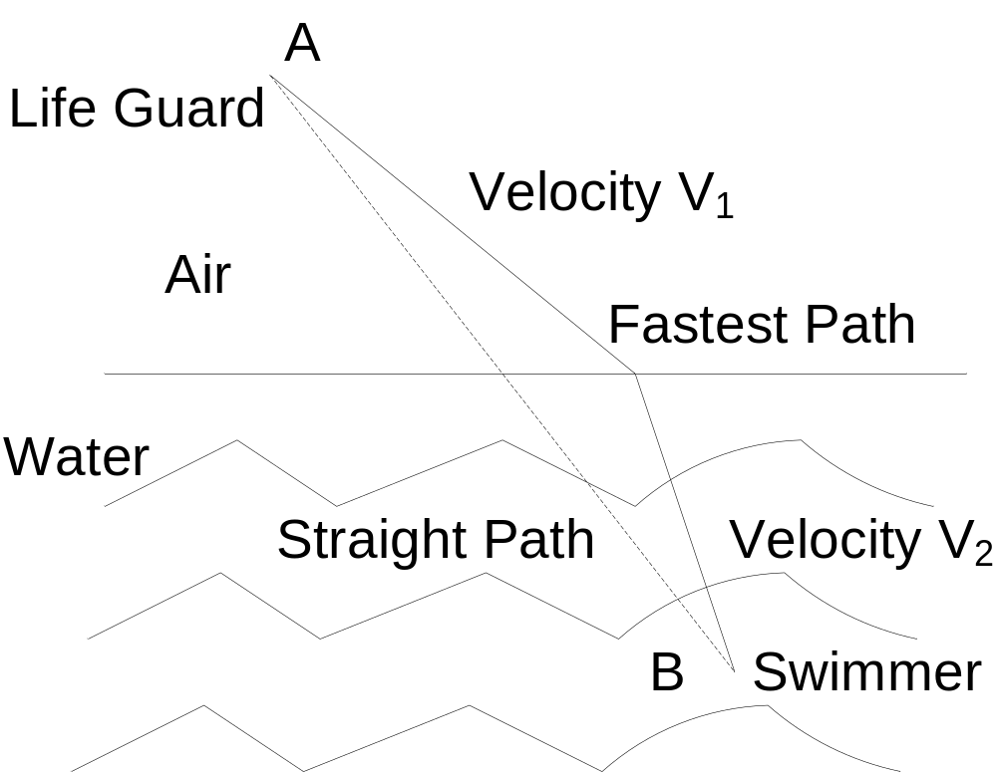
IIT Bombay
Page 12
Wave Effects
The propagation of waves from a point A to a point B follows the fastest path in time not the shortest path in length
EE 611 Lecture 1
EE 611 Lecture 1 Jayanta Mukherjee

Slide 13
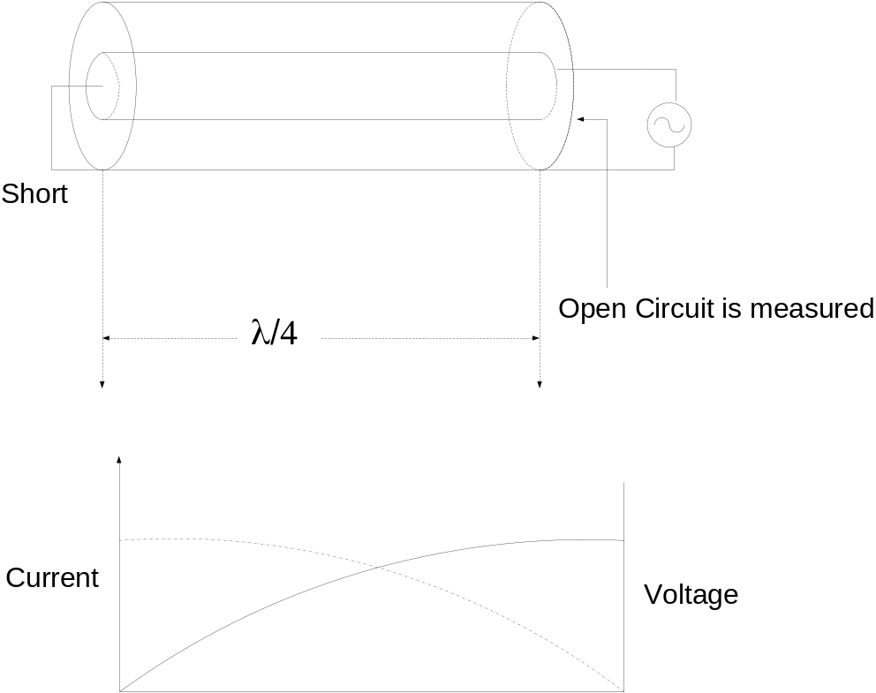
IIT Bombay
Page 13
Wave Effects
At high frequencies the wavelength of the electrical electromagnetic signal is comparable to the circuits dimension and the wave nature of the propagation of electromagnetic signal along wires needs to be accounted for
Coaxial Line
EE 611 Lecture 1
EE 611 Lecture 1 Jayanta Mukherjee

Slide 14
IIT Bombay
Page 14
Distributed Circuits Basics
Traditional lumped element circuit theory is very useful as long
as the size of the circuit remains very small compared to the
wavelength of signals in the circuit
The above statement also implies that propagation time delays
around the circuit are negligible
For a fixed circuit size if we keep increasing the frequency
eventually we reach a point where traditional circuit theory
does not apply
Since circuit theory is an approximation to Maxwell's equations
one way to solve this problem is to use Maxwell's equations to
analyze a circuit
However a useful intermediate method is to consider circuits
as distributed circuits which are described through
transmission line theory
EE 611 Lecture 1
EE 611 Lecture 1 Jayanta Mukherjee

Slide 15
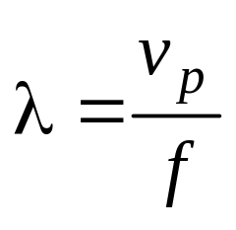
IIT Bombay
Page 15
Frequency Consideration
Since the wavelength at a specific frequency f is where
v_{p} is the velocity of light in the medium considered (3 x 10 ⁸ m/s in
free space ) we can see that
Frequency (GHz) Free Space λ (m)
0.3 1
3 0.1
30 0.01
300 0.001
EE 611 Lecture 1
EE 611 Lecture 1 Jayanta Mukherjee

Slide 16
IIT Bombay
Page 16
Frequency Consideration
The frequency range of approximately 0.3 to 30 GHz is
considered the microwave band while 30-300 GHz is
usually considered the millimeter wave band
We can see that circuits operating at microwave
frequencies which have dimensions of centimeters or
more will need distributed models
Current computers avoid this by shrinking the size; not
possible for circuits handling moderate to large powers
EE 611 Lecture 1
EE 611 Lecture 1 Jayanta Mukherjee

Slide 17
IIT Bombay
Page 17
Advantage – “Distributed Circuit Component”
Distributed circuit theory will allow us to replace inductors
and capacitors with open or short circuit lines
In many cases we can design networks according to
standard circuit theory using these generalized inductors and
capacitors
EE 611 Lecture 1
EE 611 Lecture 1 Jayanta Mukherjee

Slide 18
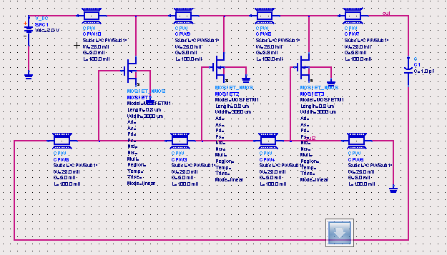
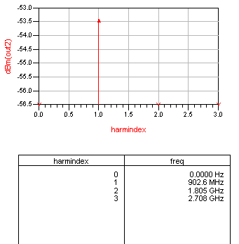
IIT Bombay
Page 18
Example – “Distributed Circuit Component”
EE 611 Lecture 1
EE 611 Lecture 1 Jayanta Mukherjee

Slide 19
IIT Bombay
Page 19
Microwave – Short History
Basic understanding of distributed electromagnetic behavior
began in with Maxwell's equations
Oliver Heaviside put these equations in a more useable form and
recognized that distributed circuit models could be useful in 1887
Real interest in microwave systems began during WWII when
radar technology (using waveguides or coax mainly) was
intensely developed
Current technologies often involve planar integrated systems
(“microwave integrated circuits”) and even direct fabrication of
active and passive devices together (“monolithic microwave
integrated circuits”)
Microwave circuits including active devices are covered in EE
614 (Winter 2010)
EE 611 Lecture 1
EE 611 Lecture 1 Jayanta Mukherjee

Slide 20
IIT Bombay
Page 20
Wireless - Milestones
1837 – Maxwell’s equations developed
1858 - First official message by submarine cable send by Queen
Victoria in London to President James Buchanan in Washington
United States by submarine cables
(See http://collections.ic.gc.ca/cable/fmessages.htm)
Oliver Heaviside casted Maxwell equations in its modern form
of 4 equations instead of 20 and established conditions for
distortion less propagation in transmission lines. For further
info see http://www-history.mcs.st-and.ac.uk/history/Mathematicians/Heaviside.html
1888 – Heinrich Hertz experimentally shows the existence of
electromagnetic waves in free space
1893 – Nicola Tesla demonstrates radio communication
1898 – Jagadish Chandra Bose demonstrates millimeter waves,
first semiconductor based detectors, horn antennas
EE 611 Lecture 1
EE 611 Lecture 1 Jayanta Mukherjee

Slide 21
IIT Bombay
Page 21
Wireless - Milestones
1912 - The Titanic liner sinks the importance of wireless is
demonstrated when other liners informed by wireless come to
her rescue
1936 - First waveguide demonstrated at ATT by G Southworth
and MIT by W L Barron
1940 - Radar developed during World War II
1980 - Cellular phone developed at Bell Lab
1990 to present - Rapid growth of the wireless industry pagers
cellular phones AMPS GSM WCDMA WLAN PAN Bluetooth
UWB RFID
EE 611 Lecture 1
EE 611 Lecture 1 Jayanta Mukherjee

Slide 22
IIT Bombay
Page 22
Wireless
Wireless obviously refers to the propagation of
electromagnetic waves without wires
In microwave engineering we focus on the propagation and
processing of microwave signals guided by wires and other
conductive structures
The paradox is that wireless systems do require wired
microwave systems for the generation and reception of
wireless signals
EE 611 Lecture 1
EE 611 Lecture 1 Jayanta Mukherjee

Slide 23
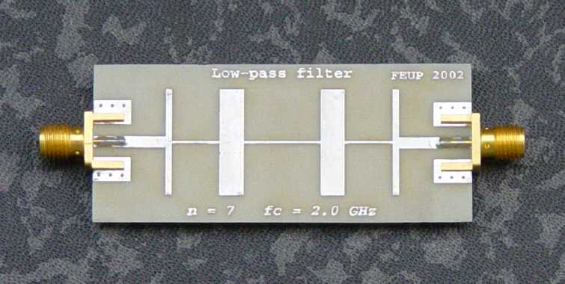
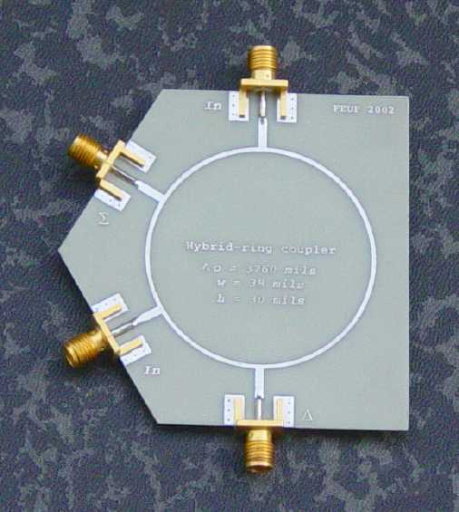
IIT Bombay
Page 23
Passive microstrip circuits
Filter
Coupler
EE 611 Lecture 1
EE 611 Lecture 1 Jayanta Mukherjee

Slide 24
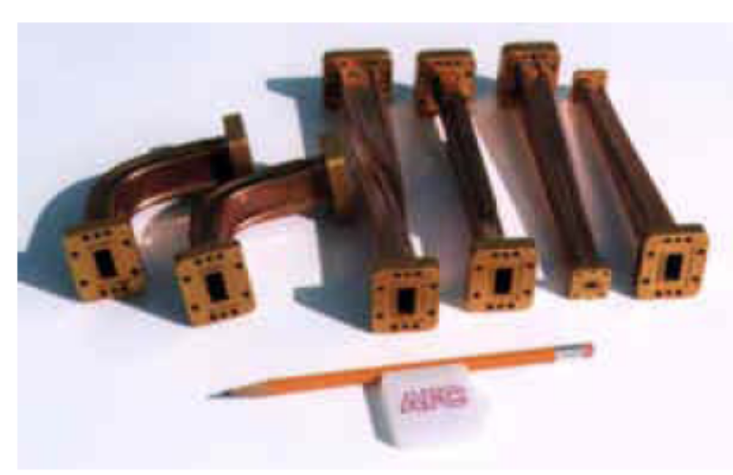
IIT Bombay
Page 24
Wave Guides
EE 611 Lecture 1
EE 611 Lecture 1 Jayanta Mukherjee

