Slide 1
IIT Bombay
Page 1
Course Code : EE 611
Department: Electrical Engineering
Instructor Name: Jayanta Mukherjee
Email: jayanta@ee.iitb.ac.in
Lecture 2
EE 611 Lecture 2 Jayanta Mukherjee

Slide 2
IIT Bombay
Page 2
Overview of the course (Recap)
In this course we will study the basic passive devices used
in microwave systems
Passive devices are those which do not produce any power
themselves i.e. there is never any gain involved
These include impedance matching networks, couplers, filters,
attenuators, phase shifters etc
Electromagnetic theory combined with Network Theory
Basic parameters used in designs of microwave systems
e.g., S parameters, impedance issues etc.
EE 611 Lecture 1
EE 611 Jayanta Mukherjee Lecture 1
EE 611 Lecture 2 Jayanta Mukherjee

Slide 3
IIT Bombay
Page 3
Distributed circuit theory
At low frequencies circuits are designed using circuit theory.
Circuit theory relies on basic lumped elements derived from
Maxwell’s equations such as:
inductors
capacitors
resistors
EE 611 Lecture 1
EE 611 Jayanta Mukherjee Lecture 1
EE 611 Lecture 2 Jayanta Mukherjee

Slide 4
IIT Bombay
Page 4
Distributed circuit theory
Similarly at microwave frequencies we will design microwave
Circuits using distributed circuit theory. Distributed circuit
theory relies on basic elements also derived from Maxwell’s
Equations, such as:
transmission lines
shorted stubs (generalized inductors)
open stubs (generalized capacitors)
coupled lines
Tapered lines
Besides using lumped elements of regular circuit theory
EE 611 Lecture 1
EE 611 Jayanta Mukherjee Lecture 1
EE 611 Lecture 2 Jayanta Mukherjee

Slide 5
IIT Bombay
Page 5
Attributes of Distributed circuit theory
Unlike Maxwell’s equation based analysis and like traditional
circuit theory, it is simpler to use
The traditional circuit theory is a subset of distributed circuit
theory
New design techniques and synthesis theorems exist in
distributed circuit theory without equivalent in traditional
circuit theory
EE 611 Lecture 1
EE 611 Jayanta Mukherjee Lecture 1
EE 611 Lecture 2 Jayanta Mukherjee

Slide 6
IIT Bombay
Page 6
Guided Wave System
Guided waves as opposed to waves in free space can flow through
the following types of systems
Transmission line system featuring 2 or more conductors
guiding the waves eg, co-axial cable, telegraph lines,
parallel plate
Closed metallic waveguides consisting of hollow conductive
pipes guiding the waves along the z axis, eg rectangular
waveguide
Dielectric waveguides typically consisting of a material with
a high dielectric constant (slab of rod) sandwiched by materials
with low dielectric constants eq microstrip, stripline
EE 611 Lecture 1
EE 611 Jayanta Mukherjee Lecture 1
EE 611 Lecture 2 Jayanta Mukherjee

Slide 7
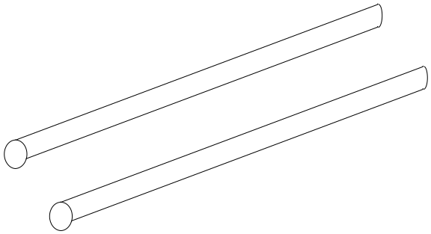
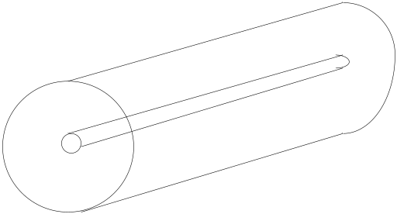
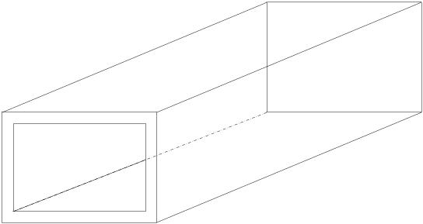
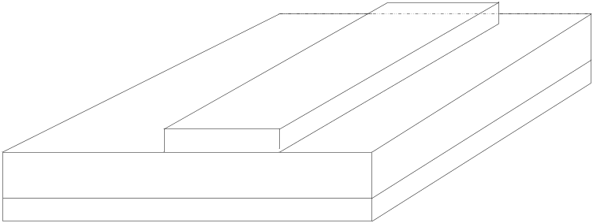
IIT Bombay
Page 7
Guided Wave System
Coaxial Cable
Two wire
Rectangular Waveguide
Microstrip
EE 611 Lecture 1
EE 611 Jayanta Mukherjee Lecture 1
EE 611 Lecture 2 Jayanta Mukherjee

Slide 8
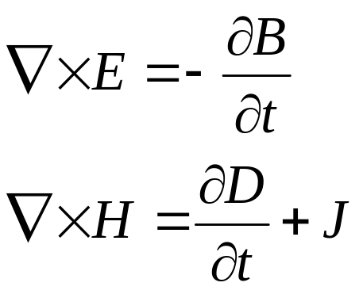
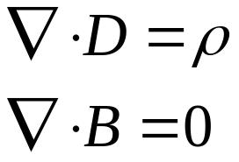
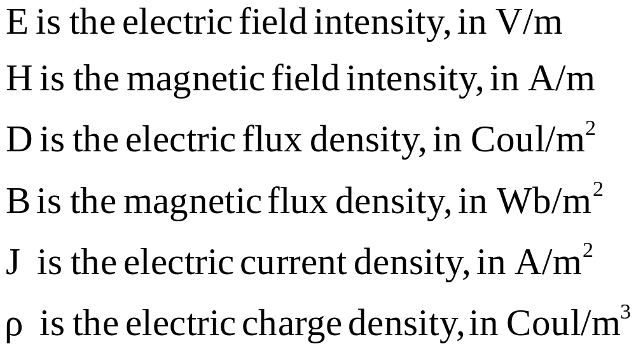
IIT Bombay
Page 8
Electromagnetic Waves
Maxwell’s Equations
EE 611 Lecture 1
EE 611 Jayanta Mukherjee Lecture 1
EE 611 Lecture 2 Jayanta Mukherjee

Slide 9
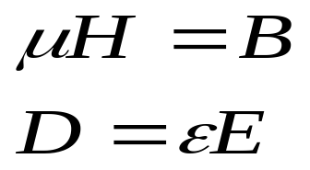
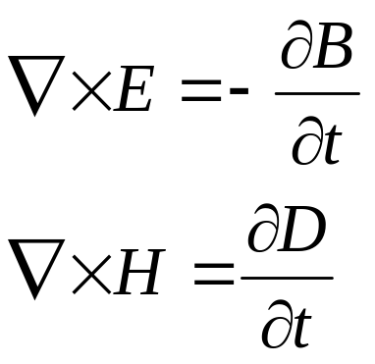
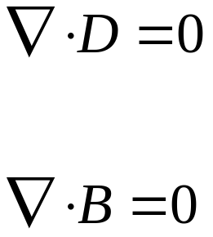
IIT Bombay
Page 9
Electromagnetic Waves
Assuming μ and ε are scalars then Maxwell’s equations in free
space becomes (ρ=J=0)
EE 611 Lecture 1
EE 611 Jayanta Mukherjee Lecture 1
EE 611 Lecture 2 Jayanta Mukherjee

Slide 10
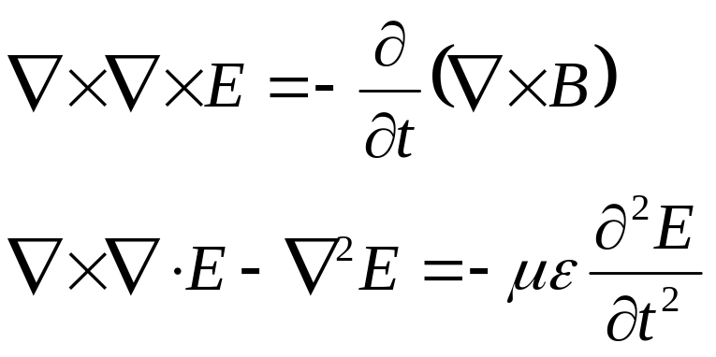
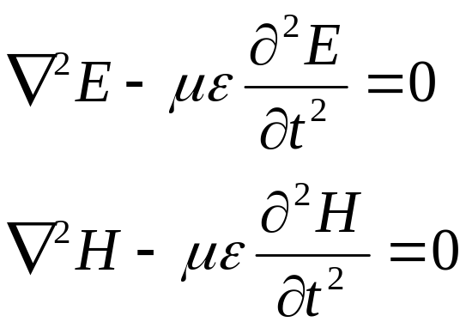
IIT Bombay
Page 10
Derivation of wave equation in free
space
Wave equation in free space
EE 611 Lecture 1
EE 611 Jayanta Mukherjee Lecture 1
EE 611 Lecture 2 Jayanta Mukherjee

Slide 11
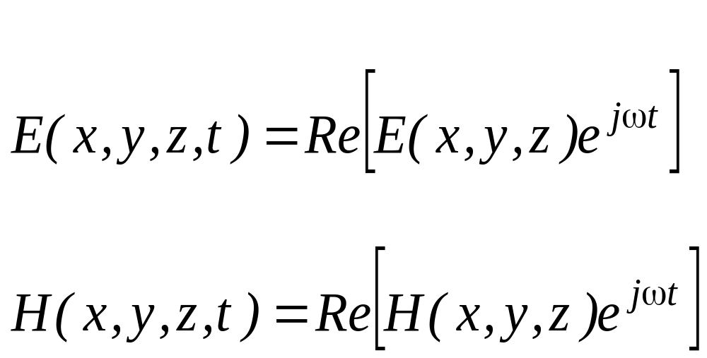
IIT Bombay
Page 11
Sinusoidal Time Dependence
So far time dependence has not been specified
E is a function of space and time {E(x,y,z,t)}
We will assume cosine time dependence
Solution only for spatial components
EE 611 Lecture 1
EE 611 Jayanta Mukherjee Lecture 1
EE 611 Lecture 2 Jayanta Mukherjee

Slide 12
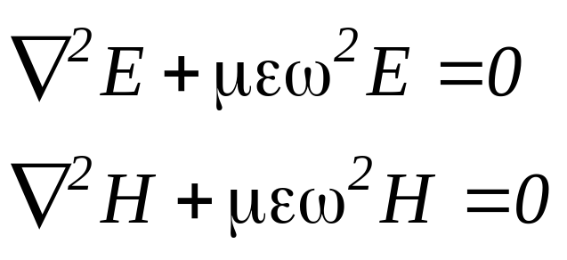
IIT Bombay
Page 12
Sinusoidal Time Dependence
The wave equations are then modified to
Helmhotz equations
EE 611 Lecture 1
EE 611 Jayanta Mukherjee Lecture 1
EE 611 Lecture 2 Jayanta Mukherjee

Slide 13
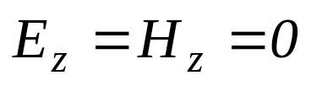
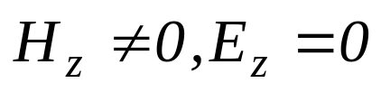
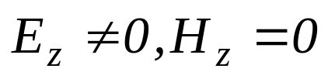
IIT Bombay
Page 13
Modes in Waveguide Systems
Various modes of electromagnetic waves can propagate in
Transmission lines and waveguide systems
TEM waves (Transverse Electromagnetic) :
TE waves (Transverse Electric) or H waves:
TM waves (Transverse Magnetic) or E waves:
EE 611 Lecture 1
EE 611 Jayanta Mukherjee Lecture 1
EE 611 Lecture 2 Jayanta Mukherjee

Slide 14
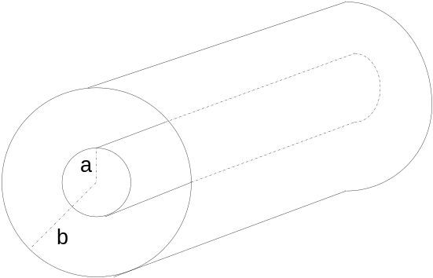
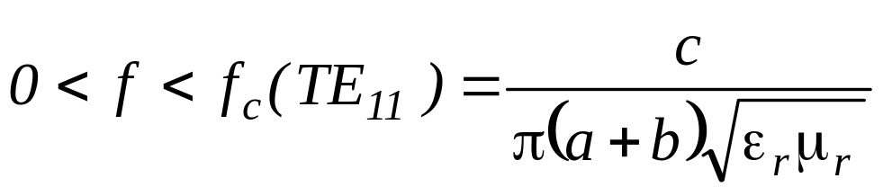
IIT Bombay
Page 14
TEM Waves (Refer Pozar Ch 3)
TEM waves require at least two conductors
Other propagation modes TE and TM are possible in systems
supporting TEM mode but are usually not desired
Example of the coaxial line
The TEM mode will be the only mode propagating in the
frequency range
Where f_{c}(TE₁₁) is the cutoff frequency at which the TE₁₁ mode
(transverse electric mode) starts to propagate in the coaxial cable
EE 611 Lecture 1
EE 611 Jayanta Mukherjee Lecture 1
EE 611 Lecture 2 Jayanta Mukherjee

Slide 15
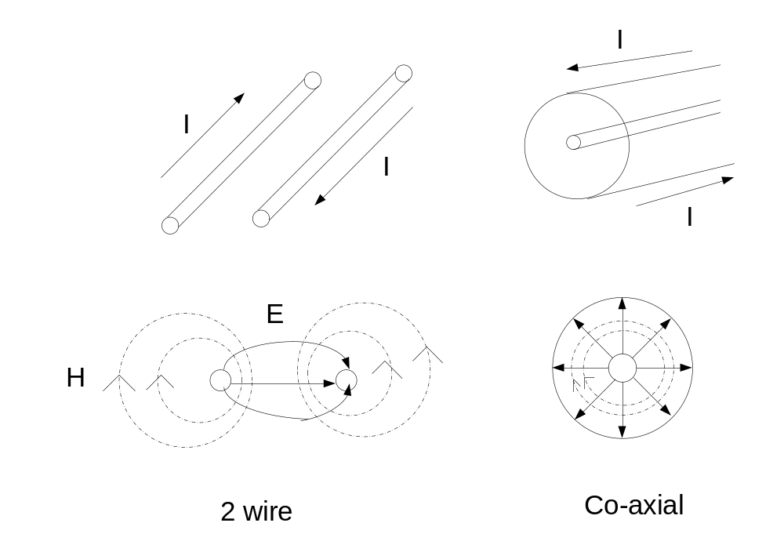
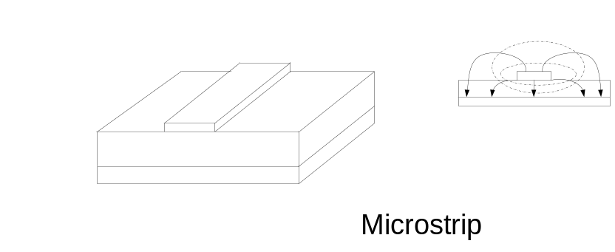
IIT Bombay
Page 15
2 conductor waveguiding systems
supporting the TEM mode
EE 611 Lecture 1
EE 611 Jayanta Mukherjee Lecture 1
EE 611 Lecture 2 Jayanta Mukherjee

Slide 16
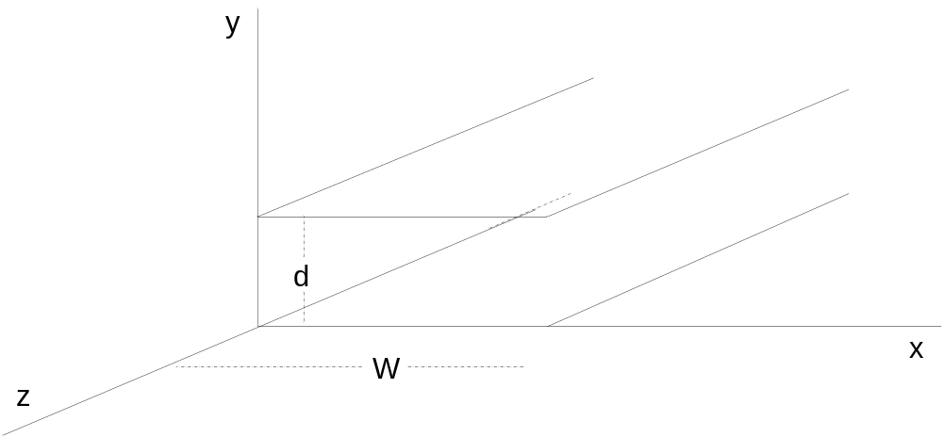
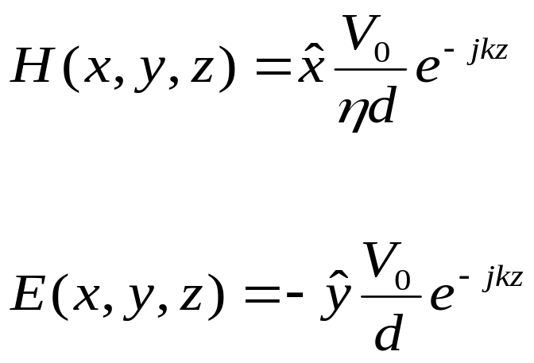
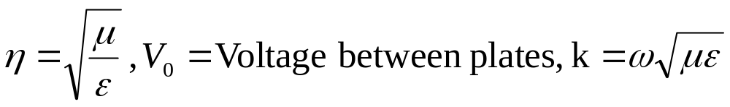
IIT Bombay
Page 16
An example – Parallel Plate Waveguide
TEM wave solution
EE 611 Lecture 1
EE 611 Jayanta Mukherjee Lecture 1
EE 611 Lecture 2 Jayanta Mukherjee

Slide 17
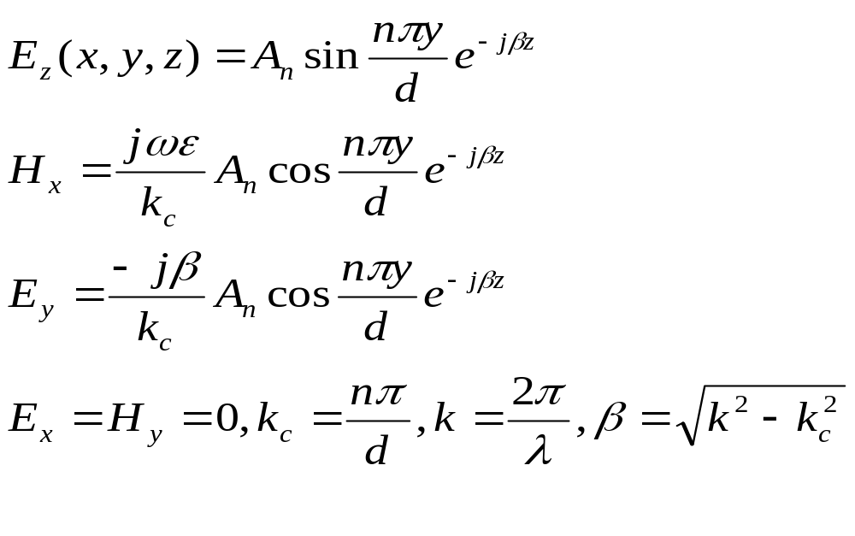
IIT Bombay
Page 17
An example – Parallel Plate Waveguide
TM mode
Various “modes” are present
A cutoff frequency f_{c} such that for f<f_{c} , k<k_{c,}and β is imaginary
Treatment for TE mode is similar
EE 611 Lecture 1
EE 611 Jayanta Mukherjee Lecture 1
EE 611 Lecture 2 Jayanta Mukherjee

Slide 18
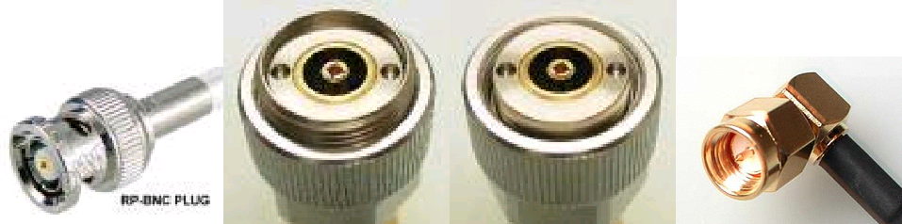
IIT Bombay
Page 18
TEM Mode in a Coaxial System
BNC
APC 7mm
APC 7mm
SMA
BNC | f < 1 or 4 GHz
APC 7mm (sex less) | f < 18 GHz
APC 3.5 mm | f < 34 GHz
SMA | f < 24 GHz
SSMA | f < 38 GHz
EE 611 Lecture 1
EE 611 Jayanta Mukherjee Lecture 1
EE 611 Lecture 2 Jayanta Mukherjee

Slide 19
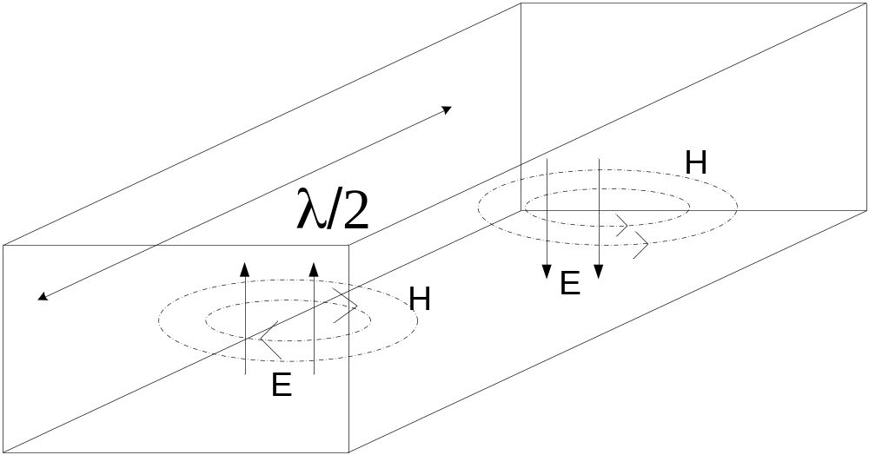
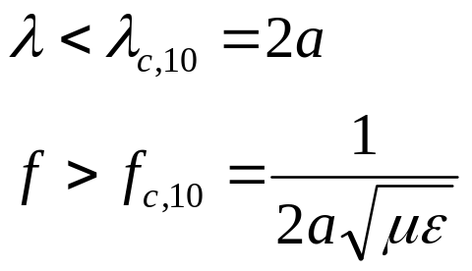
IIT Bombay
Page 19
Modes in hollow waveguides
No TEM mode can propagate in waveguides (only one conductor)
Condiser the rectangular waveguide. The dominant mode is
(lowest cutoff)TE₁₀ . The mode only propagates for frequencies
Verifying:
EE 611 Lecture 1
EE 611 Jayanta Mukherjee Lecture 1
EE 611 Lecture 2 Jayanta Mukherjee

Slide 20
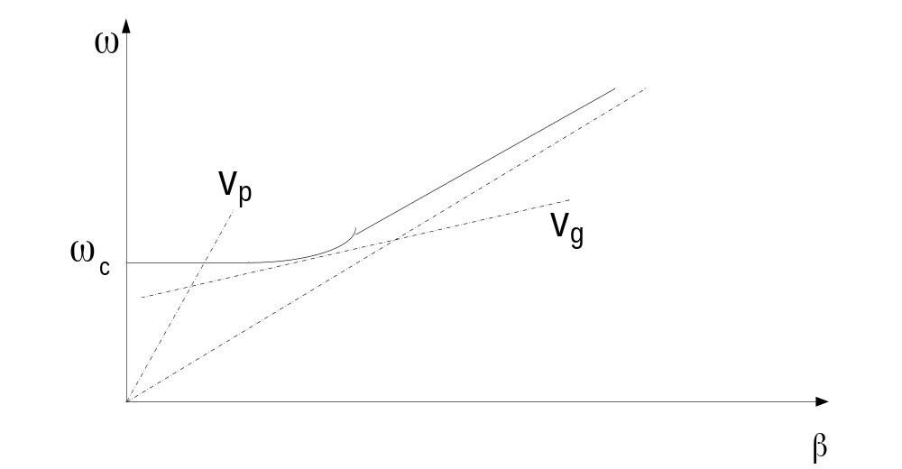
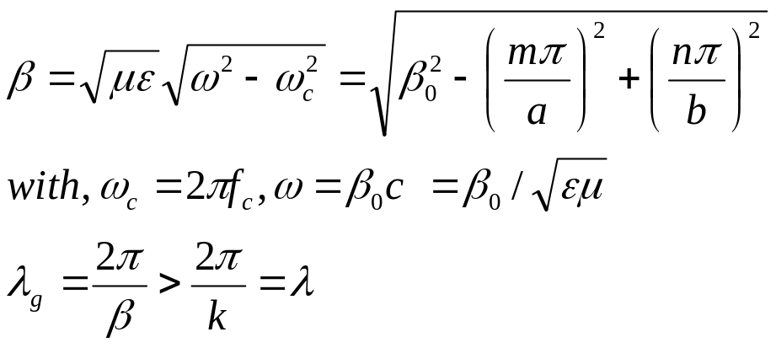
IIT Bombay
Page 20
Rectangular Waveguide Fundamental
Mode
The propagation constant β for TE₁₀ is given in terms of the
frequency ω by
Dispersion curves for a waveguide (full line) and a TEM mode
(dashed line)
EE 611 Lecture 1
EE 611 Jayanta Mukherjee Lecture 1
EE 611 Lecture 2 Jayanta Mukherjee

Slide 21
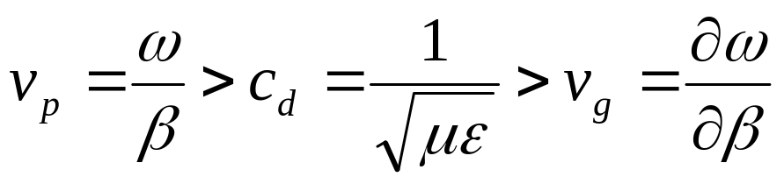
IIT Bombay
Page 21
Phase and Group Velocity
The phase velocity (cordal slope) and the group velocity (differential
Slope) are respectively larger and smaller than the speed of light
In the dielectric material considered:
Faster than light ?
No information is carried by the wave with the phase velocity v_{p}
EE 611 Lecture 1
EE 611 Jayanta Mukherjee Lecture 1
EE 611 Lecture 2 Jayanta Mukherjee

Slide 22
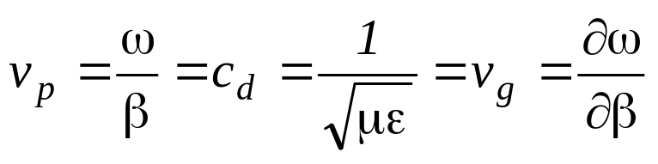
IIT Bombay
Page 22
Group Velocity and EM modes
Group velocity v_{g} gives the velocity of the information
transmission
The group velocity can be frequency dependent (e.g.
waveguide) As a result signals at different frequencies will be
transmitted at different speeds leading to the distortion of the
wave packets transmitted Such a communication medium
is said to be dispersive
On the contrary TEM modes are not dispersive as they verify
EE 611 Lecture 1
EE 611 Jayanta Mukherjee Lecture 1
EE 611 Lecture 2 Jayanta Mukherjee

Slide 23
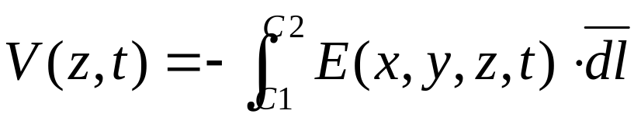
IIT Bombay
Page 23
Distributed Circuit Theory
The development of a distributed circuit theory is based on the
Introduction of a local voltage V(z,t) and local current I(z,t) from the
Electric field E(x,y,z,t) and magnetic fields H(x,y,z,t)
In a transmission line system a voltage between the conductors
C1 and C2 can be obtained from the following path integration
EE 611 Lecture 1
EE 611 Jayanta Mukherjee Lecture 1
EE 611 Lecture 2 Jayanta Mukherjee

Slide 24
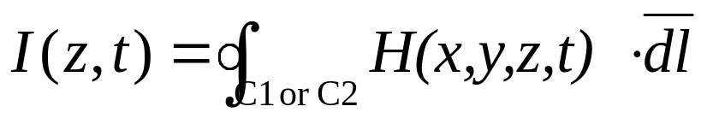
IIT Bombay
Page 24
Distributed Circuit Theory
Similarly the current flowing in conductor C1 or C2 is obtained from
The closed path integration:
For TEM modes these integrations are path independent and
The voltage and current so defined assume a unique value
For TE and TM modes the integrations are path dependent and
Hence the voltages , currents and impedance are not uniquely
define.
EE 611 Lecture 1
EE 611 Jayanta Mukherjee Lecture 1
EE 611 Lecture 2 Jayanta Mukherjee

Slide 25
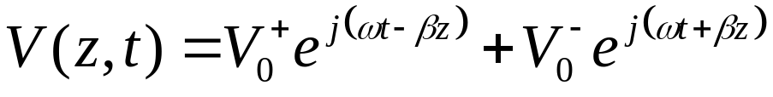
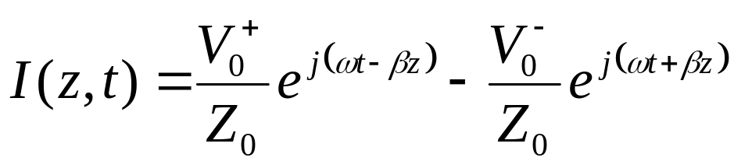
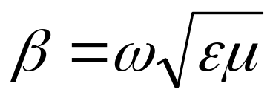
IIT Bombay
Page 25
Wave Equations for Transmission Lines
Using Maxwell Equations
The solution of the wave equation derived from Maxwell’s Equation
leads to a voltage wave of the form:
And a current wave of the form:
Where is the propagation constant
And where Z₀ is the characteristic impedance
EE 611 Lecture 1
EE 611 Jayanta Mukherjee Lecture 1
EE 611 Lecture 2 Jayanta Mukherjee

Slide 26
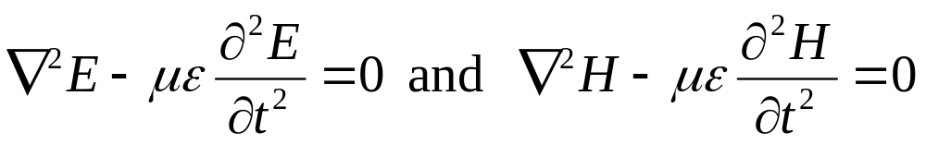
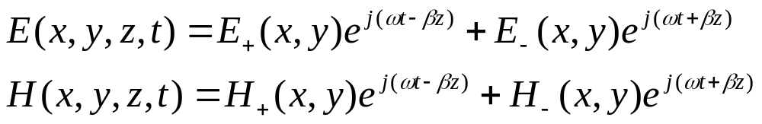
IIT Bombay
Page 26
Proof
Wave equation in free space
TEM waves are of the following form ( )
EE 611 Lecture 1
EE 611 Jayanta Mukherjee Lecture 1
EE 611 Lecture 2 Jayanta Mukherjee

Slide 27
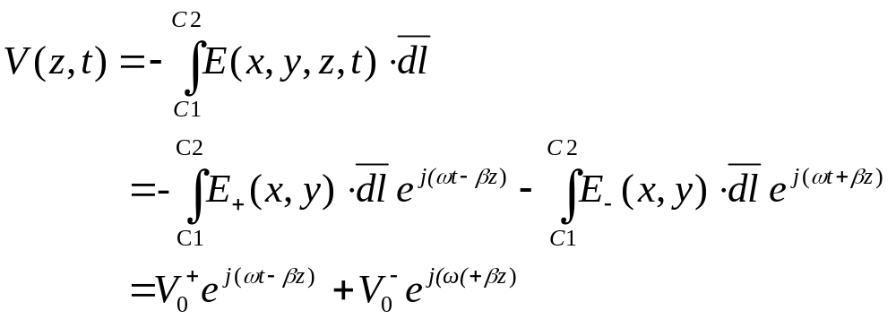
IIT Bombay
Page 27
Proof
Voltage wave between conductors C1 and C2
EE 611 Lecture 1
EE 611 Jayanta Mukherjee Lecture 1
EE 611 Lecture 2 Jayanta Mukherjee

Slide 28
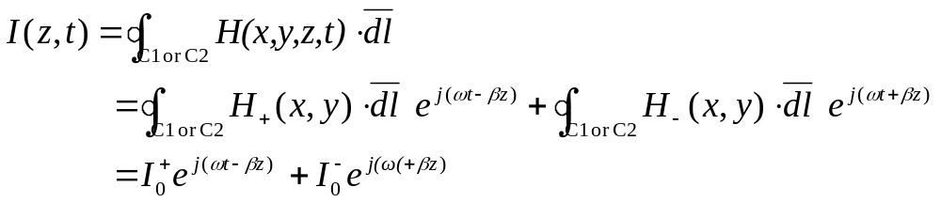
IIT Bombay
Page 28
Proof
Current wave in conductors C1 or C2
EE 611 Lecture 1
EE 611 Jayanta Mukherjee Lecture 1
EE 611 Lecture 2 Jayanta Mukherjee

Slide 29
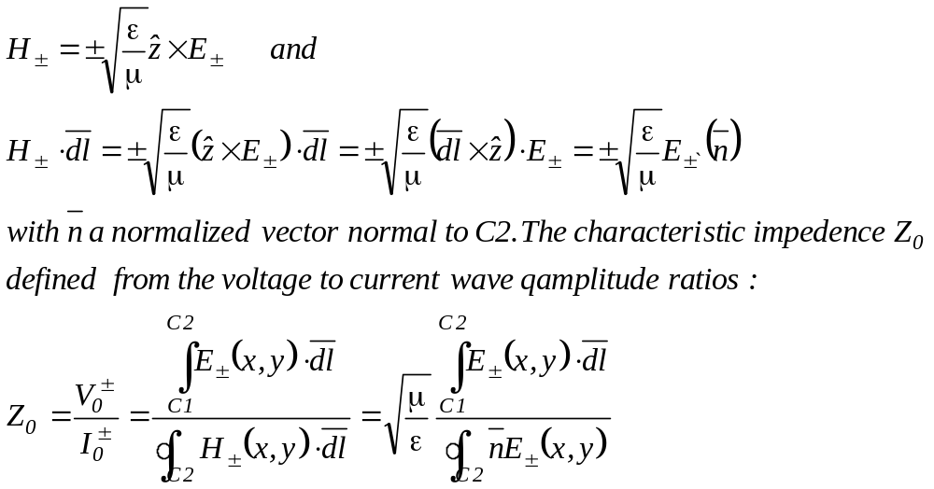
IIT Bombay
Page 29
Characteristic Equation from Maxwell
Equation
Using equation 3.18 in Pozar
EE 611 Lecture 1
EE 611 Jayanta Mukherjee Lecture 1
EE 611 Lecture 2 Jayanta Mukherjee

Slide 30
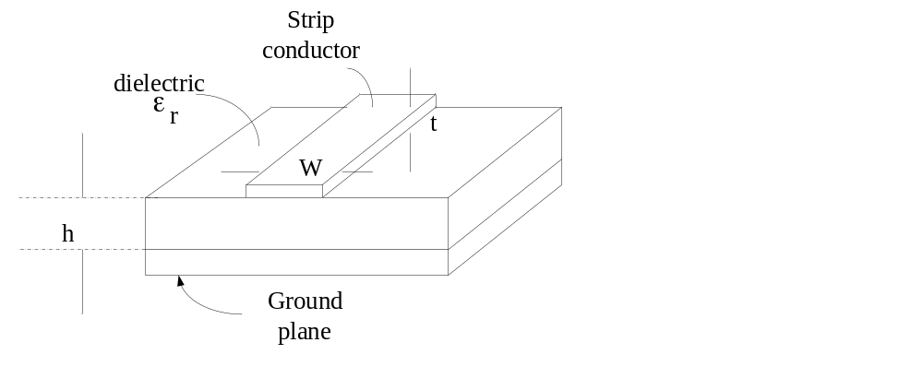
IIT Bombay
Page 30
Quasi-TEM mode in Microstrip line
EE 611 Lecture 1
EE 611 Jayanta Mukherjee Lecture 1
EE 611 Lecture 2 Jayanta Mukherjee

Slide 31
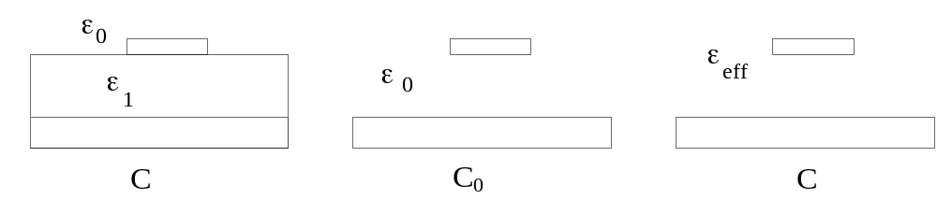
IIT Bombay
Page 31
Quasi-TEM mode in Microstrip line
The TEM derivation holds for 2 conductor systems with a uniform
dielectric between the two conductors
In the case of a microstrip system, two different dielectric
materials with dielectric constant ε₀ (air) and ε₁ are used
In such a case an effective dielectric constant can be defined for
the quasi-TEM mode such that if it were the only dielectric
material present in the system, the same capacitance per unit
length would result
EE 611 Lecture 1
EE 611 Jayanta Mukherjee Lecture 1
EE 611 Lecture 2 Jayanta Mukherjee

Slide 32
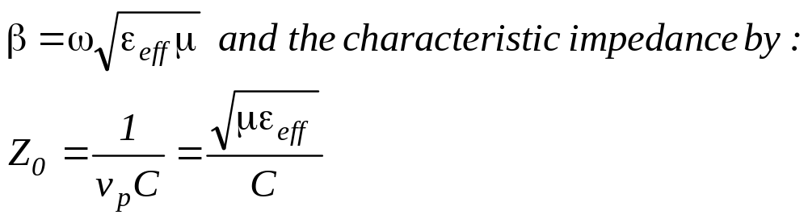
IIT Bombay
Page 32
Effective Dielectric Constant
The effective dielectric constant can be obtained from the
Capacitance per unit length C and C₀ from the above systems
From C/ε_{eff} = C₀/ ε₀ we have:
ε_{eff} = ε₀(C/C₀)
For such a quasi-TEM mode the propagation constant is then
Now given by
EE 611 Lecture 1
EE 611 Jayanta Mukherjee Lecture 1
EE 611 Lecture 2 Jayanta Mukherjee

Slide 33
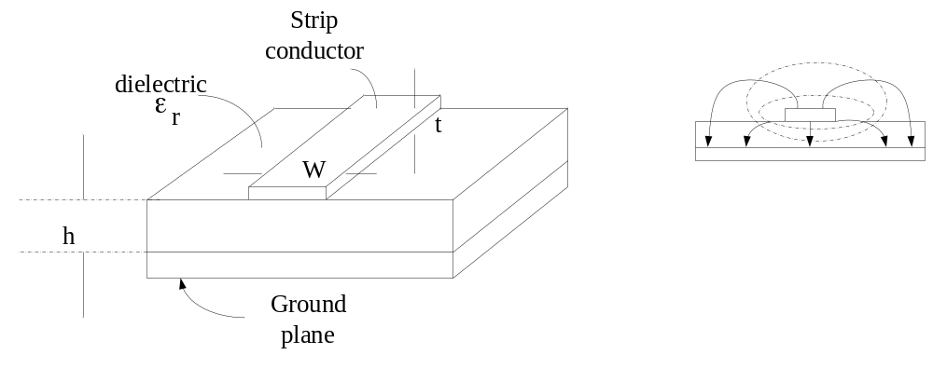
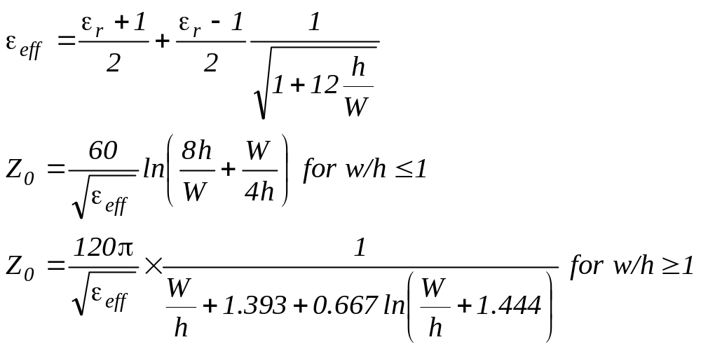
IIT Bombay
Page 33
Approximate Formula for Microstrip
EE 611 Lecture 1
EE 611 Jayanta Mukherjee Lecture 1
EE 611 Lecture 2 Jayanta Mukherjee

Slide 34
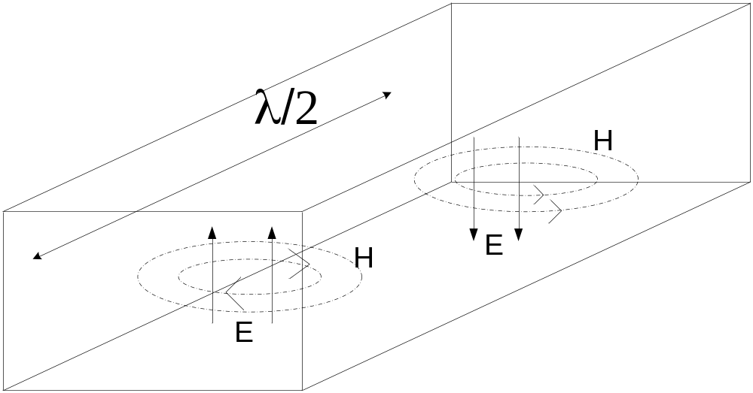
IIT Bombay
Page 34
Wave Impedance for Waveguides
The definition of a unique voltage is not possible in a waveguide depending of the choice selected the characteristic impedance for the TE mode in a rectangular waveguide is found to be
EE 611 Lecture 1
EE 611 Jayanta Mukherjee Lecture 1
EE 611 Lecture 2 Jayanta Mukherjee

Slide 35
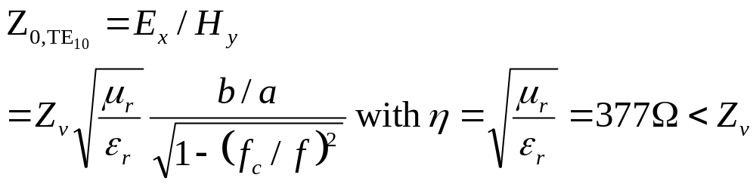
IIT Bombay
Page 35
Wave Impedance for Waveguides
The characteristic impedance is not uniquely defined in
waveguides
However once a definition has been selected the voltage and
current waves can be productively used to design waveguide
circuits.
EE 611 Lecture 1
EE 611 Jayanta Mukherjee Lecture 1
EE 611 Lecture 2 Jayanta Mukherjee

Slide 36
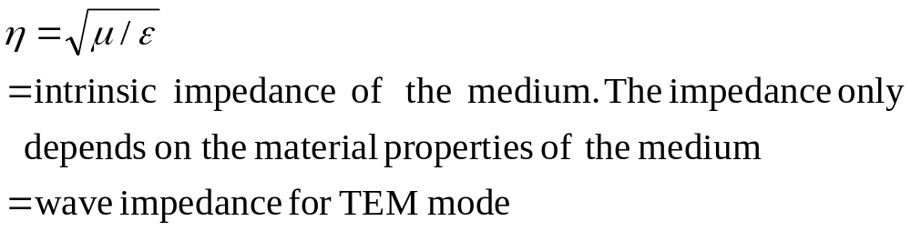
IIT Bombay
Page 36
Intrinsic Impedance
The characteristic impedance is not uniquely defined in
waveguides
However once a definition has been selected the voltage and
current waves can be productively used to design waveguide
circuits.
EE 611 Lecture 1
EE 611 Jayanta Mukherjee Lecture 1
EE 611 Lecture 2 Jayanta Mukherjee

