Slide 1
IIT Bombay
Page 1
Course Code : EE 611
Department: Electrical Engineering
Instructor Name: Jayanta Mukherjee
Email: jayanta@ee.iitb.ac.in
Lecture 3
EE 611 Lecture 3 Jayanta Mukherjee

Slide 2
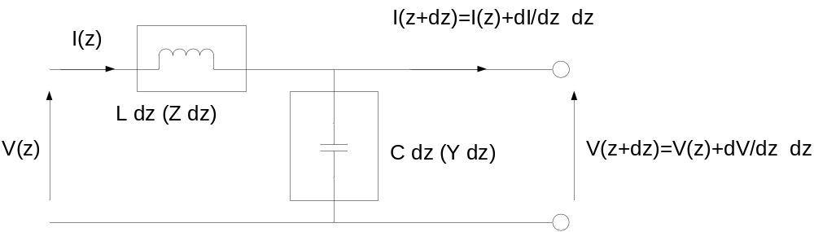
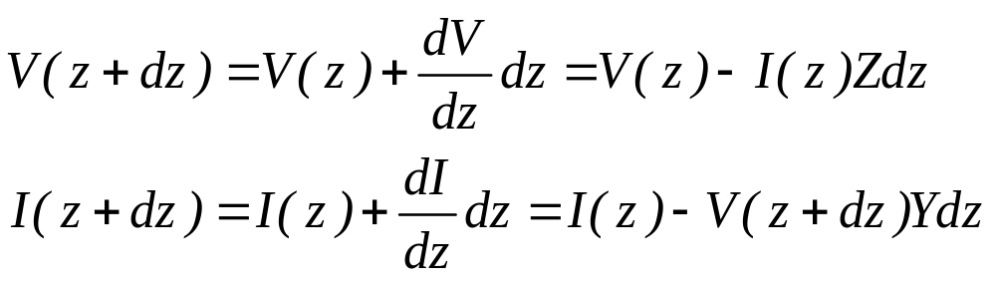
IIT Bombay
Page 2
Transmission Line Equation
Having obtained a solution of Maxwells equation in terms of voltage and current we introduce now a transmission line telegraphist model which can yield the same result
For the section dz of the above distributed circuit we can write
EE 611 Lecture 1
EE 611 Jayanta Mukherjee Lecture 1
EE 611 Lecture 3 Jayanta Mukherjee

Slide 3
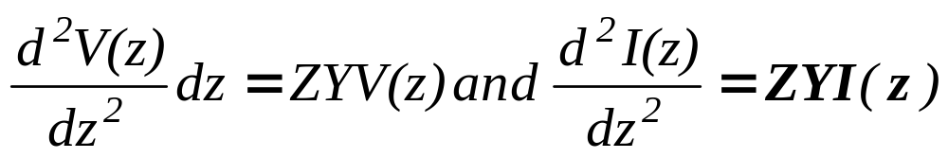
IIT Bombay
Page 3
Transmission Line Equation
Combining these two equations we obtain
EE 611 Lecture 1
EE 611 Jayanta Mukherjee Lecture 1
EE 611 Lecture 3 Jayanta Mukherjee

Slide 4
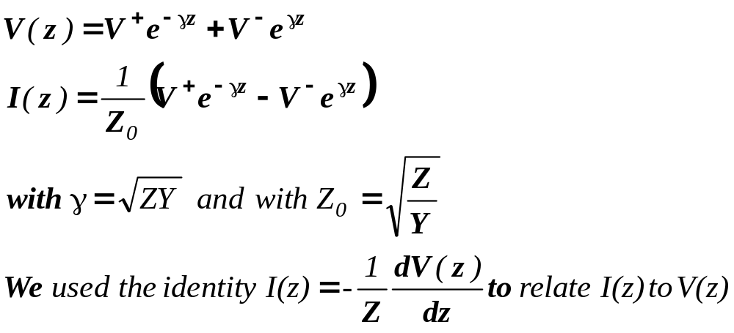
IIT Bombay
Page 4
Transmission Line Equation Solution
EE 611 Lecture 1
EE 611 Jayanta Mukherjee Lecture 1
EE 611 Lecture 3 Jayanta Mukherjee

Slide 5
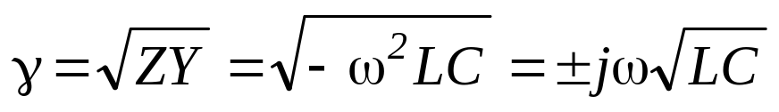
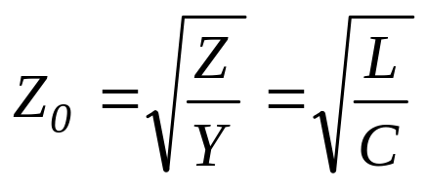
IIT Bombay
Page 5
Lossless case
For a lossless circuit (R=G=0) we have Z = jωL and Y = jωC so
and
EE 611 Lecture 1
EE 611 Jayanta Mukherjee Lecture 1
EE 611 Lecture 3 Jayanta Mukherjee

Slide 6
IIT Bombay
Page 6
Lossless case
For a lossless circuit (R=G=0) we have Z = jωL and Y = jωC so
and
EE 611 Lecture 1
EE 611 Jayanta Mukherjee Lecture 1
EE 611 Lecture 3 Jayanta Mukherjee

Slide 7
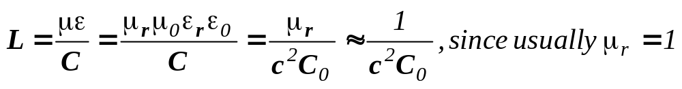
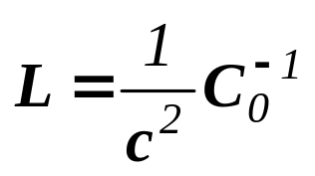
IIT Bombay
Page 7
Inductance per Unit Length
Note that the inductance can be expressed in terms of the
capacitance of the transmission line C₀ when the dielectric is
replaced by air
One notices that the effective inductance per unit length is
independent of the dielectric constant ε
This result can be extended to multi – line transmission system
where the inductance and capacitance per unit length L and C₀
are now matrices
EE 611 Lecture 1
EE 611 Jayanta Mukherjee Lecture 1
EE 611 Lecture 3 Jayanta Mukherjee

Slide 8
IIT Bombay
Page 8
Inductance per Unit Length
In practice microwave engineers rely on CAD tools as an
expert system for evaluating the characteristic impedance Z
and propagation constant in terms of the frequency and the
physical parameters of the transmission lines
EE 611 Lecture 1
EE 611 Jayanta Mukherjee Lecture 1
EE 611 Lecture 3 Jayanta Mukherjee

Slide 9

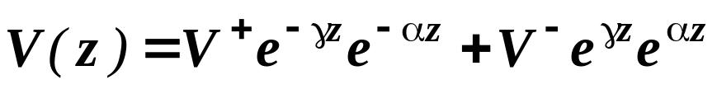
IIT Bombay
Page 9
Loss in Transmission Lines
In physical transmission lines the propagation of the voltage and current waves is attenuated by
the non infinite conductivity of the conductors (wave
attenuation constant α_{c})
lossy dielectric between the conductors (wave attenuation
constant α_{d})
radiation loss (large microstrips act as antennas) (wave
attenuation constant α_{r})
It results from the loss that the propagation constant becomes complex
And the voltage waves are accordingly attenuated:
EE 611 Lecture 1
EE 611 Jayanta Mukherjee Lecture 1
EE 611 Lecture 3 Jayanta Mukherjee

Slide 10
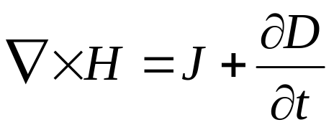
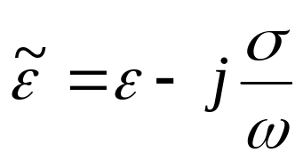


IIT Bombay
Page 10
Calculation of Loss with Maxwell’s Equation
The calculation of the dielectric loss is straight forward.
Rewriting the third Maxwell’s Equation
In the frequency domain we get using J=σE and D=εE
The complex dielectric constant:
The derivation of the wave equation is the same as for loss
less case except that now is replaced by .
EE 611 Lecture 1
EE 611 Jayanta Mukherjee Lecture 1
EE 611 Lecture 3 Jayanta Mukherjee

Slide 11
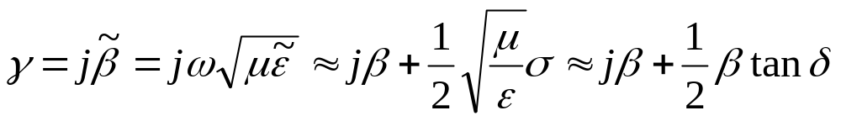
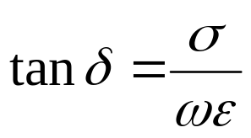
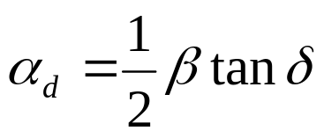
IIT Bombay
Page 11
Calculation of Loss with Maxwell’s Equation
As a result the propagation constant is now:
Where we have introduced the tangent loss defined as
It results that the dielectric attenuation constant for small loss is
In microstrip the dielectric material is usually a material with high
permittivity like Duroid (Teflon) with a dielectric constant of 2
and a loss tangent of 9 x 10⁻⁴
EE 611 Lecture 1
EE 611 Jayanta Mukherjee Lecture 1
EE 611 Lecture 3 Jayanta Mukherjee

Slide 12
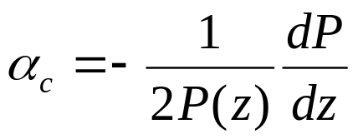
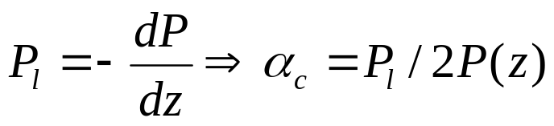
IIT Bombay
Conductive Loss
Page 12
The calculation of the conductive loss α_{c} and R parameter is
difficult as the wave is not purely TEM
Since the power transmitted varies as P(z)=P(0) exp(-2α_{c}z)
along the z axis of the waveguide, the attenuation constant
can be simply evaluated from the rate of variation of the power
dissipated using
It is the just sufficient to evaluate the power loss per unit length
An example of this calculation for a rectangular waveguide is
shown in Pozar Ch 3 example 2.7
EE 611 Lecture 1
EE 611 Jayanta Mukherjee Lecture 1
EE 611 Lecture 3 Jayanta Mukherjee

Slide 13
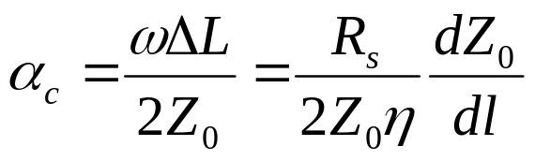
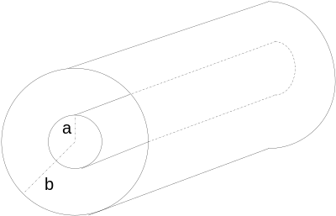
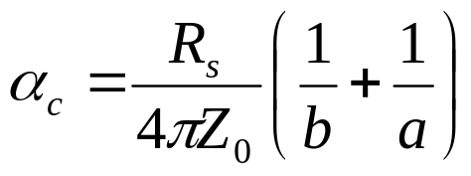
IIT Bombay
Page 13
Wheeler Incremental Rule
For TEM and quasi-TEM lines a simple theory: the “Wheeler
incremental inductance rule” (section 2.7 Pozar)
can be developed to calculate α_{c}
The penetration of the magnetic field inside the conductor up
to the skin depth δ_{s} creates an increase ΔL of the line
inductance per unit length L and
It results that the attenuation constant is given by(section 2.7):
using, Z₀=Lv_{p}
Applied to the coaxial line the attenuation constant for
conductor loss is found to be(example 2.8)
EE 611 Lecture 1
EE 611 Jayanta Mukherjee Lecture 1
EE 611 Lecture 3 Jayanta Mukherjee

Slide 14
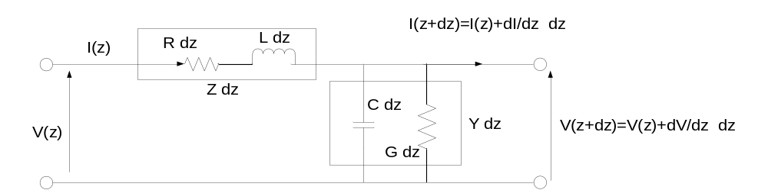
IIT Bombay
Lossy Transmission Line Model
Page 14
The lossy transmission line is modeled by including a series
resistance R (conductor loss) and a shunt conductance G(dielectric loss) per unit length
The transmission line equations remain the same except that
We now have: Z=R+jωL and Y=G+jωC.
EE 611 Lecture 1
EE 611 Jayanta Mukherjee Lecture 1
EE 611 Lecture 3 Jayanta Mukherjee

Slide 15
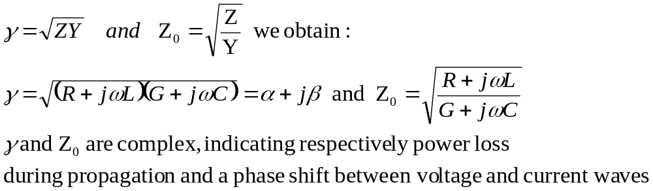
IIT Bombay
Page 15
Lossy Transmission Line Model
Substituting in
EE 611 Lecture 1
EE 611 Jayanta Mukherjee Lecture 1
EE 611 Lecture 3 Jayanta Mukherjee

Slide 16
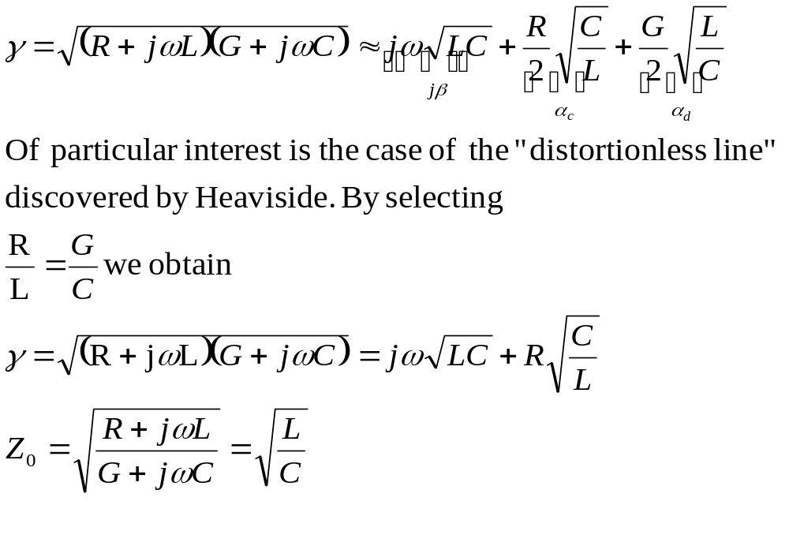
IIT Bombay
Page 16
Low Loss Lines
For low-loss lines (the desired case), we can approximate the
Propagation constant as
This is a non dispersive even though lossy line
EE 611 Lecture 1
EE 611 Jayanta Mukherjee Lecture 1
EE 611 Lecture 3 Jayanta Mukherjee

Slide 17
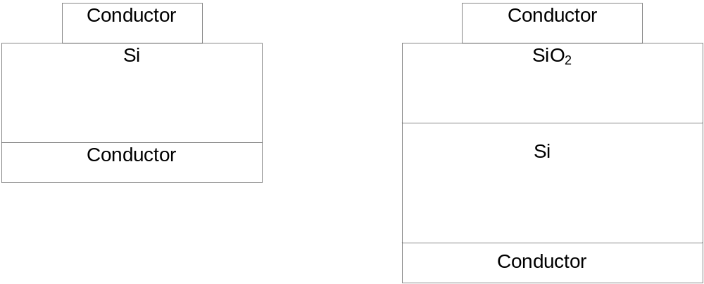
IIT Bombay
Page 17
Strongly Lossy Lines
For larger loss in the dielectric, additional modes of propagation such as slow wave mode or skin effect mode can take place
Consider the case of a Silicon substrate . Depending on the
Conductivity of the silicon layer and the wave frequency the silicon layer can behave like a shunt resistance, a capacitance
Or a ground plane.
EE 611 Lecture 1
EE 611 Jayanta Mukherjee Lecture 1
EE 611 Lecture 3 Jayanta Mukherjee

Slide 18
IIT Bombay
Page 18
Solution for strong loss
Consider a system the following model applies:
When the loss in the dielectric region is important, an exact
solution must be obtained for the propagation constant β and
the attenuation factor α
EE 611 Lecture 1
EE 611 Jayanta Mukherjee Lecture 1
EE 611 Lecture 3 Jayanta Mukherjee

Slide 19
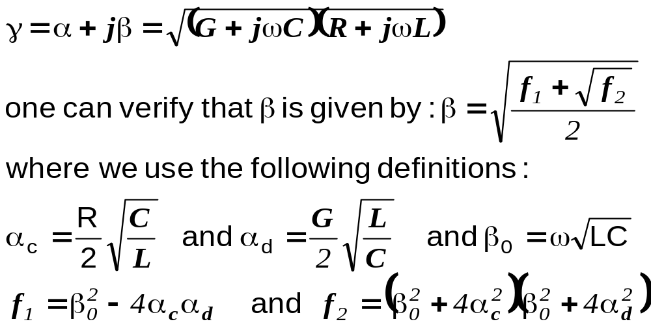
IIT Bombay
Page 19
Solution for strong loss
Starting from
EE 611 Lecture 1
EE 611 Jayanta Mukherjee Lecture 1
EE 611 Lecture 3 Jayanta Mukherjee

Slide 20
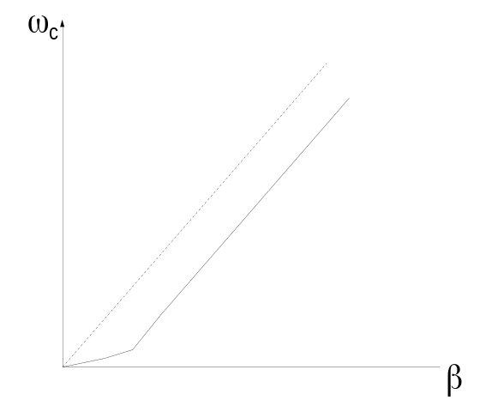
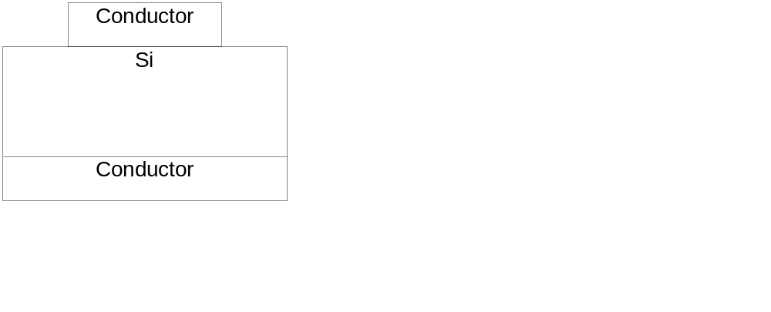
IIT Bombay
Page 20
Slow Wave dispersion
The lower slope observed at low frequency is associated
with a lower phase v_{p} and group velocity v_{g}
This originates from the penetration of the electric field in the
lossy silicon layer. A a result C is large and
the phase velocity v_{p}=1/sqrt(LC) becomes very small
EE 611 Lecture 1
EE 611 Jayanta Mukherjee Lecture 1
EE 611 Lecture 3 Jayanta Mukherjee

Slide 21
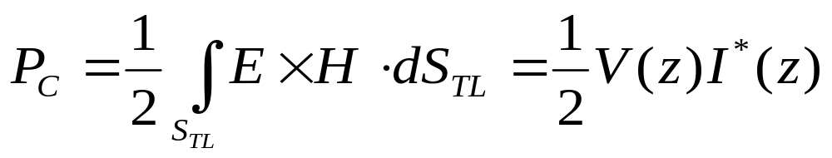
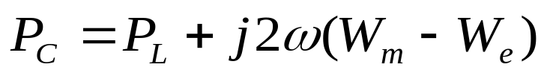
IIT Bombay
Page 21
Power Transmitted
The time averaged power transmitted down a line, is obtained
From Maxwell’s equations from the integration of the complex
Poynting power density over the transmission cross section S_{TL}
The complex power can be expressed in terms of its real part P_{L}
and imaginary part as (Poyntings Theorem section 1.6 Pozar):
EE 611 Lecture 1
EE 611 Jayanta Mukherjee Lecture 1
EE 611 Lecture 3 Jayanta Mukherjee

Slide 22
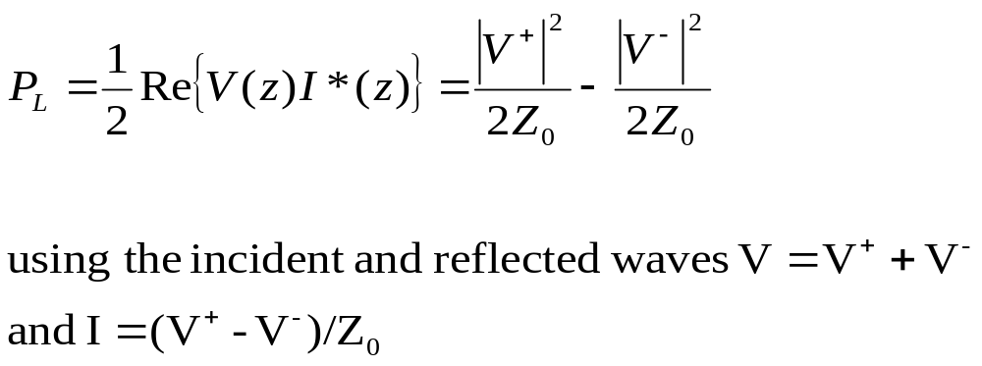
IIT Bombay
Page 22
Power Transmitted
P_{L} is the power dissipated by the load (z>0).
EE 611 Lecture 1
EE 611 Jayanta Mukherjee Lecture 1
EE 611 Lecture 3 Jayanta Mukherjee

Slide 23
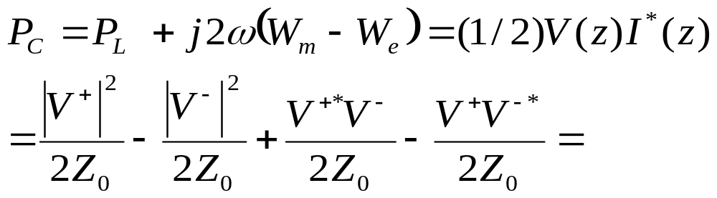
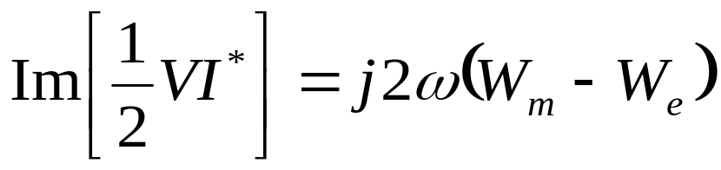
IIT Bombay
Page 23
Energy Stored
Consider the complex power delivered to the load (z>0)
The imaginary part of the complex power is 2ω times the
Total energy stored in the load.
Where W_{m} and W_{e} are respectively the magnetic and electric energy stored in the load
EE 611 Lecture 1
EE 611 Jayanta Mukherjee Lecture 1
EE 611 Lecture 3 Jayanta Mukherjee

Slide 24
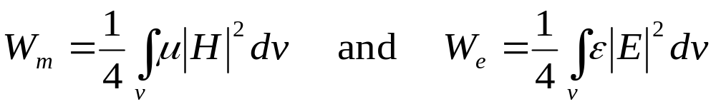
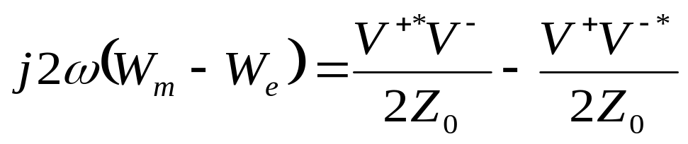
IIT Bombay
Page 24
Energy Stored
In terms of the incident and reflected waves using V=V⁺+V⁻ and
I=(V⁺-V⁻)/Z₀ the stored energy is given by
EE 611 Lecture 1
EE 611 Jayanta Mukherjee Lecture 1
EE 611 Lecture 3 Jayanta Mukherjee

Slide 25
IIT Bombay
Page 25
Discontinuities in Transmission lines
The transmission line model we have derived is only valid for
infinite lines.
Corrections to the transmission line model for lines of finite length
is needed at the discontinuities or junctions
At a junction or discontinuity evanescent modes are launched.
Although those modes do not propagate they do store energy
Corrections to the transmission line model can be implemented
with the use of an equivalent circuit.
Inductors or capacitors can be used to account for magnetic and
electrical energy stored at the discontinuities
EE 611 Lecture 1
EE 611 Jayanta Mukherjee Lecture 1
EE 611 Lecture 3 Jayanta Mukherjee

Slide 26
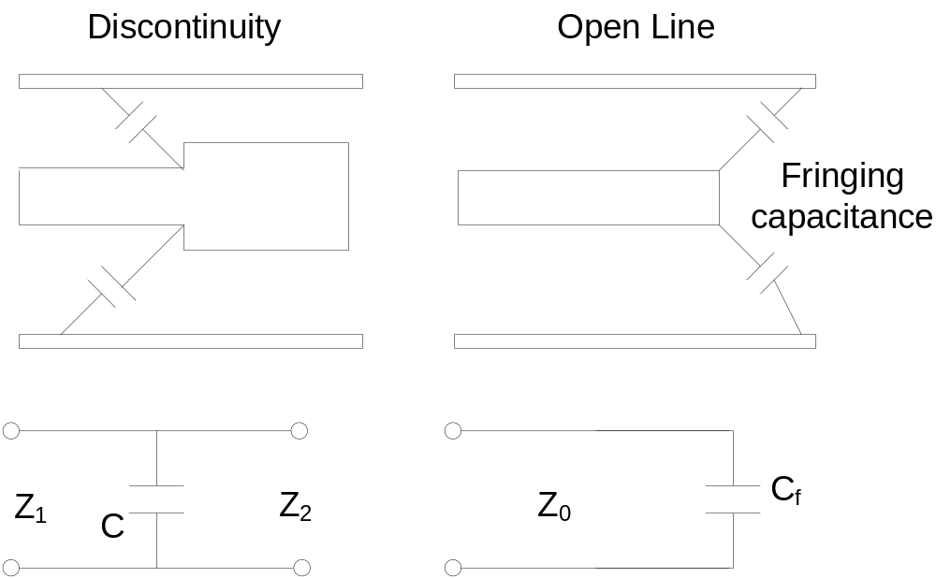
IIT Bombay
Page 26
Examples of Discontinuities
For example the junction between two transmission lines of
different impedances the fringe capacitance at the end of an open
stub stores energy.
EE 611 Lecture 1
EE 611 Jayanta Mukherjee Lecture 1
EE 611 Lecture 3 Jayanta Mukherjee

Slide 27
IIT Bombay
Page 27
Examples of Discontinuities
In a first cut design we will usually neglect the effect of
discontinuities
Once a first cut design has been obtained we can account for
these effects with the help of a CAD simulator to obtain a more
realistic simulation and optimize the design
EE 611 Lecture 1
EE 611 Jayanta Mukherjee Lecture 1
EE 611 Lecture 3 Jayanta Mukherjee

Slide 28
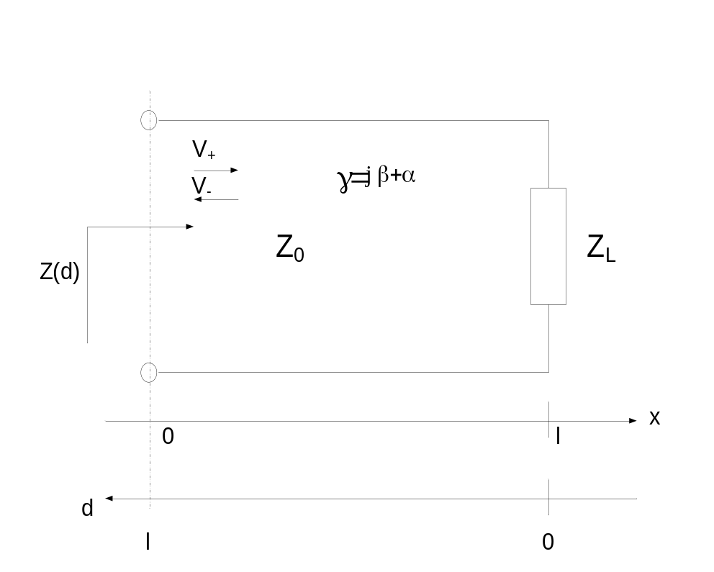
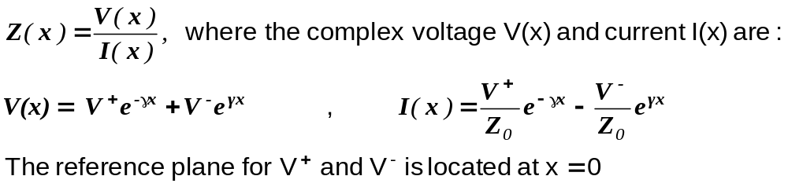
IIT Bombay
Page 28
Impedance of Loaded Transmission Lines
The impedance along a transmission line at position x is given by
EE 611 Lecture 1
EE 611 Jayanta Mukherjee Lecture 1
EE 611 Lecture 3 Jayanta Mukherjee

Slide 29
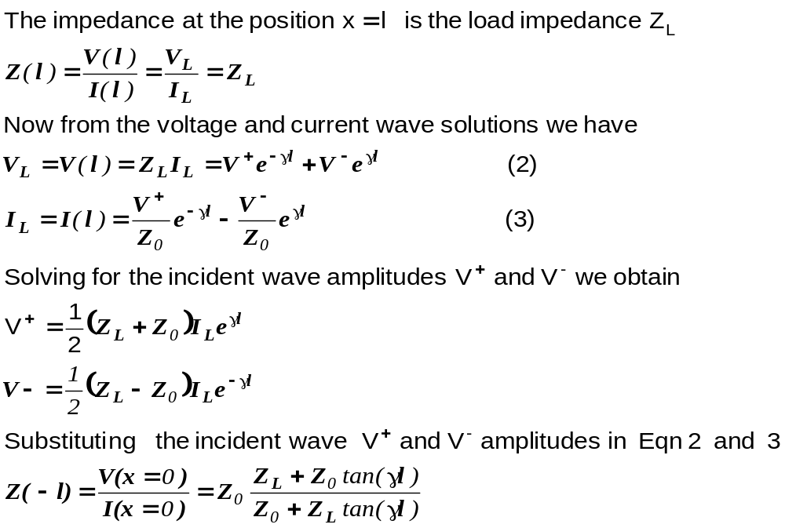
IIT Bombay
Page 29
Impedance Calculation
EE 611 Lecture 1
EE 611 Jayanta Mukherjee Lecture 1
EE 611 Lecture 3 Jayanta Mukherjee

Slide 30
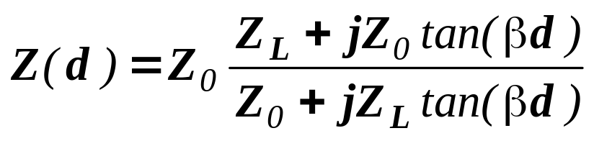
IIT Bombay
Page 30
Lossless Case
For a loss free line we have γ=jβ and the impedance reduces to:
The impedance Z is then periodic function of frequency and
position:
In terms of the electrical angle θ=βd the impedance Z repeats
every period π
In terms of position d it repeats every half wavelength λ/2 since
we have βd=(2π/λ)d
EE 611 Lecture 1
EE 611 Jayanta Mukherjee Lecture 1
EE 611 Lecture 3 Jayanta Mukherjee

