Slide 1
IIT Bombay
Page 1
Course Code : EE 611
Department: Electrical Engineering
Instructor Name: Jayanta Mukherjee
Email: jayanta@ee.iitb.ac.in
Lecture 5
EE 611 Lecture 5 Jayanta Mukherjee

Slide 2
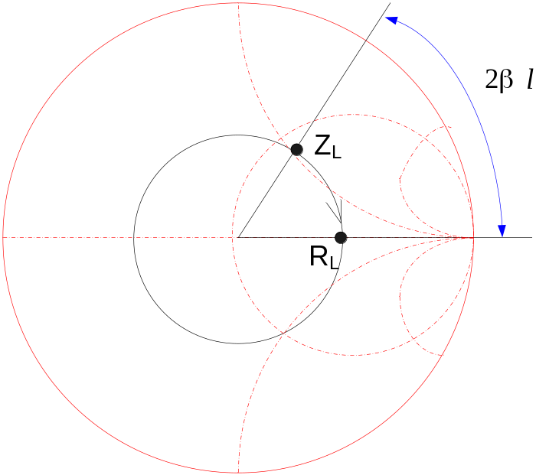
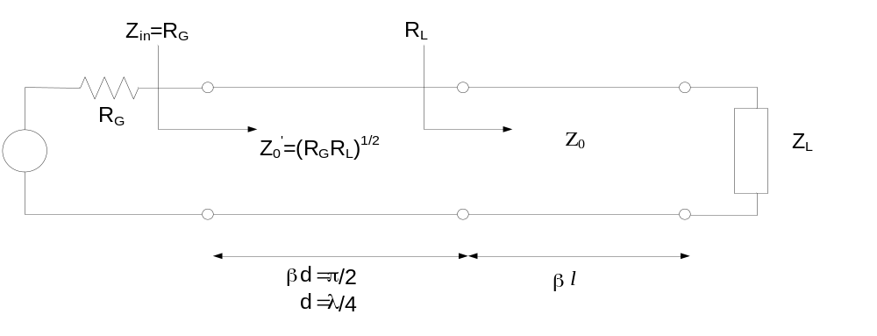
IIT Bombay
Page 2
Quarter Wave Transformer for a Complex
Load
EE 611 Lecture 1
EE 611 Jayanta Mukherjee Lecture 1
EE 611 Lecture 5 Jayanta Mukherjee

Slide 3
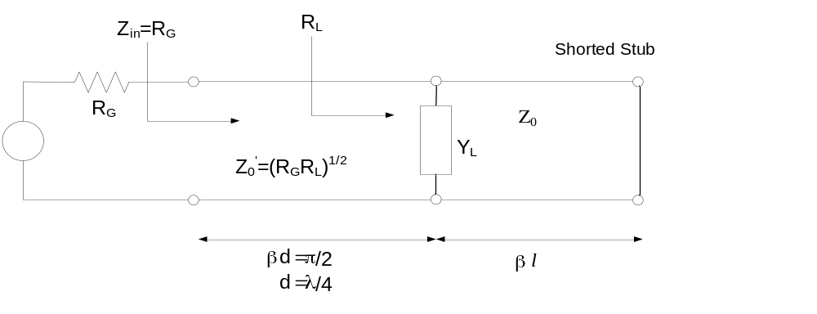
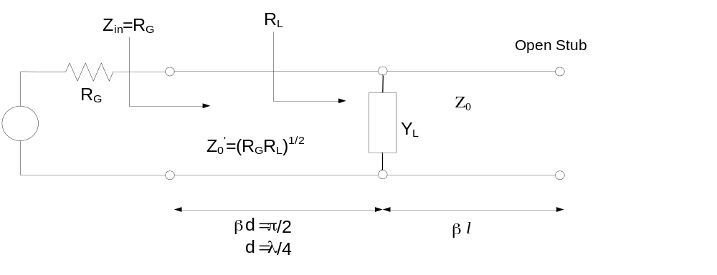
IIT Bombay
Page 3
Quarter Wave Transformer for a Complex
Load
EE 611 Lecture 1
EE 611 Jayanta Mukherjee Lecture 1
EE 611 Lecture 5 Jayanta Mukherjee

Slide 4
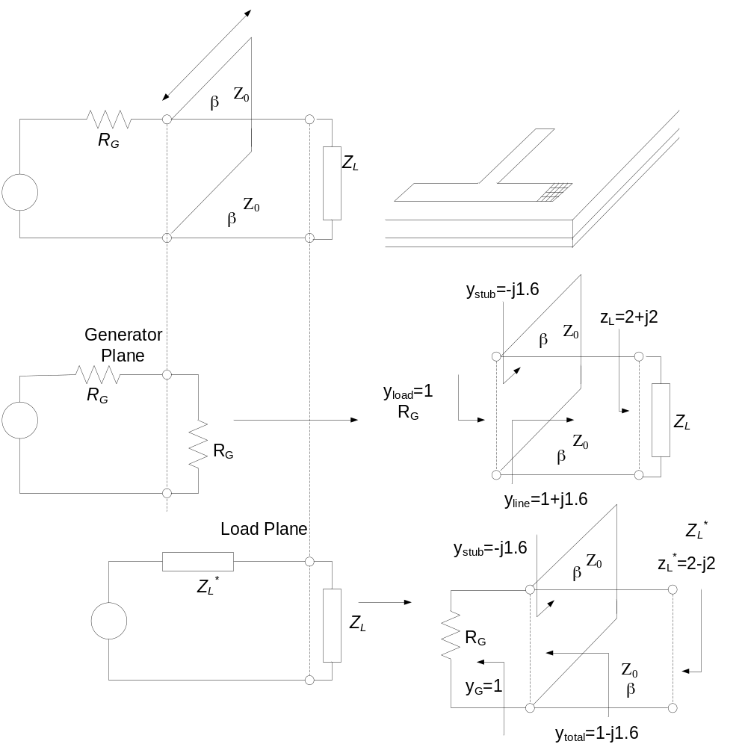
IIT Bombay
Page 4
Design of a Stub Tuner
EE 611 Lecture 1
EE 611 Jayanta Mukherjee Lecture 1
EE 611 Lecture 5 Jayanta Mukherjee

Slide 5
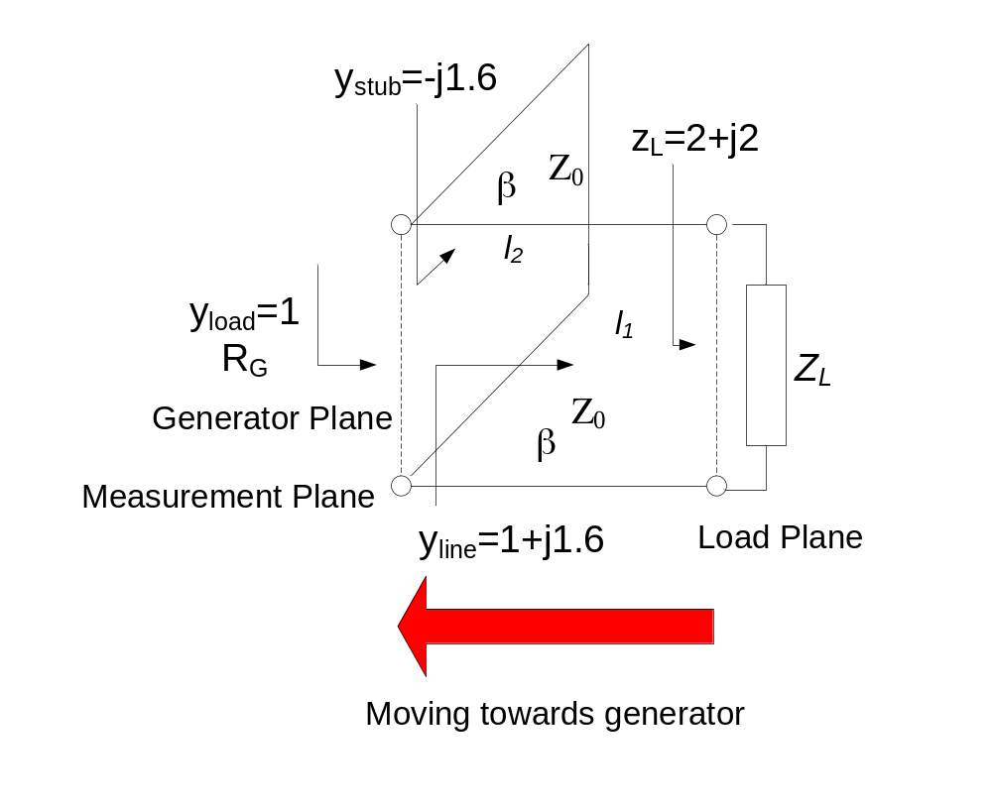
IIT Bombay
Page 5
Design Using Generator Plane
Consider the load: Z_{L}=100+j100
Using Z₀=50 ohms we have z_{L}=2+j2
Solution
l₁=0.2193λ, l₂=0.089λ
EE 611 Lecture 1
EE 611 Jayanta Mukherjee Lecture 1
EE 611 Lecture 5 Jayanta Mukherjee

Slide 6
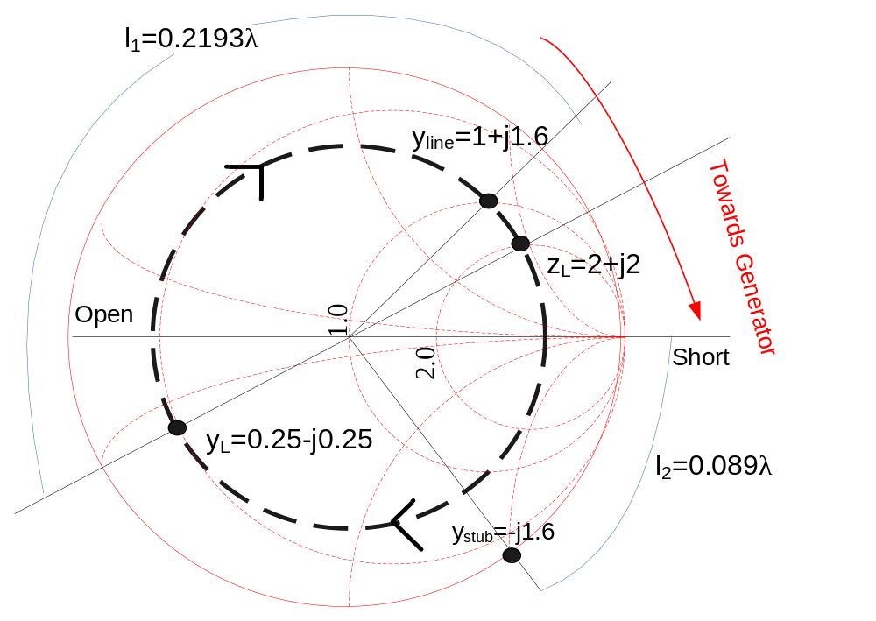
IIT Bombay
Page 6
Design Using Generator Plane
EE 611 Lecture 1
EE 611 Jayanta Mukherjee Lecture 1
EE 611 Lecture 5 Jayanta Mukherjee

Slide 7
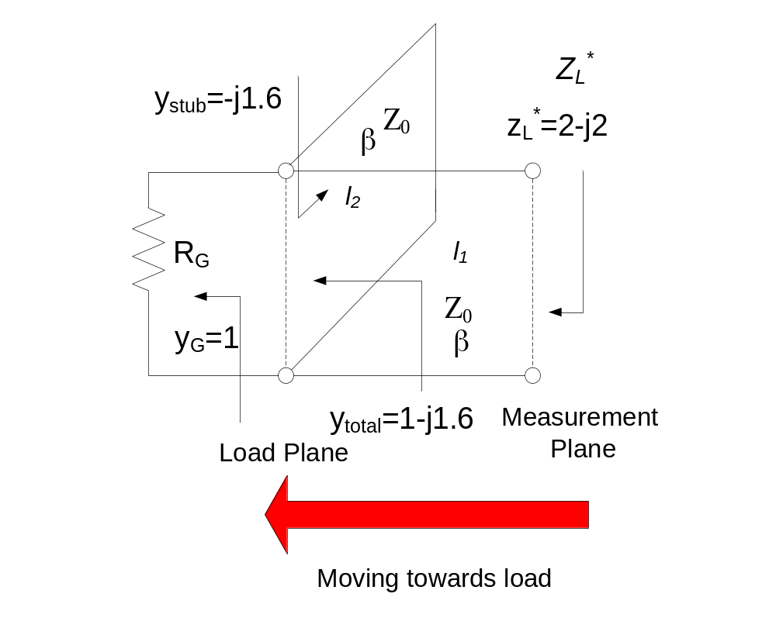
IIT Bombay
Page 7
Design Using Load Plane
Consider the load: Z_{L}=100+j100
Using Z₀=50 ohms we have z_{L}*=2-j2
Solution
l₁=0.2193λ, l₂=0.089λ
EE 611 Lecture 1
EE 611 Jayanta Mukherjee Lecture 1
EE 611 Lecture 5 Jayanta Mukherjee

Slide 8
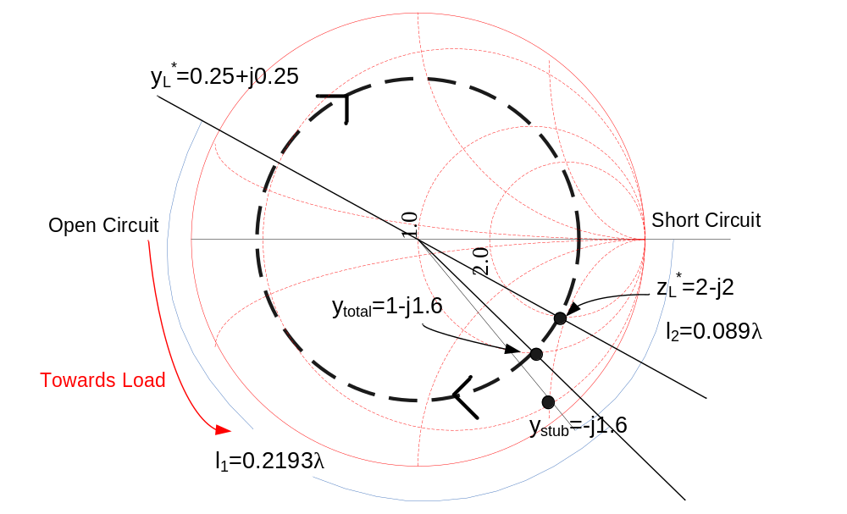
IIT Bombay
Page 8
Design Using Load Plane
EE 611 Lecture 1
EE 611 Jayanta Mukherjee Lecture 1
EE 611 Lecture 5 Jayanta Mukherjee

Slide 9
IIT Bombay
Page 9
Chapter 3
Broadband Impedance Matching
EE 611 Lecture 1
EE 611 Jayanta Mukherjee Lecture 1
EE 611 Lecture 5 Jayanta Mukherjee

Slide 10
IIT Bombay
Page 10
Overview
The analysis of microwave circuits reduces to the synthesis of the reflection coefficient of a single port device since the termination load is known
The synthesis method used will find applications in the design
of multiport devices such as multi-section (4-port) couplers and
multi section Wilkinson (3-port) power dividers.
We will also introduce a new synthesis technique to realize a
impedance function.
EE 611 Lecture 1
EE 611 Jayanta Mukherjee Lecture 1
EE 611 Lecture 5 Jayanta Mukherjee

Slide 11
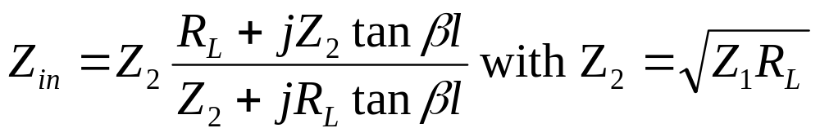
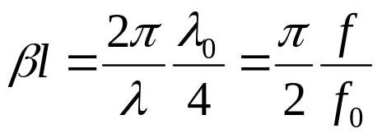
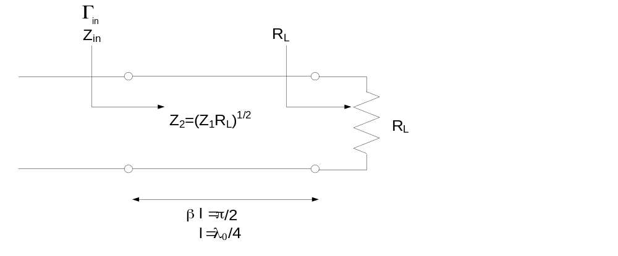
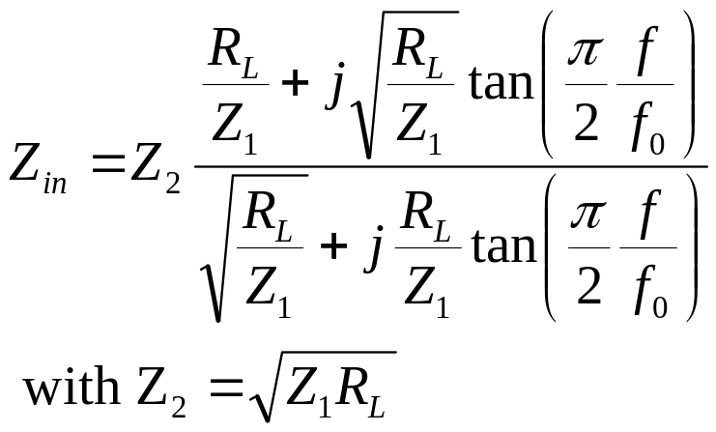
IIT Bombay
Page 11
The Quarter Wave Transformer
We need to analyze the frequency response and bandwidth of the quarter wave transformer. The input impedance Z_{in} is obtained at any frequency from the transformed load impedance using
To introduce frequency dependence we write:
where f₀ is the frequency at which l=λ₀/4
Substituting these expressions in Z_{in} we obtain:
EE 611 Lecture 1
EE 611 Jayanta Mukherjee Lecture 1
EE 611 Lecture 5 Jayanta Mukherjee

Slide 12
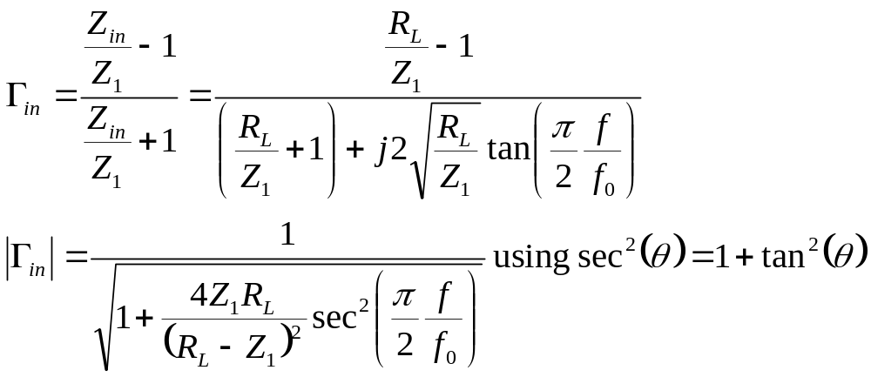
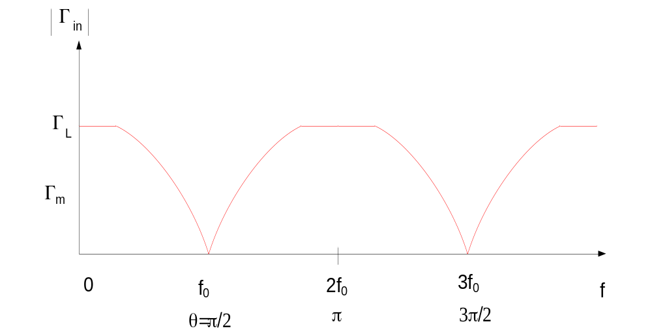
IIT Bombay
Page 12
Reflection Coefficient of The Quarter Wave
Transformer
The reflection coefficient Γ_{in} at the input is now:
EE 611 Lecture 1
EE 611 Jayanta Mukherjee Lecture 1
EE 611 Lecture 5 Jayanta Mukherjee

Slide 13
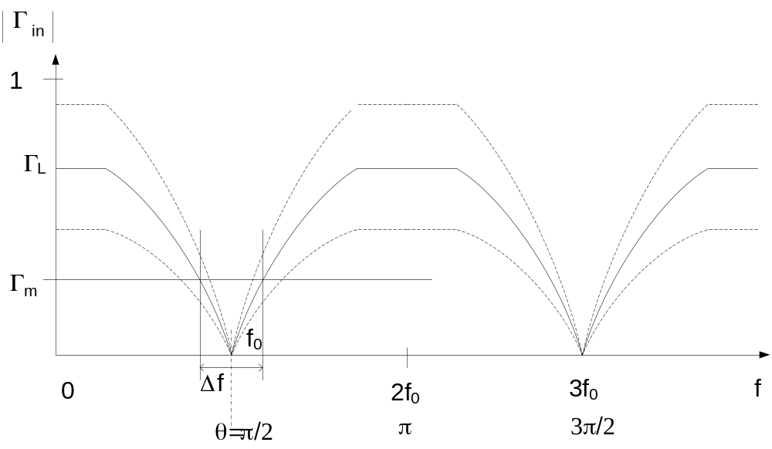
IIT Bombay
Page 13
Reflection Coefficient of The Quarter Wave
Transformer
The reflection coefficient Γ_{in} at the input is now:
EE 611 Lecture 1
EE 611 Jayanta Mukherjee Lecture 1
EE 611 Lecture 5 Jayanta Mukherjee

Slide 14
IIT Bombay
Page 14
Reflection Coefficient of The Quarter Wave
Transformer
The larger the reflection coefficient Γ_{L} the narrower the
bandwidth of the transformer
The reflection coefficient is found to be a periodic function of
frequency
A perfect match is obtained at the frequencies f₀, 3f₀, and
so on but a mismatch develops as the frequency deviates from
these frequencies
EE 611 Lecture 1
EE 611 Jayanta Mukherjee Lecture 1
EE 611 Lecture 5 Jayanta Mukherjee

Slide 15
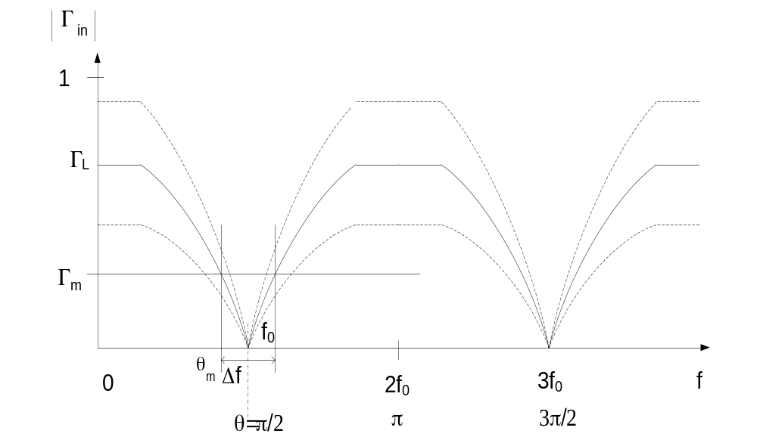
IIT Bombay
Page 15
Bandwidth Analysis
EE 611 Lecture 1
EE 611 Jayanta Mukherjee Lecture 1
EE 611 Lecture 5 Jayanta Mukherjee

Slide 16
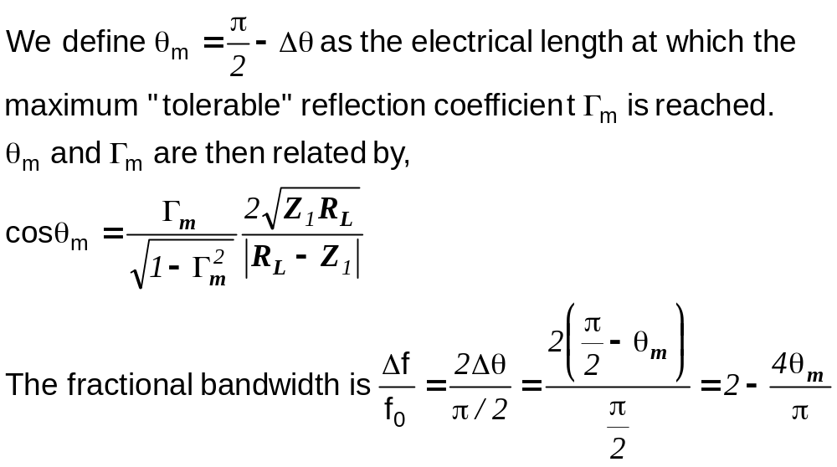
IIT Bombay
Page 16
Bandwidth Analysis
EE 611 Lecture 1
EE 611 Jayanta Mukherjee Lecture 1
EE 611 Lecture 5 Jayanta Mukherjee

Slide 17
IIT Bombay
Page 17
Multisection Transformers
The quarter wave transformer described above provides us
with a fixed bandwidth given a load mismatch Γ_{L}
In some applications a larger bandwidth might be required
To improve on the quarter wave transformer, we shall cascade
several quarter wave sections
- The additional degrees of freedom in the network will allow us
to “synthesize” an improved frequency response
- This is at the expense of increased network size and
complexity
EE 611 Lecture 1
EE 611 Jayanta Mukherjee Lecture 1
EE 611 Lecture 5 Jayanta Mukherjee

Slide 18
IIT Bombay
Page 18
Analysis Approach
The equations involved with multi-section networks can be
complicated
- There will be forward and reverse propagating voltage waves
on every section
- This leads to an infinite number of potential multiple
reflections
However, if the degree of mismatch between sections is
small,
- We can neglect multiple reflected signals
- Design the network considering only single reflections
This is the theory of small reflections (Pozar pg 275-278)
EE 611 Lecture 1
EE 611 Jayanta Mukherjee Lecture 1
EE 611 Lecture 5 Jayanta Mukherjee

Slide 19
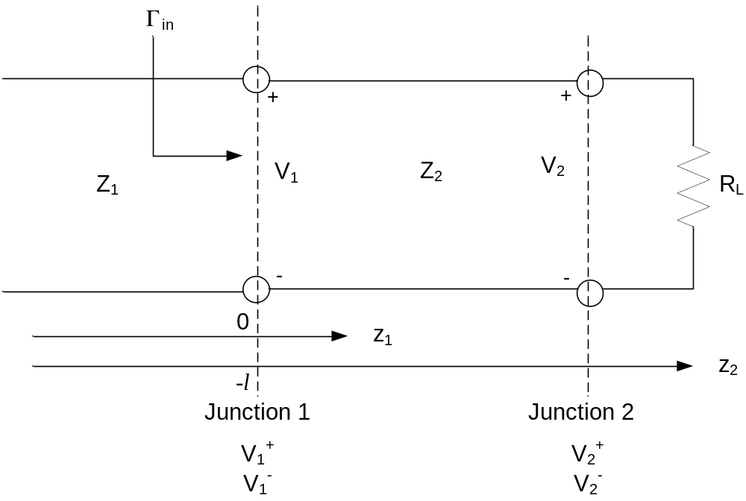
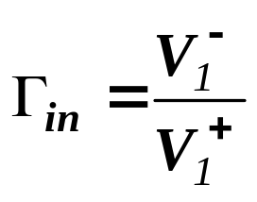
IIT Bombay
Page 19
Single Section Theory
We are interested in calculating the reflection at junction 1
as defined as
EE 611 Lecture 1
EE 611 Jayanta Mukherjee Lecture 1
EE 611 Lecture 5 Jayanta Mukherjee

Slide 20
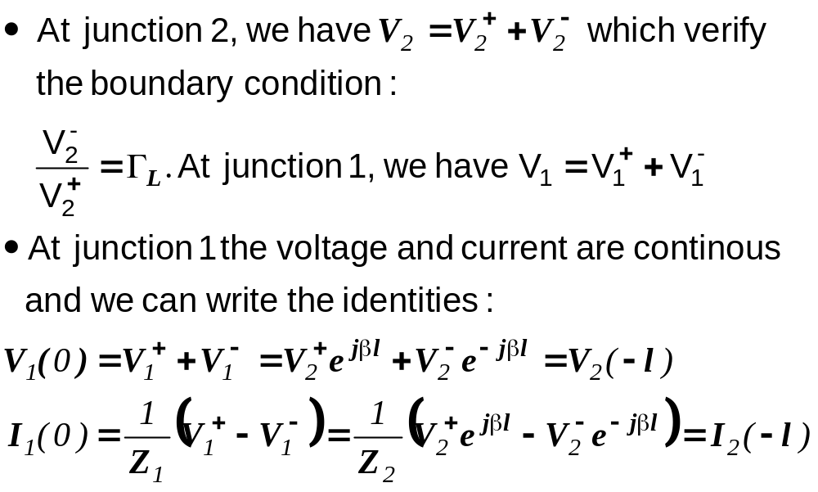
IIT Bombay
Page 20
Single Section Theory
EE 611 Lecture 1
EE 611 Jayanta Mukherjee Lecture 1
EE 611 Lecture 5 Jayanta Mukherjee

Slide 21
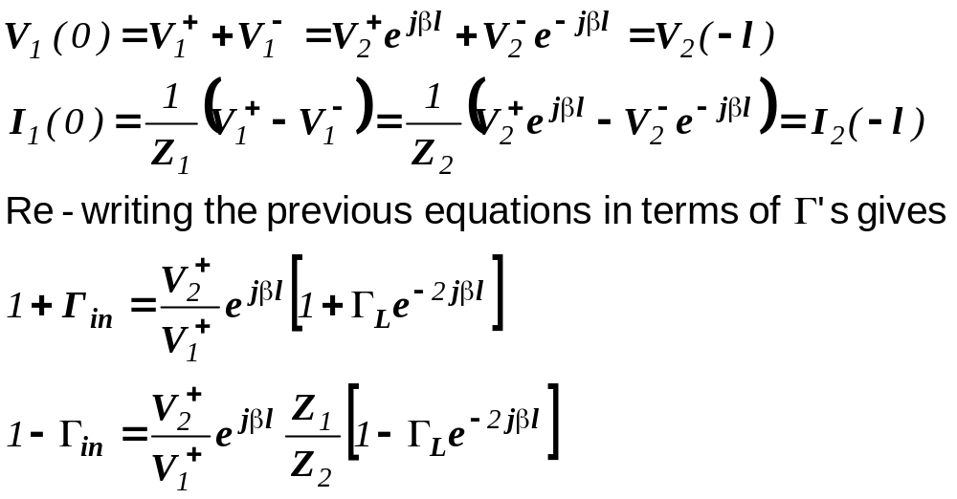
IIT Bombay
Page 21
Single Section Theory
EE 611 Lecture 1
EE 611 Jayanta Mukherjee Lecture 1
EE 611 Lecture 5 Jayanta Mukherjee

Slide 22
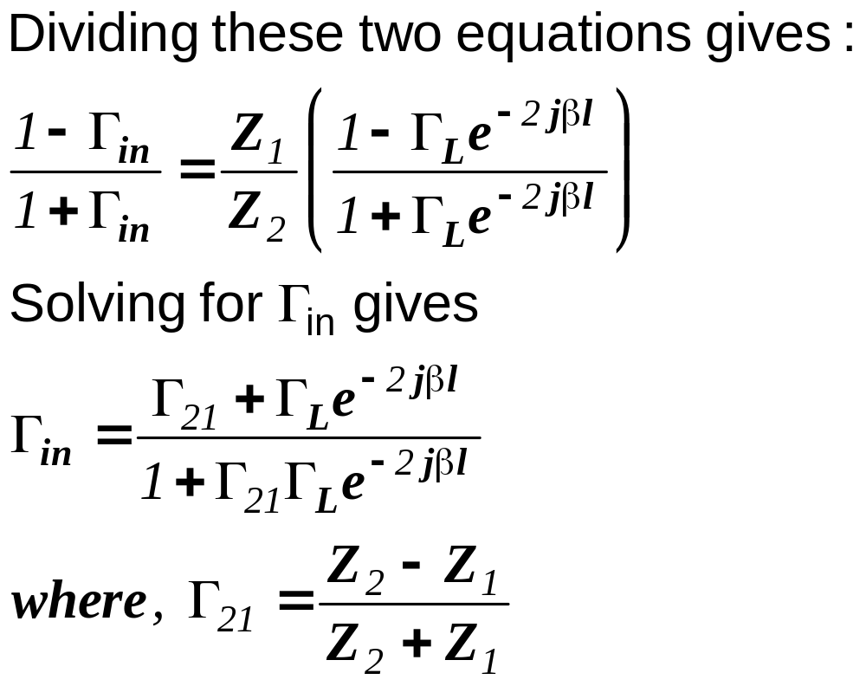
IIT Bombay
Page 22
Single Section Theory
EE 611 Lecture 1
EE 611 Jayanta Mukherjee Lecture 1
EE 611 Lecture 5 Jayanta Mukherjee

Slide 23
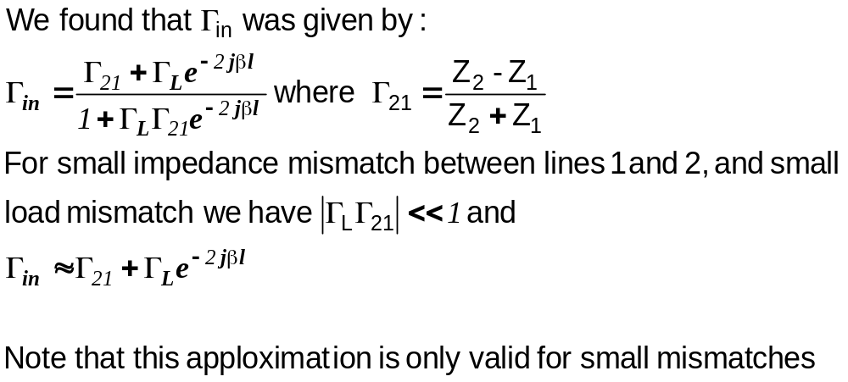
IIT Bombay
Page 23
Approximation for Small Reflections
EE 611 Lecture 1
EE 611 Jayanta Mukherjee Lecture 1
EE 611 Lecture 5 Jayanta Mukherjee

Slide 24
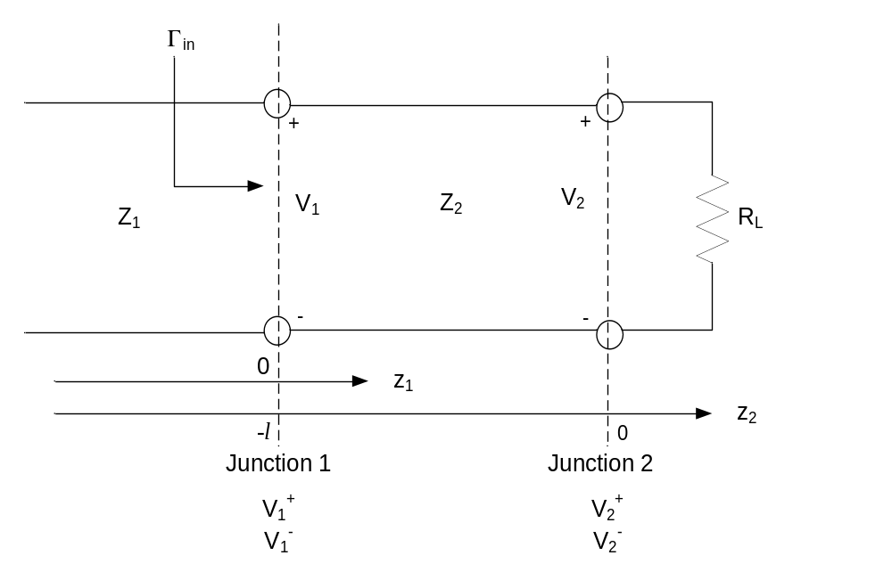
IIT Bombay
Page 24
Approximation for Small Reflections
This is simply the reflection generated by the mismatch between line characteristic impedances plus the reflection from the load phase shifted by the round trip travel along line 1. We are neglecting all other multiple reflections.
EE 611 Lecture 1
EE 611 Jayanta Mukherjee Lecture 1
EE 611 Lecture 5 Jayanta Mukherjee

Slide 25
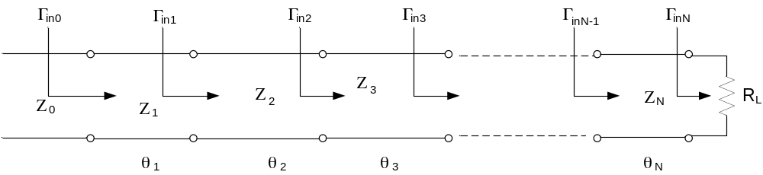
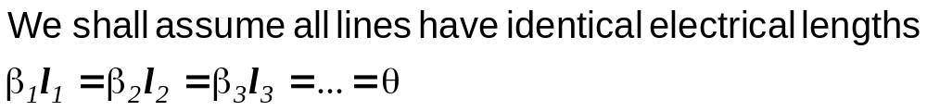
IIT Bombay
Page 25
N Section Network
Consider now the N-section network. We shall apply the small
reflection approximation derived above to this multiple line
circuit
EE 611 Lecture 1
EE 611 Jayanta Mukherjee Lecture 1
EE 611 Lecture 5 Jayanta Mukherjee

Slide 26
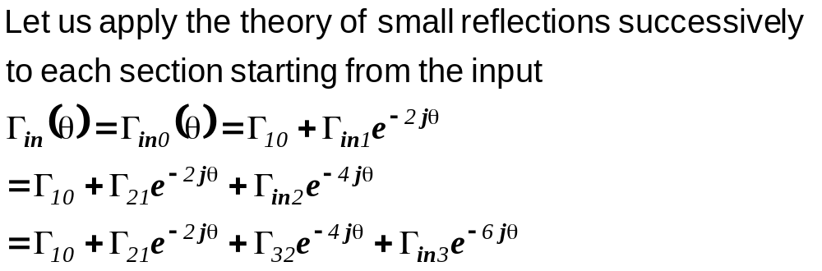
IIT Bombay
Page 26
N Section Formula
EE 611 Lecture 1
EE 611 Jayanta Mukherjee Lecture 1
EE 611 Lecture 5 Jayanta Mukherjee

Slide 27
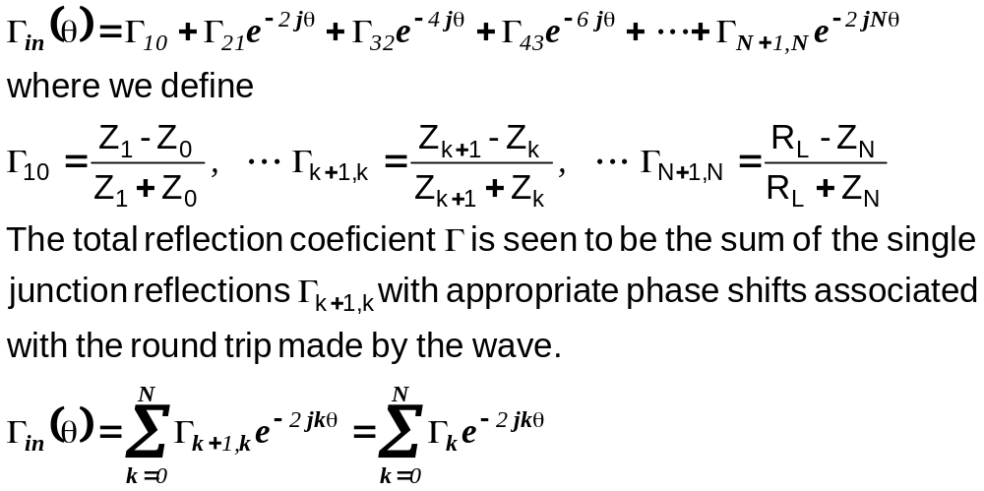
IIT Bombay
Page 27
N Section Formula
EE 611 Lecture 1
EE 611 Jayanta Mukherjee Lecture 1
EE 611 Lecture 5 Jayanta Mukherjee

Slide 28
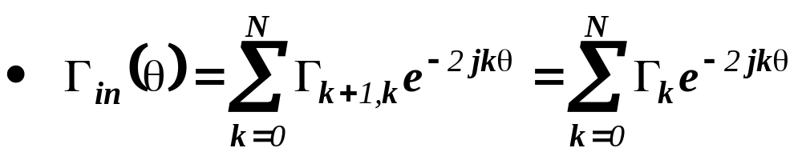
IIT Bombay
Page 28
Attribute of Γ_{in}
is in the form of a Fourier series in θ . Thus Γ(θ) is periodic in θ
with period π.
We will usually set the center frequency of the transformer to
be at θ=π/2.
Note that at θ=0 (DC) we must have Γ_{in}(θ=0)=(R_{L}-Z₀)/(R_{L}+Z₀)
since at DC the transmission lines introduce no phase shift
We will use this exact result as a boundary condition even
though this boundary is not exactly enforced by the small
reflection approximate theory we have derived.
EE 611 Lecture 1
EE 611 Jayanta Mukherjee Lecture 1
EE 611 Lecture 5 Jayanta Mukherjee

Slide 29
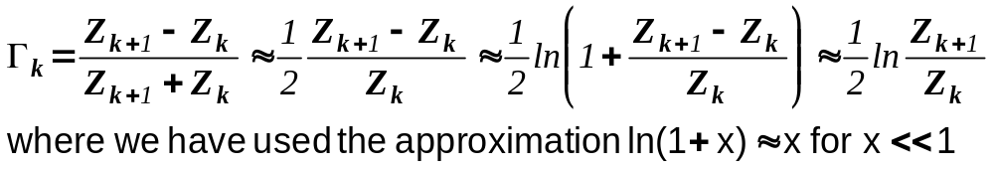
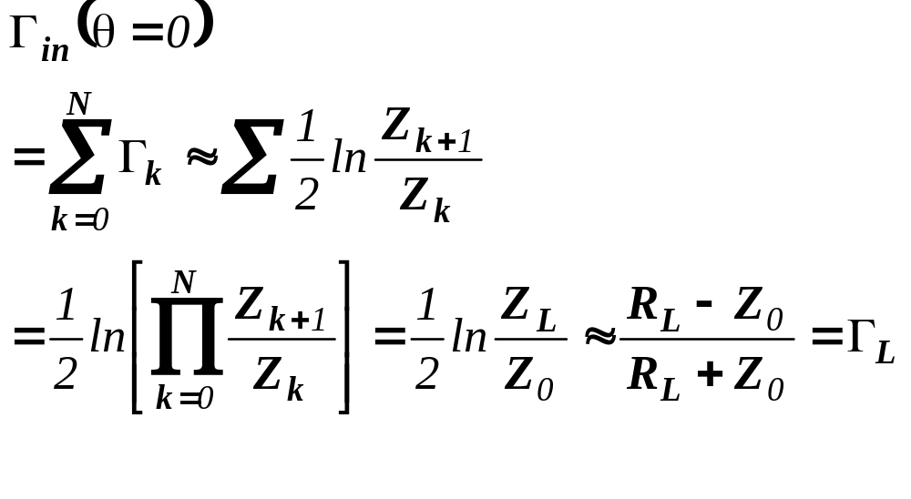
IIT Bombay
Page 29
Self Consistent Approximate Results
To obtain self-consistent results we shall make use of the
following approximation:
Using this approximation a self consistent result is obtained as
EE 611 Lecture 1
EE 611 Jayanta Mukherjee Lecture 1
EE 611 Lecture 5 Jayanta Mukherjee

Slide 30
IIT Bombay
Page 30
Summary
In summary we have applied the theory of small reflection to
multisection circuits
The small reflection approximation includes only the
reflections generated at each junction and keeps track of their
phase shifts
We obtain with this approximation a simple formula for the
input reflection coefficient Γ_{in}
􀀀
This approximation will be used to synthesize various
targeted reflection coefficients versus frequency by properly
selecting the impedance of each section
EE 611 Lecture 1
EE 611 Jayanta Mukherjee Lecture 1
EE 611 Lecture 5 Jayanta Mukherjee

