Slide 1
Substrate and Gate Current
G
Non-zero V_{G} and V_{D}
Observed in SiO₂, SiON and HKMG technology, in both NMOS and PMOS
S
D
B
Channel carrier (electron / hole) heating due to high lateral field (NMOS / PMOS)
Impact ionization → electron / hole pair generation
Substrate current → hole (NMOS), electron (PMOS)
Gate current → Electron or hole injection

Slide 2
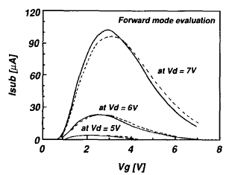
Substrate Current (Hot Carrier)
NMOS
Substrate current:
(1) Increases with V_{G}
(2) Peaks at V_{G} ~ V_{D}/2
(3) Falls for V_{G} > V_{D}/2
Heremans, TED 1988

Slide 3
Explanation of V_{G} Dependence of I_{SUB}
I_{D} increases with V_{G}
M reduces with V_{G}
N+ poly-Si
N+
ΔL
N+

Slide 4
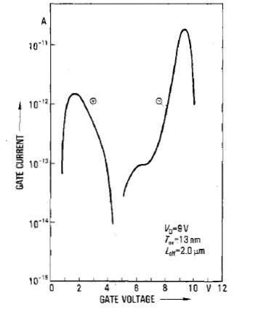
Gate Current (Hot Carrier)
Electron
NMOS, Gate Current
Electron injection for V_{G} > V_{D}/2
Hole injection for V_{G} < V_{D}/2
Negligible at V_{G} ~ V_{D}/2 (Due to injection of both electrons and holes)
Hole
Hofmann, TED 1985

Slide 5
Explanation of V_{G} Dependence of I_{G}
Lower VG, high M for impact ionization (carrier heating), low I_{D}, negative vertical field near drain favors hole injection
Higher VG, low M for impact ionization (carrier heating), high I_{D}, positive vertical field near drain favors electron injection
High V_{G}
G
Low V_{G}
S
D
B
Surface potential
S
D

Slide 6
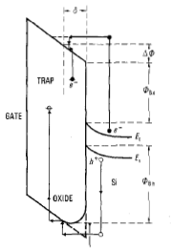
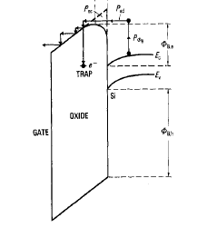
Hole and Electron Injection
Negative vertical field
Positive vertical field
Hofmann, TED 1985

Slide 7
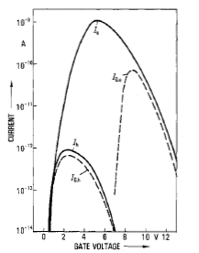
Summary: Substrate and Gate Current
Impact ionization peaks, co injection of holes and electrons
Vertical field is positive near Drain, electron injection, drops at higher V_{G} due to lower E_{LAT}
Vertical field is negative near Drain, hole injection, drops at lower V_{G} due to lower I_{D}
Hofmann, TED 1985

Slide 8
Hot Carrier Degradation
G
G
Non-zero V_{G} and V_{D}
Degradation of drain current
S
D
S
D
B
B
Observed in SiO₂, SiON and HKMG technology → Degradation of channel/oxide interface and oxide bulk
Observed in both NMOS (negative charge) and PMOS (positive charge)
Localized (near drain) degradation → Shift in V_{T} and g_{m}

Slide 9
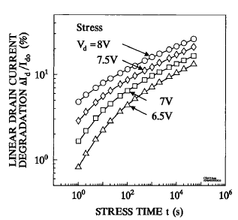
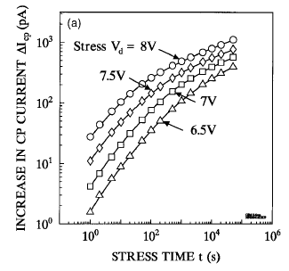
Time Evolution of Degradation
Shift in drain current due to generated interface traps (evidence from charge pumping)
Lifetime: To reach a given degradation level
Ang, MR 1999

Slide 10
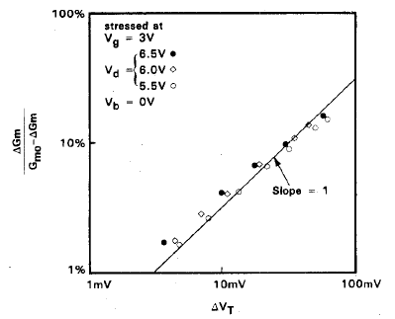
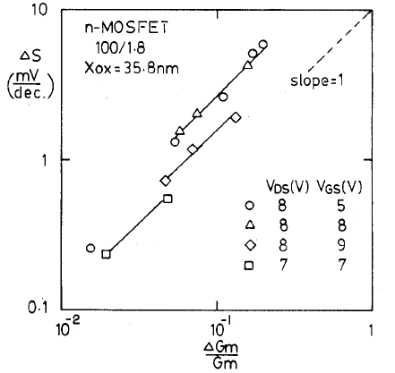
Parametric Shift
Linear correlation between ΔV_{T}, ΔSS, Δg_{m} → Interface traps (another evidence)
Hu, TED 1985

Slide 11
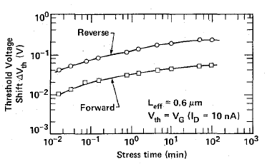
Location of HCD
G
S
D
B
Stress → V_{G} and V_{D} (physical / actual drain)
Forward read → V_{D} at actual drain, damage near actual drain
Reverse read → V_{D} at actual source, damage near electrical source, more impact
Koyanagi, TED 1987

Slide 12
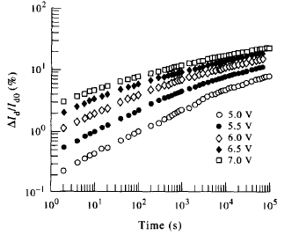
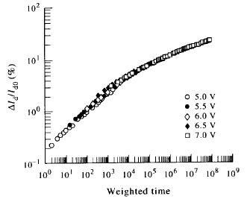
“Universality” of HCD Time Kinetics
Universal relation when time dependence at different stress conditions is shifted along the time axis
Goo, SSE 1995

Slide 13
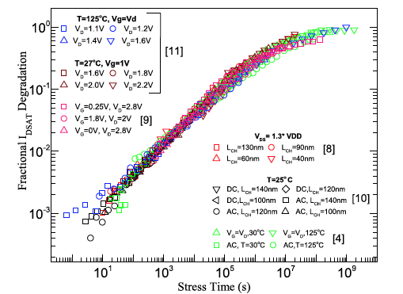
Universal “Universality”
Unique physics governing time kinetics (not understood!)
Planar and FinFET devices, different channel length, different range of V_{D}
Mahapatra, TED 2018

Slide 14
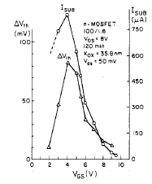
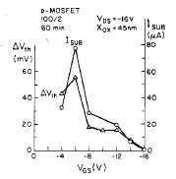
“Classical” Hot Carrier Mechanism
Maximum degradation coincides with peak I_{SUB}
Hu, TED 1985

Slide 15
Lucky Electron Model
NMOS: Channel electrons gain energy from drain bias; one of the following happens:
Impact ionization → I_{SUB}
Some electrons scatter towards oxide and get injected → I_{G}
These electrons can also break H passivated defects → N_{IT}
Hu, TED 1985
G
S
D
B
Driven by peak lateral field near drain junction

Slide 16
Lucky Electron Model
Barrier for I/I
Peak E-field
HC mean free path
Electron injection barrier
Time exponent of HCD
Trap generation barrier
Channel width
Lifetime
Hu, TED 1985

Slide 17
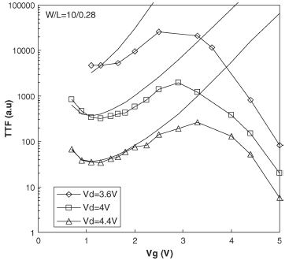
Failure of Lucky Electron Model
LEM
LEM cannot explain V_{G} dependence of lifetime (time to fail) for experiments over wide range of V_{G}
TTF ~ 1/ fixed time degradation
Data
Guerin, TDMR 2007

Slide 18
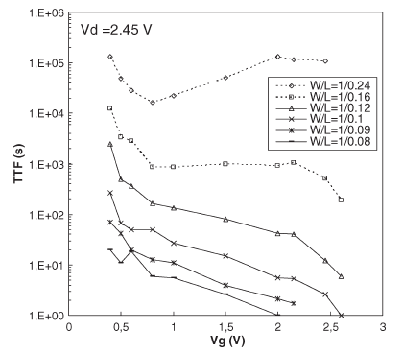
Channel Length Dependence
TTF ~ 1 / fixed time degradation
Non monotonic “U” shaped V_{G} dependence at higher L
Monotonic V_{G} dependence at lower L

Slide 19
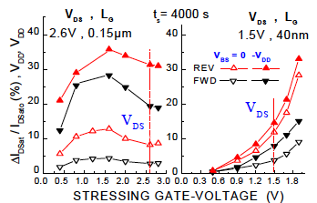
Key Experimental Signatures
Degradation at fixed time
Difference in V_{G} dependence for high L, high V_{D} and low L, low V_{D} experiments
Higher degradation with reverse V_{B}, larger impact for larger L
Reverse read more sensitive
Bravaix, IRPS 2009

Slide 20
Channel Hot Electron (CHE)
Channel electrons are heated by lateral field
Some hot electrons undergo “re-directional” collision and move towards the interface and create damage
High V_{G}
G
High V_{D}
S
D
B

Slide 21
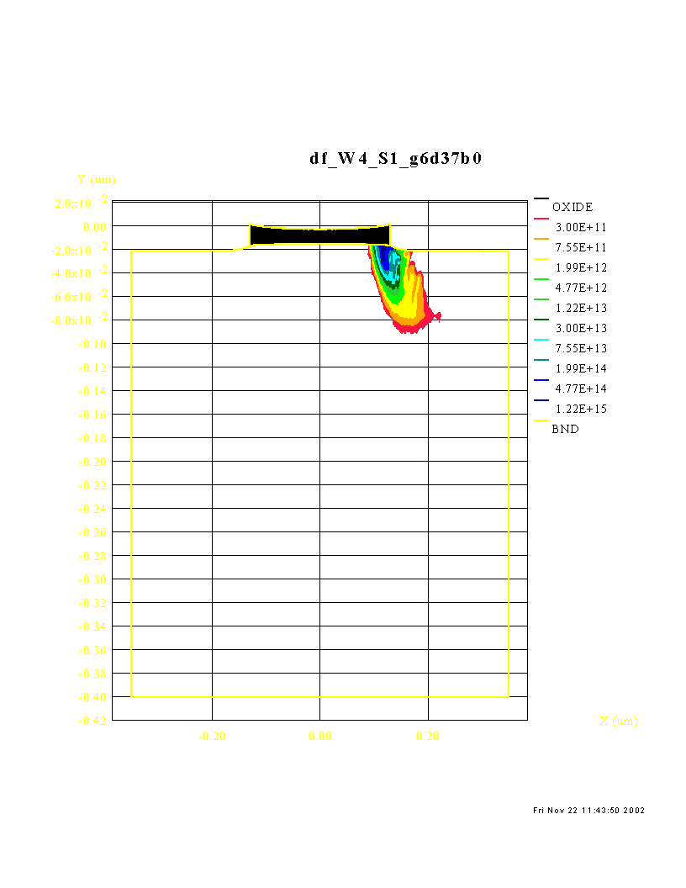
CHE: Hot Electron Generation
L_{G}=0.26μm, V_{FG}=6V, V_{D}=3.7V; Electron energy > 3.1eV
High V_{G}
G
High V_{D}
S
D
B
HED simulation from SMC
PhD thesis: Deelep Nair, IIT Bombay

Slide 22
CHannel Initiated Secondary ELectron
Channel hot electrons create primary EHP by M1
Holes flow to bulk, create secondary EHP by M2
Secondary electrons move towards the interface
Electrons create damage near drain
High V_{G}
G
High V_{D}
S
D
M1
M2
B
V_{B} <0

Slide 23
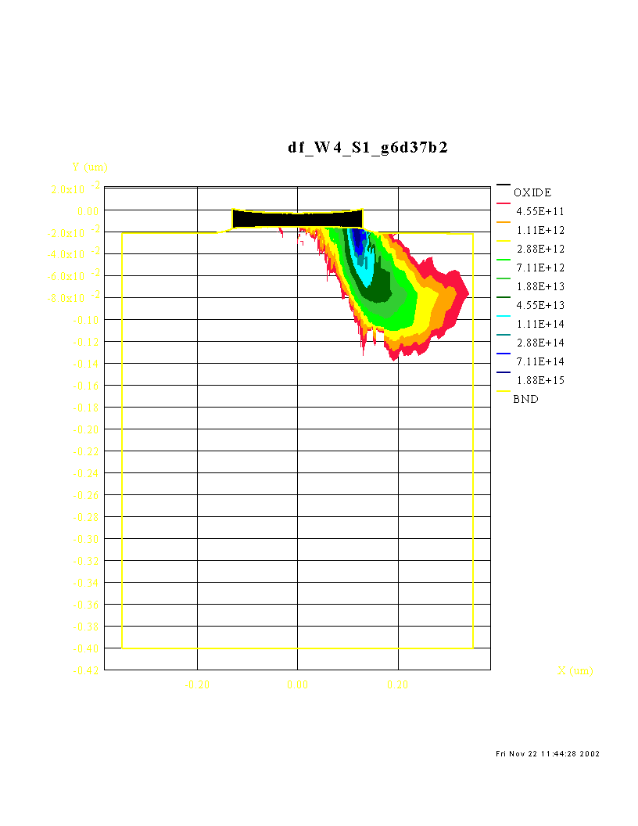
CHISEL: Hot Electron Generation
L_{G}=0.26μm, V_{FG}=6V, V_{D}=3.7V; Electron energy > 3.1eV
High V_{G}
G
High V_{D}
S
D
B
HED simulation from SMC
Broader Damage Area
PhD thesis: Deelep Nair, IIT Bombay

Slide 24
HE Distribution (1D cut along channel)
Broader HED for CHISEL compared to CHE
PhD thesis: Deelep Nair, IIT Bombay

Slide 25
Electron Energy Distribution
Simulated at maximum injection point at the interface
CHISEL offers energetically higher electron energy distribution
PhD thesis: Deelep Nair, IIT Bombay

Slide 26
Energy Driven Model
Lateral field induced heating of channel carriers near drain end
Impact ionization and interface trap generation caused by carrier energy
Carrier energy ~ electric field when V_{D} is very high and LEM would work
Electron-electron scattering plays important role when V_{D} is relatively small, and LEM would not work

Slide 27
Energy Driven Model
Electron energy distribution: f(E)
Impact ionization cross section: S_{II} (E)
Trap generation cross section: S_{IT} (E)
Impact ionization rate
Trap generation rate
More work needed to model HCD
Rauch, TDMR 2005
Guerin, TDMR 2007

