Slide 1
Flash Memory: Cell and Array Fundamentals
Memory operation → Charge storage & V_{T} shift
Basic FG cell structure, coupling
Array architecture (NOR & NAND)
Array operation → Write, Erase, Read & Disturb
Binary & Multi-level cell

Slide 2
MOSFET Fundamentals (1)
V_{G}
V_{G} > V_{T}, inversion layer formation
Current flow when V_{D} > 0
n⁺ Poly-Si
SiO₂
V_{D}
n⁺
e⁻
n⁺
I_{D}
p substrate
V_{G}
V_{T}
I_{D} = μ_{EFF}. C_{OX}. W/L (V_{G} – V_{T} – m/2 V_{D}). V_{D}

Slide 3
MOSFET Fundamentals (2)
V_{G}
Electrons trapped in insulator result in higher V_{T}
Need much higher V_{G} for current flow (no current at lower V_{G})
n⁺ Poly-Si
SiO₂
V_{D}
n⁺
n⁺
I_{D}
p substrate
V_{G}
V_{T}
V_{T}
ΔV_{T} = q. ΔN_{E} / C_{OX}
I_{D} = μ_{EFF}. C_{OX}. W/L (V_{G} – V_{T} – m/2 V_{D}). V_{D}

Slide 4
MOSFET Memory Fundamentals (1)
V_{G}
Insert Poly-Si Floating Gate (FG) inside insulator to store charge
Substrate to FG charge transfer to achieve memory operation
n⁺ Poly-Si
V_{D}
FG charge absent
n⁺
Program
n⁺
Erase
FG charge present
I_{D}
p substrate
V_{READ}
V_{G}
V_{TE}
V_{TP}
Choose V_{READ} between Erase (V_{TE}) and Program (V_{TP}) states

Slide 5
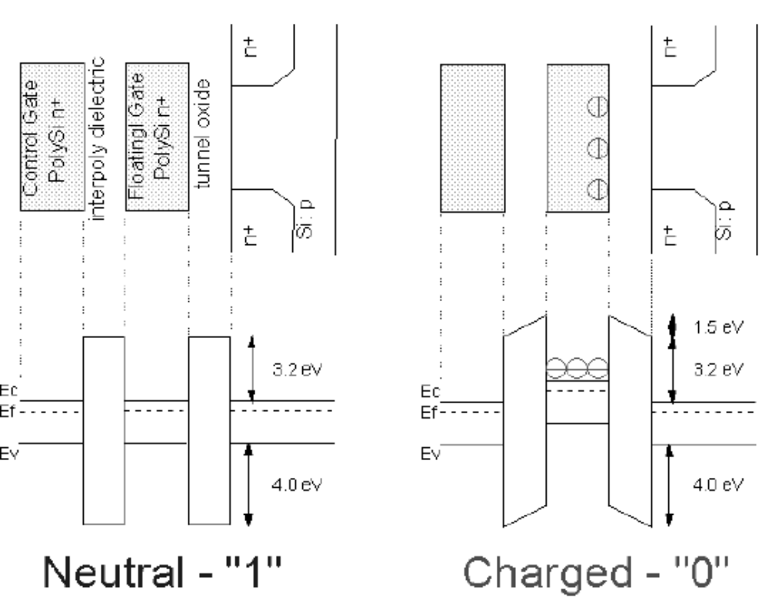
MOSFET Memory Fundamentals (2)
Once electrons are stored, barrier caused by bottom and top dielectric prevents them from leaking out

Slide 6
Memory Array - NOR
BL
Memory cell at each cross point of Bit Line (BL) and Word Line (WL)
Random access
Lower density
Code storage applications
WL

Slide 7
Memory Array - NAND
BL
Drain-Select Tr.
Memory cell string (16 or 32) between Bit Line and Source Line
String selected by Select Transistors
Serial access
Higher density
Data storage applications
WL
Source-Select Tr.
SL

Slide 8
Memory Cell Schematic
Control Gate Poly-Si (100nm-150nm)
Blocking dielectric (Oxide/Nitride/Oxide Stack), EOT ~ 12nm – 15nm
n+ Poly-Si
ONO
Floating Gate Poly-Si (50nm – 80nm)
n+ Poly-Si
Tunnel dielectric, (7nm – 9nm)
SiO₂
n⁺
n⁺
p substrate
Not to scale
Density of electrons in FG
ΔV_{T} = q. ΔN_{E} / C_{ONO}
Capacitance of top layer

Slide 9
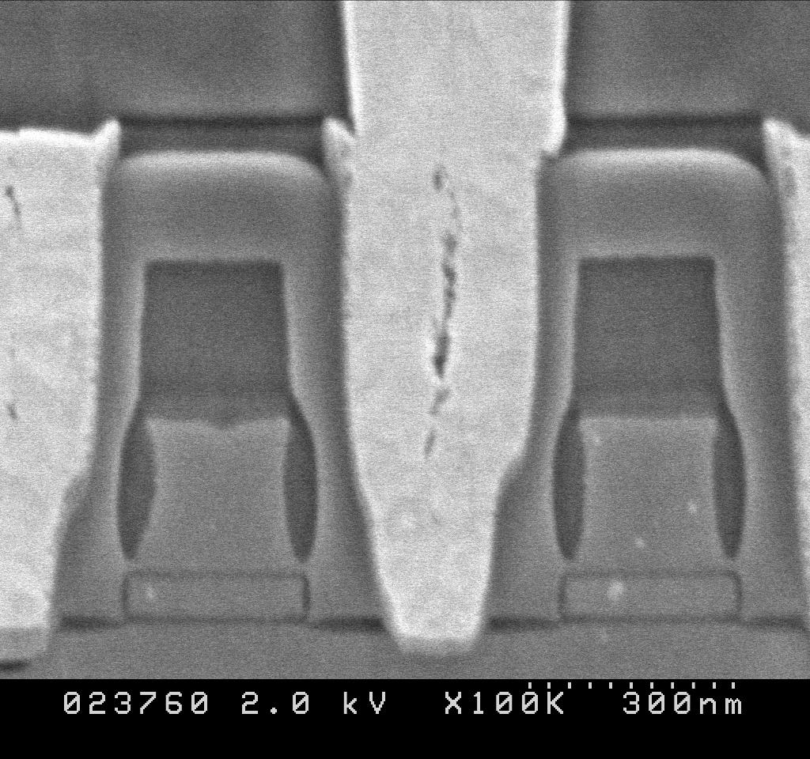
Memory Cell (NOR): SEM Photograph
WL
Source
Contact
BL
FG
CG
IPD
TOX
Figure Courtesy: Hitachi

Slide 10
Memory Cell: Coupling to Floating Gate
Total capacitance:
C_{T} = C_{G} + C_{S} + C_{B} + C_{D}
Coupling coefficients:
α_{G} = C_{G} / C_{T}
α_{B} = C_{B} / C_{T}
α_{S,D} = 1 – (α_{G} + α_{B})
CG
C_{G} (C_{ONO})
FG
C_{S}
C_{B}
C_{D}
n⁺
n⁺
p substrate
Requirement: High α_{G} for high coupling of CG bias to FG

Slide 11
Memory Cell: Coupling to Floating Gate
Spacer
CG
ONO
FG
n⁺
n⁺
p substrate
Reliability requirement: ONO thickness > tunnel oxide
CG & ONO wraps around (W direction) to maintain coupling

Slide 12
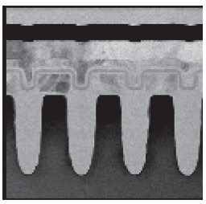
Memory Cell (NAND): SEM Photograph
CG
ONO-IPD
Word line direction* – increased CG – FG coupling due to sidewall contribution
* S/D perpendicular to slide
FG
Tunnel ox
STI
Si - channel
Figure Courtesy: Samsung

Slide 13
Flash Memory Terminology
Program (Write): Transfer of charges from substrate to FG
Erase: Transfer of charges from FG to substrate
Read: Determine the memory state (programmed / erased) of a cell
Cycling endurance: How many times a cell can be written and erased
Retention: Once written, how long can the cell hold its state
Disturb: Unintentional program / erase of a cell due to program (other cells) or read (same cell)

Slide 14
NOR: Program mechanism
BL
Program:
Gate: WL ~ +10V
Drain: BL ~ +5V
Channel Hot Electron (CHE) injection of select cell
Fast programming
WL

Slide 15
NOR: Program induced disturb mechanisms
BL
Drain disturb: Cells sharing same BL of the programmed cell
Charge gain (V_{T} rise) from erased state
Charge loss (V_{T} drop) from programmed state
WL
Cells with high drain bias and 0 gate bias

Slide 16
NOR: Program induced disturb mechanisms
BL
Gate disturb: Cells sharing same WL of the programmed cell
Charge gain (V_{T} rise) from erased state
Charge loss (V_{T} drop) from programmed state
WL
Cells with high gate bias and 0 drain bias

Slide 17
NOR: Erase mechanism
BL
Erase:
Gate: WL ~ −20V
Drain: BL = 0
Fowler Nordheim tunneling of electrons from all cells in a block
(Erase in a Flash!!!)
WL

Slide 18
NOR: Read mechanism
BL
Read:
Gate: WL ~ V_{READ} (set between program (V_{TP}) and erase (V_{TE}) state
Drain: BL ~ 2V (lower than program)
Read selected cell (random access)
WL
Read disturb: Soft programming due to repeated read

Slide 19
NAND: Program and Erase mechanisms
BL
Drain-Select Tr.
Program: WL ~ +20V
Fowler Nordheim tunneling of electrons from substrate to FG
Erase: WL ~ −20V Fowler Nordheim tunneling of electrons from FG to substrate
WL
Source-Select Tr.
SL

Slide 20
NAND: Read mechanism
BL
Select string
Apply V_{WL} (V_{PASS}) > V_{TP} for all WL (except the target WL) – all cells will conduct irrespective of state (program or erase)
Apply V_{WL} = V_{READ} (between program (V_{TP}) and erase (V_{TE}) on target WL
Cell will only conduct if in erased state → string current
Drain-Select Tr.
WL
Source-Select Tr.
SL

Slide 21
NAND: Read disturb mechanism
BL
Pass voltage to non-targeted WL
V_{WL} (V_{PASS}) > V_{TP}
Soft program (FN electron injection from substrate to FG)
Soft erase (FN electron injection from FG to CG)
Drain-Select Tr.
WL
Source-Select Tr.
SL

Slide 22
2T EEPROM – P/E/R mechanism
Program: FN
Erase: FN
Read: Select assist
V_{G}
WL
BL

Slide 23
Channel Hot Electron (CHE) Injection
Channel electrons are heated by lateral field
Some hot electrons undergo “re-directional” collision and move towards the interface
Hot electrons having E>3.1 eV get injected into gate (localized near D)
High V_{G}
CG
FG
High V_{D}
S
D
B

Slide 24
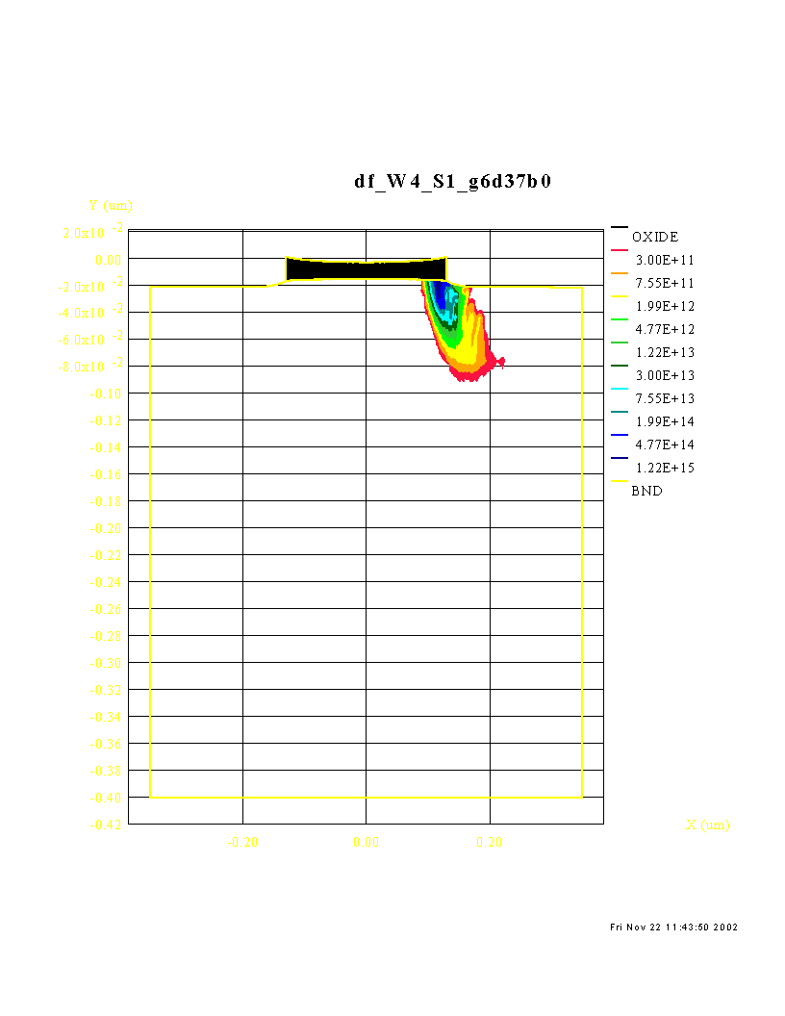
CHE: Hot Electron Generation
L_{FG}=0.26μm, V_{FG}=6V, V_{D}=3.7V; Electron energy > 3.1eV
CG
FG
S
D
B
HED simulation from SMC
PhD thesis: Deelep Nair, IIT Bombay

Slide 25
CHannel Initiated Secondary ELectron Injection
Channel hot electrons create primary EHP by M1
Holes flow to bulk, create secondary EHP by M2
Secondary electrons move towards the interface
Electrons having E>3.1 eV get injected into gate (localized near D)
Fully dependent on impact ionization
High V_{G}
CG
FG
High V_{D}
S
D
M1
M2
B
V_{B} <0 programming

Slide 26
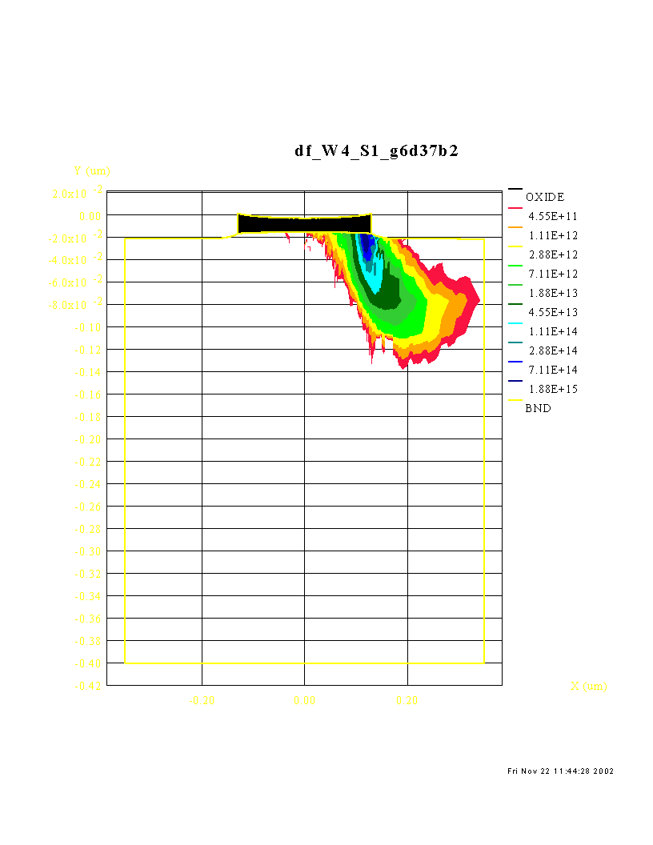
CHISEL: Hot Electron Generation
L_{FG}=0.26μm, V_{FG}=6V, V_{D}=3.7V; Electron energy > 3.1eV
CG
FG
S
D
B
HED simulation from SMC
Broader Injection Area
PhD thesis: Deelep Nair, IIT Bombay

Slide 27
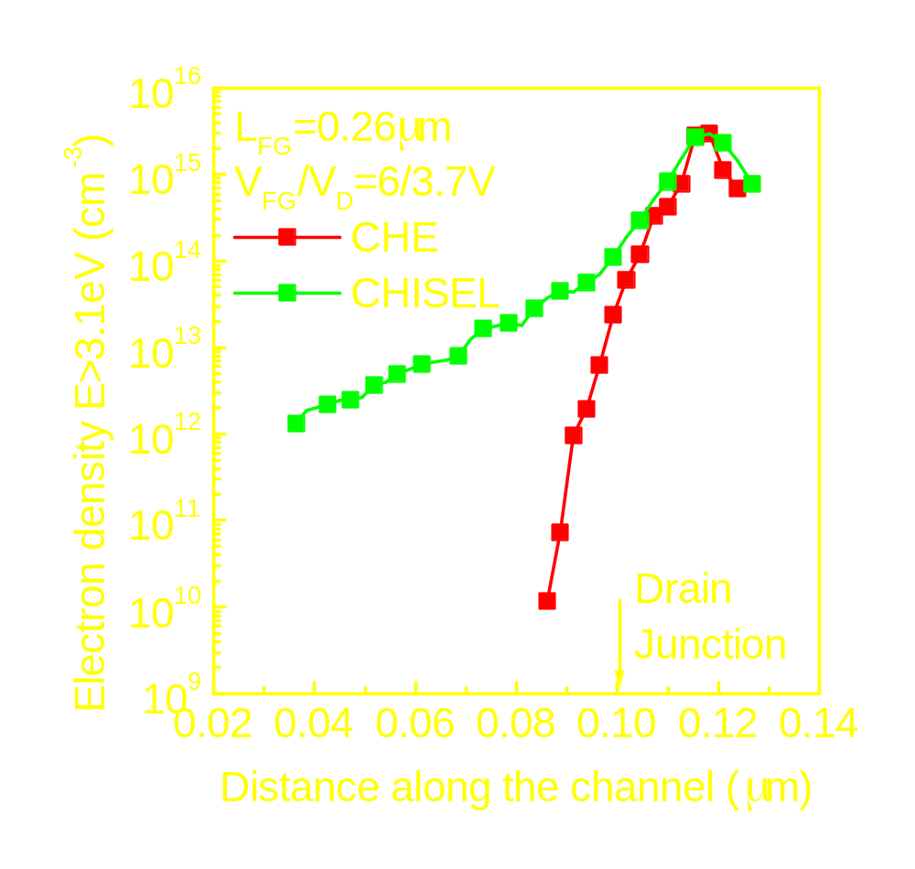
Hot Electron Distribution (1D cut along channel)
Broader HED for CHISEL compared to CHE
PhD thesis: Deelep Nair, IIT Bombay

Slide 28
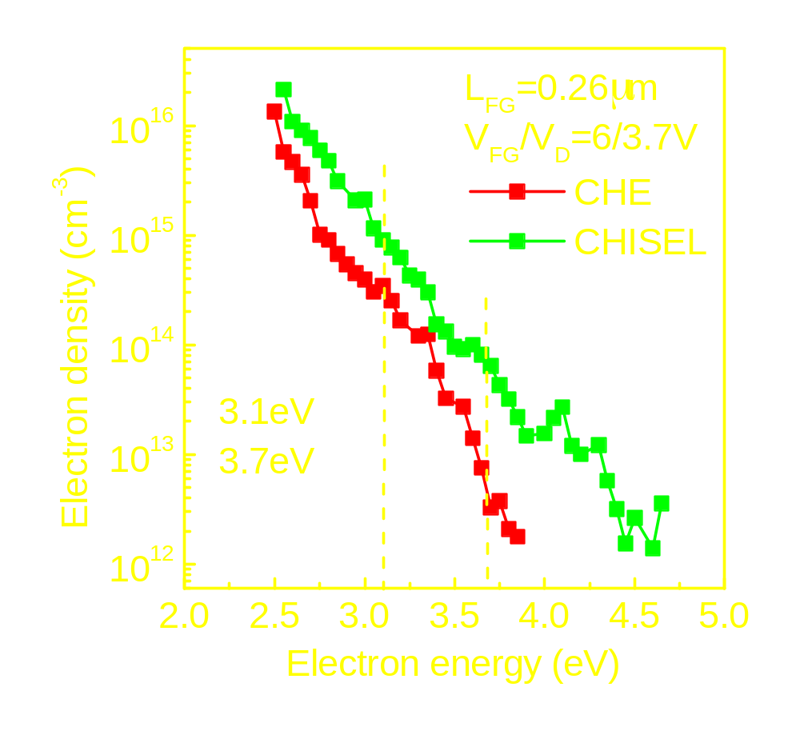
Electron Energy Distribution
Simulated at maximum injection point at the interface
CHISEL offers energetically higher electron energy distribution
PhD thesis: Deelep Nair, IIT Bombay

Slide 29
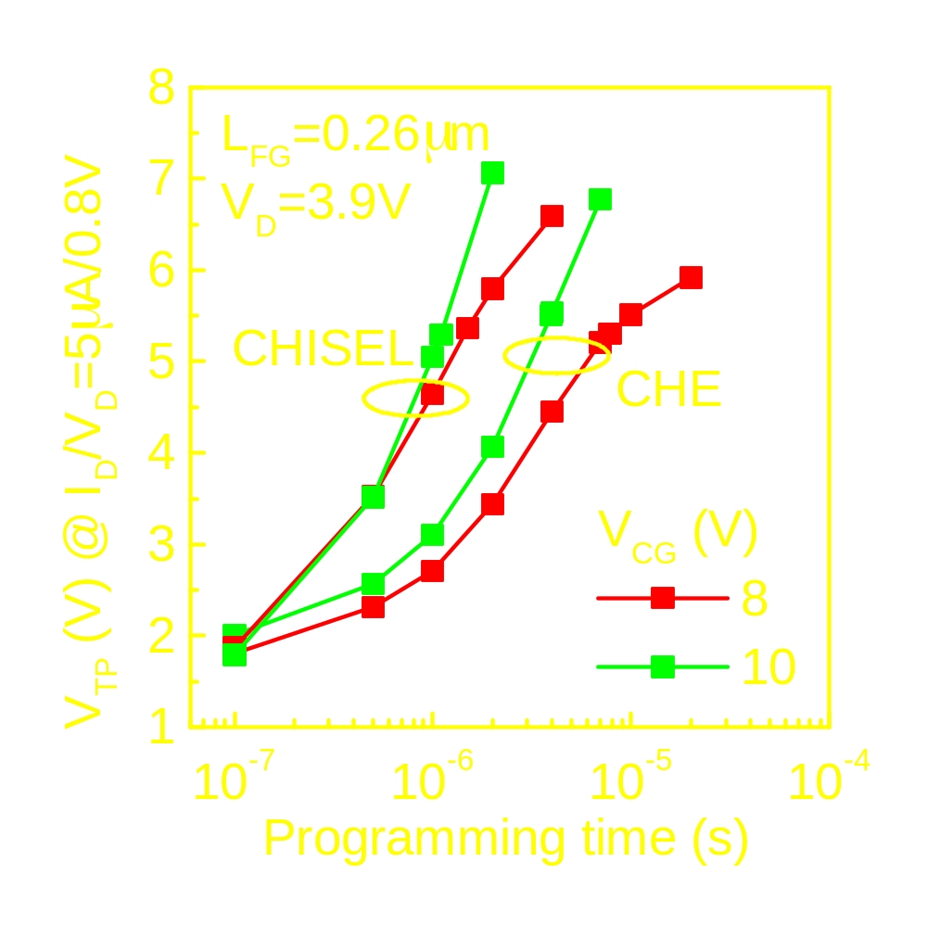
CHE & CHISEL Programming Transients
Programmed at different V_{CG} values (V_{D} constant)
CHISEL offers faster programming at identical bias
PhD thesis: Deelep Nair, IIT Bombay

Slide 30
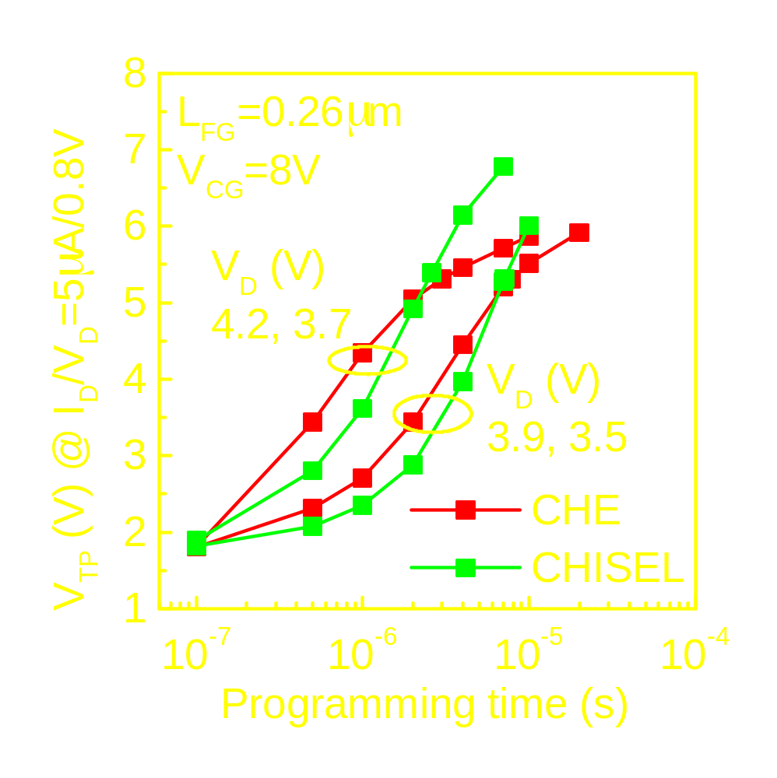
CHE & CHISEL Programming Transients
Similar programming time obtained by varying V_{D} only
CHISEL offers similar programming time at lower V_{D}
PhD thesis: Deelep Nair, IIT Bombay

Slide 31
Fowler Nordheim Program
High +V_{G} at CG
Coupling of α_{G}.V_{G} at FG
Tunneling of electrons from channel to FG
High CG-FG coupling (low CG-FG V-drop) and thicker ONO layer ensures negligible electron leakage to CG
Uniform injection
High +V_{G}
Poly-Si
n⁺
n⁺
p substrate
All other terminals grounded

Slide 32
Energy bands: Fowler Nordheim Program
FG
Substrate
FN tunneling of electrons from substrate to FG
Thicker ONO layer prevents tunneling out to CG
S/D helps inversion layer buildup (fast response) as gate is pulsed
CG
SiO₂
ONO

Slide 33
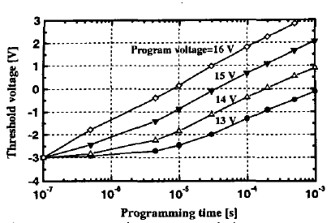
FN program transients
Program time ~ 100’s μs
Program V_{G} increase by 1V → V_{TP} increase by 1V
Figure Courtesy: Samsung

Slide 34
Fowler Nordheim Erase
High -V_{G} at CG
Coupling of α_{G}.V_{G} at FG
Tunneling of electrons from FG to channel
High CG-FG coupling (low CG-FG V-drop) and thicker ONO layer ensures negligible electron tunneling from CG
Uniform ejection
High -V_{G}
Poly-Si
n⁺
n⁺
p substrate
All other terminals grounded

Slide 35
Energy bands: Fowler Nordheim Erase
FN tunneling of electrons from FG to substrate
Thicker ONO layer prevents tunneling from CG
Hole injection from substrate to FG helps erase (over erase)
CG
FG
ONO
Substrate
SiO₂

Slide 36
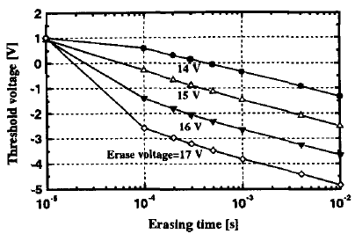
FN erase transients
Erase time ~ 100’s μs
Erase |V_{G}| increase by 1V → V_{TE} reduces by 1V
V_{TE} <0 implies hole injection
Figure Courtesy: Samsung

Slide 37
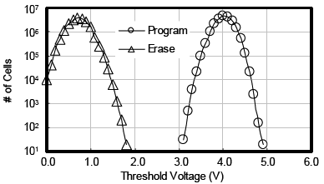
Array: Threshold Voltage Distribution
All cells in an array are not identical (statistical fluctuation)
Distribution in V_{TP} and V_{TE} levels
Target window
Example: 2Mb array
Target V_{TP}
Target V_{TE}
Figure Courtesy: Samsung

Slide 38
Multi – Level Cell
Read-Verification points
No. of cells
00
01
10
11
Threshold voltage
Larger overall memory window
Tighter distribution at each level
Smaller gap between levels

