Slide 1
Imperfect Competition:
Monopoly, Monopolistic Competition & Oligopoly
K. Narayanan
For HS 101

Slide 2
Monopoly
While a competitive firm is a price taker, a monopoly firm is a price maker.
A firm is considered a monopoly if . . .
  it is the sole seller of its product.
  its product does not have close substitutes.

Slide 3
WHY MONOPOLIES ARISE
The fundamental cause of monopoly is barriers to entry.

Slide 4
WHY MONOPOLIES ARISE
Barriers to entry have three sources:
  Ownership of a key resource.
  The government gives a single firm the exclusive right to produce some good.
  Costs of production make a single producer more efficient than a large number of producers.

Slide 5
Monopoly Resources
Although exclusive ownership of a key resource is a potential source of monopoly, in practice monopolies rarely arise for this reason.

Slide 6
Government-Created Monopolies
Governments may restrict entry by giving a single firm the exclusive right to sell a particular good in certain markets.
Patent and copyright laws are two important examples of how government creates a monopoly to serve the public interest.

Slide 7
Natural Monopolies
An industry is a natural monopoly when a single firm can supply a good or service to an entire market at a smaller cost than could two or more firms.
A natural monopoly arises when there are economies of scale over the relevant range of output.

Slide 8
Figure 1 Economies of Scale as a Cause of Monopoly
Cost
Average
total
cost
0
Quantity of Output

Slide 9
HOW MONOPOLIES MAKE PRODUCTION AND PRICING DECISIONS
Monopoly versus Competition
  Monopoly
    Is the sole producer
    Faces a downward-sloping demand curve
    Is a price maker
    Reduces price to increase sales
  Competitive Firm
    Is one of many producers
    Faces a horizontal demand curve
    Is a price taker
    Sells as much or as little at same price

Slide 10
Figure 2 Demand Curves for Competitive and Monopoly Firms
(a) A Competitive Firm
’
s Demand Curve
(b) A Monopolist
’
s Demand Curve
Price
Price
Demand
Demand
0
Quantity of Output
0
Quantity of Output
Since a monopoly is the sole producer in its market, it faces the market demand curve.

Slide 11
A Monopoly’s Revenue
Total Revenue
  P × Q = TR
Average Revenue
  TR/Q = AR = P
Marginal Revenue
  ∆TR/∆ Q = MR

Slide 12
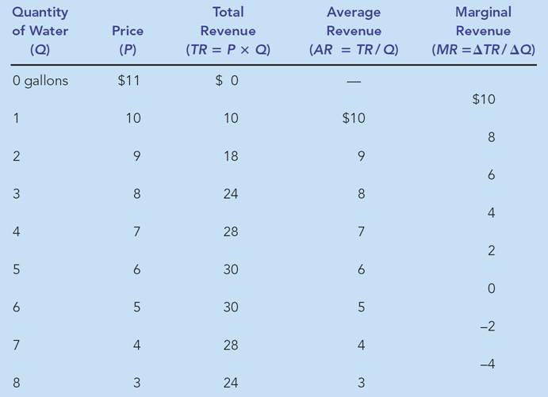
Table 1 A Monopoly’s Total, Average, and Marginal Revenue

Slide 13
A Monopoly’s Revenue
A Monopoly’s Marginal Revenue
  A monopolist’s marginal revenue is always less than the price of its good.
    The demand curve is downward sloping.
    When a monopoly drops the price to sell one more unit, the revenue received from previously sold units also decreases.

Slide 14
A Monopoly’s Revenue
A Monopoly’s Marginal Revenue
  When a monopoly increases the amount it sells, it has two effects on total revenue (P × Q).
    The output effect—more output is sold, so Q is higher.
    The price effect—price falls, so P is lower.

Slide 15
Figure 3 Demand and Marginal-Revenue Curves for a Monopoly
Price
If a monopoly wants to sell more, it must lower price.
$11
10
Price falls for ALL units sold.
9
8
This is why MR is < P.
7
6
5
4
3
Demand
2
Marginal
(average
1
revenue
revenue)
0
–1
1
2
3
4
5
6
7
8
Quantity of Water
–2
–3
–4

Slide 16
Profit Maximization
A monopoly maximizes profit by producing the quantity at which marginal revenue equals marginal cost.
It then uses the demand curve to find the price that will induce consumers to buy that quantity.

Slide 17
Figure 4 Profit Maximization for a Monopoly
Costs and
Revenue
2. . . . and then the demand
1. The intersection of the
curve shows the price
marginal-revenue curve
consistent with this quantity.
and the marginal-cost
curve determines the
B
profit-maximizing
Monopoly
quantity . . .
price
Average total cost
A
Marginal
Demand
cost
Marginal revenue
0
Q
Q_{MAX}
Q
Quantity

Slide 18
Profit Maximization
Comparing Monopoly and Competition
  For a competitive firm, price equals marginal cost.
    P = MR = MC
  For a monopoly firm, price exceeds marginal cost.
    P > MR = MC
Remember, all profit-maximizing firms set
MR = MC.

Slide 19
A Monopoly’s Profit
Profit equals total revenue minus total costs.
  Profit = TR – TC
  Profit = (TR/Q – TC/Q) × Q
  Profit = (P – ATC) × Q

Slide 20
Figure 5 The Monopolist’s Profit
Costs and
Revenue
Marginal cost
Monopoly
E
B
price
Monopoly
Average total cost
profit
Average
total
D
C
cost
Demand
Marginal revenue
0
Q_{MAX}
Quantity

Slide 21
A Monopolist’s Profit
The monopolist will receive economic profits as long as price is greater than average total cost.

Slide 22
Figure 6 The Market for Drugs
Costs and
Revenue
Price
during
patent life
Price after
Marginal
patent
cost
expires
Marginal
Demand
revenue
0
Monopoly
Competitive
Quantity
quantity
quantity

Slide 23
THE WELFARE COST OF MONOPOLY
In contrast to a competitive firm, the monopoly charges a price above the marginal cost.
From the standpoint of consumers, this high price makes monopoly undesirable.
However, from the standpoint of the owners of the firm, the high price makes monopoly very desirable.

Slide 24
Figure 7 The Efficient Level of Output
Price
Marginal cost
Value
Cost
to
to
buyers
monopolist
Demand
Cost
Value
(value to buyers)
to
to
monopolist
buyers
0
Quantity
Value to buyers
Value to buyers
is greater than
is less than
cost to seller.
cost to seller.
Efficient
quantity

Slide 25
The Deadweight Loss
Because a monopoly sets its price above marginal cost, it places a wedge between the consumer’s willingness to pay and the producer’s cost.
  This wedge causes the quantity sold to fall short of the social optimum.

Slide 26
Figure 8 The Inefficiency of Monopoly
Price
Deadweight
Marginal cost
loss
Monopoly
price
Marginal
revenue
Demand
0
Monopoly
Efficient
Quantity
quantity
quantity

Slide 27
The Deadweight Loss
The Inefficiency of Monopoly
  The monopolist produces less than the socially efficient quantity of output.

Slide 28
The Monopoly’s Profit: A Social Cost?
The deadweight loss caused by a monopoly is similar to the deadweight loss caused by a tax.
The difference between the two cases is that the government gets the revenue from a tax, whereas a private firm gets the monopoly profit.

Slide 29
PUBLIC POLICY TOWARD MONOPOLIES
Government responds to the problem of monopoly in one of four ways.
  Making monopolized industries more competitive.
  Regulating the behavior of monopolies.
  Turning some private monopolies into public enterprises.
  Doing nothing at all.

Slide 30
Increasing Competition with Antitrust Laws
Antitrust laws are a collection of statutes aimed at curbing monopoly power.
Antitrust laws give government various ways to promote competition.
  They allow government to prevent mergers.
  They allow government to break up companies.
  They prevent companies from performing activities that make markets less competitive.

Slide 31
Regulation
Government may regulate the prices that the monopoly charges.
  The allocation of resources will be efficient if price is set to equal marginal cost.

Slide 32
Figure 9 Marginal-Cost Pricing for a Natural Monopoly
Price
If regulators set P = MC, the natural monopoly will lose money.
Average total
cost
Average total cost
Loss
Regulated
price
Marginal cost
Demand
0
Quantity

Slide 33
Regulation
In practice, regulators will allow monopolists to keep some of the benefits from lower costs in the form of higher profit, a practice that requires some departure from marginal-cost pricing.

Slide 34
Public Ownership
Rather than regulating a natural monopoly that is run by a private firm, the government can run the monopoly by itself (e.g. in India, the government runs the Railways and Postal Service).

Slide 35
Doing Nothing
Government can do nothing at all if the market failure is deemed small compared to the imperfections of public policies.

Slide 36
PRICE DISCRIMINATION
Price discrimination is the business practice of selling the same good at different prices to different customers, even though the costs for producing for the two customers are the same.

Slide 37
The Analytics of Price Discrimination
Price discrimination is not possible when a good is sold in a competitive market since there are many firms all selling at the market price. In order to price discriminate, the firm must have some market power.
Perfect Price Discrimination
  Perfect price discrimination refers to the situation when the monopolist knows exactly the willingness to pay of each customer and can charge each customer a different price.

Slide 38
The Analytics of Price Discrimination
Two important effects of price discrimination:
  It can increase the monopolist’s profits.
  It can reduce deadweight loss.

Slide 39
Figure 10 Welfare with and without Price Discrimination
(a) Monopolist with Single Price
Price
Consumer
surplus
Monopoly
Deadweight
price
loss
Profit
Marginal cost
Marginal
Demand
revenue
0
Quantity sold
Quantity

Slide 40
Figure 10 Welfare with and without Price Discrimination
(b) Monopolist with Perfect Price Discrimination
Price
Consumer surplus and deadweight loss have both been converted into profit.
Every consumer gets charged a different price -- the highest price they are willing to pay -- so in this special case, the demand curve is also MR!
Profit
Marginal cost
Demand
Marginal revenue
0
Quantity sold
Quantity

Slide 41
Examples of Price Discrimination
Movie tickets
Airline prices
Discount coupons
Financial aid
Quantity discounts

Slide 42
CONCLUSION: THE PREVALENCE OF MONOPOLY
How prevalent are the problems of monopolies?
  Monopolies are common.
  Most firms have some control over their prices because of differentiated products.
  Firms with substantial monopoly power are rare.
  Few goods are truly unique.

Slide 43
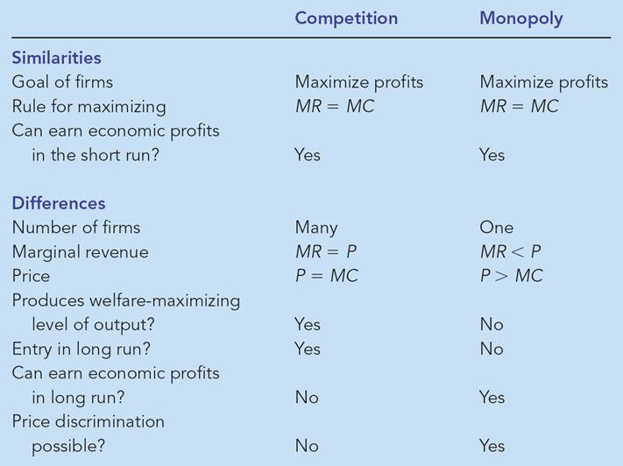
Table 2 Competition versus Monopoly: A Summary Comparison

Slide 44
Monopolistic Competition
Imperfect competition refers to those market structures that fall between perfect competition and pure monopoly.

Slide 45
Monopolistic Competition
Types of Imperfectly Competitive Markets
  Monopolistic Competition
    Many firms selling products that are similar but not identical.
  Oligopoly
    Only a few sellers, each offering a similar or identical product to the others.

Slide 46
Monopolistic Competition
Markets that have some features of competition and some features of monopoly.
Attributes of monopolistic competition:
  Many sellers
  Product differentiation
  Free entry and exit

Slide 47


Monopolistic Competition
Many Sellers
  There are many firms competing for the same group of customers.
    Product examples include books, CDs, movies, computer games, restaurants, piano lessons, cookies, furniture, etc.

Slide 48
Monopolistic Competition
Product Differentiation
  Each firm produces a product that is at least slightly different from those of other firms.
  Rather than being a price taker, each firm faces a downward-sloping demand curve.

Slide 49
Monopolistic Competition
Free Entry or Exit
Firms can enter or exit the market without restriction.
The number of firms in the market adjusts until economic profits are zero.

Slide 50
COMPETITION WITH DIFFERENTIATED PRODUCTS
The Monopolistically Competitive Firm in the Short Run
  Short-run economic profits encourage new firms to enter the market. This:
    Increases the number of products offered.
    Reduces demand faced by firms already in the market.
    Incumbent firms’ demand curves shift to the left.
    Demand for the incumbent firms’ products fall, and their profits decline.

Slide 51
Figure 1 Monopolistic Competition in the Short Run
(a) Firm Makes Profit
Price
MC
ATC
Price
Average
total cost
Demand
Profit
MR
0
Profit-
Quantity
maximizing
quantity

Slide 52
The Monopolistically Competitive Firm in the Short Run
Short-run economic losses encourage firms to exit the market.
  Decreases the number of products offered.
  Increases demand faced by the remaining firms.
  Shifts the remaining firms’ demand curves to the right.
  Increases the remaining firms’ profits.

Slide 53
Figure 1 Monopolistic Competitors in the Short Run
(b) Firm Makes Losses
Price
MC
ATC
Losses
Average
total cost
Price
MR
Demand
0
Loss-
Quantity
minimizing
quantity

Slide 54
The Long-Run Equilibrium
Firms will enter and exit until the firms are making exactly zero economic profits.

Slide 55
Figure 2 A Monopolistic Competitor in the Long Run
Price
MC
ATC
The demand curve is tangent to the ATC curve.
P
=
ATC
And this tangency lies vertically above the intersection of MR and MC.
Demand
MR
0
Profit-maximizing
Quantity
quantity

Slide 56
The Long-Run Equilibrium
Two Characteristics
  As in a monopoly, price exceeds marginal cost.
    Profit maximization requires marginal revenue to equal marginal cost.
    The downward-sloping demand curve makes marginal revenue less than price.
  As in a competitive market, price equals average total cost.
    Free entry and exit drive economic profit to zero.

Slide 57
Monopolistic versus Perfect Competition
There are two noteworthy differences between monopolistic and perfect competition:
  Excess capacity
  Markup over marginal cost

Slide 58
Monopolistic versus Perfect Competition
Excess Capacity
  There is no excess capacity in perfect competition in the long run.
  Free entry results in competitive firms producing at the point where average total cost is minimized, which is the efficient scale of the firm.
  There is excess capacity in monopolistic competition in the long run.
  In monopolistic competition, output is less than the efficient scale of perfect competition.

Slide 59
Figure 3 Monopolistic versus Perfect Competition
(a) Monopolistically Competitive Firm
(b) Perfectly Competitive Firm
Price
Price
MC
ATC
MC
ATC
P
P
=
MC
P
=
MR
(demand
curve)
MR
Demand
0
Quantity
Efficient
Quantity
0
Quantity produced =
Quantity
produced
scale
Efficient scale

Slide 60
Monopolistic versus Perfect Competition
Markup over Marginal Cost
  For a competitive firm, price equals marginal cost.
  For a monopolistically competitive firm, price exceeds marginal cost.
  Because price exceeds marginal cost, an extra unit sold at the posted price means more profit for the monopolistically competitive firm.

Slide 61
Figure 3 Monopolistic versus Perfect Competition
(a) Monopolistically Competitive Firm
(b) Perfectly Competitive Firm
Price
Price
MC
ATC
MC
ATC
Markup
P
P
=
MC
P
=
MR
(demand
Marginal
curve)
cost
MR
Demand
0
Quantity
Quantity
0
Quantity produced
Quantity
produced

Slide 62
Figure 3 Monopolistic versus Perfect Competition
(a) Monopolistically Competitive Firm
(b) Perfectly Competitive Firm
Price
Price
MC
ATC
MC
ATC
Markup
P
P
=
MC
P
=
MR
(demand
Marginal
curve)
cost
MR
Demand
0
Quantity
Efficient
Quantity
0
Quantity produced =
Quantity
produced
scale
Efficient scale
Excess capacity

Slide 63
Monopolistic Competition and the Welfare of Society
Monopolistic competition does not have all the desirable properties of perfect competition.

Slide 64
Monopolistic Competition and the Welfare of Society
There is the normal deadweight loss of monopoly pricing in monopolistic competition caused by the markup of price over marginal cost.
However, the administrative burden of regulating the pricing of all firms that produce differentiated products would be overwhelming.

Slide 65
Monopolistic Competition and the Welfare of Society
Another way in which monopolistic competition may be socially inefficient is that the number of firms in the market may not be the “ideal” one. There may be too much or too little entry.

Slide 66
Monopolistic Competition and the Welfare of Society
Externalities of entry include:
  Product-variety externalities.
    Because consumers get some consumer surplus from the introduction of a new product, entry of a new firm conveys a positive externality on consumers.
  Business-stealing externalities.
    Because other firms lose customers and profits from the entry of a new competitor, entry of a new firm imposes a negative externality on existing firms.

Slide 67
ADVERTISING
When firms sell differentiated products and charge prices above marginal cost, each firm has an incentive to advertise in order to attract more buyers to its particular product.

Slide 68
ADVERTISING
Firms that sell highly differentiated consumer goods typically spend between 10 and 20 percent of revenue on advertising.
Overall, about 2 percent of total revenue, or over $200 billion a year, is spent on advertising.

Slide 69
The Debate over Advertising
Critics of advertising argue that firms advertise in order to manipulate people’s tastes.
They also argue that it impedes competition by implying that products are more different than they truly are.

Slide 70
The Debate over Advertising
Defenders argue that advertising provides information to consumers
They also argue that advertising increases competition by offering a greater variety of products and prices.

Slide 71
Advertising as a Signal of Quality
The willingness of a firm to spend advertising dollars can be a signal to consumers about the quality of the product being offered.

Slide 72
Brand Names
Critics argue that brand names cause consumers to perceive differences that do not really exist.

Slide 73
Brand Names
Economists have argued that brand names may be a useful way for consumers to ensure that the goods they are buying are of high quality.
  providing information about quality.
  giving firms incentive to maintain high quality.

Slide 74
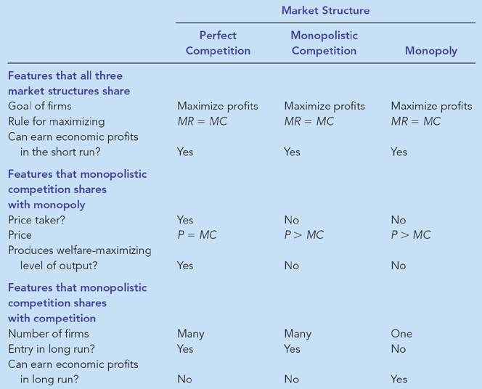
Table 1 Monopolistic Competition: Between Perfect Competition and Monopoly

Slide 75
BETWEEN MONOPOLY AND PERFECT COMPETITION
Imperfect competition refers to those market structures that fall between perfect competition and pure monopoly.
Imperfect competition includes industries in which firms have competitors but do not face so much competition that they are price takers.

Slide 76
BETWEEN MONOPOLY AND PERFECT COMPETITION
Types of Imperfectly Competitive Markets
  Oligopoly
    Only a few sellers, each offering a similar or identical product to the others.
  Monopolistic Competition
    Many firms selling products that are similar but not identical.

Slide 77
MARKETS WITH ONLY A FEW SELLERS
Because of the few sellers, the key feature of oligopoly is the tension between cooperation and self-interest.
Characteristics of an Oligopoly Market
  Few sellers offering similar or identical products
  Interdependent firms
  Best off cooperating and acting like a monopolist by producing a small quantity of output and charging a price above marginal cost

Slide 78
A Duopoly Example
A duopoly is an oligopoly with only two members. It is the simplest type of oligopoly.

Slide 79
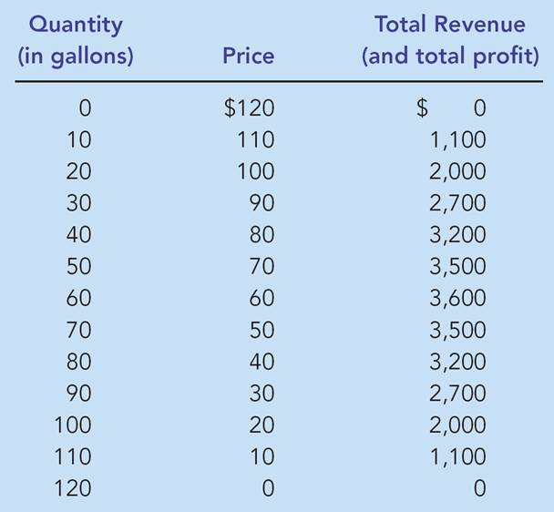
Table 1 The Demand Schedule for Water

Slide 80
A Duopoly Example
Price and Quantity Supplied
  The price of water in a perfectly competitive market would be driven to where the marginal cost is zero:
    P = MC = $0
    Q = 120 gallons
  The price and quantity in a monopoly market would be where total profit is maximized:
    P = $60
    Q = 60 gallons

Slide 81
A Duopoly Example
Price and Quantity Supplied
  The socially efficient quantity of water is 120 gallons, but a monopolist would produce only 60 gallons of water.
  So what outcome then could be expected from duopolists?

Slide 82
The Market for Water
Cost
In a competitive market, quantity would equal 120 and P = MC = $0.
$120
A monopoly would produce 60 gallons and charge $60. Note that P > MC.
$60
Total industry output with a duopoly will probably exceed 60, but be less than 120.
Demand
MC is constant and = $0.
0
60
120
Quantity of Output
Marginal Revenue

Slide 83
Competition, Monopolies, and Cartels
The duopolists may agree on a monopoly outcome.
  Collusion
    An agreement among firms in a market about quantities to produce or prices to charge.
  Cartel
    A group of firms acting in unison.

Slide 84
Competition, Monopolies, and Cartels
Although oligopolists would like to form cartels and earn monopoly profits, often that is not possible. Antitrust laws prohibit explicit agreements among oligopolists as a matter of public policy.

Slide 85
The Equilibrium for an Oligopoly
A Nash equilibrium is a situation in which economic actors interacting with one another each choose their best strategy given the strategies that all the others have chosen.

Slide 86
The Equilibrium for an Oligopoly
When firms in an oligopoly individually choose production to maximize profit, they produce quantity of output greater than the level produced by monopoly and less than the level produced by competition.
The oligopoly price is less than the monopoly price but greater than the competitive price (which equals marginal cost).

Slide 87
Equilibrium for an Oligopoly
Summary
  Possible outcome if oligopoly firms pursue their own self-interests:
    Joint output is greater than the monopoly quantity but less than the competitive industry quantity.
    Market prices are lower than monopoly price but greater than competitive price.
    Total profits are less than the monopoly profit.

Slide 88
How the Size of an Oligopoly Affects the Market Outcome
How increasing the number of sellers affects the price and quantity:
  The output effect: Because price is above marginal cost, selling more at the going price raises profits.
  The price effect: Raising production will increase the amount sold, which will lower the price and the profit per unit on all units sold.

Slide 89
How the Size of an Oligopoly Affects the Market Outcome
As the number of sellers in an oligopoly grows larger, an oligopolistic market looks more and more like a competitive market.
The price approaches marginal cost, and the quantity produced approaches the socially efficient level.

Slide 90
Thank you
For your attention

