Slide 1
Market, Trade and Government
K. Narayanan
HS 101 Economics

Slide 2
What is a Market?
In contemporary Indian economy most economic decisions are made in markets, which are mechanisms through which buyers and sellers meet to trade and to determine prices and quantities for goods and services.
Adam Smith proclaimed that the invisible hand of markets would lead to the optional economic outcome as individuals pursue their own self-interest.
And while markets are far from perfect, they have proved remarkably effective at solving the problem of how, what, and for whom.

Slide 3
Market….
The market mechanism works as follows to determine the what and the how: The rupee votes of people affect prices of goods; these prices serve as guides for the amount of the different goods to be produced. When people demand more of a good, its price will increase and business can profit by expanding production of that good.
Under perfect competition, a business must find the cheapest method of production, efficiently using labour, land, and other factors; otherwise, it will incur losses and be eliminated from the market.

Slide 4
Market….
At the same time that the what and how problems are being resolved by prices, so is the problem of for whom. The distribution of income is determined by the ownership of factors of production (land, labour and capital) and by factor-prices.
People possessing fertile land or the ability to hit home runs will earn many rupee votes to buy consumer goods. Those without property or with skills, colour, or sex that the market undervalues will receive low incomes.

Slide 5
Trade, Money and Capital
As economies develop, they become more specialized. Division of labour allows a task to be broken into a number of smaller chores that can each be mastered and performed more quickly by a single worker.
Specialisation arises from the increasing tendency to use roundabout methods of production that require many specialised skills.
As individuals and countries become increasingly specialised, they tend to concentrate on particular commodities and trade their surplus output for goods produced by others.
Voluntary trade, based on specialisation, benefits all.

Slide 6
Consider your typical day:
You wake up to an alarm clock made in China.
You pour yourself orange juice made from Nagpur oranges and coffee from beans grown in Brazil.
You put on some clothes made of cotton grown in India and sewn in factories in Thailand.
You watch the morning news broadcast from New York on your TV made in Japan.
You drive to class in a car made of parts manufactured in a half-dozen different countries.
. . . and you haven’t been up for more than two hours yet!

Slide 7
Interdependence and the Gains from Trade
Remember, economics is the study of how societies produce and distribute goods in an attempt to satisfy the wants and needs of their members.

Slide 8

Interdependence and the Gains from Trade
How do we satisfy our wants and needs in a global economy?
We can be economically self-sufficient.
We can specialize and trade with others, leading to economic interdependence.

Slide 9
Interdependence and the Gains from Trade
Individuals and nations rely on specialized production and exchange as a way to address problems caused by scarcity.
But this gives rise to two questions:
Why is interdependence the norm?
What determines production and trade?

Slide 10
Interdependence and the Gains from Trade
Why is interdependence the norm?
Interdependence occurs because people are better off when they specialize and trade with others.
What determines the pattern of production and trade?
Patterns of production and trade are based upon differences in opportunity costs.

Slide 11
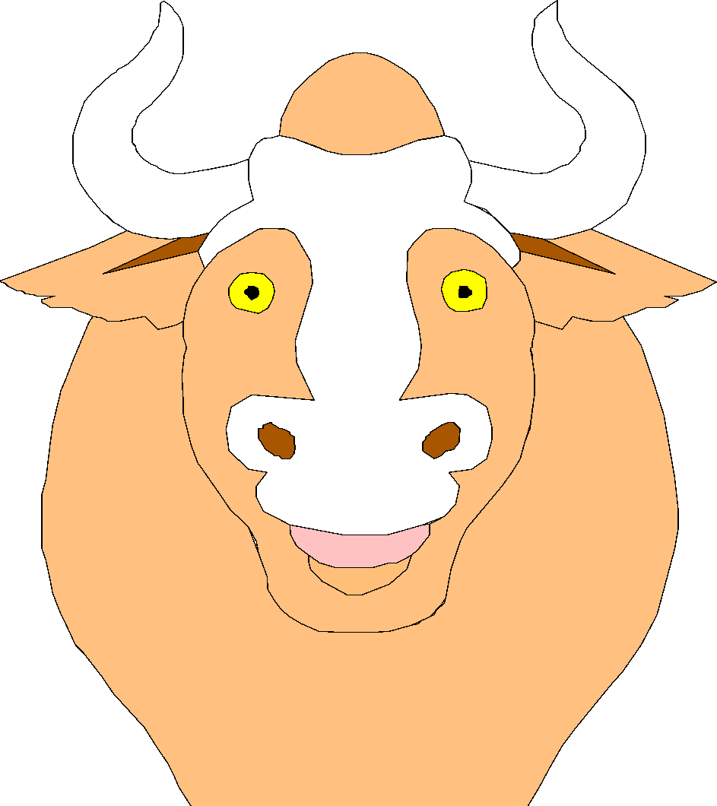
A PARABLE FOR THE MODERN ECONOMY
Imagine an economic system with only two goods, potatoes and meat and only two people, a potato farmer and a cattle rancher
What should each person produce?
Why should these people trade?

Slide 12
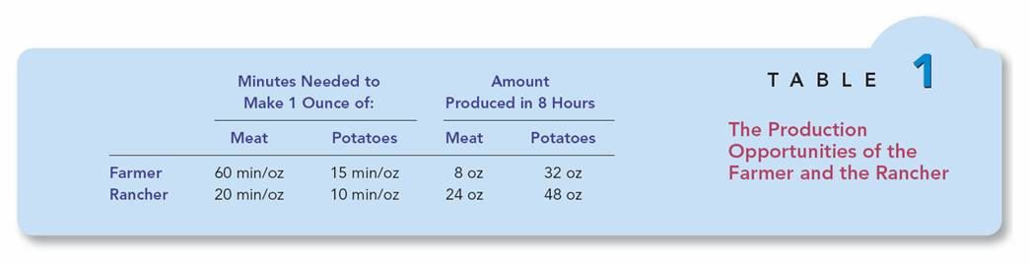

Slide 13
Production Possibilities
Suppose the farmer and rancher decide not to engage in trade:
Each consumes only what he or she can produce alone.
The production possibilities frontier is also the consumption possibilities frontier.
Without trade, economic gains are diminished.

Slide 14
Figure 1 The Production Possibilities Frontier
(a) The Farmer
’
s Production Possibilities Frontier
Meat (ounces)
If there is no trade,
the farmer chooses
8
this production and
consumption.
4
A
0
16
32
Potatoes (ounces)
Copyright©2003 Southwestern/Thomson Learning

Slide 15
Figure 1 The Production Possibilities Curve
(b) The Rancher
’
s Production Possibilities Frontier
Meat (ounces)
24
If there is no trade,
the rancher chooses
this production and
consumption.
12
B
0
24
48
Potatoes (ounces)
Copyright©2003 Southwestern/Thomson Learning

Slide 16
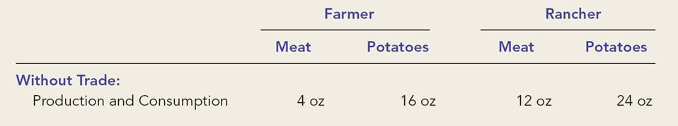
Production and Consumption Without Trade

Slide 17
Specialization and Trade
Suppose instead the farmer and the rancher decide to specialize and trade…
Both would be better off if they specialize in producing the product they are more suited to produce, and then trade with each other.
The farmer should produce potatoes.
The rancher should produce meat.

Slide 18
Figure 2 How Trade Expands the Set of Consumption Opportunities
(a) The Farmer
’
s Production and Consumption
Meat (ounces)
Farmer's
consumption
8
with trade
Farmer's
production and
A*
consumption
5
without trade
4
A
Farmer's
production
with trade
0
32
Potatoes (ounces)
16
17
Copyright©2003 Southwestern/Thomson Learning

Slide 19
Figure 2 How Trade Expands the Set of Consumption Opportunities
(b) The Rancher
’
s Production and Consumption
Meat (ounces)
24
Rancher's
production
with trade
Rancher's
consumption
18
with trade
13
B*
Rancher's
B
production and
12
consumption
without trade
0
12
24
27
48
Potatoes (ounces)
Copyright © 2004 South-Western

Slide 20
Money
Trade in specialized goods and a service today relies on money to lubricate its wheels.
Money is the universally acceptable medium of exchange- including primarily currency and checking deposits. It is used to pay for everything form apple tarts to zebra skins. By accepting money, people and nations can trade them for others; without money, we would waste much time negotiating and bartering.

Slide 21
Capital goods:
Capital goods- produced inputs such as machinery, structures, and inventories of goods in process - permit roundabout methods of production that add much to a nation’s output.
These roundabout methods take time and resources to get started and therefore require a temporary sacrifice of present consumption in order to increase future consumption.
The rules that define how capital and other assets can be bought, sold, and used are the system of property rights.
In no economic system are private-property rights unlimited.

Slide 22
The Economic Role of Government
Although the market mechanism is an admirable way of producing and allocating goods, sometimes market failures lead to deficiencies in the economic outcomes. The government may step in to correct these failures.
Its role in a modern economy is to ensure efficiency, to correct an unfair distribution of income, and to promote economic growth and stability.

Slide 23
Market Failure
Markets fail to provide an efficient allocation of resources in the presence of imperfect competition or externalities. Imperfect competition, such as monopoly, produces high prices and low levels of output. To combat these conditions, governments regulate business or put legal antitrust constraints on business behaviour.
Externality arises when activities impose costs or bestow benefits that are not paid for in the marketplace. Governments mat decide to step in and regulate these spillovers (as it does with air pollution) or provide for public goods (as in the case of public health).

Slide 24
Income Distribution
Markets do not necessarily produce a fair distribution of income; they may spin off unacceptably high inequality of income and consumption. In response, governments can alter the pattern of incomes (the for whoms) generated by market wages, rents, interest, and dividends.
Modern governments use taxation to raise revenues for transfers or income- support programmes that plays a financial safety net under the needy.

Slide 25
Mixed Economy
Since the development of macro economics in the 1930’s, the government has undertaken a third role: using fiscal powers (affecting credit and interest rates) to promote long – run economic growth and productivity and to tame the business cycle’s excesses of inflation and unemployment.
Since 1980, the blend of mixed economy called the welfare state has been on the defensive in the enduring struggle over the boundary between state and market.

Slide 26
Role of Government in Resource Allocation
One of the most important non-market forces that affect the allocation of resources in an economy is government.
Governments tend to modify the operation of equilibrium prices for social and political reasons.

Slide 27
The role of government could be studied at both micro and macro economic levels:
Governments in developed countries have tried several methods to resolve, for example, the problem of low and unstable farm incomes in a free market.
Price supports can give farmers a stable price but have a problem for the government to dispose off surplus stocks at the supported price. Guaranteed prices ensure that each farmer will receive the price determined by the government, and thus qualify for a subsidy or a deficiency payment in excess of the newly determined market price. A farm-support system can be based on making food imports more expensive by imposing levies or taxes. This system means that consumers bear the burden of the policy rather than tax payers.

Slide 28
Market failure
Market failure is a situation in which unrestrained market system causes too few or too many resources to be allocated to a specific economic activity. Government intervenes in various ways to correct these failures.
To achieve economic stability, governments pursue various objectives: Full employment, stable prices, equilibrium on the balance of payments, a clean environment, steady growth and a redistribution of income and welfare.

Slide 29
Private and Social Costs - Externalities:
Private costs are those explicit costs that are borne directly by consumers and producers. Social costs include private costs plus any other costs that are external to the decision-maker. When private costs differ from social costs, externalities exist. When social costs exceed private costs, environmental problems may arise. These are problems of externalities. One way to make private costs equal to social costs is to internalize the externality by imposing a tax or government regulation.

Slide 30
Public Goods
Public goods are jointly consumed. Merit and demerit goods are those goods & services identified as ‘good’ and ‘bad’ for the society.
The provision of public goods and merit goods contributes to a nation’s standard of living.

Slide 31
Market & Govt.
Market failures justify a role for government.
Government failure suggests a role for markets.
The solution to this dilemma lies in mixed economy.

Slide 32
Each person consumes goods and services produced by many other people both in our country and around the world.
Interdependence and trade are desirable because they allow everyone to enjoy a greater quantity and variety of goods and services.

Slide 33
There are two ways to compare the ability of two people producing a good.
The person who can produce a good with a smaller quantity of inputs has an absolute advantage.
The person with a smaller opportunity cost has a comparative advantage.

Slide 34
The gains from trade are based on comparative advantage, not absolute advantage.
Trade makes everyone better off because it allows people to specialize in those activities in which they have a comparative advantage.
The principle of comparative advantage applies to countries as well as people.

Slide 35
Government plays a very important role in modern times – in both developing and developed countries.
Globalisation has changed the nature and direction of government intervention in economic activities.
Available evidence point towards high economic growth and welfare in economies with pro-active state interventions.

