Slide 1
K. NARAYANAN HSS DEPARTMENT, IIT BOMBAY
Consumers, Producers and the Efficiency of Markets

Slide 2
Consumers, Producers and the Efficiency of Markets
Revisiting the Market Equilibrium
Do the equilibrium price and quantity maximize the total welfare of buyers and sellers?
Market equilibrium reflects the way markets allocate scarce resources.
Whether the market allocation is desirable can be addressed by welfare economics.

Slide 3
Consumers, Producers and the Efficiency of Markets
Welfare Economics
Welfare economics is the study of how the allocation of resources affects economic well-being.
Buyers and sellers receive benefits from taking part in the market.
The equilibrium in a market maximizes the total welfare of buyers and sellers.

Slide 4
Consumers, Producers and the Efficiency of Markets
Welfare Economics
Equilibrium in the market results in maximum benefits, and therefore maximum total welfare for both the consumers and the producers of the product.

Slide 5
Consumers, Producers and the Efficiency of Markets
Welfare Economics
Consumer surplus measures economic welfare from the buyer’s side.
Producer surplus measures economic welfare from the seller’s side.

Slide 6
CONSUMER SURPLUS
Willingness to pay is the maximum amount that a buyer will pay for a good.
It measures how much the buyer values the good or service.

Slide 7
CONSUMER SURPLUS
Consumer surplus is the buyer’s willingness to pay for a good minus the amount the buyer actually pays for it.

Slide 8
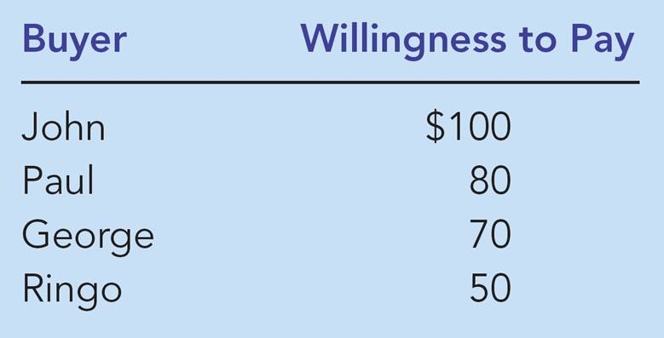
Table 1: Four Possible Buyers’ Willingness to Pay

Slide 9
Using the Demand Curve to Measure Consumer Surplus
The market demand curve depicts the various quantities that buyers would be willing and able to purchase at different prices.

Slide 10
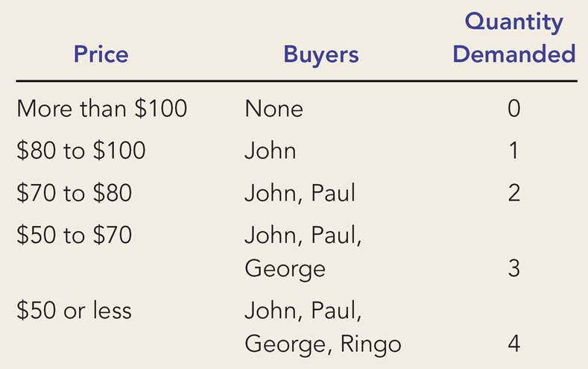
The Demand Schedule and the Demand Curve

Slide 11
Figure 1 The Demand Schedule and the Demand Curve
Price of
Album
$100
John
’
s willingness to pay
80
Paul
’
s willingness to pay
70
George
’
s willingness to pay
50
Ringo
’
s willingness to pay
Demand
0
1
2
3
4
Quantity of
Albums

Slide 12
Figure 2 Measuring Consumer Surplus with the Demand Curve
(a) Price = $80
Price of
Album
$100
John
’
s consumer surplus ($20)
80
70
50
Demand
0
1
2
3
4
Quantity of
Albums

Slide 13
Figure 2 Measuring Consumer Surplus with the Demand Curve
(b) Price = $70
Price of
Album
$100
John
’
s consumer surplus ($30)
80
Paul
’
s consumer
70
surplus ($10)
Total
50
consumer
surplus ($40)
Demand
0
1
2
3
4
Quantity of
Albums

Slide 14
Using the Demand Curve to Measure Consumer Surplus
The area below the demand curve and above the price measures the consumer surplus in the market.

Slide 15
Figure 3 How the Price Affects Consumer Surplus
(a) Consumer Surplus at Price
P
Price
A
Consumer
surplus
P₁
B
C
Demand
0
Q₁
Quantity

Slide 16
Figure 3 How the Price Affects Consumer Surplus
(b) Consumer Surplus at Price
P
Price
A
Initial
consumer
surplus
P₁
C
Consumer surplus
B
to new consumers
P₂
F
D
E
Additional consumer
Demand
surplus to initial
consumers
0
Q₁
Q₂
Quantity

Slide 17
What Does Consumer Surplus Measure?
Consumer surplus, the amount that buyers are willing to pay for a good minus the amount they actually pay for it, measures the benefit that buyers receive from a good as the buyers themselves perceive it.

Slide 18
PRODUCER SURPLUS
Producer surplus is the amount a seller is paid for a good minus the seller’s cost.
It measures the benefit to sellers participating in a market.

Slide 19
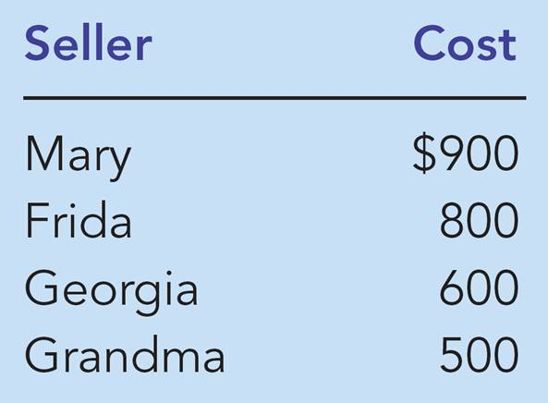
Table 2: The Costs of Four Possible Sellers

Slide 20
Using the Supply Curve to Measure Producer Surplus
Just as consumer surplus is related to the demand curve, producer surplus is closely related to the supply curve.

Slide 21
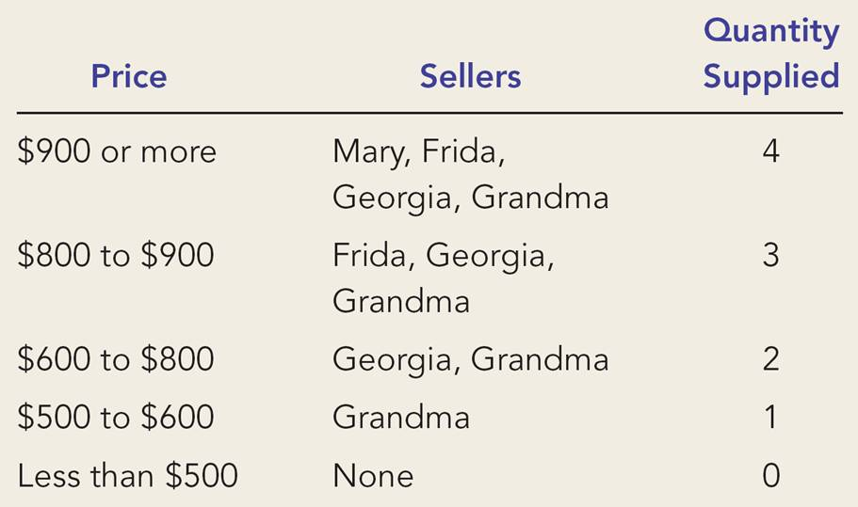
The Supply Schedule and the Supply Curve

Slide 22
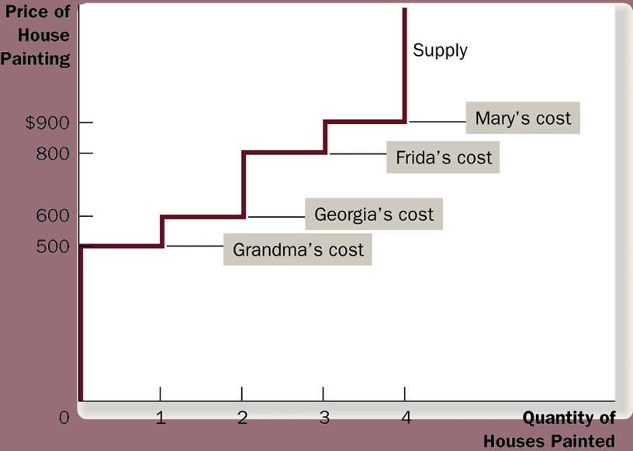
Figure 4 The Supply Schedule and the Supply Curve

Slide 23
Using the Supply Curve to Measure Producer Surplus
The area below the price and above the supply curve measures the producer surplus in a market.

Slide 24
Figure 5 Measuring Producer Surplus with the Supply Curve
(a) Price = $600
Price of
House
Painting
Supply
$900
800
600
500
Grandma
’
s producer
surplus ($100)
0
1
2
3
4
Quantity of
Houses Painted

Slide 25
Figure 5 Measuring Producer Surplus with the Supply Curve
(b) Price = $800
Price of
House
Painting
Supply
Total
producer
$900
surplus ($500)
800
600
Georgia
’
s producer
500
surplus ($200)
Grandma
’
s producer
surplus ($300)
0
1
2
3
4
Quantity of
Houses Painted

Slide 26
Figure 6 How the Price Affects Producer Surplus
(a) Producer Surplus at Price
P
Price
Supply
P₁
B
C
Producer
surplus
A
0
Q₁
Quantity

Slide 27
Figure 6 How the Price Affects Producer Surplus
(b) Producer Surplus at Price
P
Price
Additional producer
Supply
surplus to initial
producers
D
E
P₂
F
P₁
B
Initial
C
Producer surplus
producer
to new producers
surplus
A
0
Q₁
Q₂
Quantity

Slide 28
MARKET EFFICIENCY
Consumer surplus and producer surplus may be used to address the following question:
Is the allocation of resources determined by free markets in any way desirable?

Slide 29
The Benevolent Social Planner
Consumer Surplus
= Value to buyers – Amount paid by buyers
and
Producer Surplus
= Amount received by sellers – Cost to sellers

Slide 30
The Benevolent Social Planner
Total surplus
= Consumer surplus + Producer surplus
or
Total surplus
= Value to buyers – Cost to sellers

Slide 31
The Benevolent Social Planner
Efficiency is the property of a resource allocation of maximizing the total surplus received by all members of society.

Slide 32
The Benevolent Social Planner
In addition to market efficiency, a social planner might also care about equity – the fairness of the distribution of well-being among the various buyers and sellers.

Slide 33
Figure 7 Consumer and Producer Surplus in the Market Equilibrium
Price
A
D
Supply
Consumer
surplus
Equilibrium
E
price
Producer
surplus
Demand
B
C
0
Equilibrium
Quantity
quantity

Slide 34
Evaluating the Market Equilibrium
Three Insights Concerning Market Outcomes
Free markets allocate the supply of goods to the buyers who value them most highly, as measured by their willingness to pay.
Free markets allocate the demand for goods to the sellers who can produce them at least cost.
Free markets produce the quantity of goods that maximizes the sum of consumer and producer surplus.

Slide 35
Figure 8 The Efficiency of the Equilibrium Quantity
Price
Supply
Value
Cost
to
to
buyers
sellers
Cost
Value
to
to
sellers
buyers
Demand
0
Equilibrium
Quantity
quantity
Value to buyers is greater
Value to buyers is less
than cost to sellers.
than cost to sellers.

Slide 36
Application: The Costs of Taxation
Welfare economics is the study of how the allocation of resources affects economic well-being.
Buyers and sellers receive benefits from taking part in the market.
The equilibrium in a market maximizes the total welfare of buyers and sellers.

Slide 37

THE DEADWEIGHT LOSS OF TAXATION
How do taxes affect the economic well-being of market participants?

Slide 38
THE DEADWEIGHT LOSS OF TAXATION
It does not matter whether a tax on a good is levied on buyers or sellers of the good . . . the price paid by buyers rises, and the price received by sellers falls.

Slide 39
Figure 1 The Effects of a Tax
Price
The price paid by consumers is higher
The price received by firms is lower.
Supply
Price buyers
Size of tax
pay
Who benefits?
Price
without tax
Price sellers
receive
Demand
And the quantity declines.
0
Quantity
Quantity
Quantity
with tax
without tax

Slide 40
How a Tax Affects Market Participants
A tax places a wedge between the price buyers pay and the price sellers receive.
Because of this tax wedge, the quantity sold falls below the level that would be sold without a tax.
The size of the market for that good shrinks.

Slide 41
How a Tax Affects Market Participants
Tax Revenue
T = the size of the tax
Q = the quantity of the good sold
T × Q = the government’s tax revenue

Slide 42
Figure 2 Tax Revenue
Price
Supply
Price buyers
Size of tax (T)
pay
Tax
revenue
(T × Q)
Price sellers
receive
Quantity
Demand
sold (Q)
0
Quantity
Quantity
Quantity
with tax
without tax

Slide 43
Figure 3 How a Tax Effects Welfare
Price
Price
A
Supply
buyers
=
P^{B}
pay
B
Price
C
without tax
=
P¹
D
E
Price
sellers
=
P^{S}
receive
F
Demand
0
Q²
Q¹
Quantity

Slide 44
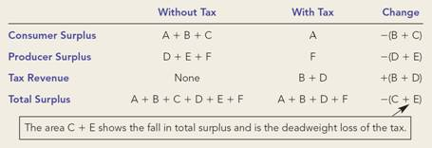
Figure 3 How a Tax Effects Welfare
Price
Price
A
Supply
buyers
=
P^{B}
pay
B
Price
C
without tax
=
P¹
D
E
Price
sellers
=
P^{S}
receive
F
Demand
0
Q²
Q¹
Quantity

Slide 45
How a Tax Affects Market Participants
Changes in Welfare
A deadweight loss is the fall in total surplus that results from a market distortion, such as a tax.

Slide 46
How a Tax Affects Market Participants
The change in total welfare includes:
The change in consumer surplus,
The change in producer surplus, and
The change in tax revenue.
The losses to buyers and sellers exceed the revenue raised by the government.
This fall in total surplus is called the deadweight loss.

Slide 47
Deadweight Losses and the Gains from Trade
Taxes cause deadweight losses because they prevent buyers and sellers from realizing some of the gains from trade.

Slide 48
Figure 4 The Deadweight Loss
Price
Lost gains
Supply
from trade
P_{B}
Size of tax
Price
without tax
P_{S}
Cost to
sellers
Demand
Value to
buyers
0
Q₂
Q₁
Quantity
Reduction in quantity due to the tax

Slide 49
THE DETERMINANTS OF THE DEADWEIGHT LOSS
What determines whether the deadweight loss from a tax is large or small?
The magnitude of the deadweight loss depends on how much the quantity supplied and quantity demanded respond to changes in the price.
That, in turn, depends on the price elasticities of supply and demand.

Slide 50
Figure 5 Tax Distortions and Elasticities
(a) Inelastic Supply
Price
Supply
When supply is
relatively inelastic,
the deadweight loss
of a tax is small.
Size of tax
Demand
0
Quantity

Slide 51
Figure 5 Tax Distortions and Elasticities
(b) Elastic Supply
Price
When supply is relatively
elastic, the deadweight
loss of a tax is large.
Size
Supply
of
tax
Demand
0
Quantity

Slide 52
Figure 5 Tax Distortions and Elasticities
(c) Inelastic Demand
Price
Supply
Size of tax
When demand is
relatively inelastic,
the deadweight loss
of a tax is small.
Demand
0
Quantity

Slide 53
Figure 5 Tax Distortions and Elasticities
(d) Elastic Demand
Price
Supply
Size
of
tax
Demand
When demand is relatively
elastic, the deadweight
loss of a tax is large.
0
Quantity

Slide 54
THE DETERMINANTS OF THE DEADWEIGHT LOSS
The greater the elasticities of demand and supply:
the larger will be the decline in equilibrium quantity and,
the greater the deadweight loss of a tax.

Slide 55
DEADWEIGHT LOSS AND TAX REVENUE AS TAXES VARY
The Deadweight Loss Debate
Some economists argue that labor taxes are highly distorting and believe that labor supply is more elastic.
Some examples of workers who may respond more to incentives:
Workers who can adjust the number of hours they work
Families with second earners
Elderly who can choose when to retire
Workers in the underground economy (i.e., those engaging in illegal activity)

Slide 56
DEADWEIGHT LOSS AND TAX REVENUE AS TAXES VARY
With each increase in the tax rate, the deadweight loss of the tax rises even more rapidly than the size of the tax.

Slide 57
Figure 6 How Deadweight Loss and Tax Revenue Vary with the Size of the Tax
(a) Small Tax
Price
Deadweight
loss
Supply
P_{B}
Tax revenue
P_{S}
Demand
0
Q₂
Q₁
Quantity

Slide 58
Figure 6 How Deadweight Loss and Tax Revenue Vary with the Size of the Tax
(b) Medium Tax
Price
Deadweight
P_{B}
loss
Supply
Tax revenue
P_{S}
Demand
0
Q₂
Q₁
Quantity

Slide 59
Figure 6 How Deadweight Loss and Tax Revenue Vary with the Size of the Tax
(c) Large Tax
Price
P_{B}
Deadweight
loss
Supply
Tax revenue
Demand
P_{S}
0
Q₂
Q₁
Quantity

Slide 60
Evaluating the Market Equilibrium
Because the equilibrium outcome is an efficient allocation of resources, the social planner can leave the market outcome as he/she finds it.
This policy of leaving well enough alone goes by the French expression laissez faire.

Slide 61
Evaluating the Market Equilibrium
Market Power
If a market system is not perfectly competitive, market power may result.
Market power is the ability to influence prices.
Market power can cause markets to be inefficient because it keeps price and quantity from the equilibrium of supply and demand.

Slide 62
Evaluating the Market Equilibrium
Externalities
created when a market outcome affects individuals other than buyers and sellers in that market.
cause welfare in a market to depend on more than just the value to the buyers and cost to the sellers.
When buyers and sellers do not take externalities into account when deciding how much to consume and produce, the equilibrium in the market can be inefficient.

Slide 63
Consumer surplus equals buyers’ willingness to pay for a good minus the amount they actually pay for it.
Consumer surplus measures the benefit buyers get from participating in a market.
Consumer surplus can be computed by finding the area below the demand curve and above the price.

Slide 64
Producer surplus equals the amount sellers receive for their goods minus their costs of production.
Producer surplus measures the benefit sellers get from participating in a market.
Producer surplus can be computed by finding the area below the price and above the supply curve.

Slide 65
An allocation of resources that maximizes the sum of consumer and producer surplus is said to be efficient.
Policymakers are often concerned with the efficiency, as well as the equity, of economic outcomes.

Slide 66
The equilibrium of demand and supply maximizes the sum of consumer and producer surplus.
This is as if the invisible hand of the marketplace leads buyers and sellers to allocate resources efficiently.
Markets do not allocate resources efficiently in the presence of market failures.

