Slide 1
Consumer Behaviour
K. Narayanan
IIT Bombay

Slide 2
The Theory of Consumer Choice
The theory of consumer choice addresses the following questions:
Do all demand curves slope downward?
How do wages affect labor supply?
How do interest rates affect household saving?

Slide 3
THE BUDGET CONSTRAINT: WHAT THE CONSUMER CAN AFFORD
The budget constraint depicts the limit on the consumption “bundles” that a consumer can afford.
People consume less than they desire because their spending is constrained, or limited, by their income.

Slide 4
THE BUDGET CONSTRAINT: WHAT THE CONSUMER CAN AFFORD
The budget constraint shows the various combinations of goods the consumer can afford given his or her income and the prices of the two goods.

Slide 5
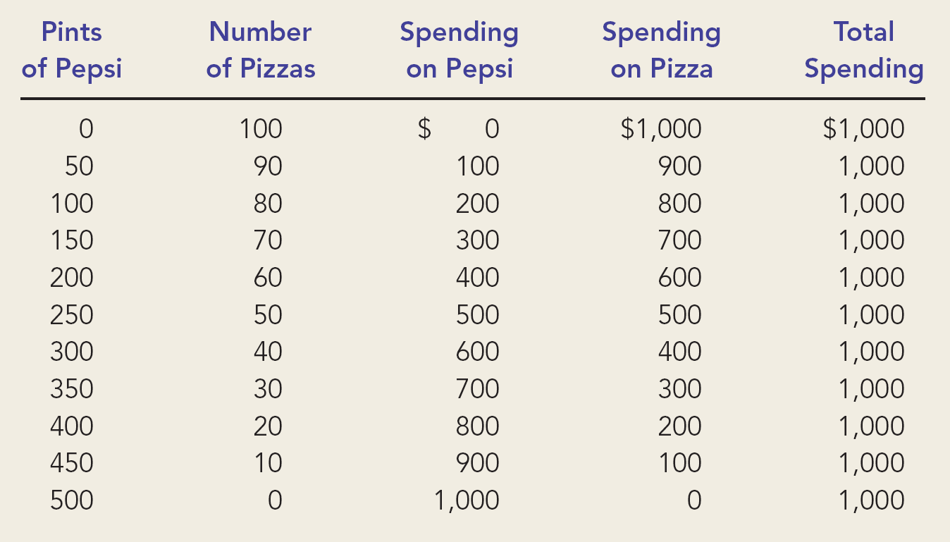
Figure 1 The Consumer’s Budget Constraint

Slide 6
THE BUDGET CONSTRAINT: WHAT THE CONSUMER CAN AFFORD
The Consumer’s Budget Constraint
Any point on the budget constraint line indicates the consumer’s combination or trade-off between two goods.
For example, if the consumer buys no pizzas, he can afford 500 pints of Pepsi (point B). If he buys no Pepsi, he can afford 100 pizzas (point A).

Slide 7
Figure 1 The Consumer’s Budget Constraint
Quantity
of Pepsi
B
500
Consumer’s
budget constraint
A
0
100
Quantity
of Pizza

Slide 8
THE BUDGET CONSTRAINT: WHAT THE CONSUMER CAN AFFORD
The Consumer’s Budget Constraint
Alternately, the consumer can buy 50 pizzas and 250 pints of Pepsi.

Slide 9
Figure 1 The Consumer’s Budget Constraint
Quantity
of Pepsi
B
500
C
250
Consumer’s
budget constraint
A
0
50
100
Quantity
of Pizza

Slide 10
THE BUDGET CONSTRAINT: WHAT THE CONSUMER CAN AFFORD
The slope of the budget constraint line equals the relative price of the two goods, that is, the price of one good compared to the price of the other.
It measures the rate at which the consumer can trade one good for the other.

Slide 11
PREFERENCES: WHAT THE CONSUMER WANTS
A consumer’s preference among consumption bundles may be illustrated with indifference curves.

Slide 12
Representing Preferences with Indifference Curves
An indifference curve is a curve that shows consumption bundles that give the consumer the same level of satisfaction.

Slide 13
Figure 2 The Consumer’s Preferences
Quantity
of Pepsi
C
B
D
I₂
Indifference
A
curve,
I₁
0
Quantity
of Pizza

Slide 14
Representing Preferences with Indifference Curves
The Consumer’s Preferences
The consumer is indifferent, or equally happy, with the combinations shown at points A, B, and C because they are all on the same curve.
The Marginal Rate of Substitution
The slope at any point on an indifference curve is the marginal rate of substitution.
It is the rate at which a consumer is willing to trade one good for another.
It is the amount of one good that a consumer requires as compensation to give up one unit of the other good.

Slide 15
Figure 2 The Consumer’s Preferences
Quantity
of Pepsi
C
B
D
MRS
I₂
1
Indifference
A
curve,
I₁
0
Quantity
of Pizza

Slide 16
Four Properties of Indifference Curves
Higher indifference curves are preferred to lower ones.
Indifference curves are downward sloping.
Indifference curves do not cross.
Indifference curves are bowed inward.

Slide 17
Four Properties of Indifference Curves
Property 1: Higher indifference curves are preferred to lower ones.
Consumers usually prefer more of something to less of it.
Higher indifference curves represent larger quantities of goods than do lower indifference curves.

Slide 18
Figure 2 The Consumer’s Preferences
Quantity
of Pepsi
C
B
D
I₂
Indifference
A
curve,
I₁
0
Quantity
of Pizza

Slide 19
Four Properties of Indifference Curves
Property 2: Indifference curves are downward sloping.
A consumer is willing to give up one good only if he or she gets more of the other good in order to remain equally happy.
If the quantity of one good is reduced, the quantity of the other good must increase.
For this reason, most indifference curves slope downward.
Remember, a consumer is equally happy at all points along a given indifference curve.

Slide 20
Figure 2 The Consumer’s Preferences
Quantity
of Pepsi
Indifference
curve,
I₁
0
Quantity
of Pizza

Slide 21
Four Properties of Indifference Curves
Property 3: Indifference curves do not cross.
Points A and B should make the consumer equally happy.
Points B and C should make the consumer equally happy.
This implies that A and C would make the consumer equally happy.
But C has more of both goods compared to A.

Slide 22
Figure 3 The Impossibility of Intersecting Indifference Curves
Quantity
of Pepsi
C
A
B
0
Quantity
of Pizza

Slide 23
Four Properties of Indifference Curves
Property 4: Indifference curves are bowed inward.
People are more willing to trade away goods that they have in abundance and less willing to trade away goods of which they have little.
These differences in a consumer’s marginal substitution rates cause his or her indifference curve to bow inward.

Slide 24
Figure 4 Bowed Indifference Curves
Quantity
of Pepsi
14
MRS
= 6
8
A
1
4
MRS
= 1
B
3
1
Indifference
curve
0
2
3
6
7
Quantity
of Pizza

Slide 25
Two Extreme Examples of Indifference Curves
Perfect substitutes
Perfect complements

Slide 26
Two Extreme Examples of Indifference Curves
Perfect Substitutes
Two goods with straight-line indifference curves are perfect substitutes.
The marginal rate of substitution is a fixed number.

Slide 27
Figure 5 Perfect Substitutes and Perfect Complements
(a) Perfect Substitutes
Nickels
6
4
2
I₁
I₂
I₃
0
1
2
3
Dimes

Slide 28
Two Extreme Examples of Indifference Curves
Perfect Complements
Two goods with right-angle indifference curves are perfect complements.
Since these goods are always used together, extra units of one good, outside the desired consumption ratio, add no additional satisfaction.

Slide 29
Figure 5 Perfect Substitutes and Perfect Complements
(b) Perfect Complements
Left
Shoes
I₂
7
5
I₁
0
5
7
Right Shoes

Slide 30
OPTIMIZATION: WHAT THE CONSUMER CHOOSES
Consumers want to get the combination of goods on the highest possible indifference curve.
However, the consumer must also end up on or below his budget constraint.

Slide 31
The Consumer’s Optimal Choices
Combining the indifference curve and the budget constraint determines the consumer’s optimal choice.
Consumer optimum occurs at the point where the highest indifference curve and the budget constraint are tangent.

Slide 32
The Consumer’s Optimal Choice
The consumer chooses consumption of the two goods so that the marginal rate of substitution equals the relative price.
At the consumer’s optimum, the consumer’s valuation of the two goods equals the market’s valuation.

Slide 33
Figure 6 The Consumer’s Optimum
Quantity
of Pepsi
The consumer would prefer to be on indifference curve I₃, but does not have enough income to reach that indifference curve.
Optimum
B
The consumer can afford most of the bundles on I₁, but why stay there when you can move out to a higher indifference curve, I₂?
A
I₃
I₂
I₁
Budget constraint
0
Quantity
of Pizza

Slide 34
How Changes in Income Affect the Consumer’s Choices
An increase in income shifts the budget constraint outward.
The consumer is able to choose a better combination of goods on a higher indifference curve.

Slide 35
Figure 7 An Increase in Income
Quantity
of Pepsi
New budget constraint
1. An increase in income shifts the
budget constraint outward . . .
New optimum
3. . . . and
Pepsi
Initial
consumption.
optimum
I₂
Initial
budget
I₁
constraint
0
Quantity
2. . . . raising pizza consumption . . .
of Pizza

Slide 36
How Changes in Income Affect the Consumer’s Choices
Normal versus Inferior Goods
If a consumer buys more of a good when his or her income rises, the good is called a normal good.
If a consumer buys less of a good when his or her income rises, the good is called an inferior good.

Slide 37
Figure 8 An Inferior Good
Quantity
of Pepsi
New budget constraint
1. When an increase in income shifts the
3. . . . but
Initial
budget constraint outward . . .
Pepsi
optimum
consumption
falls, making
New optimum
Pepsi an
inferior good.
Initial
budget
I₁
I₂
constraint
0
Quantity
2. . . . pizza consumption rises, making pizza a normal good . . .
of Pizza

Slide 38
How Changes in Prices Affect Consumer’s Choices
A fall in the price of any good rotates the budget constraint outward and changes the slope of the budget constraint.

Slide 39
Figure 9 A Change in Price
Quantity
of Pepsi
1,000
D
New budget constraint
New optimum
500
B
1. A fall in the price of Pepsi rotates
the budget constraint outward . . .
3. . . . and
raising Pepsi
Initial optimum
consumption.
Initial
I₂
budget
I₁
constraint
A
0
100
Quantity
2. . . . reducing pizza consumption . . .
of Pizza

Slide 40
Income and Substitution Effects
A price change has two effects on consumption.
An income effect
A substitution effect

Slide 41
Income and Substitution Effects
The Income Effect
The income effect is the change in consumption that results when a price change moves the consumer to a higher or lower indifference curve.
The Substitution Effect
The substitution effect is the change in consumption that results when a price change moves the consumer along an indifference curve to a point with a different marginal rate of substitution.

Slide 42
Income and Substitution Effects
A Change in Price: Substitution Effect
A price change first causes the consumer to move from one point on an indifference curve to another on the same curve.
Illustrated by movement from point A to point B.
A Change in Price: Income Effect
After moving from one point to another on the same curve, the consumer will move to another indifference curve.
Illustrated by movement from point B to point C.

Slide 43
Figure 10 Income and Substitution Effects
Quantity
of Pepsi
New budget constraint
C
New optimum
Income
effect
B
Initial optimum
Substitution
Initial
effect
budget
constraint
A
I₂
I₁
0
Quantity
Substitution effect
of Pizza
Income effect

Slide 44
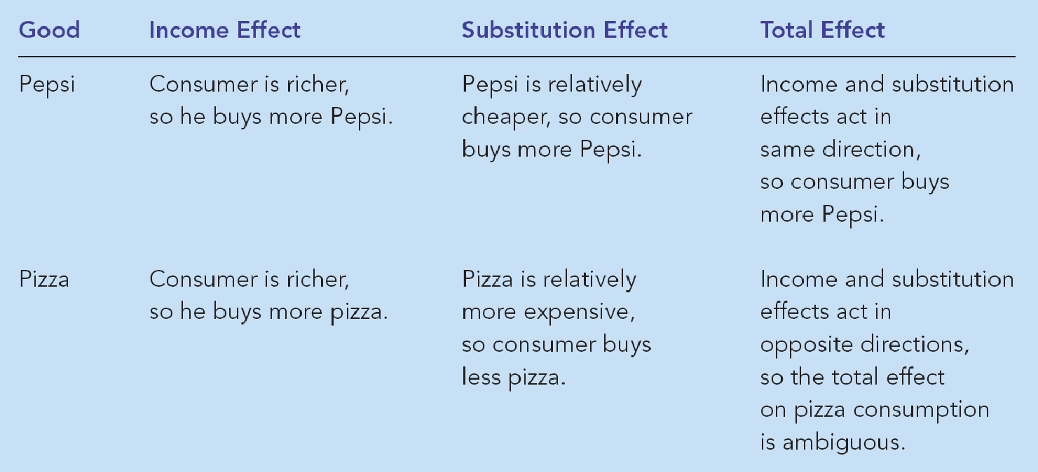
Table 1 Income and Substitution Effects When the Price of Pepsi Falls

Slide 45
Deriving the Demand Curve
A consumer’s demand curve can be viewed as a summary of the optimal decisions that arise from his or her budget constraint and indifference curves.

Slide 46
Figure 11 Deriving the Demand Curve
(a) The Consumer
’
s Optimum
(b) The Demand Curve for Pepsi
Quantity
Price of
of Pepsi
New budget constraint
Pepsi
750
B
$2
A
I₂
B
A
1
250
Demand
I₁
0
Initial budget
Quantity
0
250
750
Quantity
constraint
of Pizza
of Pepsi

Slide 47
THREE APPLICATIONS
Do all demand curves slope downward?
How do wages affect labor supply?
How do interest rates affect household saving?

Slide 48
Do All Demand Curves Slope Downward?
Demand curves can sometimes slope upward.
This happens when a consumer buys more of a good when its price rises.
Giffen goods
Economists use the term Giffen good to describe an inferior good that violates the law of demand.
Giffen goods are goods for which an increase in the price raises the quantity demanded.
The income effect dominates the substitution effect.
They have demand curves that slope upwards.

Slide 49
Figure 12 A Giffen Good
Quantity of
Potatoes
Initial budget constraint
At the higher price, more potatoes are demanded!
B
Optimum with high
price of potatoes
Optimum with low
D
price of potatoes
2. . . . which
E
1. An increase in the price of
increases
C
potatoes rotates the budget
potato
constraint inward . . .
consumption
if potatoes
I₁
are a Giffen
New budget
I₂
good.
constraint
0
A
Quantity
of Meat

Slide 50
How Do Wages Affect Labor Supply?
If the substitution effect is greater than the income effect for the worker, he or she works more.
If income effect is greater than the substitution effect, he or she works less.

Slide 51
Figure 13 The Work-Leisure Decision
Consumption
$5,000
Optimum
I₃
2,000
I₂
I₁
0
60
100
Hours of Leisure

Slide 52
Figure 14 An Increase in the Wage
(a) For a person with these preferences
. . .
. . . the labor supply curve slopes upward.
Consumption
Wage
Labor
supply
1. When the wage rises . . .
BC₁
BC₂
I₂
I₁
0
Hours of
0
Hours of Labor
2. . . . hours of leisure decrease . . .
Leisure
3. . . . and hours of labor increase.
Supplied
The opportunity cost of taking leisure has increased, so the individual substitutes consumption for leisure and works more.

Slide 53
Figure 14 An Increase in the Wage
(b) For a person with these preferences
. . .
. . .
the labor supply curve slopes backward.
Consumption
Wage
BC₂
1. When the wage rises . . .
Labor
BC₁
supply
I₂
I₁
0
Hours of
0
Hours of Labor
2. . . . hours of leisure increase . . .
Leisure
3. . . . and hours of labor decrease.
Supplied
In this example, the individual uses the higher wage rate to “buy” more leisure and decides to work less.

Slide 54
How Do Interest Rates Affect Household Saving?
If the substitution effect of a higher interest rate is greater than the income effect, households save more.
If the income effect of a higher interest rate is greater than the substitution effect, households save less.

Slide 55
Figure 15 The Consumption-Saving Decision
Consumption
Budget
when Old
constraint
$110,000
55,000
Optimum
I₃
I₂
I₁
0
$50,000
100,000
Consumption
when Young

Slide 56
Figure 16 An Increase in the Interest Rate
(a) Higher Interest Rate Raises Saving
(b) Higher Interest Rate Lowers Saving
Consumption
Consumption
when Old
BC₂
when Old
BC₂
1. A higher interest rate rotates
1. A higher interest rate rotates
the budget constraint outward . . .
the budget constraint outward . . .
BC₁
BC₁
I₂
I₁
I₂
I₁
0
Consumption
0
Consumption
2. . . . resulting in lower
when Young
2. . . . resulting in higher
when Young
consumption when young
consumption when young
and, thus, higher saving.
and, thus, lower saving.

Slide 57
How Do Interest Rates Affect Household Saving?
Thus, an increase in the interest rate could either encourage or discourage saving.

Slide 58
A consumer’s budget constraint shows the possible combinations of different goods he can buy given his income and the prices of the goods.
The slope of the budget constraint equals the relative price of the goods.
The consumer’s indifference curves represent his preferences.

Slide 59
Points on higher indifference curves are preferred to points on lower indifference curves.
The slope of an indifference curve at any point is the consumer’s marginal rate of substitution.
The consumer optimizes by choosing the point on his budget constraint that lies on the highest indifference curve.

Slide 60
When the price of a good falls, the impact on the consumer’s choices can be broken down into an income effect and a substitution effect.
The income effect is the change in consumption that arises because a lower price makes the consumer better off.
The income effect is reflected by the movement from a lower to a higher indifference curve.

Slide 61
The substitution effect is the change in consumption that arises because a price change encourages greater consumption of the good that has become relatively cheaper.
The substitution effect is reflected by a movement along an indifference curve to a point with a different slope.

Slide 62
The theory of consumer choice can explain:
Why demand curves can potentially slope upward.
How wages affect labor supply.
How interest rates affect household saving.

