Slide 1
Production and Costs
K. Narayanan
H & SS Department
IIT Bombay

Slide 2
The Costs of Production
The Market Forces of Supply and Demand
  Supply and demand are the two words that economists use most often.
  Supply and demand are the forces that make market economies work.
  Modern microeconomics is about supply, demand, and market equilibrium.

Slide 3
WHAT ARE COSTS?
According to the Law of Supply:
  Firms are willing to produce and sell a greater quantity of a good when the price of the good is high.
  This results in a supply curve that slopes upward.

Slide 4


WHAT ARE COSTS?
The Firm’s Objective
  The economic goal of the firm is to maximize profits.

Slide 5
Total Revenue, Total Cost, and Profit
Total Revenue
  The amount a firm receives for the sale of its output.
Total Cost
  The market value of the inputs a firm uses in production.

Slide 6
Total Revenue, Total Cost, and Profit
Profit is the firm’s total revenue minus its total cost.
Profit = Total revenue - Total cost

Slide 7
Costs as Opportunity Costs
A firm’s cost of production includes all the opportunity costs of making its output of goods and services.
Explicit and Implicit Costs
  A firm’s cost of production include explicit costs and implicit costs.
    Explicit costs are input costs that require a direct outlay of money by the firm.
    Implicit costs are input costs that do not require an outlay of money by the firm.

Slide 8
Economic Profit versus Accounting Profit
Economists measure a firm’s economic profit as total revenue minus total cost, including both explicit and implicit costs.
Accountants measure the accounting profit as the firm’s total revenue minus only the firm’s explicit costs.

Slide 9
Economic Profit versus Accounting Profit
When total revenue exceeds both explicit and implicit costs, the firm earns economic profit.
Economic profit is smaller than accounting profit.

Slide 10
Figure 1 Economists versus Accountants
How an Economist
How an Accountant
Views a Firm
Views a Firm
Economic
profit
Accounting
profit
Implicit
Revenue
costs
Revenue
Total
opportunity
costs
Explicit
Explicit
costs
costs

Slide 11
PRODUCTION AND COSTS
The Production Function
  The production function shows the relationship between quantity of inputs used to make a good and the quantity of output of that good.

Slide 12
The Production Function
Marginal Product
  The marginal product of any input in the production process is the increase in output that arises from an additional unit of that input.

Slide 13
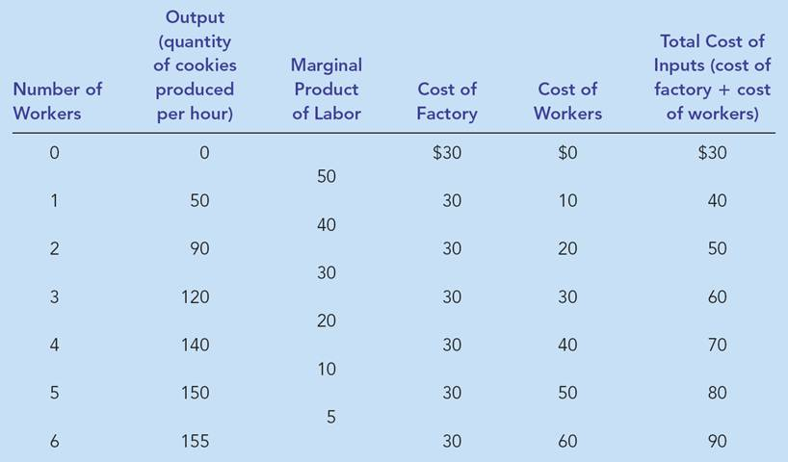
Table 1 A Production Function and Total Cost: Hungry Helen’s Cookie Factory

Slide 14
The Production Function
Diminishing marginal product is the property whereby the marginal product of an input declines as the quantity of the input increases.
  Example: As more and more workers are hired at a firm, each additional worker contributes less and less to production because the firm has a limited amount of equipment.

Slide 15
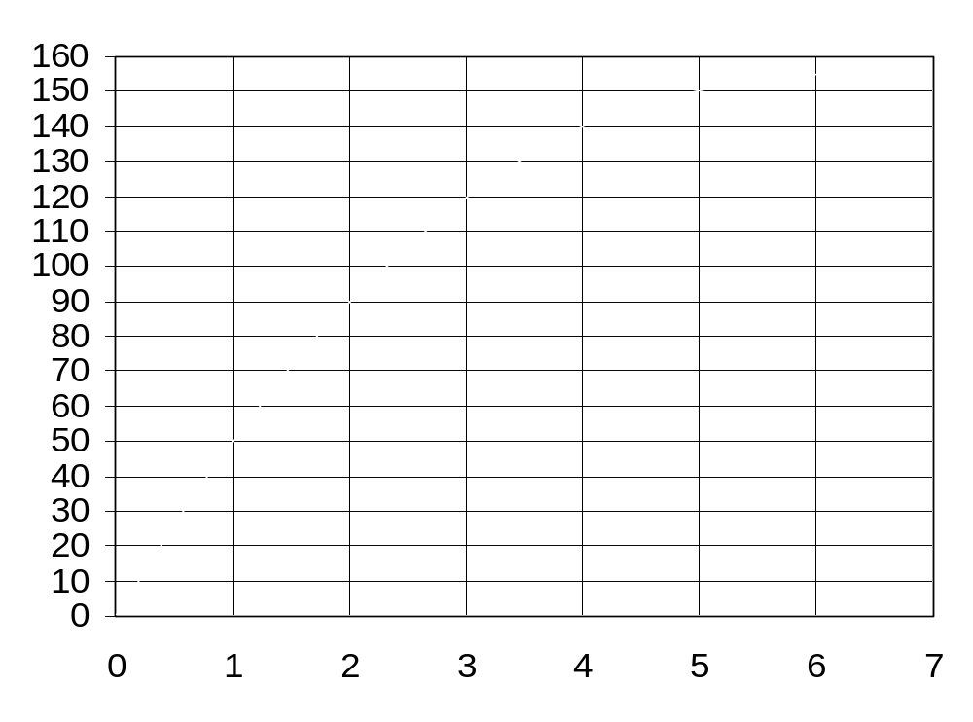
Figure 2 Hungry Helen’s Production Function
Quantity of output
Number of Workers Hired

Slide 16
The Production Function
Diminishing Marginal Product
  The slope of the production function measures the marginal product of an input, such as a worker.
  When the marginal product declines, the production function becomes flatter.

Slide 17
From the Production Function to the Total-Cost Curve
The relationship between the quantity a firm can produce and its costs determines pricing decisions.
The total-cost curve shows this relationship graphically.

Slide 18
Table 1 A Production Function and Total Cost: Hungry Helen’s Cookie Factory

Slide 19
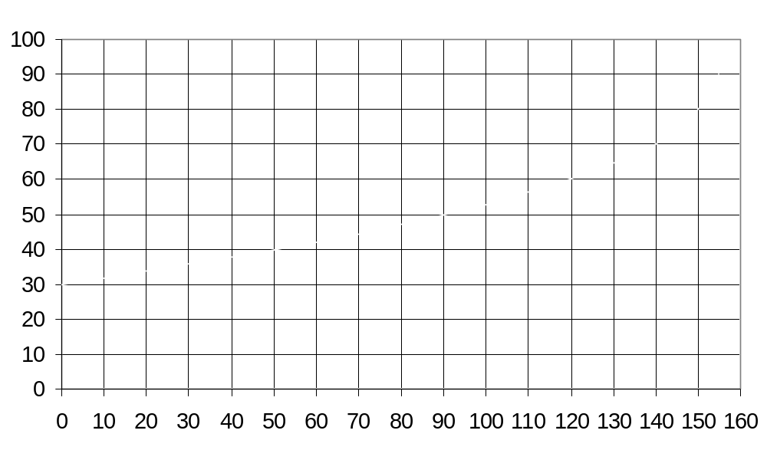
Figure 2 Hungry Helen’s Total-Cost Curve
Total
Cost
Quantity
of Output
(cookies per hour)

Slide 20
THE VARIOUS MEASURES OF COST
Costs of production may be divided into fixed costs and variable costs.
  Fixed costs are those costs that do not vary with the quantity of output produced.
  Variable costs are those costs that do vary with the quantity of output produced.

Slide 21
Fixed and Variable Costs
Total Costs
  Total Fixed Costs (TFC)
  Total Variable Costs (TVC)
  Total Costs (TC)
  TC = TFC + TVC

Slide 22
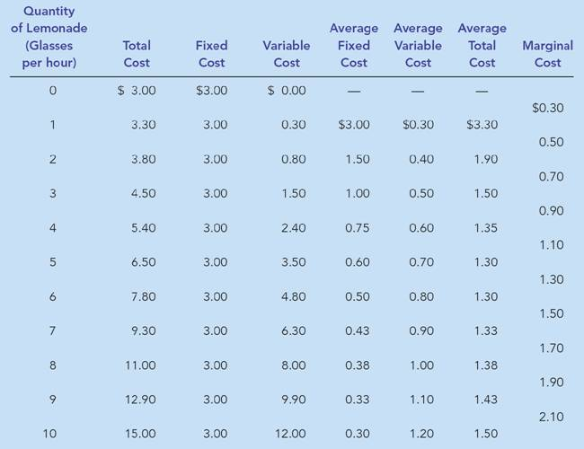
Table 2 The Various Measures of Cost: Thirsty Thelma’s Lemonade Stand

Slide 23
Fixed and Variable Costs
Average Costs
  Average costs can be determined by dividing the firm’s costs by the quantity of output it produces.
  The average cost is the cost of each typical unit of product.

Slide 24
Fixed and Variable Costs
Average Costs
  Average Fixed Costs (AFC)
  Average Variable Costs (AVC)
  Average Total Costs (ATC)
  ATC = AFC + AVC

Slide 25
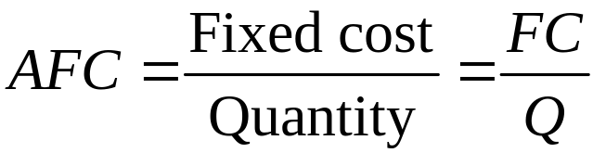
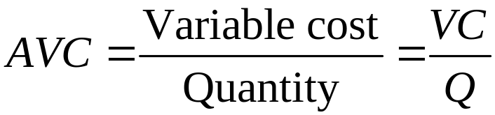
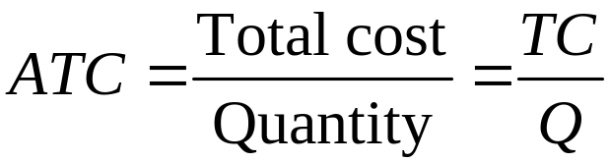
Average and Marginal Costs

Slide 26
Average and Marginal Costs
Marginal Cost
  Marginal cost (MC) measures the increase in total cost that arises from an extra unit of production.
  Marginal cost helps answer the following question:
    How much does it cost to produce an additional unit of output?

Slide 27
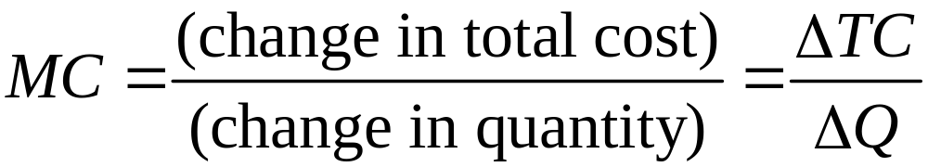
Average and Marginal Cost

Slide 28
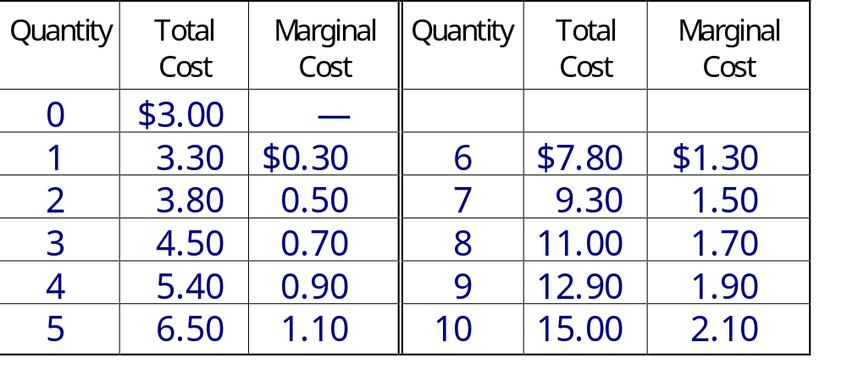
Thirsty Thelma’s Lemonade Stand
Note how Marginal Cost changes with each change in Quantity.

Slide 29
Figure 3 Thirsty Thelma’s Total-Cost Curves
Total Cost
$15.00
Total-cost curve
14.00
13.00
12.00
11.00
10.00
9.00
8.00
7.00
6.00
5.00
4.00
3.00
2.00
1.00
0
1
2
3
4
5
6
7
8
9
10
Quantity
of Output
(glasses of lemonade per hour)

Slide 30
Figure 4 Thirsty Thelma’s Average-Cost and Marginal-Cost Curves
Costs
$3.50
3.25
3.00
2.75
2.50
2.25
MC
2.00
1.75
1.50
ATC
1.25
AVC
1.00
0.75
0.50
0.25
AFC
0
1
2
3
4
5
6
7
8
9
10
Quantity
of Output
(glasses of lemonade per hour)

Slide 31
Cost Curves and Their Shapes
Marginal cost rises with the amount of output produced.
  This reflects the property of diminishing marginal product.

Slide 32
Cost Curves and Their Shapes
The average total-cost curve is U-shaped.
At very low levels of output average total cost is high because fixed cost is spread over only a few units.
Average total cost declines as output increases.
Average total cost starts rising because average variable cost rises substantially.

Slide 33
Cost Curves and Their Shapes
The bottom of the U-shaped ATC curve occurs at the quantity that minimizes average total cost. This quantity is sometimes called the efficient scale of the firm.

Slide 34
Cost Curves and Their Shapes
Relationship between Marginal Cost and Average Total Cost
  Whenever marginal cost is less than average total cost, average total cost is falling.
  Whenever marginal cost is greater than average total cost, average total cost is rising.

Slide 35
Cost Curves and Their Shapes
Relationship between Marginal Cost and Average Total Cost
  The marginal-cost curve crosses the average-total-cost curve at the efficient scale.
    Efficient scale is the quantity that minimizes average total cost.

Slide 36
Typical Cost Curves
It is now time to examine the relationships that exist between the different measures of cost.

Slide 37
Figure 5 Cost Curves for a Typical Firm
Note how MC hits both ATC and AVC at their minimum points.
Marginal Cost declines at first and then increases due to diminishing marginal product.
Costs
$3.00
AFC, a short-run concept, declines throughout.
2.50
MC
2.00
1.50
ATC
1.00
AVC
0.50
AFC
0
2
4
6
8
10
12
14
Quantity of Output

Slide 38
Typical Cost Curves
Three Important Properties of Cost Curves
  Marginal cost eventually rises with the quantity of output.
  The average-total-cost curve is U-shaped.
  The marginal-cost curve crosses the average-total-cost curve at the minimum of average total cost.

Slide 39
COSTS IN THE SHORT RUN AND IN THE LONG RUN
For many firms, the division of total costs between fixed and variable costs depends on the time horizon being considered.
  In the short run, some costs are fixed.
  In the long run, all fixed costs become variable costs.
Because many costs are fixed in the short run but variable in the long run, a firm’s long-run cost curves differ from its short-run cost curves.

Slide 40
Economies and Diseconomies of Scale
Economies of scale refer to the property whereby long-run average total cost falls as the quantity of output increases.
Diseconomies of scale refer to the property whereby long-run average total cost rises as the quantity of output increases.
Constant returns to scale refers to the property whereby long-run average total cost stays the same as the quantity of output increases.

Slide 41
Figure 6 Average Total Cost in the Short and Long Run
Average
Total
ATC
in short
ATC
in short
ATC
in short
Cost
run with
run with
run with
small factory
medium factory
large factory
ATC
in long run
$12,000
10,000
Economies
Constant
of
returns to
scale
scale
Diseconomies
of
scale
0
1,000
1,200
Quantity of
Cars per Day

Slide 42
The goal of firms is to maximize profit, which equals total revenue minus total cost.
When analyzing a firm’s behavior, it is important to include all the opportunity costs of production.
Some opportunity costs are explicit while other opportunity costs are implicit.

Slide 43
A firm’s costs reflect its production process.
  A typical firm’s production function gets flatter as the quantity of input increases, displaying the property of diminishing marginal product.
  A firm’s total costs are divided between fixed and variable costs. Fixed costs do not change when the firm alters the quantity of output produced; variable costs do change as the firm alters quantity of output produced.

Slide 44
Average total cost is total cost divided by the quantity of output.
Marginal cost is the amount by which total cost would rise if output were increased by one unit.
The marginal cost always rises with the quantity of output.
Average cost first falls as output increases and then rises.

Slide 45
The average-total-cost curve is U-shaped.
The marginal-cost curve always crosses the average-total-cost curve at the minimum of ATC.
A firm’s costs often depend on the time horizon being considered.
In particular, many costs are fixed in the short run but variable in the long run.

