Slide 1
Rights and Responsibilities
General Rights

Slide 2
Legal and Moral Rights
Legal rights: recognized in law
  Vary with place and time
  May be too limited or too extensive
Moral rights: what ought to be recognized in law
  Don’t vary with time or place (much)
  Allow for critique of legal system

Slide 3
Rights and Obligations
A right corresponds to a perfect obligation
X has a right that Y do A <=>
Y has a perfect obligation to X to do A

Slide 4
General Rights
Often we speak of a right to life, or to a fair trial, without saying who has the obligation
Michael has a right to life <=>
Others have a perfect obligation not to kill Michael =>
Others shouldn’t kill Michael

Slide 5
General Rights
X has a general right to A <=>
Others have a perfect obligation not to interfere with X’s A-ing =>
Others shouldn’t interfere with X’s A-ing
If anyone interferes with X’s A-ing, that is not only wrong but unjust

Slide 6
Examples: Bill of Rights
Speech: others shouldn’t interfere with your speaking
Assembly: others shouldn’t interfere with your gathering
Exercise of religion: others shouldn’t interfere with your worshiping
Arms: others shouldn’t interfere with your keeping and bearing arms

Slide 7
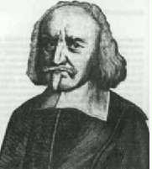
Thomas Hobbes (1588-1679)
All general rights follow from a right to liberty
Others shouldn’t interfere with me
Others shouldn’t interfere with my doing what I want to do

Slide 8
Social Contract Theory
A government is legitimate if people would voluntarily submit to its authority
Central idea: government (and its authority) are rational

Slide 9
Social Contract Theory
Imagine two situations:
  Government (the state)
  No government (the state of nature)
Which would you choose?

Slide 10
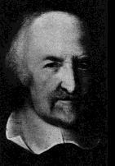
Thomas Hobbes
You would choose government
Life in the state of nature would be “solitary, poor, nasty, brutish, and short”

Slide 11
Hobbes’s state of nature
Equality of ability —>
Equality of hope —>
Conflict (most goods are private) —>
War —>
Poverty
To escape this, we’d agree to a government

Slide 12
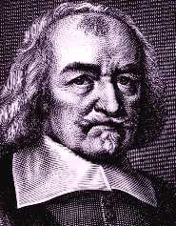
Hobbes’s Social Contract
You would give up
Liberty
To gain
Security

Slide 13
Hobbes on Liberty and Rights
You have a general right to liberty
Liberty = the absence of external impediments
Your right is natural, independent of government
A right is a liberty to do or forebear
This is weaker than a general right
There are no positive rights

Slide 14
Hobbes’s laws of nature
Natural law tradition: laws of nature are God-given laws ordering the universe
Hobbes: laws of nature are rational principles of conduct

Slide 15
Hobbes’s laws of nature
Key laws
  Seek peace
  Defend yourself
  Surrender some liberty for peace, keeping only as much as you will allow others against yourself

Slide 16
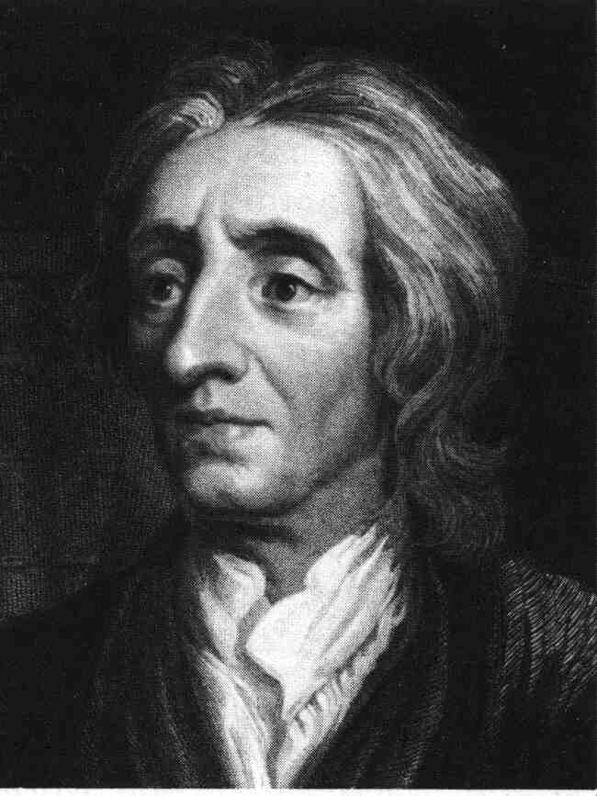
John Locke
Rationality justifies government
But also limits its authority

Slide 17
Locke’s state of nature
Equality of power and jurisdiction
Liberty, not license
Law of nature: no one ought to harm another is his life, health, liberty, or possessions

Slide 18
Locke’s state of nature
You have natural rights in the state of nature:
  Rights to life, health, liberty, and property
  Right of self-preservation
  Right to execute the law of nature
Not a state of war

Slide 19
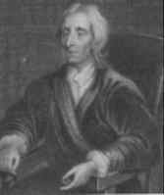
Locke’s Social Contract
Problem: finding an impartial arbitrator— who shall be judge?
You would give up
Your right to execute the law of nature
You gain
Impartial judgment

Slide 20
Natural and social rights
Rights to life, health, liberty, and property are natural— you have them in the state of nature
You do not give them up in the social contract
You can’t give them up
Slavery would be wrong even if voluntary

Slide 21
Voluntary Slavery
Hobbes thinks you would give up liberty even to an absolute monarch
But, for Locke, that would be like selling yourself into slavery
You can’t surrender your rights to life, liberty, and property
But you can be placed under laws that limit them (taxation, punishment)

Slide 22
Locke on Rights
All substantive rights are general rights
They follow from your right to self-preservation => your rights to life, health, liberty, and property
All positive rights are procedural— rights to a fair, speedy, public trial, to a trial by jury, to confront your accuser, etc.

Slide 23
Freedom under government
To have settled rules
In common
Made by a legislature duly erected
To follow my will where the rule is silent
Not to be subject to the arbitrary will of another

Slide 24
Social Contract
Positive Rights

Slide 25
Positive Rights
Some philosophers think there’s another legitimate conception of rights
X has a positive right to A <=>
Others have a perfect obligation to enable X to A

Slide 26
Procedural positive rights
Some less controversial positive rights are procedural— pertaining not to outcomes but to processes
You have a right to a fair, speedy, public trial by jury <=>
Others have a perfect obligation to enable you to have one

Slide 27
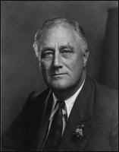
Substantive positive rights
Substantive rights pertain to outcomes: Entitlements
New Deal (Roosevelt): “The duty of the State toward the citizen is the duty of the servant to its master. . . . One of these duties of the State is that of caring for those of its citizens who find themselves the victims of such adverse circumstances as make them unable to obtain even the necessities for mere existence without the aid of others. . . .”

Slide 28
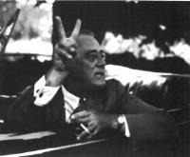
Substantive positive rights
“To these unfortunate citizens aid must be extended by governments, not as a matter of charity but as a matter of social duty.”
“[No one should go] unfed, unclothed, or unsheltered.”
For FDR, our duties to feed, clothe, and shelter others are perfect: not like charity, but matters of social justice

Slide 29
Substantive Positive Rights
Alleged examples: People are entitled to:
  Housing: others must enable you to have housing
  Health care: others must enable you to have health care
  Employment: others must enable you to have a job
  Food: others must enable you to have food

Slide 30
Positive vs. General Rights
Positive rights and general rights conflict with each other
If you have a positive right to housing, then others must provide it for you, whether they want to or not
Positive rights entail interference with the lives of others

Slide 31
Positive vs. General Rights
Positive rights come at the expense of general rights
Procedural: My right to a jury trial may limit your rights— you may have to serve on the jury
Substantive: My right to a job may limit your rights— you might prefer not to hire me

Slide 32
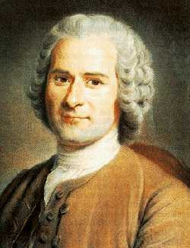
Jean-Jacques Rousseau
The social contract justifies government
But also limits it
The limit is established by the general will
General will = common good

Slide 33
Natural vs. Civil Rights
Locke: “Bottom-up” model
  Some rights are natural, independent of government
  Government derives its power from the rights individuals consign to it

Slide 34
Natural vs. Civil Rights
Rousseau: “Top-down” model
  All rights are civil, dependent on government
  Rights of individuals derive from government

Slide 35
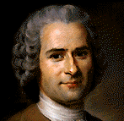
Rousseau’s Social Contract
You give up everything
You get everything back
What’s the point?

Slide 36
Rousseau’s Social Contract
You give up everything willingly to the group
You get back your fair share of the fruits of cooperation
Force —> right; possession —> property

Slide 37
Hobbes, Locke, Rousseau
General rights: Hobbes*, Locke*, Rousseau
Procedural positive rights: Locke, Rousseau
Substantive positive rights: Rousseau
* some are natural rights

Slide 38
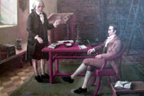
Rights in Kant

Slide 39
A Kantian Account of Rights
What rights do people have?
Categorical imperative: Treat everyone as an end, not merely as a means
Everyone has a right to be treated as an end
Everyone has a right to respect
This yields some general rights: no one may use me

Slide 40
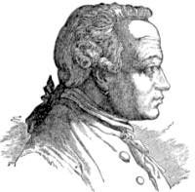
Kantian Arguments
Categorical imperative
  Act only on that maxim you can will to be universal law (don’t make an exception for yourself)
  Treat others as ends-in-themselves (don’t use people)

Slide 41
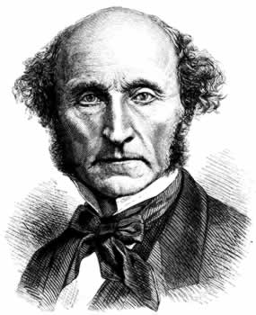
Rights in Utilitarianism

Slide 42
A Utilitarian Account of Rights
A right is something society should protect my possession of (Mill)
X has a right to A <=>
Society ought to protect X’s possession of A
General rights: Society protects me from interference
Positive rights: I have a right to protection
Why should society protect my possession of something? Utility.

Slide 43
Utilitarianism and Rights
A fetus has a right to life <=>
Society ought to protect a fetus’s possession of life <=>
Protecting a fetus’s life is for the best (maximizes utility)
Is it best that we protect the fetus’s life or the mother’s choice?

Slide 44
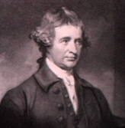
Rights in Burke

Slide 45
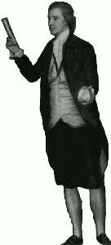
Burke’s Critique of Rights
What rights do we have?
How do we resolve conflicts between rights? Between rights and other moral considerations?
No moral theory can answer these questions
We work out answers in practice

Slide 46
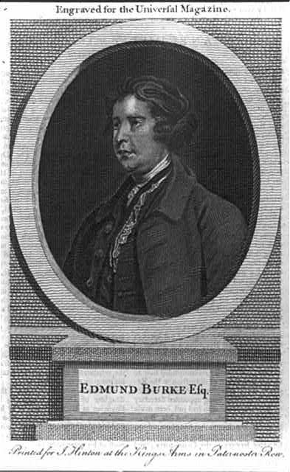
Examples of rights conflicts
Abortion: fetus’s right to life vs. mother’s right to control her own body
Capital punishment: prisoner’s right to life vs. society’s interest in protection and punishment
Euthanasia: right to life vs. quality of life
War on terrorism: civil liberties vs. national security

Slide 47
Burke’s Arguments
Complexity: circumstances, human nature, and society are all intricate; we can’t settle conflicts by an abstract rule
Experience: we must learn to resolve conflicts through experience; politics is experimental, not a priori
Balance, Compromise: we must balance competing goods, strike compromises between them

Slide 48
Burkean Arguments
Classic case of conflict of rights
  Fetus’s right top life
  Mother’s right to liberty
There is no principled way of telling which takes precedence
We must seek compromise,
Reasoning by analogy
On basis of experience

