Slide 1
EE 746 Spring 2019-20
Project Proposals: Vivek Saraswat
Learning in SNNs – 3 projects
Liquid State Machines – 4 projects
Boltzmann Machines – 1 project

Slide 2
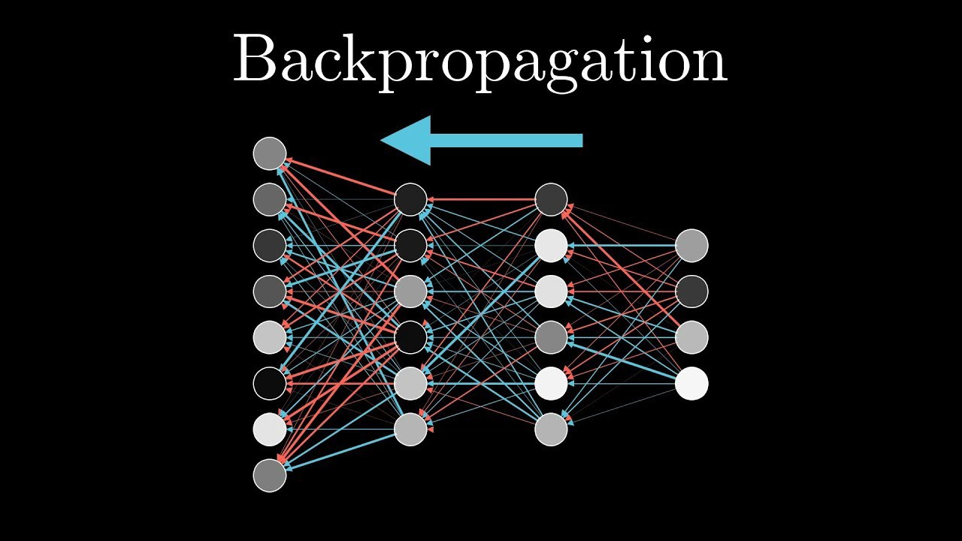
A. Backpropagation in Deep SNNs
Background:
Continuous valued activation neurons are trained by minimising error by adjusting weights
Gradient Descent over spike signals is difficult
Spike signals converted to rate to get continuous valued functions and offline gradient descent sets the weights
Can variables of SNNs be used to execute backpropagation?

Slide 3
A. Backpropagation in Deep SNNs
Stage I:
How do SNNs learn – supervised vs unsupervised learning?
How to implement backpropagation using spikes or spiking neuron’s membrane potential?
Stage II:
Implement an SNN based on backpropagation on MNIST and comment on its hardware feasibility
https://www.frontiersin.org/articles/10.3389/fnins.2016.00508/full

Slide 4
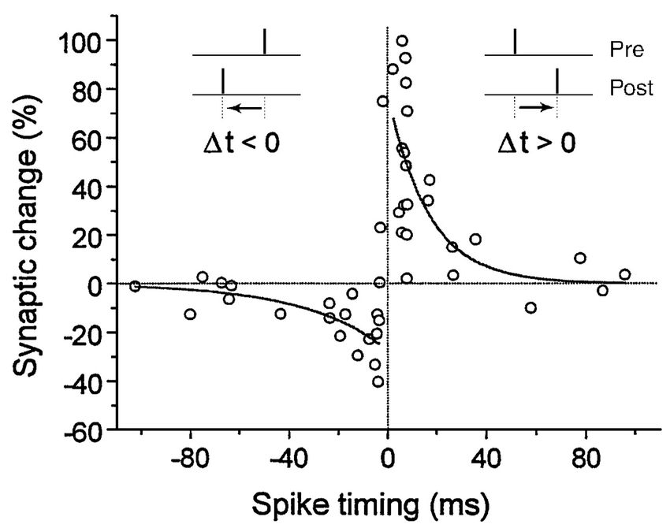
B. STDP and Backpropagation
Background:
The spiking neurons communicate based on spiking events.
Spike timing dependent plasticity is a local and hardware friendly learning rule.
Backpropagation is a general weight update rule for a variety of neural network applications.
Can STDP be used to approximate backpropagation?

Slide 5
B. STDP and Backpropagation
Stage I:
How is backpropagation used to learn weights for arbitrary problems?
How is STDP used to update weights for a classification problem?
What is the performance loss in the approximation?
Stage II:
Implement an SNN based on BP-STDP on MNIST and comment on the hardware feasibility of the learning rule
https://www.sciencedirect.com/science/article/pii/S0925231218313420
https://www.frontiersin.org/articles/10.3389/fnins.2018.00435/full

Slide 6
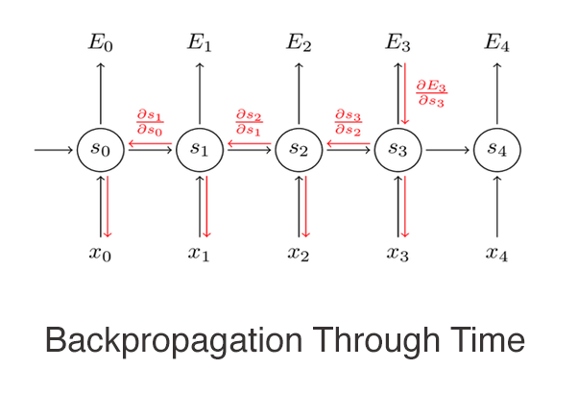
C. Learning in RNNs
Background:
Deep Neural Networks and Recurrent Neural Networks are two important class of NNs.
Backpropagation through time suggested for learning in RNNs.
Can BPTT be achieved in SNNs?

Slide 7
C. Learning in RNNs
Stage I:
How do RNNs improve performance for specific applications?
How is BPTT implemented for ANNs?
What are the biologically plausible ways to implement BPTT?
Stage II:
Implement an RNN with local information based BPTT to perform learning and comment on hardware feasibility.
https://arxiv.org/pdf/1909.07486.pdf
https://arxiv.org/abs/1803.09574

Slide 8
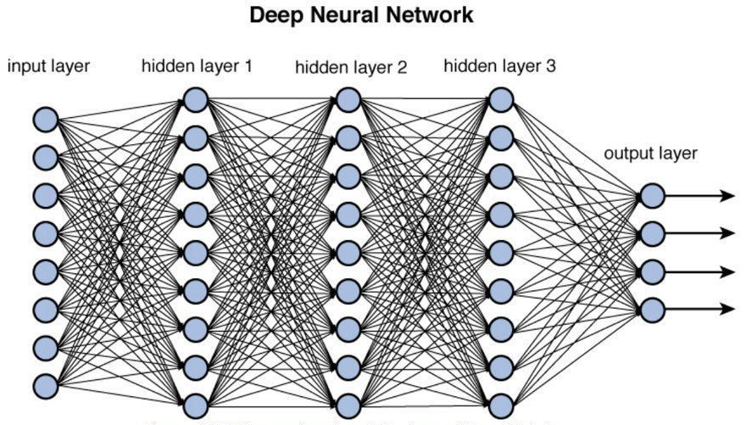
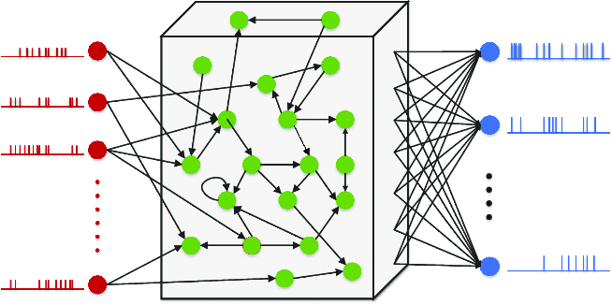
A. Should reservoirs learn?
Background:
Deep neural networks have several layers of fully connected weights to be trained.
Liquid state machines have a fixed reservoir of neurons and a single output layer of weights to be trained.

Slide 9
A. Should reservoirs learn?
Stage I:
How do fixed weight reservoir improve output performance?
Is reduction in the set of learning weights matched well with the increased complexity of implementing the reservoir?
Stage II:
Compare a learning reservoir with a fixed one and comment on the application where this facility is useful
https://ieeexplore.ieee.org/stamp/stamp.jsp?tp=&arnumber=7568626

Slide 10
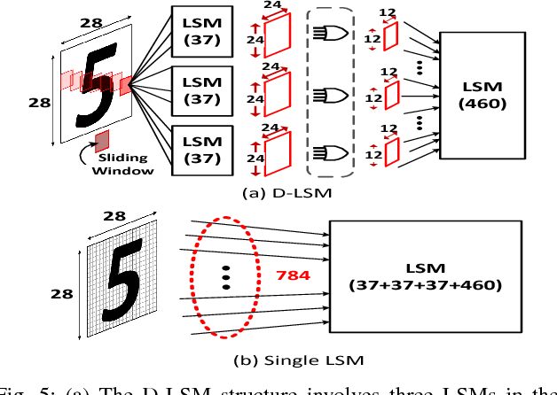
B. Deep LSMs
Background:
Convolutional neural networks are conventionally used for image and video activity recognition
LSMs have a single layer of output classification weights to be learnt.
Can multiple reservoirs be used for deep neural networks?

Slide 11
B. Deep LSMs
Stage I:
Identify which deep neural networks can benefit from reservoir stages
Come up with the standard scheme to include reservoirs in multi-stage neural networks
Stage II:
Implement a deep LSM CNN for video activity classification or image recognition
https://www.frontiersin.org/articles/10.3389/fnins.2019.00686/full

Slide 12
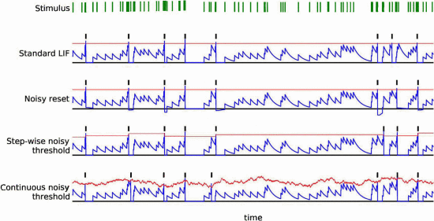
C. Neuron models in LSM
Background:
Reservoir computing is about have a RNN of neurons after the input layer and before the output layer
Apart from the architectural comment, there is no comment about the neuronal features to incorporate in the reservoir neurons.
Do higher order neuron models or stochasticity in neuron models affect reservoir performance?

Slide 13
C. Neuron models in LSM
Stage I:
Implement the simple LIF neuron based LSM
Do LIF parameters affect the output performance significantly?
Is neuron model or synaptic connectivity more critical for LSM performance
Stage II:
Implement the LSM with a different neuron model HH or Morris Lecar or include sources of stochasticity and comment on the output performance.
https://ieeexplore.ieee.org/abstract/document/6033639

Slide 14
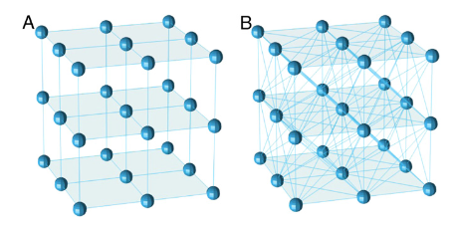
D. Connectivity and Topologies
Background:
The reservoir has a specific connectivity in terms of which neurons are connected and what is the synaptic strength distribution.
There are different ways to build the reservoir starting from scratch
Is there a method to build the reservoir which is tailor made for the applications?

Slide 15
D. Connectivity and Topologies
Stage I:
Find out different ways to build a reservoir – connection topologies and rules to include a connection
Find out ways to assign the synaptic strength to the reservoir for different applications
Stage II:
Implement and comment on hardware friendly topologies and the associated reduction in the performance, is there a formal way to assign synaptic weights in the reservoir for an application?
https://www.sciencedirect.com/science/article/pii/S0893608012002808
https://www.tandfonline.com/doi/abs/10.2976/1.3240502

Slide 16
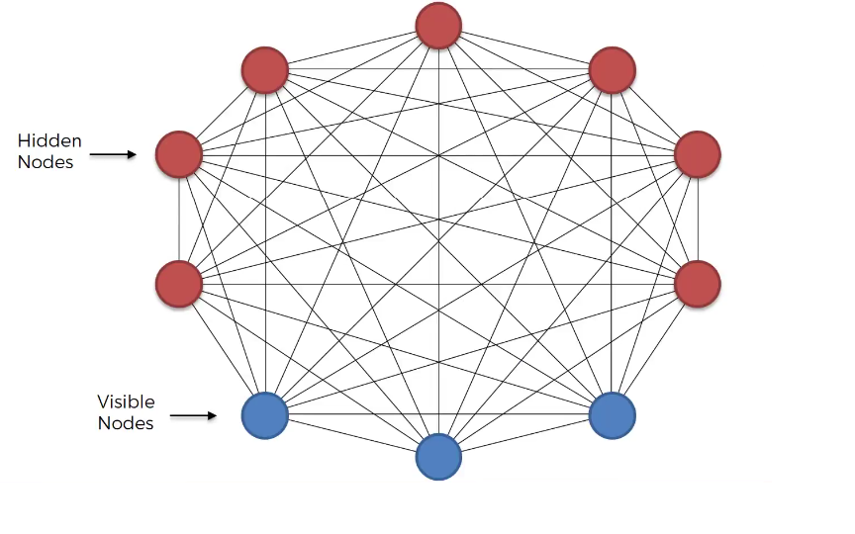
A. Chaotic Boltzmann Machines
Background:
Stochastic Hopfield Networks are popular for optimisation problems.
Stochastic devices have been proposed for effective implementations of Stochastic Boltzmann Machines
Chaotic BMs are claimed to have same power as SBMs.
Is randomness necessary for optimisation?
Energy
Configurations

Slide 17
A. Chaotic Boltzmann Machines
Stage I:
Compare and contrast Stochastic Boltzmann Machines with Chaotic Boltzmann Machines
Comment on the required functionalities to achieve the necessary operations in the two networks.
Stage II:
Implement a chaotic BM and comment on the output performance vs. the reduction in the hardware complexity/requirement due to removal of randomness.
https://www.nature.com/articles/srep01610.pdf
https://ieeexplore.ieee.org/stamp/stamp.jsp?arnumber=7965991

