Slide 1
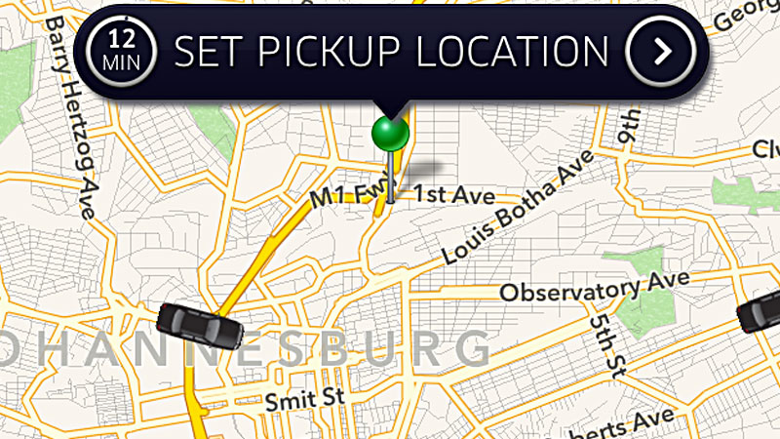
Predicting Cab Booking Cancellations by Devesh Khandelwal

Slide 2

Problem Statement
Customers can cancel the booking up to the last minute of pick up at no cost to them
Cancelled booking dents the revenue of the company and adds operational overheads
Use the Data collected over time to predict the probability of booking cancellation
Data Science Workflow – Identify the Problem

Slide 3

Problem Statement
Customers can cancel the booking up to the last minute of pick up at no cost to them
Cancelled booking dents the revenue of the company and adds operational overheads
Use the Data collected over time to predict the probability of booking cancellation
The problem is of significant importance to any company in the ride sharing business as:
It could help to streamline the operations
It could help reduce the overheads and costs
It could help the company make the best and most efficient use of its resources
Data Science Workflow – Identify the Problem

Slide 4
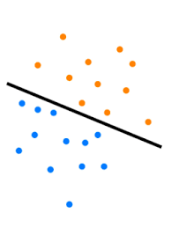
Problem Analysis
Classification Task – Classify the Cancellation feature into :
‘0’ (Not Cancelled)
or
‘1’ (Cancelled)
Data Science Workflow – Identify the Problem

Slide 5


Dataset
Training Data-
43 K records
18 Features
Uneven Classes
Approx 7% of the total bookings are actually Cancelled(Training Data)
Source:- https://inclass.kaggle.com/c/predicting-cab-booking-cancellations/data
Data Science Workflow – Acquire the Data

Slide 6


Features at a Glance
Features set includes:
Vehicle attributes
Booking attributes including-
Online
GPS data
Mobile
Travel Type
Source
Destination
Data Science Workflow – Acquire the Data

Slide 7
Features at a Glance(Contd..)
Data Science Workflow – Acquire the Data

Slide 8
Hypothesis
The solution could be to make a Machine learning model that could achieve the following:
A classification accuracy in the range of 60-90%
To explain what are the most important features of the data set that drive this relationship
Data Science Workflow – Acquire the Data

