Slide 1
OrgaNice
Track: Community
Organize + Nice !!
One stop solution for Self Organization Management..
Go Soft.. Go Smart..

Slide 2
Problem Statement
To-Do List
01
02
Organisation Calendar
Tired of writing old time sticky notes??
Still planning your events/meeting manually and even unable to share easily??
03
Expense Tracker
Do you find managing your daily/weekly expenses still burdensome??

Slide 3

A smarter solution for this ..
Get rid of again and again making sticky notes
Try our ‘To-Do List’ with the most convenient and customized features

Slide 4

Easier way to track your expenses
Forgetting your wallet transactions
Try our ‘Expense Tracker’, which makes your accounting pretty handy and convenient at your end of the day

Slide 5

Generalized way to deal with this..
Never again make your calendar and update things manually
Try our ‘Orgo-Calendar’ , where you just have to “check” .. no additions, deletions, upgradations any more

Slide 6
All in one!!
Integrated Web Platform Solution to tackle all these Community Problems
Here we come
The OrgaNice

Slide 7
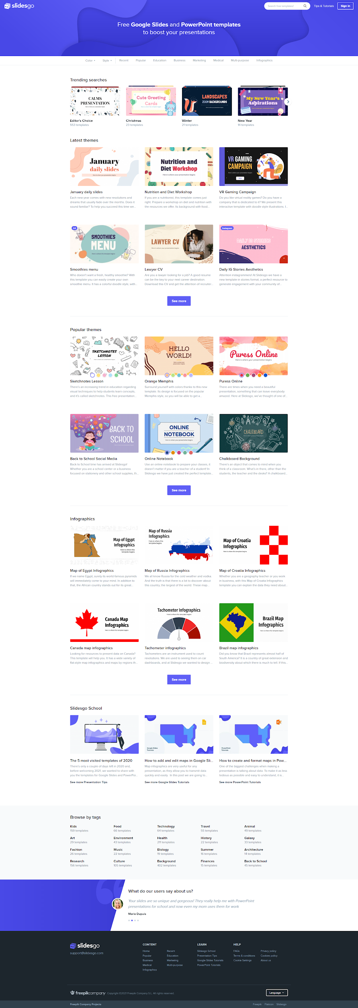
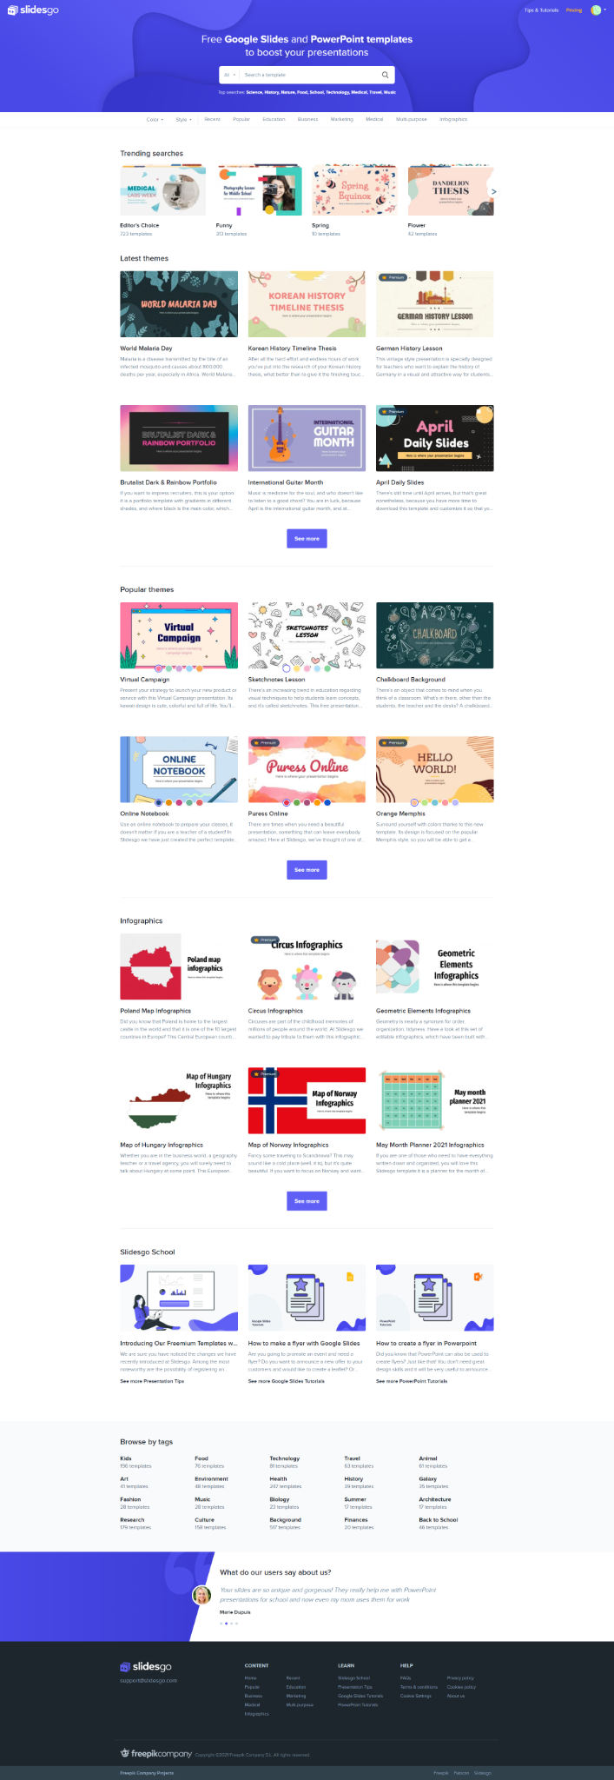
Desktop
Technical Background
The project will be a Web Application
Technologies;
-Google Calendars API
-Form to txt file downloader
-JS calculator
Tablet
Mobile

Slide 8

A picture is worth is a thousand words

