Slide 1
Q 1
The participants find a .7z compressed file that they download. Upon downloading and extracting it they get an image of a red flag. If they veiw the image's hex code using some online hex editor, they will find the flag at the end if the description lines.
FLAG --> C0ngRatS_y0u_g0t_tHis
QUESTION TEXT: S0m3thing, ab0ut that 1mage, has been bugg1ng me since I was “16”! Help me out!
NOTE : The number 16 in the inverted commas is a hint to HEX.

Slide 2
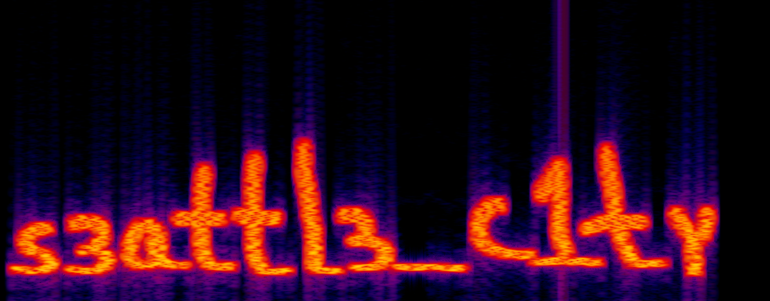
Q.2
The participants find a .wav audio file which they can download.
This question is a mix of forensics and steganography.
The Question text has capitalized letters that make up the word SPECTROGRAM. The participants need to use an online spectrogram generator to make the spectrogram (see image alongside) of the give audio file to see the flag.
QUESTION TEXT (Copy & Paste as it is): no SPEaker, no sound! if only you Could see ThROuGh and tuRn this Around! HmmMmm...
FLAG: s3attl3_c1ty

