Slide 1
Assignment Round - Analyst I - MiQ
Analysis of the Fashion Dataset for the period of October 2017
Prepared By: Devesh Singh

Slide 2
· Overview of the brand's sales performance
Total sales during the given period: 101332 , that is 101.3K
Total revenue during the given period: 6699843.72, that is 6.69M
Total number of orders: 49984
Average revenue per order: 134.04
Total number of unique users: 41808
All the orders are from: 5347 cities across Australia and New Zealand
Total number of unique products: 20029, that is 20.02K

Slide 3
· Product Affinity
There are 20.02K unique products
Of these unique products, 5991 products(30%) are sold alone.
Some of the items more likely to be sold together are:
Distressed Sweatshirt and Energy Pullover
Florale Pants and Florale Crop Top
Noosa Strappy Briefs and Salsa Dress
And many more

Slide 4
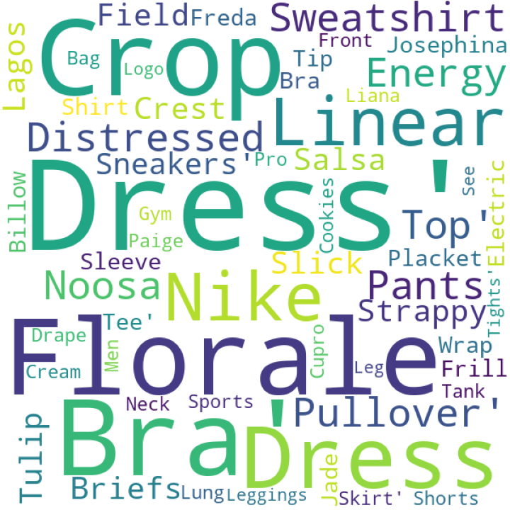
Some of the products more likely to sell together are represented in the Word-cloud at the left hand side.

Slide 5
Segmentation
Segmentation Slides Ahead

Slide 6
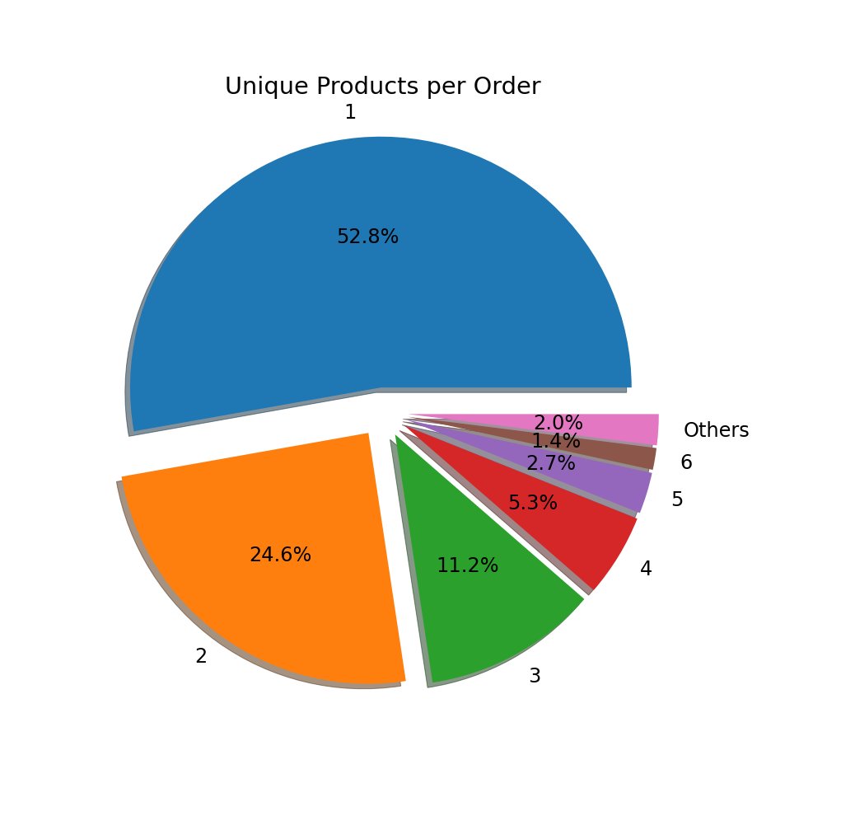
Segment-1: Avg. Unique Quantity and Revenue per order
Average unique quantity per order: 1
Average revenue per order: 134.04
52.80% orders contain only 1 product
24.60% orders contain 2 products
Maximum number of products in an order: 17

Slide 7
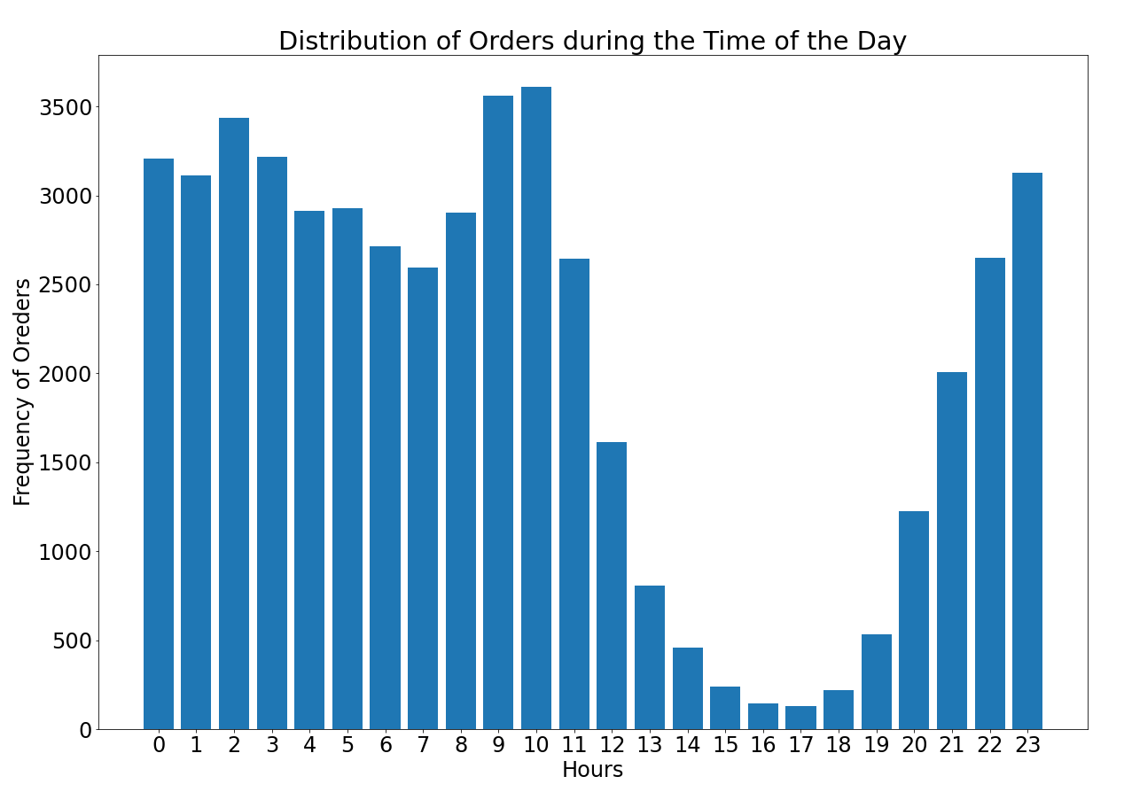
Segment-2: Attributes-Time of Day, Day of Week, Geography, Payment Type
Time of Day
Maximum sales happened during the day time
At 9 hrs and 10 hrs most of the sales happened
Least sales happened during the evening time
After 10 hrs, the sales dropped till 17hrs
Least sales happened at 17 hrs

Slide 8
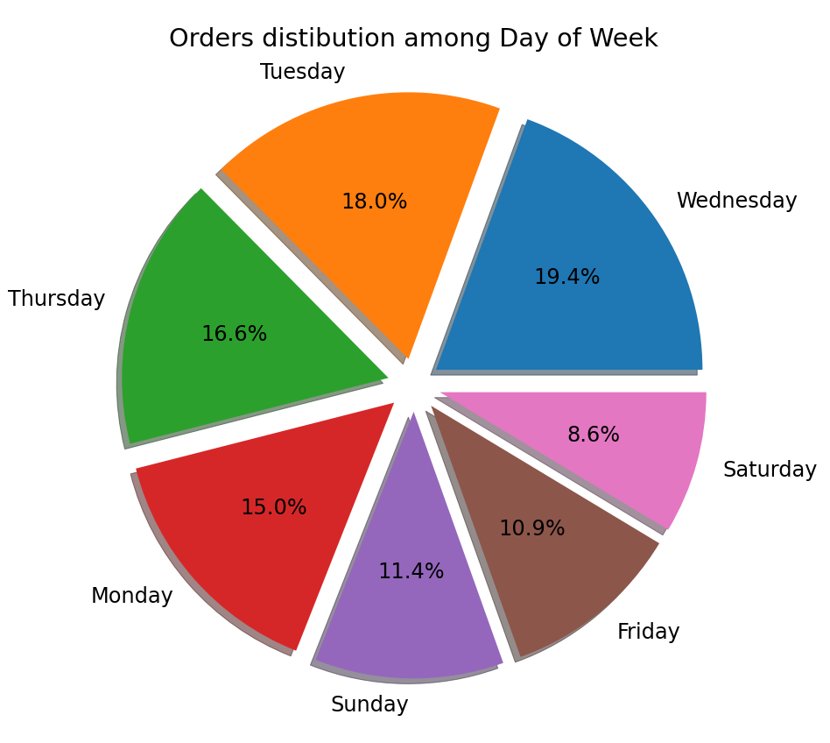
Day of Week
Most sales happened on Wednesdays
Least sales happened on Saturdays

Slide 9
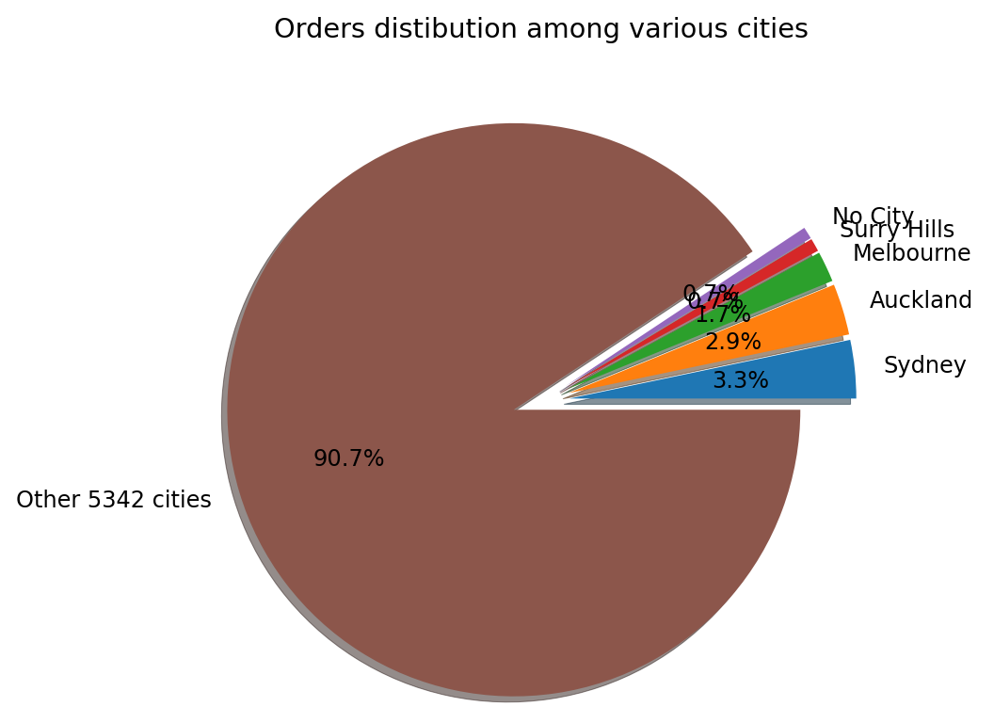
Geography:Cities
All the orders are from: 5347 different cities
Of all the cities:
Sydney has the highest number(1642) of orders
Auckland has the second highest number(1443) of orders
Melbourne has the third highest number(865) of orders, and so on
Other cities constitute:
90.7% of the total orders
These cities have less than 100 orders each

Slide 10
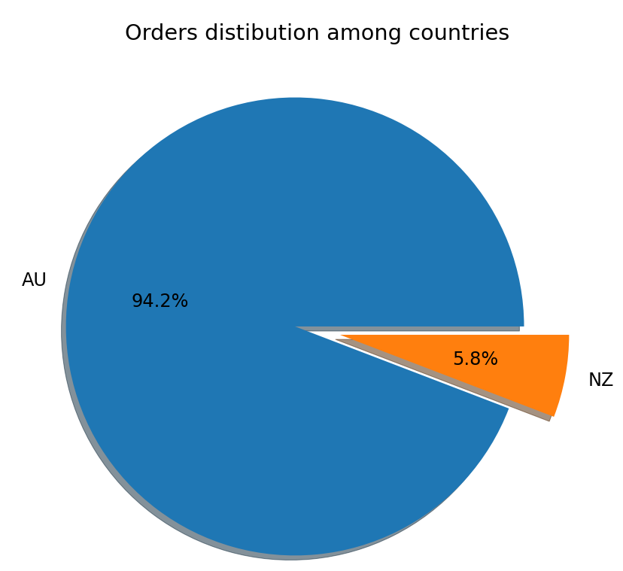
Geography:Countries
Australia constitute 94.2% of the total orders
New Zealand constitute 5.8% of the total orders

Slide 11
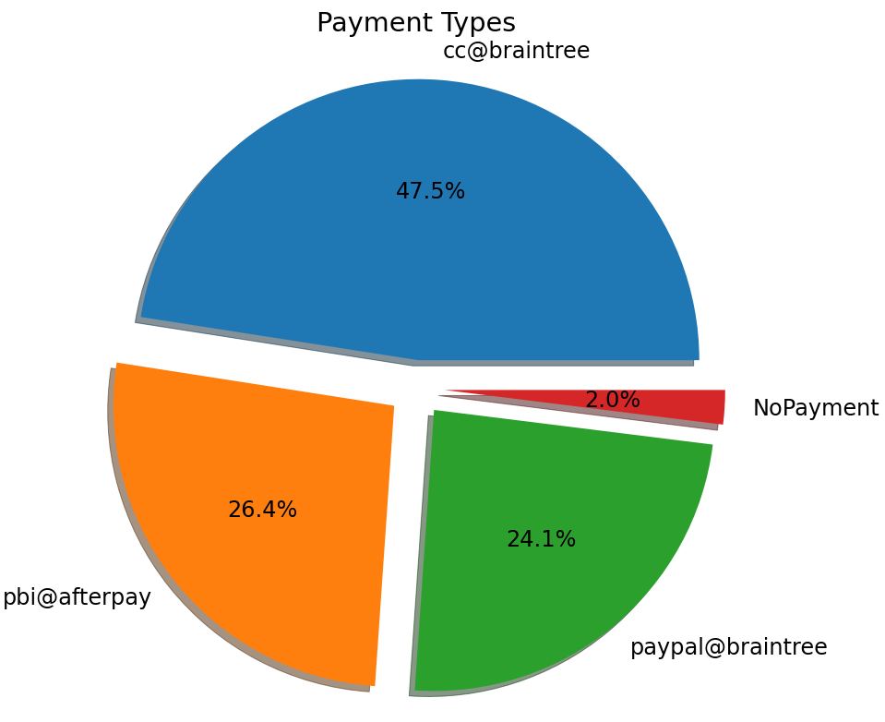
Payment Type
Most of the payments were made through cc@braintree (47.5%)
For 2% of orders no payment was made

Slide 12
Segment-3: Frequency- Single Purchasers, Multiple purchasers and Frequency of Multi-Purchase
Definitions:
Single Purchaser: User who purchased only once
Multiple Purchaser: User who purchased more than once
Frequency of Multi Purchase: Number of times multiple purchases happened by a unique user

Slide 13
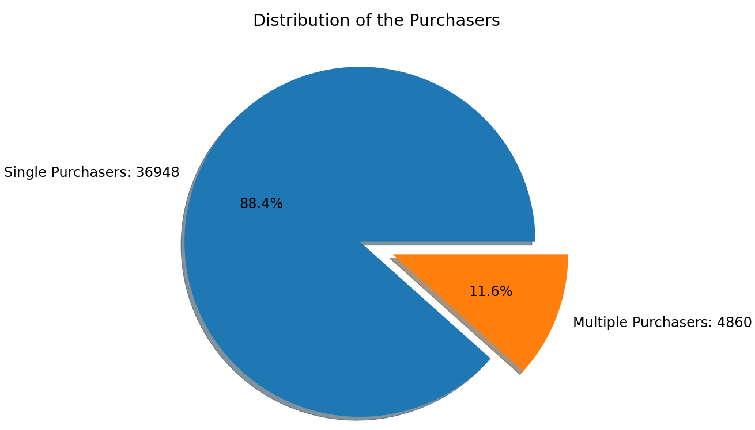
Type of Purchaser
We found unique users by considering unique IP addresses
There are 41808 unique users
Number of Single Purchasers: 36948 (88.37%)
Number of Multiple Purchasers: 4860 (11.62%)

Slide 14
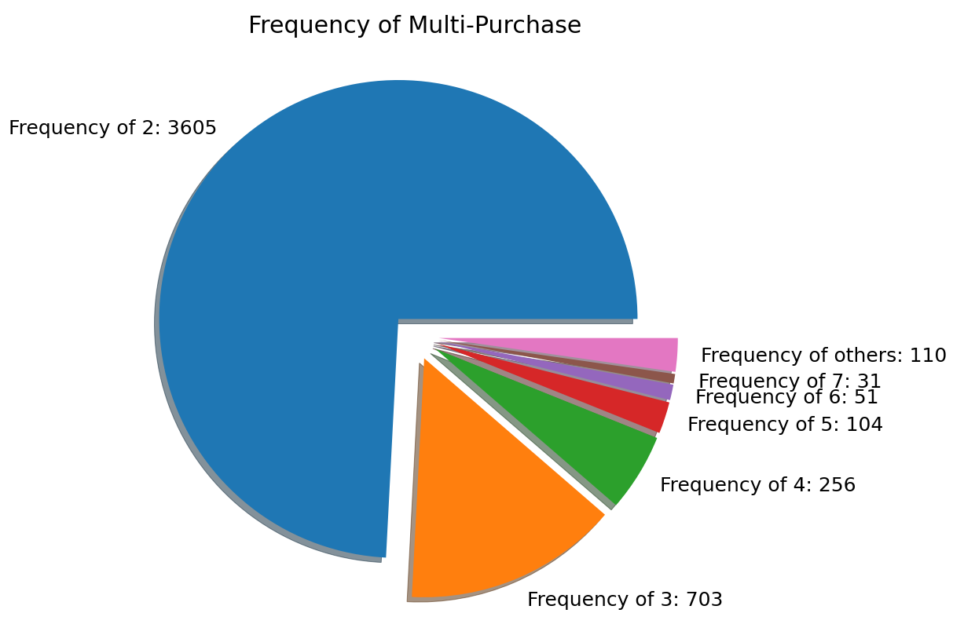
Frequency of Multi- Purchase
Frequency distribution of Multi Purchase shows that:
8.62% users(3605 out of 41808) ordered twice
1.62% users(703 out of 41808) ordered thrice
Only two users ordered more than 100 times
104 times, and
202 times

Slide 15
Media Strategy to target more users
After the complete analysis of the data, new users could be attracted by the following media strategies:
Promotional/Coupon Codes for new users
Running promotions during the day time to attract more users
Running promotions in major cities such as Sydney, Auckland, Melbourne
Gifts after shopping for more than the average revenue per order
Sales on Tuesdays, Wednesdays, and Thursdays
Special promotions for Brain-Tree Credit Card holders
Sales on products that are usually bought together
Discounts at a certain cart value

