Slide 1
AWS Introduction
How can we use it for MMM?

Slide 2
Cloud computing offers numerous benefits.
Swap upfront expense for variable expense.
Gain from significant economies of scale.
Cease estimating capacity.
Enhance speed and flexibility.
Eliminate costs of running and maintaining data centres.
Expand globally in minutes.

Slide 3
Cloud computing
Types of Deployment:
1. Cloud Based Deployment: All applications are run on the cloud. Existing applications are migrated and new apps are built on the cloud.
2. On-Premise Deployment: Resources are developed using virtualisation and resource management tools, with increased resource utilisation through app management and virtualisation technologies.
3. Hybrid Deployment: Cloud based resources are connected to on premise infrastructure, and integrated with legacy IT infrastructure.

Slide 4
Moving applications and data to the cloud.
The AWS Cloud Adoption Framework (AWS CAF) organizes guidance into six Perspectives. Each Perspective has distinct responsibilities. The planning process prepares the organization for changes.
The Business, People, and Governance Perspectives focus on business capabilities, while the Platform, Security, and Operations Perspectives focus on technical capabilities.
The Governance Perspective aligns IT strategy with business strategy, maximizing business value and minimizing risks.
Use the Governance Perspective to update staff skills and processes for business governance in the cloud. Manage and measure cloud investments for evaluating business outcomes.

Slide 5
Governance
I can help you with clarity and conciseness in your sentences. Please provide me with the sentence that you would like me to reword.

Slide 6

EC2 stands for Elastic Compute Cloud.
EC2 provides secure, resizable compute capacity in the cloud as Amazon EC2 instances. Compared to traditional on-premises resources, using an Amazon EC2 instance offers several advantages. Instead of spending money upfront to purchase hardware, waiting for server delivery, and installing them in a physical data center, you can quickly provision and launch an Amazon EC2 instance within minutes. When you're done running a workload, you can stop using the instance and only pay for the compute time you actually use. This flexibility allows you to save costs by paying only for the server capacity you need.

Slide 7
Serverless computing is a cloud computing model where the cloud provider manages the infrastructure and dynamically allocates resources for executing code.
To run applications in Amazon EC2, follow these steps:
- Provision virtual servers (instances).
- Upload your code.
- Manage the instances during application runtime.
In serverless computing, your code runs on servers you don't have to provision or manage. This allows you to focus on innovating rather than server maintenance.
Serverless computing offers the advantage of automatic scaling for applications. By adjusting consumption units like throughput and memory, serverless applications can adapt their capacity.

Slide 8
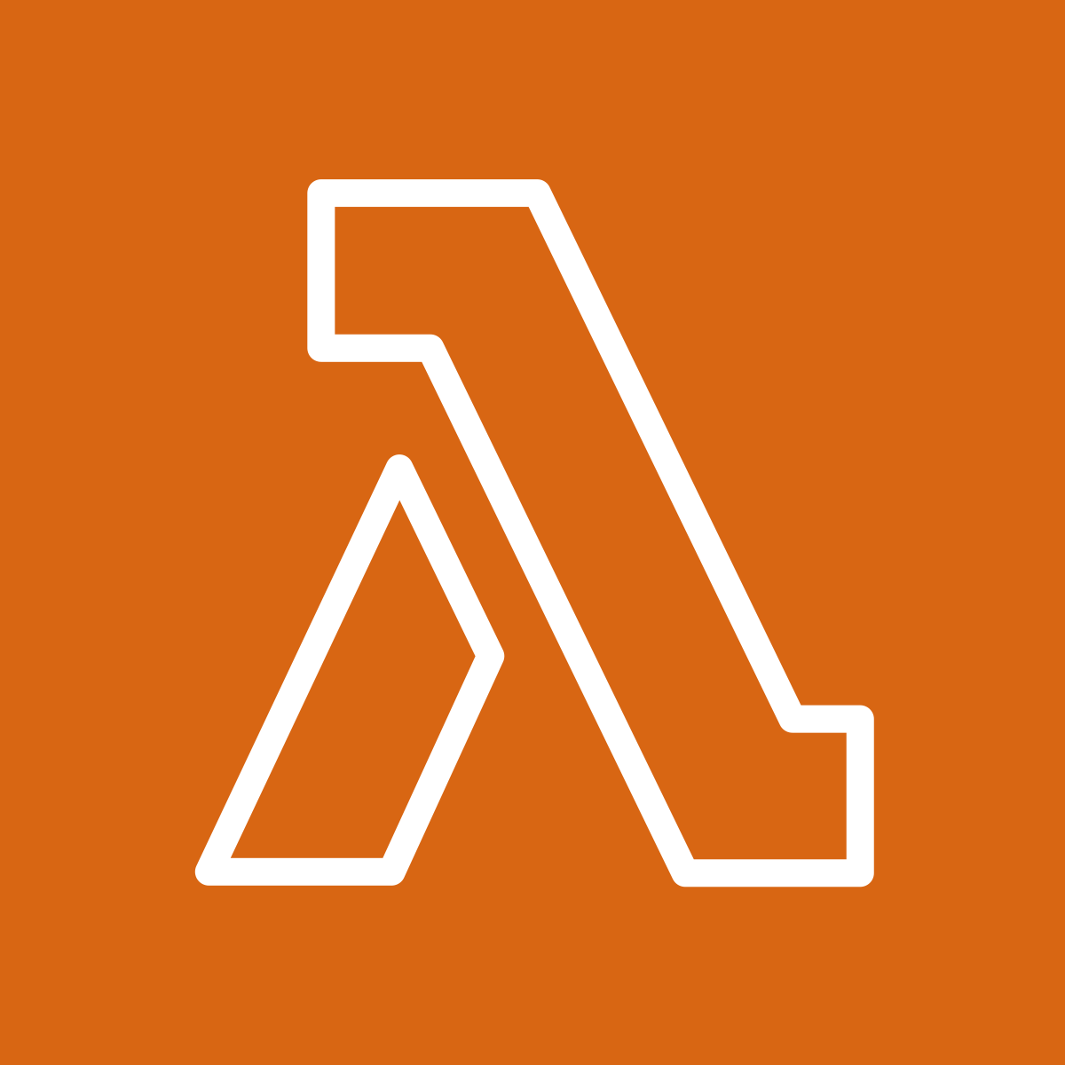
AWS Lambda is a serverless computing service provided by Amazon Web Services.
AWS Lambda is a serverless service that allows you to run code without having to worry about servers. You are only charged for the compute time your code uses, and you can run code for any type of application or backend service without any administration.
Here's how it works:
1. You upload your code to Lambda.
2. You set your code to be triggered by an event source, like AWS services, mobile apps, or HTTP endpoints.
3. Lambda runs your code whenever it's triggered.
4. You only pay for the compute time you actually use.

Slide 9


S3 Buckets refer to Simple Storage Service.
Amazon S3 is a service for storing objects, while Amazon EBS provides block-level storage volumes for use with EC2 instances. When you upload a file to S3, you can set permissions and track changes using versioning. With EBS, data on attached volumes remains available even if the EC2 instance is stopped or terminated.

Slide 10
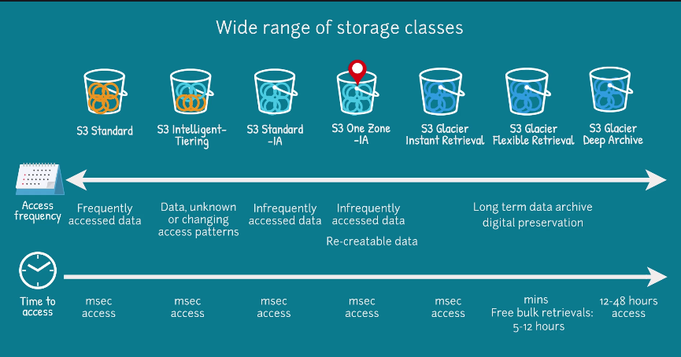

Slide 11

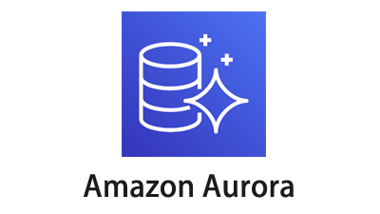
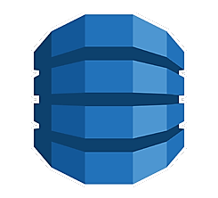

AWS offers various database services.
Amazon RDS enables you to run relational databases in the AWS Cloud.
Amazon Aurora is an enterprise-class relational database compatible with MySQL and PostgreSQL. It is up to five times faster than standard MySQL databases and up to three times faster than standard PostgreSQL databases.
Amazon DynamoDB is a key-value database service that delivers single-digit millisecond performance at any scale.
Amazon Redshift is a data warehousing service for big data analytics. It collects data from many sources and helps you understand relationships and trends across your data.

Slide 12
Comparison between relational databases (RDS) and flat data placeholder
Sure, I can help you reword sentences to make them clear and concise. Just provide me with the sentences you would like me to work on.

Slide 13

IAM
AWS Identity and Access Management (IAM) allows secure management of access to AWS services and resources. It provides flexibility to configure access based on your company's operational and security requirements. This is achieved by utilizing IAM users, groups, roles, policies, and multi-factor authentication.

Slide 14
Try it yourself.
I can help you with that. Just let me know what sentence you want me to reword.

