Slide 1
AWS: An Overview
And how it can be utilized for MMM.

Slide 2
Cloud Computing Advantages
Swap fixed costs for variable costs.
Leverage significant economies of scale.
Eliminate capacity predictions.
Boost speed and flexibility.
Save money by not operating or maintaining data centres.
Achieve global expansion rapidly.

Slide 3
Cloud Computing Overview
Deployment Types:
Cloud Deployment
Entire operation is cloud-based, including migration of current applications and design of new ones.
On-Premise Deployment
Resources established through virtualisation and resource tools, application management and virtualisation technologies enhance resource usage.
Hybrid Deployment
Combines cloud resources with on-premise infrastructure, integrating cloud resources with traditional IT infrastructure.

Slide 4
"Cloud Computing Transition"
The AWS Cloud Adoption Framework (AWS CAF) categorizes its guidance into six 'Perspectives', each targeting different responsibilities. This aids organizational preparation for impending changes. The Business, People, and Governance Perspectives concentrate on business capabilities, while the Platform, Security, and Operations Perspectives handle technical capacities.
The Governance Perspective aligns IT and business strategy, maximizing business value and reducing risk.
Use this perspective to understand how to manage and upgrade staff skills and processes to maintain cloud governance and evaluate business outcomes from cloud investments.

Slide 5
"Governance Overview"

Slide 6

"EC2: Elastic Compute Cloud"
Amazon EC2 offers secure, scalable cloud computing power via EC2 instances. Picture this: As your company's architectural lead, you're tasked with supporting new websites. Traditionally, this requires significant upfront investment in hardware, waiting time for server delivery, physical installation in a data center, and detailed configurations. Contrastingly, Amazon EC2 allows applications to run on a virtual server in the AWS Cloud. EC2 instances can be initialized in minutes, and terminated at workload completion, with payment applicable solely to active running time, not when stopped or terminated. This approach permits cost-cutting by only paying for server capacity you need.

Slide 7
Serverless Architecture
To utilize Amazon EC2 for running applications, you must provision virtual servers, upload your code, and manage these servers during application operation.
"Serverless" refers to running code on servers without the responsibility of provisioning or management, enabling innovation-focus rather than server maintenance.
Serverless computing also offers auto-scaling flexibility, adjusting application capacity by modifying consumption units like throughput and memory.

Slide 8
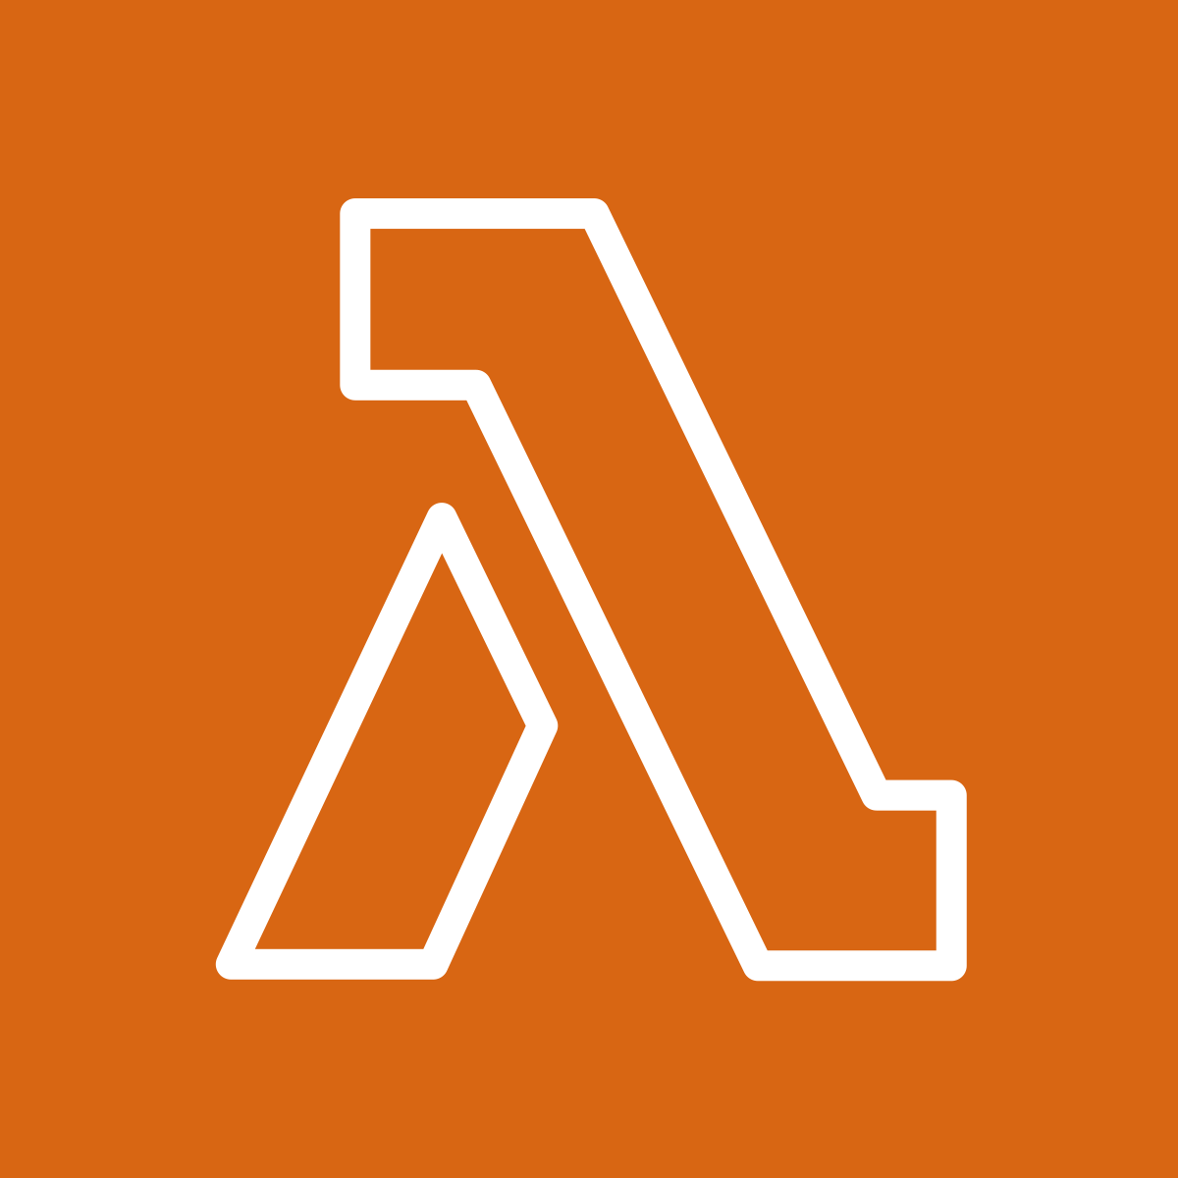
AWS Lambda Overview
AWS Lambda is a service enabling serverless code execution. It operates on a cost-effective, pay-per-use basis, charging only for actual compute time. Suitable for virtually any application or backend service, it requires zero administration. To use Lambda, upload code and set a trigger event from sources like AWS services, mobile apps, or HTTP endpoints, hence it executes code solely when triggered.

Slide 9


S3 Buckets - Simplified Storage Service
Amazon Simple Storage Service (Amazon S3) offers object-level storage, storing data as objects in buckets. Uploading a file to Amazon S3 allows you to control access, and versioning tracks object changes over time.
Amazon Elastic Block Store (Amazon EBS) offers block-level storage volumes for Amazon EC2 instances. Data on attached EBS volumes remains accessible after stopping or terminating the EC2 instances.

Slide 10
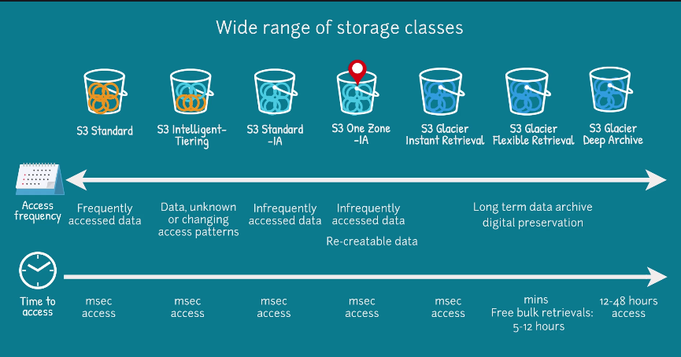

Slide 11

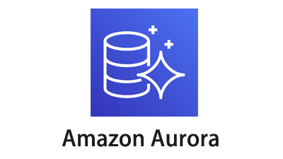
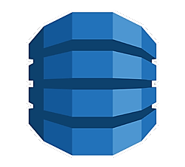

Database Services in AWS
Amazon RDS facilitates the operation of relational databases in the AWS Cloud. Amazon Aurora, an enterprise-level relational database, is MySQL and PostgreSQL compatible, offering five times the speed of standard MySQL and tripling PostgreSQL's speed. Amazon DynamoDB, a key-value database service, provides single-digit millisecond performance at any scale. Finally, Amazon Redshift, a data warehousing service, supports big data analytics by aggregating multi-source data to expose trends and relationships.

Slide 12
"RDS vs Flat Data Comparison"

Slide 13

Access and Identity Management
AWS Identity and Access Management (IAM) lets you securely manage access to AWS services and resources.
With IAM, you can tailor access to suit your company's operational and security requirements using features such as IAM users, groups, roles, policies, and multi-factor authentication.

Slide 14
Try It Yourself

Slide 15
Executive Summary
• Overview of AWS and benefits of cloud computing for MMM, noting the advantages in cost scaling, agility, reduction in maintenance costs, and global reach.
• Discussion on deployment methods in cloud computing, including Cloud-Based Deployment, On-premise deployment, and Hybrid deployment.
• Explanation of Cloud migration through AWS Cloud Adoption Framework (AWS CAF), discussing how to align IT strategy with business strategy while managing and measuring cloud investments.
• Breakdown of key AWS services such as Elastic Compute Cloud (EC2) and Serverless computing, including their advantages over traditional on-premise servers and their capacity to scale automatically.
• Dive into other AWS services such as AWS Lambda, Simple Storage Service (S3 Buckets), Database services, and Identity Access Management, highlighting their benefits and uses in a variety of applications.

