Slide 1
Learning About Cloud Trains
How we can use it for MMM.

Slide 2
"Why Cloud Computing is Good"
Save money now, pay as you use.
Enjoy big savings sharing with others.
No need to guess how much you need.
Be quick and flexible.
No need to spend on managing big computer houses.
Get worldwide quickly.

Slide 3
"Cloud Magic Just Like Thomas"
Deployment Styles:
Cloud Style
Everything operates in the 'cloud', old and new games work there.
Home Style
Developed through tools for better use of resources and technology.
Mixed Style
Join 'cloud' operations with home systems, mix 'cloud' games with old computer systems.

Slide 4
Moving to the Cloud
The AWS Cloud Adoption Framework (AWS CAF) is like a big train station with six different tracks. These tracks are Business, People, Governance, Platform, Security, and Operations. Just like trains have different jobs, each track has different things to focus on.
The Business, People, and Governance tracks help with things like running the train station smoothly and making sure everyone gets along. The Platform, Security, and Operations tracks help with things like making sure the trains are safe and work properly.
One track, Governance, is like a train guidebook. It helps match the jobs of IT professionals (the train drivers) with the goals of the business (the destinations of the trains). This way, everyone gets where they need to go safely and efficiently. This guidebook also helps teach how to improve worker skills and processes for better station management.

Slide 5
"Who Leads Thomas?"
Sure, please provide the sentence(s) you wish to be reworded.

Slide 6

"Cloud Computing Fun"
Imagine you're playing with your Thomas the Tank Engine toys and you want to build more train tracks. Normally, you'd have to buy more tracks, wait for them to come in the mail, set them up, and arrange them how you like. But, what if you could instantly have as many tracks as you want, put them together instantly, only use them for as long as you need, and only pay for the time you actually played with them? That's what Amazon EC2 does in the computer world!

Slide 7
"Magic of Computer-less Working"
Like how Thomas the Tank Engine gets fuel to go, apps need a place to run. This is like providing Thomas with tracks (instances) and uploading your code is like putting Thomas on the tracks.
In a "serverless" system, it's like having invisible tracks that appear for Thomas when needed, so you don't need to worry about setting them up or maintaining them.
Just like Thomas can take on more cars when there's more to transport, a serverless system can handle more stuff automatically. It's like adding more fuel or a bigger engine to Thomas when more power is needed!

Slide 8
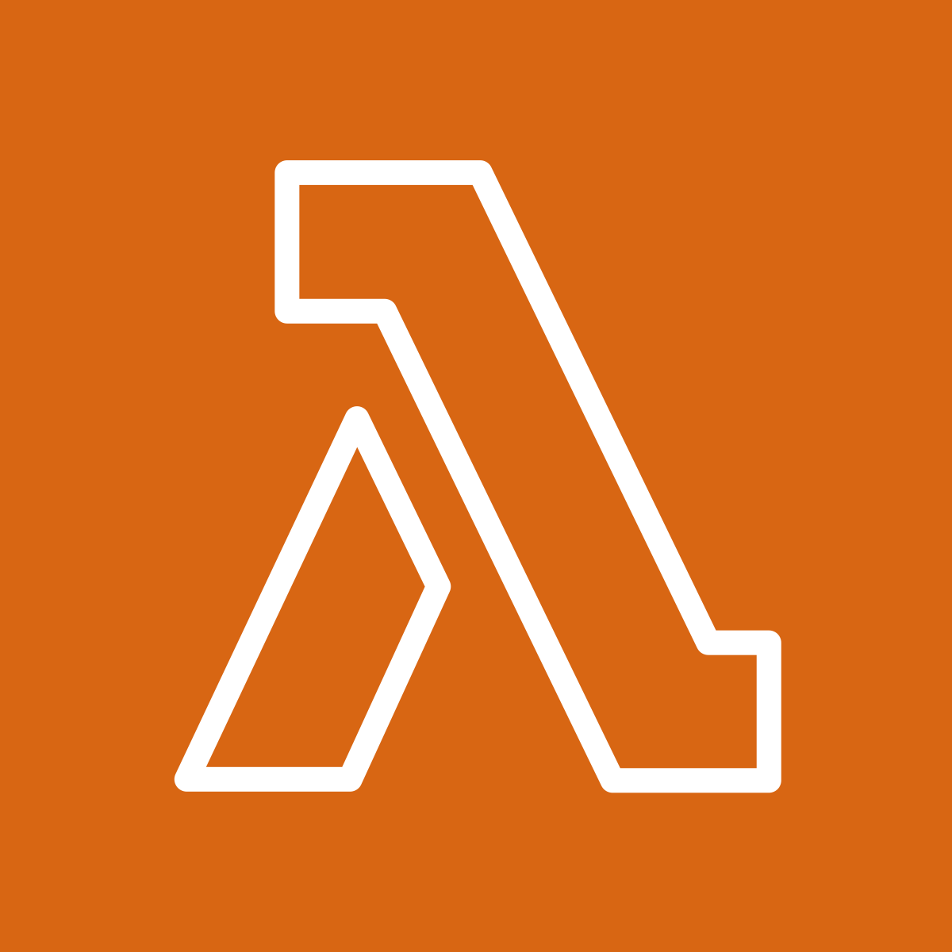
"Magic Computer Task Worker"
AWS Lambda is like a train station where you can send your computer code. This station doesn't need you to look after it. It's like paying only when your train is running on the tracks. You send your code to Lambda, just like Thomas going to the station. Your code is like a train, it only runs when something makes it go, like another AWS service, app or a website. So, you only pay when your train (code) is running.

Slide 9


"Big Toy Boxes like S3 Buckets"
Amazon S3 is like a toy box where you can keep your special things (objects) in containers (buckets). When you put something in, you can choose who can see or use it. You can also keep track of how these things change over time with versioning.
Amazon EBS is like a bigger toy box that you can use with your toy trains (Amazon EC2 instances). Even if you stop playing with your trains, all the toys in this big box stay there.

Slide 10
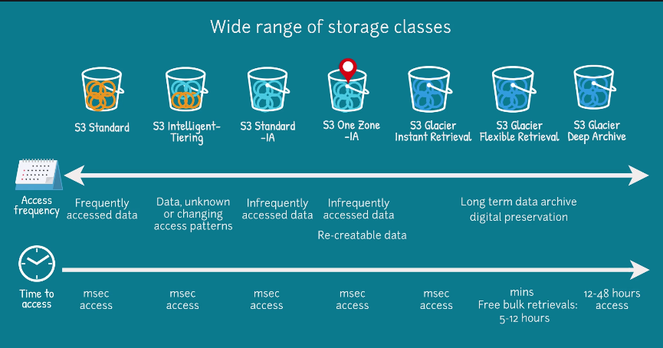

Slide 11

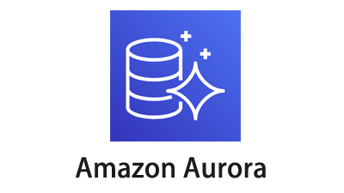
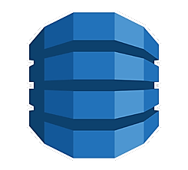

"Thomas's Train Track Databases"
Amazon RDS is like a train station where you can manage different types of data trains in the Cloud. Amazon Aurora is a super-fast train, it's as fast as 5 regular MySQL trains or 3 PostgreSQL ones! Amazon DynamoDB is a special train that can deliver packages extra quick, no matter how big the station! Amazon Redshift is like a big storage room where you can keep and explore all kinds of data goodies, it helps to see the links and patterns between them.

Slide 12
"Rds vs Simple Data for Kids"
Before: The transportation system of railroads is really important, just like the trains in Thomas the Tank Engine, making sure we can travel from one place to another quickly and safely and delivering goods we need to survive.
After: Trains, like Thomas the Tank Engine, help us travel and bring us things we need, quickly and safely.

Slide 13

"Who Can Use What?"
AWS Identity and Access Management (IAM) lets you safely control who can use AWS services and resources, just like how the controller decides which jobs Thomas and his friends can do.
You can set this based on your company's needs with IAM tools:
Users, groups, and roles
Policies
Double-check authentications

Slide 14
Try It Yourself
"Today children, we are going to uncover the various operational aspects of Thomas the Train and his pals. The best part is, we will be incorporating interactive and educational aspects to keep you all engaged and make this exciting journey more fun. So come on, let's all hop aboard Thomas's train!"
Reworded: "Today kids, let's learn about Thomas the Tank Engine and his friends. We will make it exciting with fun and learning games. So, let's all jump aboard Thomas's train!"

