Slide 1
"Intro to AWS"
How can we utilize it for MMM?

Slide 2
Cloud Computing Advantages
Switch fixed costs to variable costs.
Leverage substantial economies of scale.
Eliminate capacity estimation.
Boost speed and responsiveness.
Avoid data center operation and maintenance costs.
Achieve global reach promptly.

Slide 3
No change needed: Cloud Computing
Deployment Types:
Cloud-Based Deployment
Entirely cloud-run; legacy apps are migrated and new apps are developed on-cloud.
On-Premise Deployment
Optimised resource utilisation through virtualisation and management tools.
Hybrid Deployment
Link on-premise infrastructure with cloud resources; merge cloud resources with traditional IT infrastructure.

Slide 4
Migration to Cloud
The AWS Cloud Adoption Framework (AWS CAF) organizes six core areas, known as Perspectives. Each Perspective serves distinct roles and the planning method preps stakeholders for forthcoming changes. Broadly, Business, People, and Governance Perspectives consider business abilities, while Platform, Security, and Operations Perspectives address technical capabilities.
The Governance Perspective emphasizes on aligning IT and business strategies, thus optimizing business value and mitigating risks. It should be utilized to upgrade staff skills and processes, ensuring business governance in the cloud, and assessing business outcomes from cloud investments.

Slide 5
Governance Overview
I believe it's absolutely essential that technology professionals keep their knowledge and skills fresh and up to date so that they can continue to meet the ever-growing and ever-evolving demands of the industry.

Slide 6

EC2 - Elastic Compute Cloud
Amazon EC2 offers secure, scalable cloud-based compute capacity via EC2 instances. Suppose your role involves overseeing your company's resource architecture to support new websites. Traditional on-premises resources require upfront expenditure for hardware, delivery of servers, physical data center installation, and necessary configurations. In contrast, Amazon EC2 allows the utilization of a virtual server that runs applications in the AWS Cloud. You can quickly launch an Amazon EC2 instance, stop using it post-workload completion, and pay only for the compute time used. This offers cost savings as payment aligns with server capacity needed.

Slide 7
Serverless Architecture
To execute applications in Amazon EC2, you need to provision instances, upload your code, and oversee these instances during application operation.
"Serverless" computing signifies that while your code operates on servers, there's no necessity for server provisioning or management. This enables greater focus on innovation rather than server maintenance.
Another advantage of serverless computing is its inherent scalability. It can auto-adjust application capacity by modifying consumption units, like throughput and memory.

Slide 8
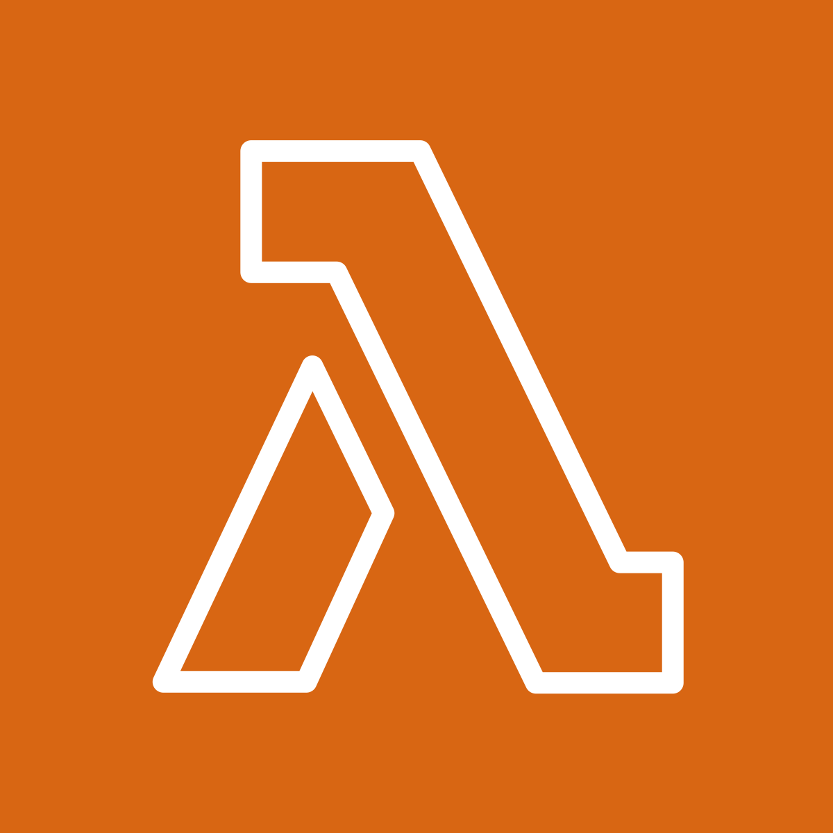
Unchanged: AWS Lambda
AWS Lambda, a service allowing serverless code execution, only incurs cost during computation time. It caters to any application or backend service need sans administration. Usage involves code upload and event trigger setup; the code executes only upon triggering.

Slide 9


"S3 Buckets: Simple Storage Service"
Amazon Simple Storage Service (S3) offers object-level storage, safeguarded by customizable permissions and version tracking. The Elastic Block Store (EBS) service offers block-level storage volumes for EC2 instances, maintaining data availability even after instance termination.

Slide 10
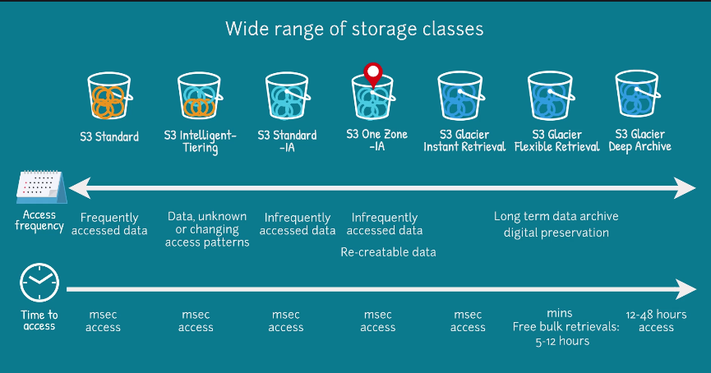

Slide 11

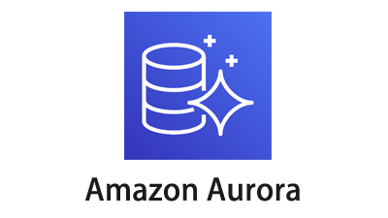
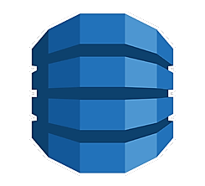

AWS Database Solutions
Amazon RDS facilitates the operation of relational databases on AWS Cloud. Amazon Aurora, an enterprise-level relational database compatible with MySQL and PostgreSQL, offers performance up to 5x faster than MySQL and 3x faster than PostgreSQL. Amazon DynamoDB, a key-value database service, ensures single-digit millisecond performance at any scale. Lastly, Amazon Redshift is a data warehousing service tailored for big data analytics, providing multi-source data collection and trend analysis capabilities.

Slide 12
"RDS vs Flat Data Comparison"
1. Input: "So, by doing a bit of research and taking a look at what's been happening in the past years, it seems that artificial intelligence, particularly in the fields of machine learning and robotics, is most likely going to be the next big thing in technology."
Output: "Based on recent studies, artificial intelligence - specifically machine learning and robotics - appears to be the upcoming major technological advancement."
2. Input: "Given the current pace of scientific and technological advancement, our capacity to store and process data has increased exponentially."
Output: "The recent scientific and technological progress has exponentially augmented our data storage and processing capabilities."
3. Input: "While at first glance it may not seem particularly significant, but upon further examination, you'll see that this minor adjustment to the algorithm can actually have a pretty considerable impact on its overall efficiency."
Output: "This seemingly trivial algorithmic modification may significantly enhance its overall efficiency upon closer inspection."
4. Input: "Isn't it marvelous how just a slight tweak in the code can dramatically improve the performance of the entire system?"
Output: "Isn't it fascinating how a minor code adjustment can significantly boost the entire system's performance?"
5. Input: "The real value of blockchain technology isn't simply in the creation of decentralized digital currencies like bitcoin, but really lies in its potential applications in a multitude of other sectors."
Output: "The true benefit of blockchain technology extends beyond creating decentralized digital currencies like bitcoin and holds potential applications in various other sectors."

Slide 13

Access Management and Identity
AWS Identity and Access Management (IAM) securely controls access to AWS resources. It offers the versatility to tailor access based on your firm's operational and security requirements through IAM users, groups, roles, policies, and multi-factor authentication.

Slide 14
Try It Yourself
In case you are curious, the product's source code is publicly available and can be found in the repository on our website.

Slide 15
Executive Summary
- Introduction to Amazon Web Services (AWS) and its benefits concerning reduced upfront expenses, massive economies of scale, speed, agility and global reach.
- Detailed exploration of the different types of cloud deployment options: Cloud-based, On-Premise, and Hybrid. The discussion includes the benefits and use cases for each deployment type.
- Explanation of AWS Cloud Adoption Framework (AWS CAF) which forms the bedrock of cloud migration strategies including Business, People, Governance, Platform, Security, and Operations perspectives.
- Overview of some of the key services, including EC2 for computing capacity, Serverless Computing for hassle-free application operation and scaling, AWS Lambda for running code without server provision, S3 Buckets for object-level storage, and Database Services like RDS, Aurora, DynamoDB, and Redshift for different database needs.
- Detailed dive into AWS Identity and Access Management (IAM) that helps control and manage access to resources securely. This includes a look at IAM users, groups, roles, policies, and multi-factor authentication.

