Slide 1
“STOCK MARKET TRENDS USING DATA MINING”
Presented by
DEVESH BINJOLA
NICHOLAS HANKS
Instructor
Dr. Meiliu Lu
Dept of Computer Science & Engineering

Slide 2
Background
Data source: nyse.com
Data ranged from 1990 – 2010
Sampled data from Forty-one (41) companies starting with work K.
Too much data (120,000 for this much only)
Data kept and used in .csv format for Tableau and .csv for WEKA.

Slide 3
What Questions we had related to Stocks
Finding how the price of the stocks change?
Difference between the Adjusted Stock Price and Close Price
Difference between the Opening and Closing Price of Stocks
Difference between the Highest and Lowest Price of Stocks
Difference in volumes of stocks based on the price of stock.
What happened during the 2008 recession?
Highest Gainer (Stock) ?

Slide 4
Analysis between the Adjusted Stock Price and Close Price
Close Price is simply the closing price of the stock on that day
What is Adjusted Stock Price?
It is the closing price of the stock based on rumors that comes from different companies.

Slide 5
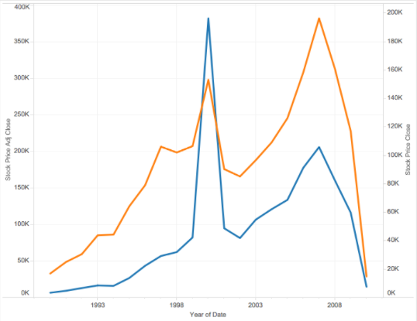
Analysis

Slide 6
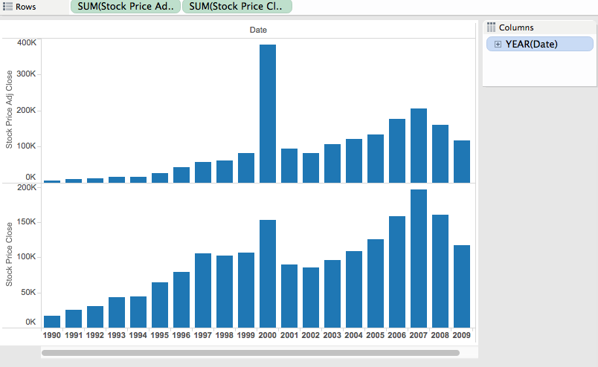
Analysis

Slide 7
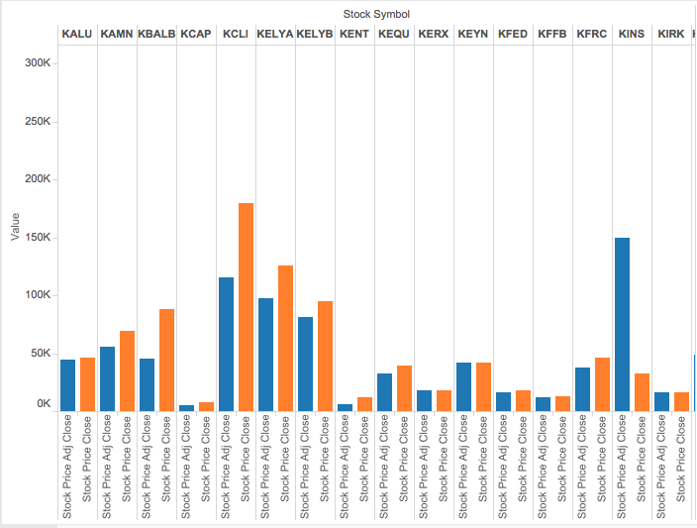
Analysis

Slide 8
Analysis
The difference between adjusted close stock price and close price narrowing by years.
Now the difference is really small, few factors can be:
Companies being Smart by hiring people to avoid this situation
Share market people having better links to get the correct information.

Slide 9
Difference in volumes of stocks based on the price of stock.
It is the difference between volume of stocks when the prices are low or when the prices are high.

Slide 10
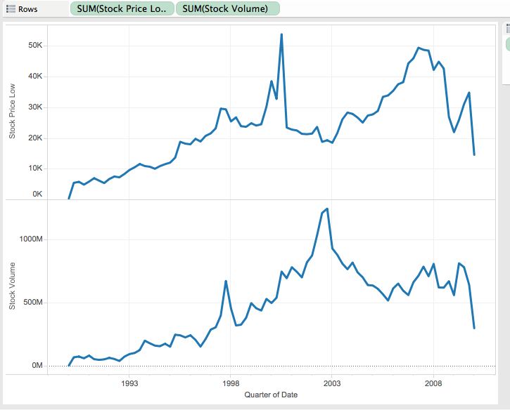
When the Stock Prices are Low?

Slide 11
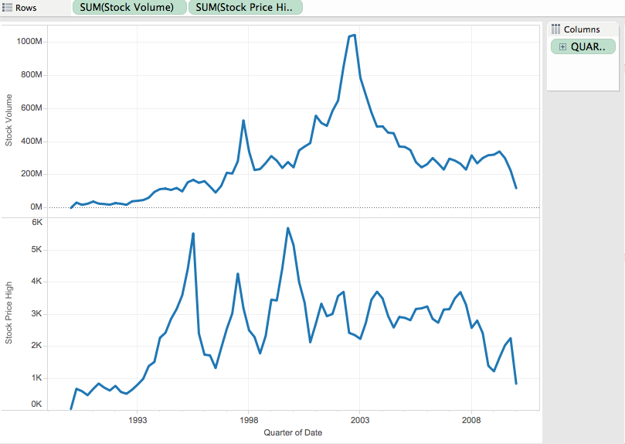
When the Stock Prices are High?

Slide 12
Difference between the Highest and Lowest Price of Stocks

Slide 13
Highest Gainer
KLA-Tencor Corporation (KLAC ) was the highest gainer and by a margin.
It is a semiconductor and nanoelectronics related manufacturing company based in Milpitas, California.
The Stock prices went from 8$ to 88$ high, (currently around 70$)

Slide 14
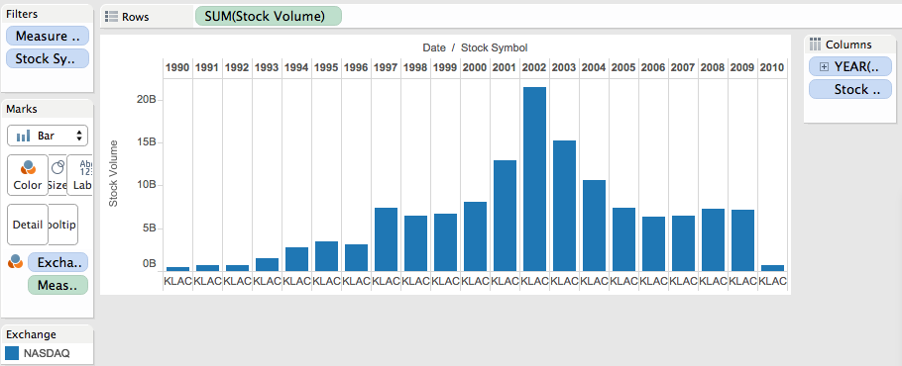
Analysis

Slide 15
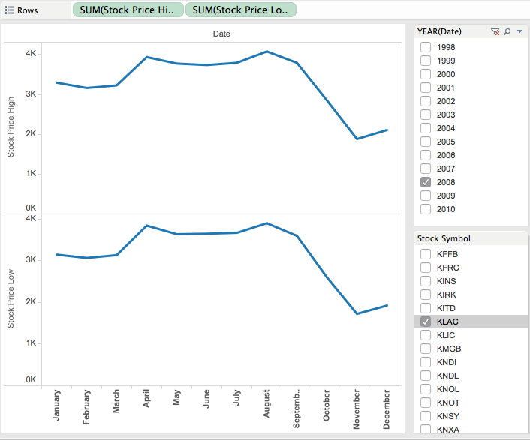
What Happened during recession?

Slide 16
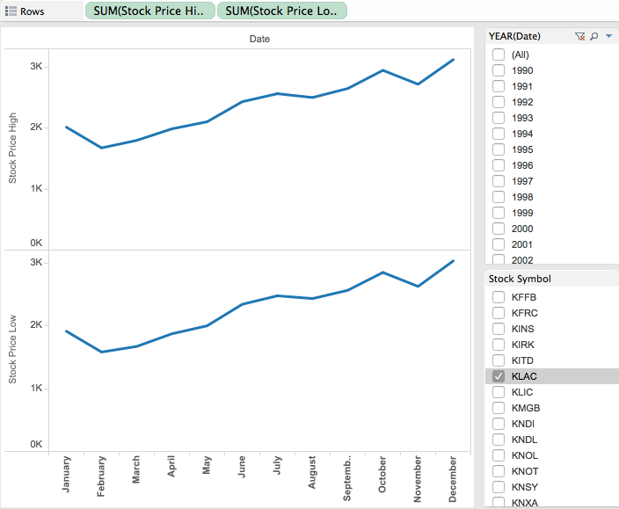
What Happened during recession?

Slide 17
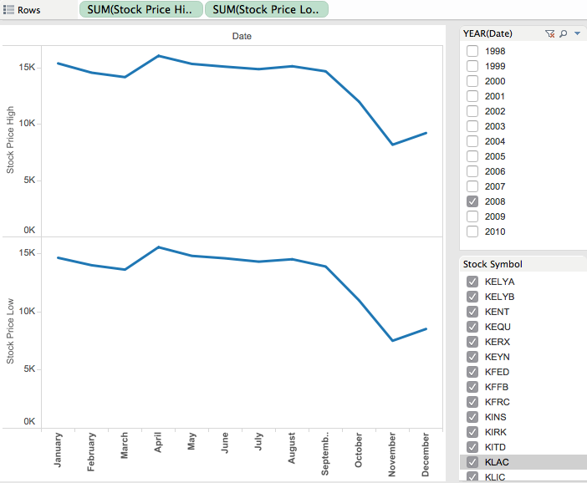
What Happened during recession?

Slide 18
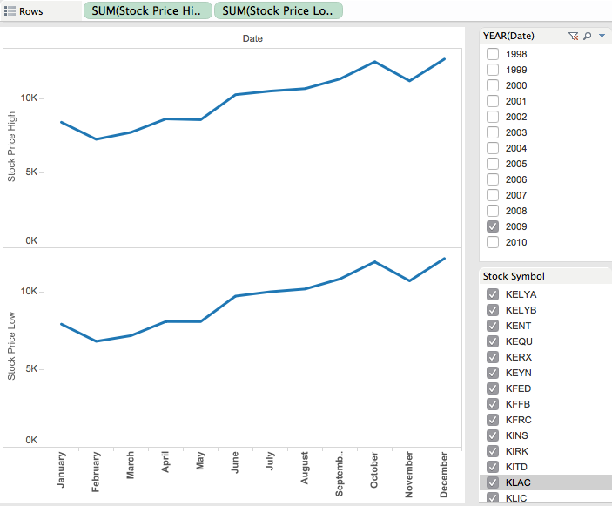
What Happened during recession?

Slide 19
Quiz 1 ?
Which of the following clustering algorithms when implemented on a large dataset gives the solutions faster ?
a) K-Means
b) EM - Algorithm

