Slide 1
Golf Champions Data Mart
CSC 177 - Team #3
Nicholas Hanks
Dinesh Binjola

Slide 2
Agenda
Introduction
Background & Scope
Implementation
Data cleaning & preprocessing
Data mart design
Demo
Lessons Learned
References
Questions?

Slide 3
Introduction
The objective: produce a comprehensive data mart to query golf tournament champions
Data was available online, but in multiple disparate data sets/pages on the website

Slide 4
Background & Scope
Data source: www.databasegolf.com
Data ranged from 1860 – 2015
Sampled data from four tournaments: PGA Championship, Augusta Masters, US Open, & Open Championship (British Open)
Data available on winning player & tournament
Data changed in .csv format

Slide 5
Implementation

Slide 6
Cleaning & Preprocessing
Data loaded into Excel & scanned for errors
Removed non-required attributes
Noise detected in player names & scores
Manually corrected errors in records
Prepared to load into SQL Server

Slide 7
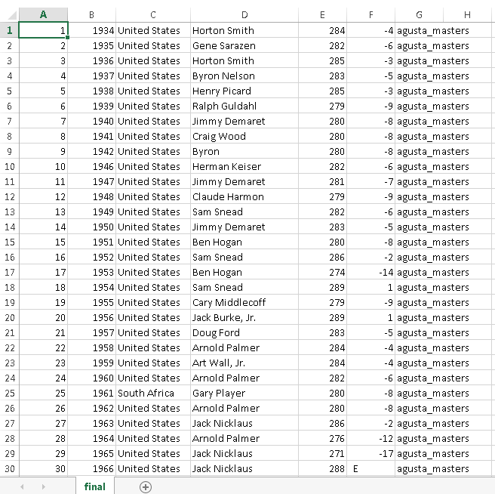

Slide 8
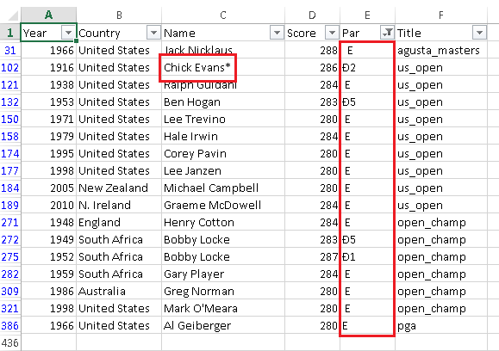

Slide 9
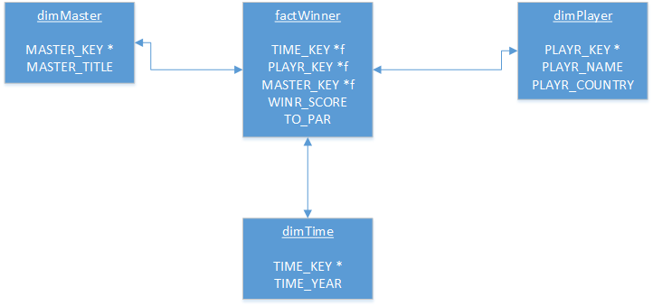
Data Mart Design - Star Schema

Slide 10
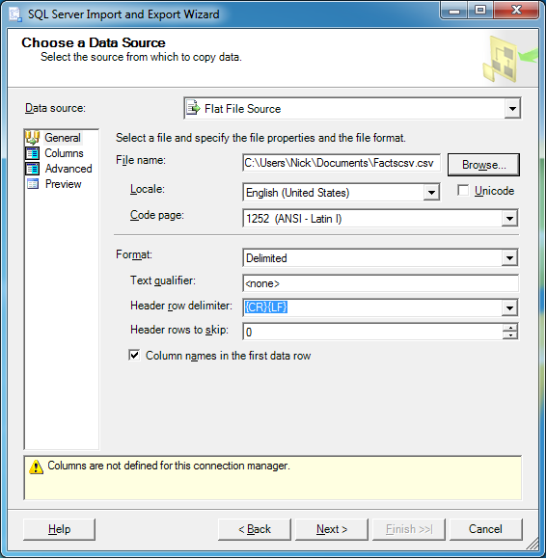
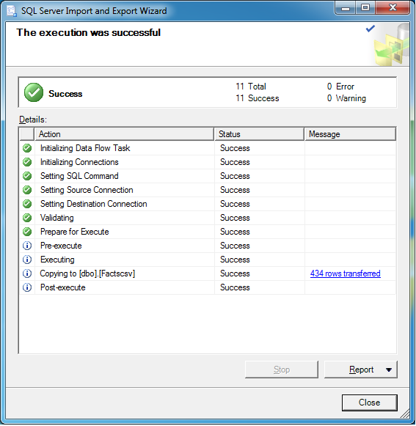
Data Loading in SQL Server

Slide 11
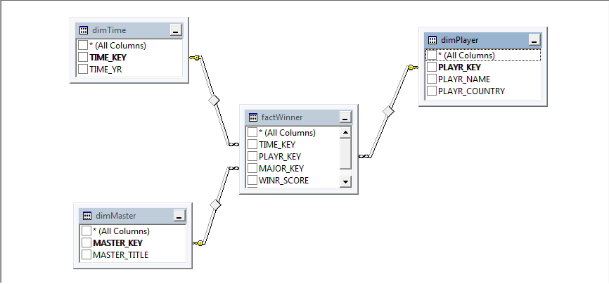

Slide 12
Demo!

Slide 13
Fun Quiz
Which file format was imported in Weka?
.csv
.arff
.excel
.dat

Slide 14
Lessons Learned
Data cleaning & preprocessing takes time
It’s important to start early
Many tools to choose from
Excel for cleaning and preprocessing
MySQL, Sql Server & SS Management Studio for DB implementation
Learning PHP, MySQL, CSS, HTML, Javascript, and bootstrap for website implementation
Learning WEKA and Tableau
Coordination & teamwork are key.
Always Start Early. Don't keep it for the last minute.
We believe that Tableau was the best of the tools among we used. We had outputs from WEKA and Tableau and outputs and analysis from Tableau were far better than WEKA.

Slide 15
References
www.databasegolf.com
https://en.wikipedia.org/wiki/Main_Page
http://www.masters.com/index.html
www.amatuergolf.com

Slide 16
Questions??

