Slide 1

AI reinvention made real
Accenture Innovation Challenge 2026

Slide 2



Team details
TEAM NAME : Claudemax69
Devesh Choudhury
Chitransh Gangwar
Atharva Katiyar
TEAM LEADER
College
IIT Kanpur
College
IIT Kanpur
College
IIT Kanpur
Stream
Statistics and Data Science
Stream
Civil Engineering
Stream
Mechanical Engineering
Year of graduation
2028
Year of graduation
2027
Year of graduation
2027
Accenture Innovation Challenge 2026 · Round 2 · Problem Track 2 · PatientTriage.ai

Slide 3
>
PROBLEM
INSIGHT
SOLUTION
PRODUCT
ARCHITECTURE
IMPACT
EXECUTION
PatientTriage.ai
UNDERSTANDING THE PROBLEM
WHY NOW - THE EVIDENCE
Triage decides who waits, and in most emergency departments it is executed once, at the door. Acuity is then treated as fixed while the patient’s physiology keeps moving. Three structural failures follow: judgment varies between nurses, half the room sits inside one crowded colour band with no ordering, and nothing re-measures a patient who was judged safe. A single adult-calibrated vital-sign scale then adds a fourth, because the same numbers mean opposite things at age 3 and age 78.
66%
sensitivity of human triage for patients who go on to need a life-saving intervention. One in three is not identified.
Sax et al., JAMA Netw Open 2023 · 5.3 mn encounters, 21 hospitals
50%
of arrivals have no prior record on file, so history cannot be assumed as an input.
HOW IT FAILS - ONE PATIENT, NINETY-TWO MINUTES
Round 2 brief reference parameter
ESI v5
extended vital-sign checks to low-acuity patients explicitly to prevent under-triage.
T = 0
T + 45
T + 75
T + 92
ESI Handbook v5 · AIIMS three-tier, prospectively validated
Arrives, triaged once
Still in the waiting room
Deteriorating, unseen
Critical event
de-identified ED stays with linked outcomes are now public, so training no longer needs a hospital partnership.
HR 92 · RR 18 · BP 128/80 · SpO₂ 97%. No chest pain - all four inside the adult band.
No re-measurement is scheduled. No mechanism exists to look at her again.
Diabetes blunts the cardiac pain that would have raised the alarm.
Severe multi-vessel coronary disease. Ejection fraction 25-30%.
425,000
MIMIC-IV-ED, PhysioNet
Jan 2026
FDA CDS guidance: the clinician must be able to independently review the basis of a recommendation.
ESI-4 · POSITION 11 / 14
UNOBSERVED
UNOBSERVED
ESI-1 · TOO LATE
FDA CDS final guidance · DPDP Act 2023 names the processor boundary
One decision. Ninety-two minutes. Nothing in the department was designed to revisit it.
FRAMING DECISIONS, TAKEN UP FRONT
THREE SEPARABLE GAPS - AND WHAT EACH ONE COSTS
Jurisdiction
India · DPDP Act 2023
GAP 01 · VARIABILITY
GAP 02 · QUEUE BLINDSPOT
GAP 03 · STATIC MEASUREMENT
Acuity scale
ESI, five levels
0.46-0.91
50%+
92 min
Display
RED / YELLOW / GREEN
Deployment
100-500+ visits per day
inter-rater agreement
of visits in one band
unobserved, case P01
Evidence
500 synthetic encounters
Two competent nurses assign different levels to the same patient. Judgment, not protocol, decides.
Inside a colour, arrival time decides position. A crowded ESI-3 band has no ordering at all.
Triage executes once. Deterioration in the waiting room is invisible until someone walks past.
WHAT WE ASSUME — AND LABEL AS OURS
Synthetic evidence. All engine figures are measured on data we generated against ground truth we assigned.
OUR MECHANISM Deterministic acuity floor: four rule layers combined with min().
OUR MECHANISM Continuous within-colour ranking by risk and trend.
OUR MECHANISM Re-triage loop on a timer, plus two mandatory triggers.
Crowding share, 50%. The only invented input in the top-down sizing chain.
Two-thirds haircut. Applied to our own simulated impact before we quote it.
.
Notes:
Conclusion for this slide: triage fails structurally, in three separable ways, and the failure is invisible to the department it happens in. Lead with P01 and let the three gaps land as mechanism, not opinion.

Slide 4
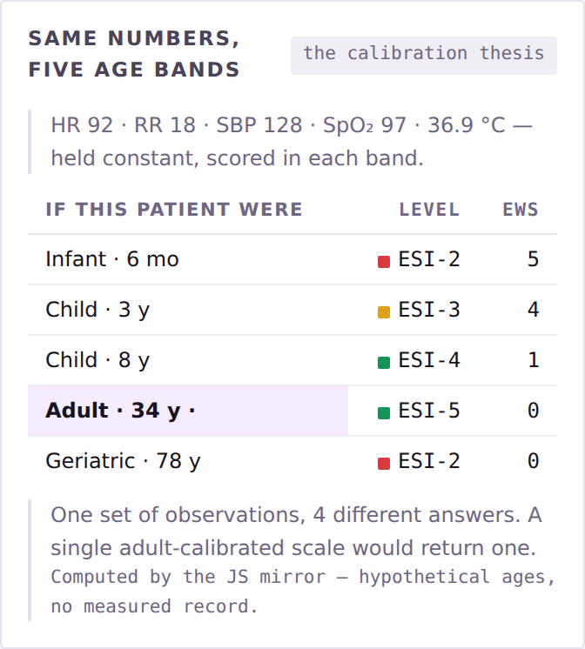


>
PROBLEM
INSIGHT
SOLUTION
PRODUCT
ARCHITECTURE
IMPACT
EXECUTION
PatientTriage.ai
ONE ADULT BAND, TWO OPPOSITE FAILURES
ONE SET OF OBSERVATIONS, FOUR ANSWERS
WHAT THE CONTEXT LAYER IS WORTH
3-YEAR-OLD, FEBRILE
HIGH-ACUITY MISSED · 500-ENCOUNTER COHORT
HR 140 · RR 28 · 38.5 °C · alert, capillary refill under 2 s
Adult-calibrated vitals only
45.0%
ADULT-CALIBRATED MODEL RETURNS
Risk modifiers removed
20.0%
NEWS2 7 - emergency response
HR 140 is band-normal for ages 1-4; heart rate rises about 10 bpm per 1 °C of fever. Every observed cue is reassuring.
Full engine as proposed
7.5%
ERROR: OVER-TRIAGE
→ ESI-3 + fever pathway
Six times fewer misses at the same over-triage cost.
78-YEAR-OLD, “NORMAL”
Over-triage held at 33.2% in the vitals-only baseline and 32.0% in the full engine - the improvement is not bought with extra false alarms. Removing the context layer nearly triples misses, so the layer is not a refinement; it is the product.
HR 95 · RR 18 · 37.0 °C · BP 112/68 · new confusion
ADULT-CALIBRATED MODEL RETURNS
Every parameter scores 0 - GREEN
MEASURED, NOT ASSERTED
Blunted fever response. Beta-blockade caps the tachycardia: HR 95 here is the equivalent of 130. Systolic 112 against a baseline of 150 is a 25% drop.
ERROR: UNDER-TRIAGE
Live from the prototype: the same observations held constant and scored in each age band. A single adult-calibrated scale would return one answer for all five.
16 of 21
0
→ ESI-2 + sepsis screen
hidden-sick caught
monotonicity violations
THE MECHANISM WE BUILT INSTEAD
WHY THE OLD PATTERN PERSISTS
genuinely high-acuity on entirely normal vitals
8 features × 1,200 held-out rows
Five vital-sign bands. 0-1, 1-4, 5-11, 12-17 and adult, plus a ≥ 65 profile working on deviation from the patient’s own baseline.
Diabetes blunts cardiac pain. Up to 40% of infarctions in diabetics present atypically - the alarm signal is absent, not weak.
0.943
3.0%
held-out AUROC
encounters abstain
Deviation, not raw values. Features are engineered as distance outside the patient’s own age band - which is what makes the monotonic constraint clinically meaningful.
Older women present atypically. Nearly half of over-65s with an infarction arrive with no chest pain at all.
AUPRC 0.838 · Brier 0.058 · logistic baseline 0.934
confidence below 0.50 routes to a clinician
Observed cues are first-class. ACVPU, work of breathing, colour and gait are structured inputs. New confusion alone scores +3 on NEWS2; a vitals-only pipeline drops it.
The benign pattern is more available. GI symptoms read as gastritis under time pressure, because gastritis is far more common.
SYNTHETIC · NOT CLINICAL
Ground truth is constructed at generation, independent of the engine — these figures show the architecture behaves as designed, not that it helps patients.
Notes:
Conclusion: a single adult band does not average the two errors — it commits both. The toddler costs a bed; the 78-year-old costs a life. The context layer is what closes it, and the ablation proves the layer is load-bearing.

Slide 5







>
PROBLEM
INSIGHT
SOLUTION
PRODUCT
ARCHITECTURE
IMPACT
EXECUTION
PatientTriage.ai
THE DETERMINISTIC ACUITY FLOOR
WHY THE GUARANTEE HOLDS
WHAT THE ARCHITECTURE INHERITS
MACHINE LEARNING
Enforced by construction
Acuity scale
ESI v5, four decision points
Monotonic GBM finds hidden risk the rules cannot see.
The four rule layers combine with min(); the learned score is clamped to the result. It is a constraint, not a weighting we hope holds.
Local protocol
AIIMS three-tier, validated
Vital scoring
NEWS2, five age bands
MAY RAISE ACUITY
ESI-4 → ESI-2, without asking permission
Training data
MIMIC-IV-ED, ~425,000 stays
DETERMINISTIC ACUITY FLOOR
Provable without a test set
Regulatory test
FDA CDS guidance, Jan 2026
min ( )
Monotonicity is a property of the code, so the guarantee holds on data the model has never seen — including the day the case mix shifts.
ESI Point A · red-flag rules · age & history modifiers · NEWS2 five bands
Data law
DPDP Act 2023 · ABDM policy
NO PATH DOWN EXISTS IN CODE
No component can lower a level
SOLVED
Verified · zero violations
Acuity scoring
solved
LICENSED CLINICIAN — THE ONLY DOWNWARD PATH
Every clinical feature raised by 1 SD across 8 features × 1,200 held-out rows. Worse physiology never once scored safer.
Safety architecture
solved
Reason code plus re-measured evidence, under their licence number.
Deployability
solved
Clinical trust
not solved
THE INVARIANT · MAY RAISE, NEVER LOWER
TRAINED ON OUTCOMES, NOT OPINIONS
WHY NOT THE CHEAPER ANSWERS
The system is allowed to be cautious. It is not allowed to be falsely reassuring and that is a property of the code, not of the training run.
Train on the acuity a human assigned and you teach the model to reproduce the miss. P01 was assigned low acuity by a competent nurse.
Do nothing. One in three critically ill patients is not identified, and the failure is invisible to the department it happens in.
WHEN THE ENGINE DOES NOT KNOW
Labels come from what happened next - ICU transfer, admission, death, or intervention within 24 hours.
Missing data is not permission to guess. Below 0.50 confidence the engine abstains, holds the level rather than lowering it, and routes the case to a clinician - naming the test that would resolve the uncertainty, never a diagnosis.
Hire two more triage nurses. Buys throughput, not consistency - two more sets of judgment ranging 0.46-0.91, and none of them re-checks the waiting room.
WHAT WE WILL NOT CLAIM
· Synthetic training proves the pipeline, not the medicine.
0.47
2.8%
11.4%
· Real data will need recalibration - Boston 2011-2019 in Uttar Pradesh is distribution shift.
Buy a commercial AI triage product. The canonical deployed example scored AUC 0.63 externally, missed 67% of sepsis, and alerted on 18% of all patients.
confidence, case P14
missed · with a record
missed · no record
· Subgroups are audited before deployment: 0.941 paediatric, 0.945 adult, 0.935 geriatric.
· No claim of clinical efficacy is made anywhere in this deck.
Every constraint in this deck derives from a published failure of a shipped system.
Notes:
Conclusion: the contribution is not the score — it is the constraint around the score. Say the invariant once, slowly: the engine may raise a patient’s acuity and has no code path to lower one.

Slide 6
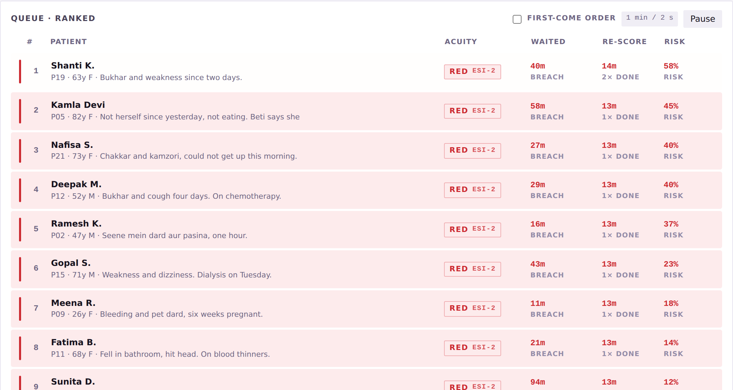
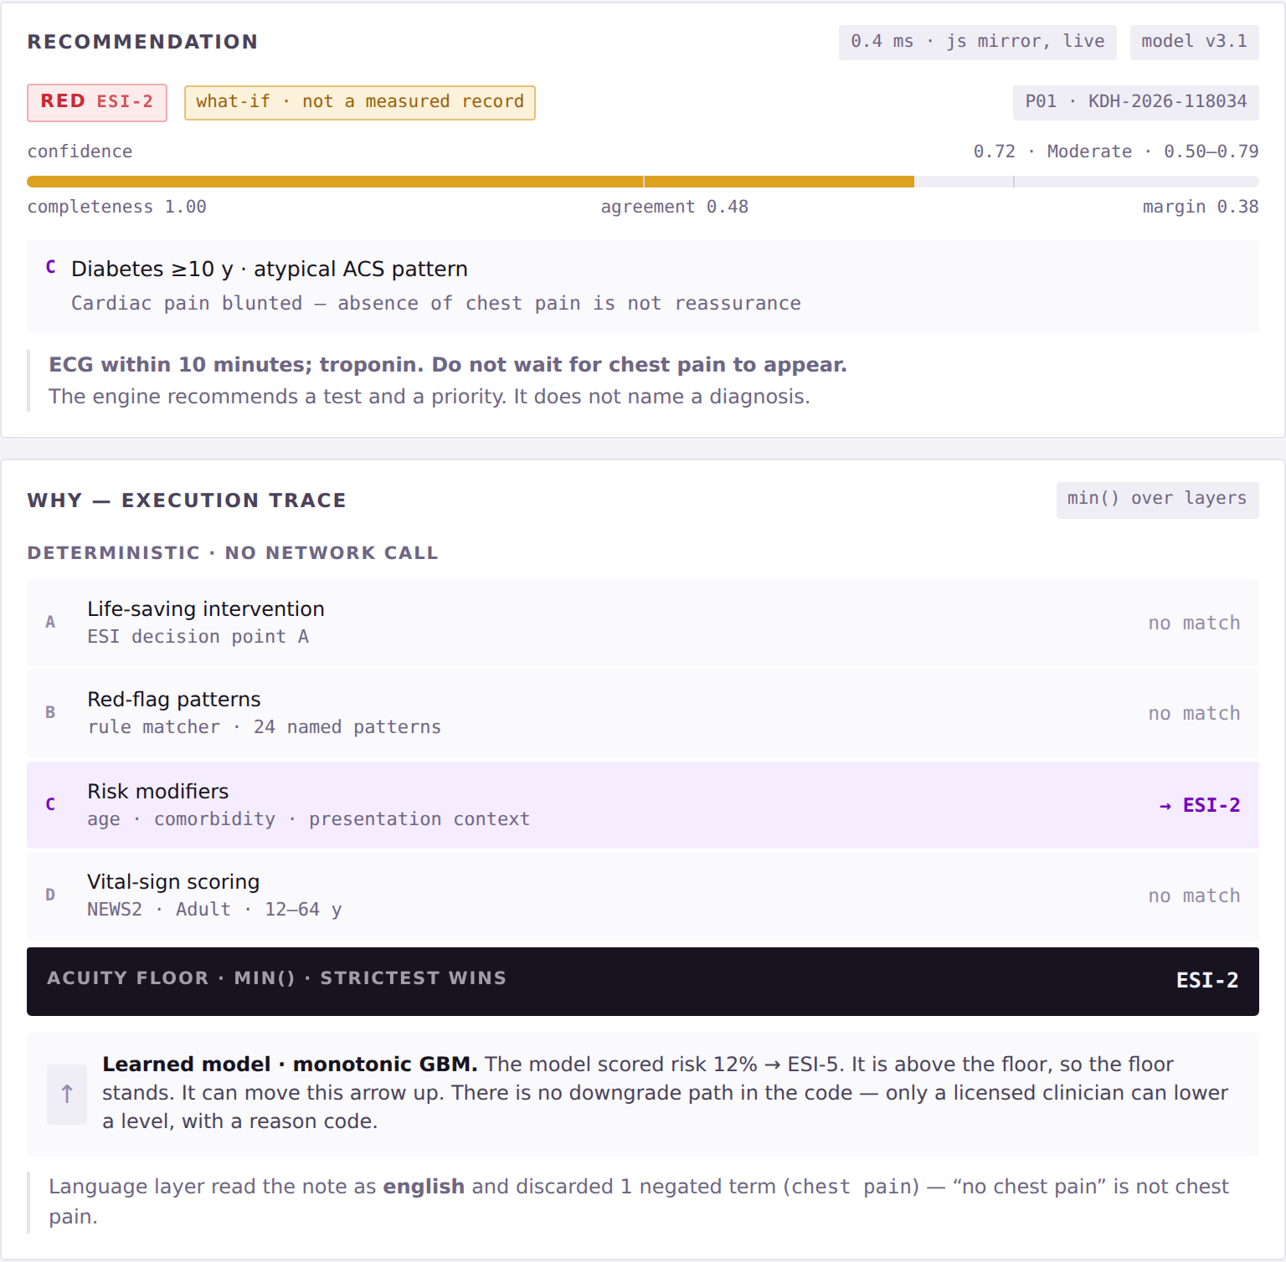
>
PROBLEM
INSIGHT
SOLUTION
PRODUCT
ARCHITECTURE
IMPACT
EXECUTION
PatientTriage.ai
THE WAITING ROOM - RANKED, AND RE-SCORED ON A TIMER
WHY - THE EXECUTION TRACE BEHIND EVERY SCORE
1
Rank + movement
2
Acuity, never colour alone
3
Safe-wait breach
4
Re-score counter
The ▲ badge shows how far a patient moved since the last re-score, and why.
RED / YELLOW / GREEN always ships with the ESI level as text.
Waited time turns red when it passes the safe window for that level.
Every patient carries how many times the timer has re-evaluated them.
Every recommendation opens its own reasoning: which deterministic layers fired, the floor min() produced, the confidence figure and its band, and the note that the learned model may move the arrow up but has no downgrade path. No score is ever returned without a confidence figure - enforced as a failing test, not a convention.
Shanti K. arrived stable and moved thirteen places to #1 on a re-score - no nurse had to walk past her.
THE CLINICIAN’S JOURNEY, END TO END
1 · INTAKE
2 · SCORE
3 · EXPLAIN
4 · DECIDE
5 · WATCH
6 · PROVE
Vitals, free text in English or Hinglish, history and observed cues at the desk. Three taps, no typing on shift.
Four rule layers run deterministically on-device in under 800 ms. No network call in the clinical path.
RED / YELLOW / GREEN with an ESI level, a confidence figure & at most three plain reasons or an explicit abstention.
Accept with one tap, or override with one tap and a pre-populated reason code. Both cost the same.
The whole waiting room is re-scored on a timer and on every new observation; ranking updates itself.
Every decision and override writes an append-only, hash-chained record with model and ruleset version.
Notes:
Conclusion: this is built, and the escalation happens without anyone noticing. Walk the queue left to right in twenty seconds, then point at the black ACUITY FLOOR bar on the right — the thesis rendered in the interface, not diagrammed on a slide.

Slide 7
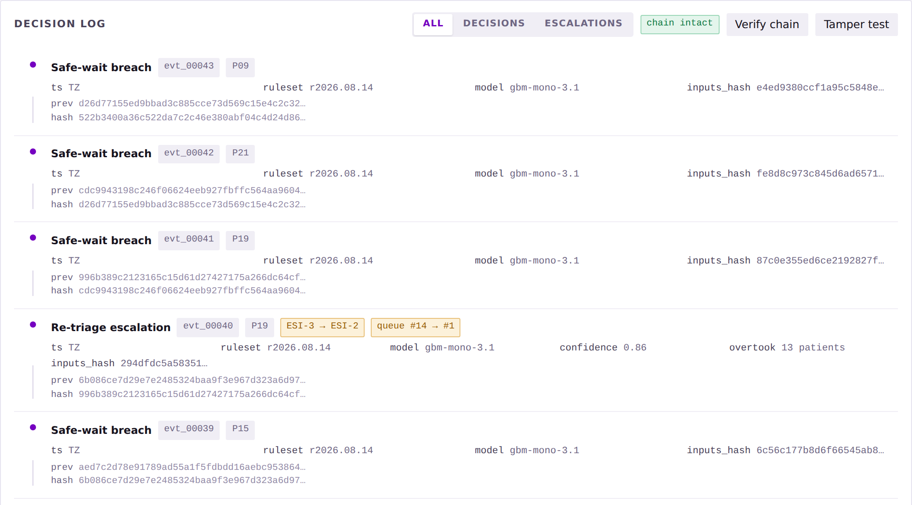
>
PROBLEM
INSIGHT
SOLUTION
PRODUCT
ARCHITECTURE
IMPACT
EXECUTION
PatientTriage.ai
SYSTEM ARCHITECTURE - INPUT → INTERFACE → INTELLIGENCE → DATA → OUTPUT
USER / INPUT
INTERFACE
INTELLIGENCE
DATA / GOVERNANCE
OUTPUT / ACTION
Measured vitals
Triage console
01 Life-saving check
Tokenised at ingest
RED / YELLOW / GREEN
available even on paper - highest weight
intake, score and disposition for one patient
ESI decision point A
HMAC-SHA256(ABHA ‖ salt), salt in hospital HSM
with ESI level, confidence and three reasons
Observed cues
Waiting room
02 Red-flag patterns
On-premise
Or an abstention
gait, speech, colour, work of breathing
live ranked queue with breach countdowns
24 named deterministic patterns
default-deny egress, air-gap capable
below 0.50 it routes to a clinician instead
Self-reported
Three taps
03 Risk modifiers
Append-only log
Queue re-rank
free text, English or Hinglish
card → accept or override → reason code
age, comorbidity, presentation context
hash-chained, WORM-backed, versioned
continuous, within colour, by risk and trend
Record history
P95 < 800 ms
04 Vital scoring
Data Processor
Audit + exports
richest, present for half of arrivals
rules 15 · inference 40 · render 120
NEWS2 across five age bands
hospital is Fiduciary under DPDP Act 2023
compliance packs, FHIR R4, delta feeds
The learned monotonic GBM sits above the floor and is clamped to it - it may raise the level, and has no code path to lower one.
ACUITY FLOOR = min(01…04)
A licensed clinician is the only downward path, with a reason code and re-measured evidence.
DEPLOYS AT THREE MATURITY TIERS
CONFIGURATION, NOT A CODE FORK
THE DATA BOUNDARY, AND WHO OWNS IT
TIER 0 · PAPER ED
~100 visits/day
threshold_profile
acuity_scale
No EHR, manual vitals, intermittent power. Standalone offline tablet with CSV export - the deterministic layers and the re-triage timer need no network at all.
age-band table
ESI-5 or local
wait_time_thresholds
surge_trigger
TIER 1 · DISTRICT
~250 visits/day
safe windows
arrivals per hour
Basic HIS. One-way HL7 v2 ADT feed for registration and demographics; vitals still entered by hand.
language_pack
specialty_routing_map
Hinglish, regional
pathways
TIER 2 · TERTIARY
500+ visits/day
integration_tier
escalation_contacts
Full EMR. Bidirectional FHIR R4 - Observation and Condition in, triage note back, Location for bed state.
0, 1 or 2
alert recipients
Local protocol owns every hard threshold. No globally copied table ships, and no site needs a code fork.
Identity never enters. ABHA and MRN are tokenised at the gateway; re-identification needs two key custodians.
No hospital needs Tier 2 to get the Tier 0 safety benefit.
Runs on one tablet - no GPU, no cloud, no API latency.
Nothing leaves, and every entry is provable. On-premise, default-deny egress. Each record commits to the one before it, so a silent edit breaks verification everywhere after.
Notes:
Conclusion: the architecture is deployable at the bottom of the market and compliant by construction, not by policy. If a CIO asks about breach liability, the answer is that our exposure surface contains no identity at all.

Slide 8
>
PROBLEM
INSIGHT
SOLUTION
PRODUCT
ARCHITECTURE
IMPACT
EXECUTION
PatientTriage.ai
ONE DEPARTMENT, ONE YEAR
TUNED INSIDE THE TRAUMA STANDARD
THE HOSPITAL BUSINESS CASE
109,500
4.0%
32.0%
≈ ₹127 lakh
modelled ICU delay avoidance a year
annual visits at 300/day
under-triage
over-triage
35% of the 967 detections × 1.5 ICU days × ₹25,000. Sensitivity ₹85 L - ₹178 L across ₹18k - ₹35k per ICU day.
10,950
ACS-COT ceiling is 5%
ACS-COT band is 25-35%
Flat
over-triage cost
high-acuity · 10% share
CONFUSION MATRIX · 500 SYNTHETIC ENCOUNTERS
32.0% against a 33.2% adult-calibrated baseline - the return is not funded by extra unnecessary workup.
3,723
 | True 1-2 | True 3 | True 4-5
Pred 1-2 | 74 | 45 | 10
Pred 3 | 5 | 167 | 72
Pred 4-5 | 1 | 14 | 112
missed today · human 34%
≈ ₹19 lakh
ward capacity released
821
0.4 days average LOS reduction ≈ 387 bed-days; a further ₹19 lakh modelled from a 0.5 pp LWBS improvement.
missed with the engine · 7.5%
₹35,000
Tier 0 deployment
967
additional high-acuity patients identified per year - a two-thirds haircut on the simulated 2,902, because simulation will not transfer intact.
Amber cells are under-triage - the only errors that can kill. 20 of 500. Roughly eight over-triages are accepted to prevent one miss: one over-triage costs an avoidable ECG and about twelve minutes of nurse time; one under-triage costs a missed infarction. There is no exchange rate, which is why we never optimise average accuracy.
One tablet plus configuration. No integration project, and no licence in Phase 0 or Phase 1.
Top-down cross-check: 1.40 bn → 119 mn ED registrations → 60 mn in crowded EDs (est. 50%, ours) → 6.5 mn under-triaged (11%) → 6.5 lakh time-critical at the conservative 10% floor. Halving our crowding assumption still leaves ~3.3 lakh.
SYNTHETIC · NOT CLINICAL
MODELLED · NOT MEASURED
Modelled payback under 12 months at Tier 2.
FIVE USERS, ONE MEASURE
AND IT HOLDS UNDER 3× LOAD
AND THE ARGUMENT THAT SURVIVES A BOARD
Triage nurse
A ranked recommendation, three plain reasons, one tap.
MEDIAN WAIT, HIGH-ACUITY PATIENTS · IDENTICAL ARRIVAL STREAMS
Liability shield. Claims are lost on documentation, not only on care. Every decision writes what was known, what was recommended, who decided otherwise, and on what stated ground.
Used, not worked around
First-come order
200.4
Charge nurse
Queue depth, breach countdowns, one batched alert channel.
No new breach surface. Nothing identifiable leaves the network; no third party sits in a life-safety path.
Zero un-actioned breaches
Continuously ranked
8.4
ED physician
The reasoning trace and the authority to move a patient down.
Override rate in a healthy band
Minutes. Mean wait is unchanged by construction - ranking moves the sickest forward, so someone less sick waits longer. That is the trade, and it is the correct one. Every operational number degrades honestly: peak queue depth multiplies 22×, and 66% of safe-wait windows are breached at 3× volume.
Reversible. A charge nurse can switch it off without degrading the existing triage process.
Quality / NABH
Hash-chained audit trail, under-triage reporting by subgroup.
Tamper-evident evidence
NABH-ready. Append-only under-triage reporting by subgroup, with no extraction project.
Hospital CIO
A tier matching actual maturity; no PHI leaves the network.
Live without an IT project
No threshold, rule or floor moves under surge. Only how often we look.
Not the patient · not a diagnostic engine · not a staffing substitute - it changes the order of the queue, not its length.
The return is bought with detection, not with more false alarms.
Notes:
Conclusion: the impact is real, conservatively stated, and paid for by detection rather than by extra false alarms. Lead with the haircut — we discount our own simulated number by two-thirds before quoting it.

Slide 9


>
PROBLEM
INSIGHT
SOLUTION
PRODUCT
ARCHITECTURE
IMPACT
EXECUTION
PatientTriage.ai
PHASED ROADMAP - EVERY PHASE HAS A GATE, AND PHASE 0 IS A STOP
PHASE 0
PHASE 1
PHASE 2
PHASE 3
PHASE 4
months 0-3
months 4-6
months 7-12
months 13-18
months 19-24
Silent retrospective validation
Shadow mode, one ED
Assisted mode under veto
Multi-site, three tiers
ABDM integration, scale
The engine scores de-identified historical records. No clinician sees an output; no queue is reordered; no patient’s care changes.
Runs live alongside clinicians with no autonomous impact on any patient’s position in the queue.
Decision support inside the workflow. The clinician confirms every recommendation before it takes effect.
Paper, district and tertiary departments on one engine - configuration only, no code forks.
National identifier and consent architecture; sustained monitoring and per-site recalibration.
GATE · Under-triage below the department’s own baseline
GATE · Agreement rate and clinician trust
GATE · No increase in adverse events
GATE · Profiles work without code forks
GATE · Sustained performance across sites
RISK AND MITIGATION
THE ASK - THREE INPUTS, NO CAPITAL
Risk | Control - architectural wherever possible | Owner
Patient harm from a wrong recommendation | No component can lower acuity; Phase 0 gate before any live use | Clinical advisor
Automation bias - the nurse stops thinking | Override rate monitored both ways; <2% or >30% triggers review | Charge nurse
Alert fatigue under surge | Alerts batch into one board; ≤ 6 alerts per nurse per hour | Charge nurse
Model drift after deployment | Monthly recalibration; every decision reproducible from the log | Quality lead
Distribution shift across sites | Rules floor is locally owned; recalibration is a Phase 3 gate | Local protocol
Device reclassification | Recommends a test and a priority, never a diagnosis; a human confirms | Regulatory
Data breach | On-premise; tokenised at ingest; every read audited | Hospital CIO
Clinician rejection of the tool | Shadow mode first; an override costs one tap and no form | Triage nurse
01 One partner emergency department
Any tier. A department running on paper is as useful to Phase 0 as a tertiary centre, because the engine needs no integration to be scored against.
02 De-identified historical records
Complaint, age, sex, recorded vitals, assigned acuity and what happened next: admission, ICU transfer, intervention within 24 hours.
03 One clinical advisor
An emergency physician or senior triage nurse to review the rule catalogue and hold local ownership of every hard threshold.
No integration
No capital outlay
No workflow change
No patient exposure
We are not asking a hospital to trust AI with its patients.
The strongest argument against us: every figure in this deck comes from data we generated, scored against ground truth we assigned. We accept it — which is exactly why the roadmap opens with a department’s own historical records, and why the correct response to a failed Phase 0 is to stop, not to re-tune until it passes.
We are asking for the chance to prove
whether it deserves that trust.
967 additional high-acuity patients a year, in one 300-visit department — the number we commit to.
Notes:
Conclusion: the ask is small, reversible, and costs the hospital nothing — and if Phase 0 fails, we stop. Close on the last line and stop talking; this slide stays on screen through Q&A.

Slide 10
Thank you

