Slide 1
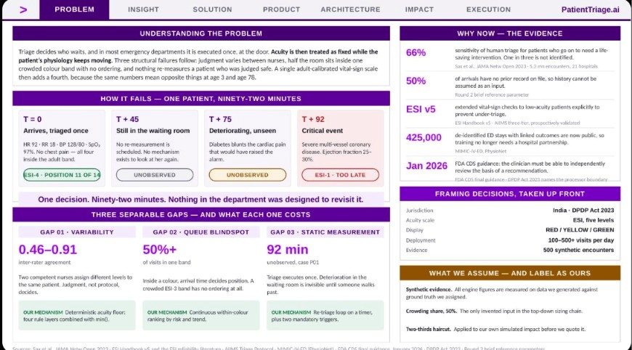
Notes:
PROBLEM

Slide 2
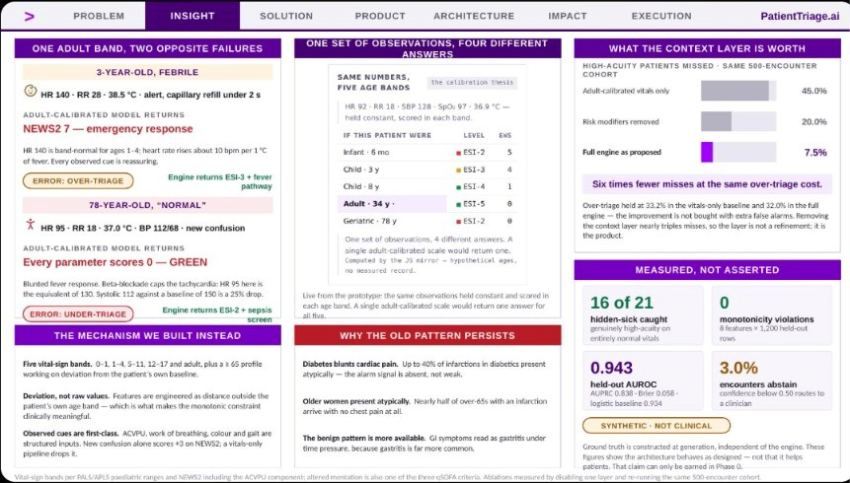
Notes:
INSIGHT

Slide 3
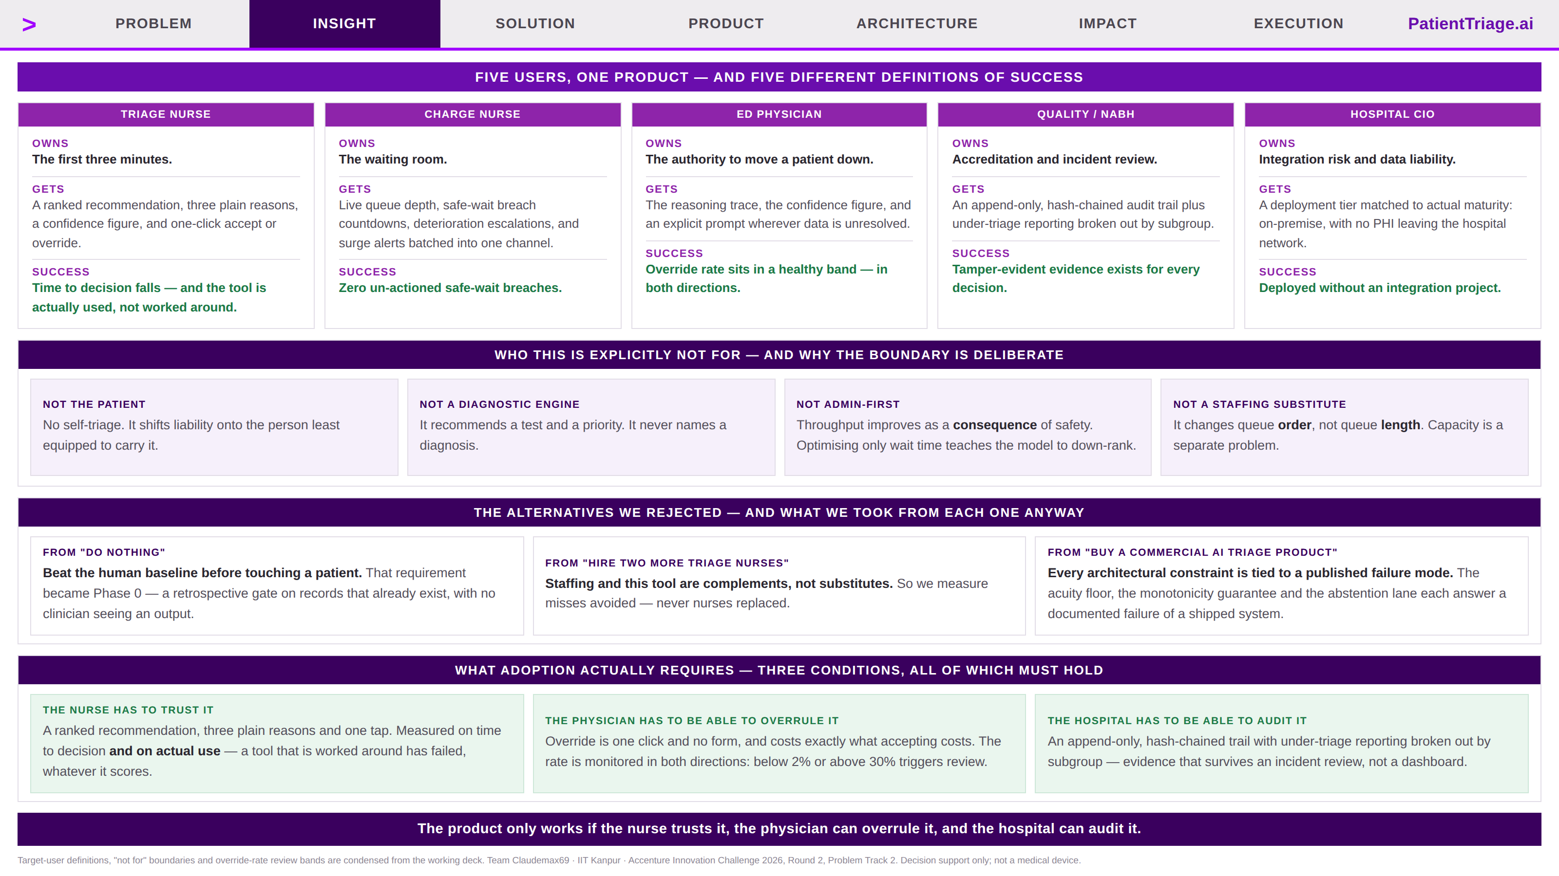
Notes:
INSIGHT · new

Slide 4
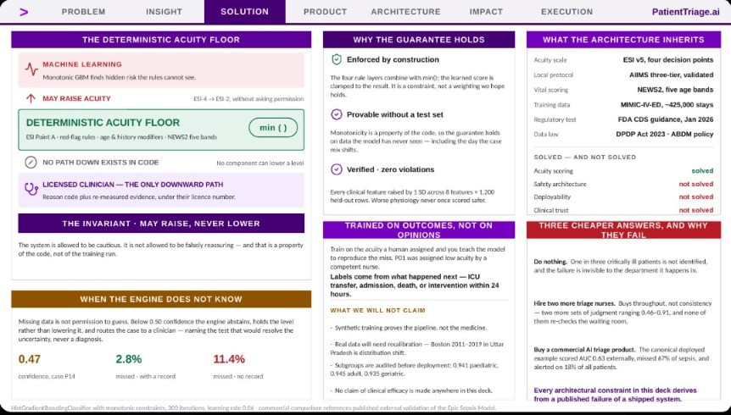
Notes:
SOLUTION

Slide 5
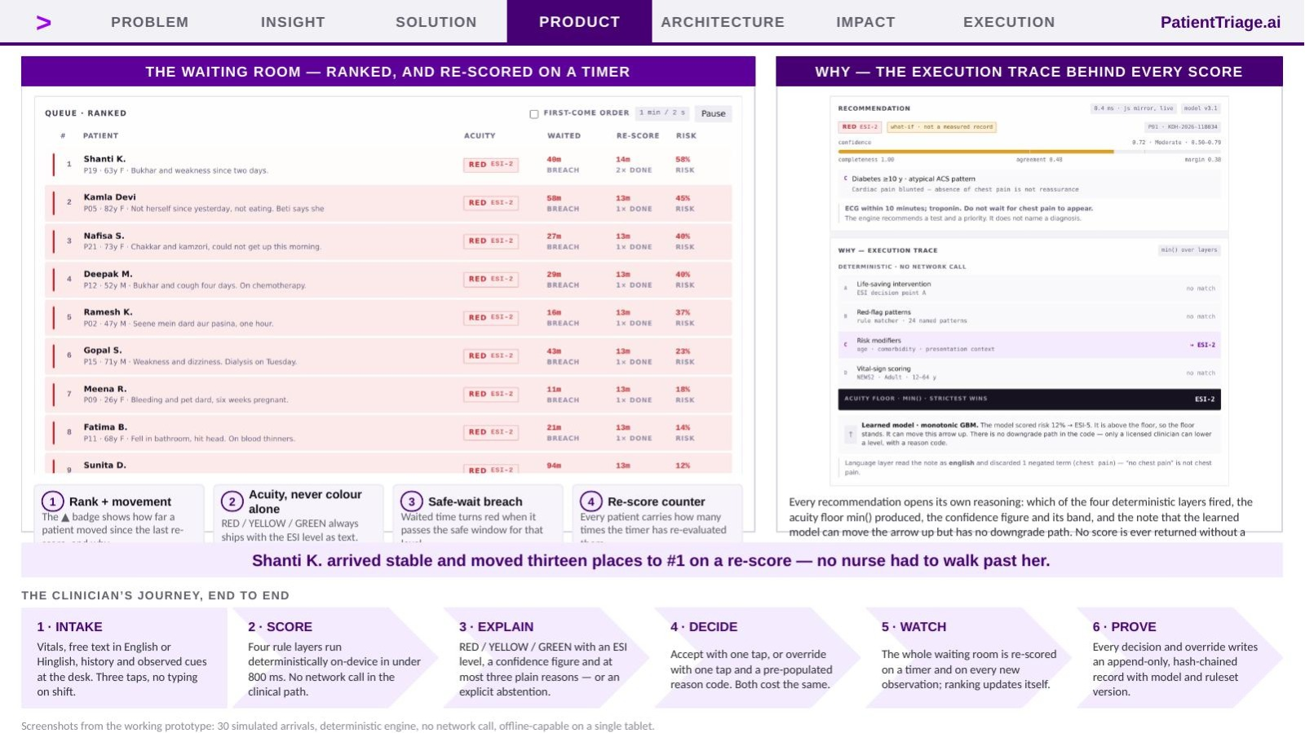
Notes:
PRODUCT

Slide 6
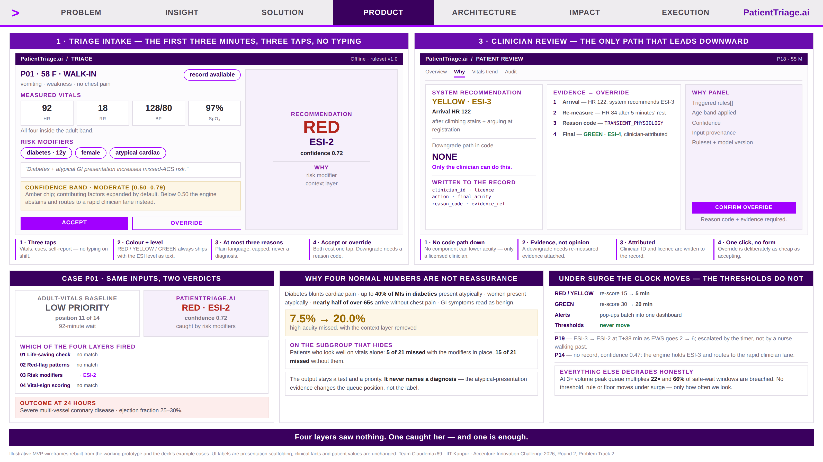
Notes:
PRODUCT · new

Slide 7
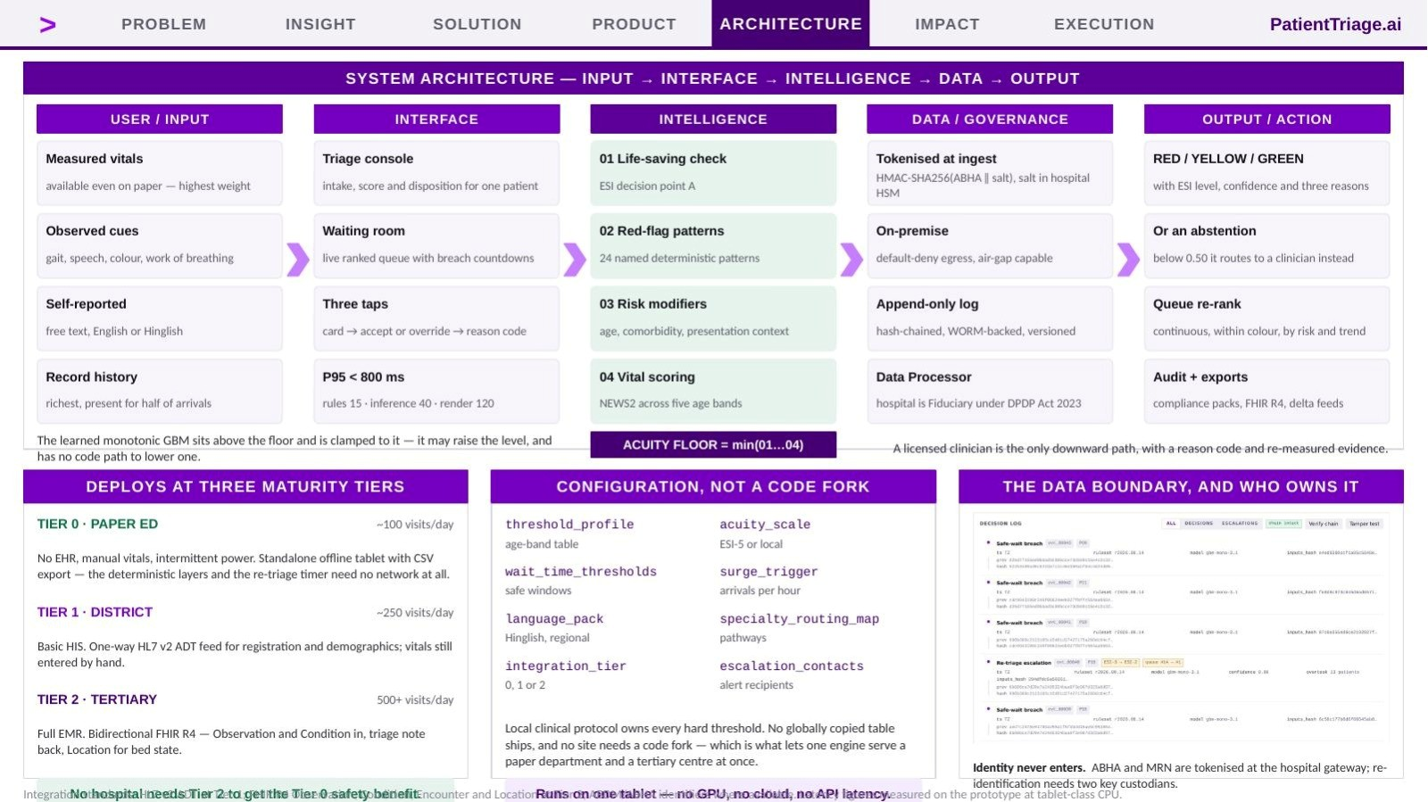
Notes:
ARCHITECTURE

Slide 8
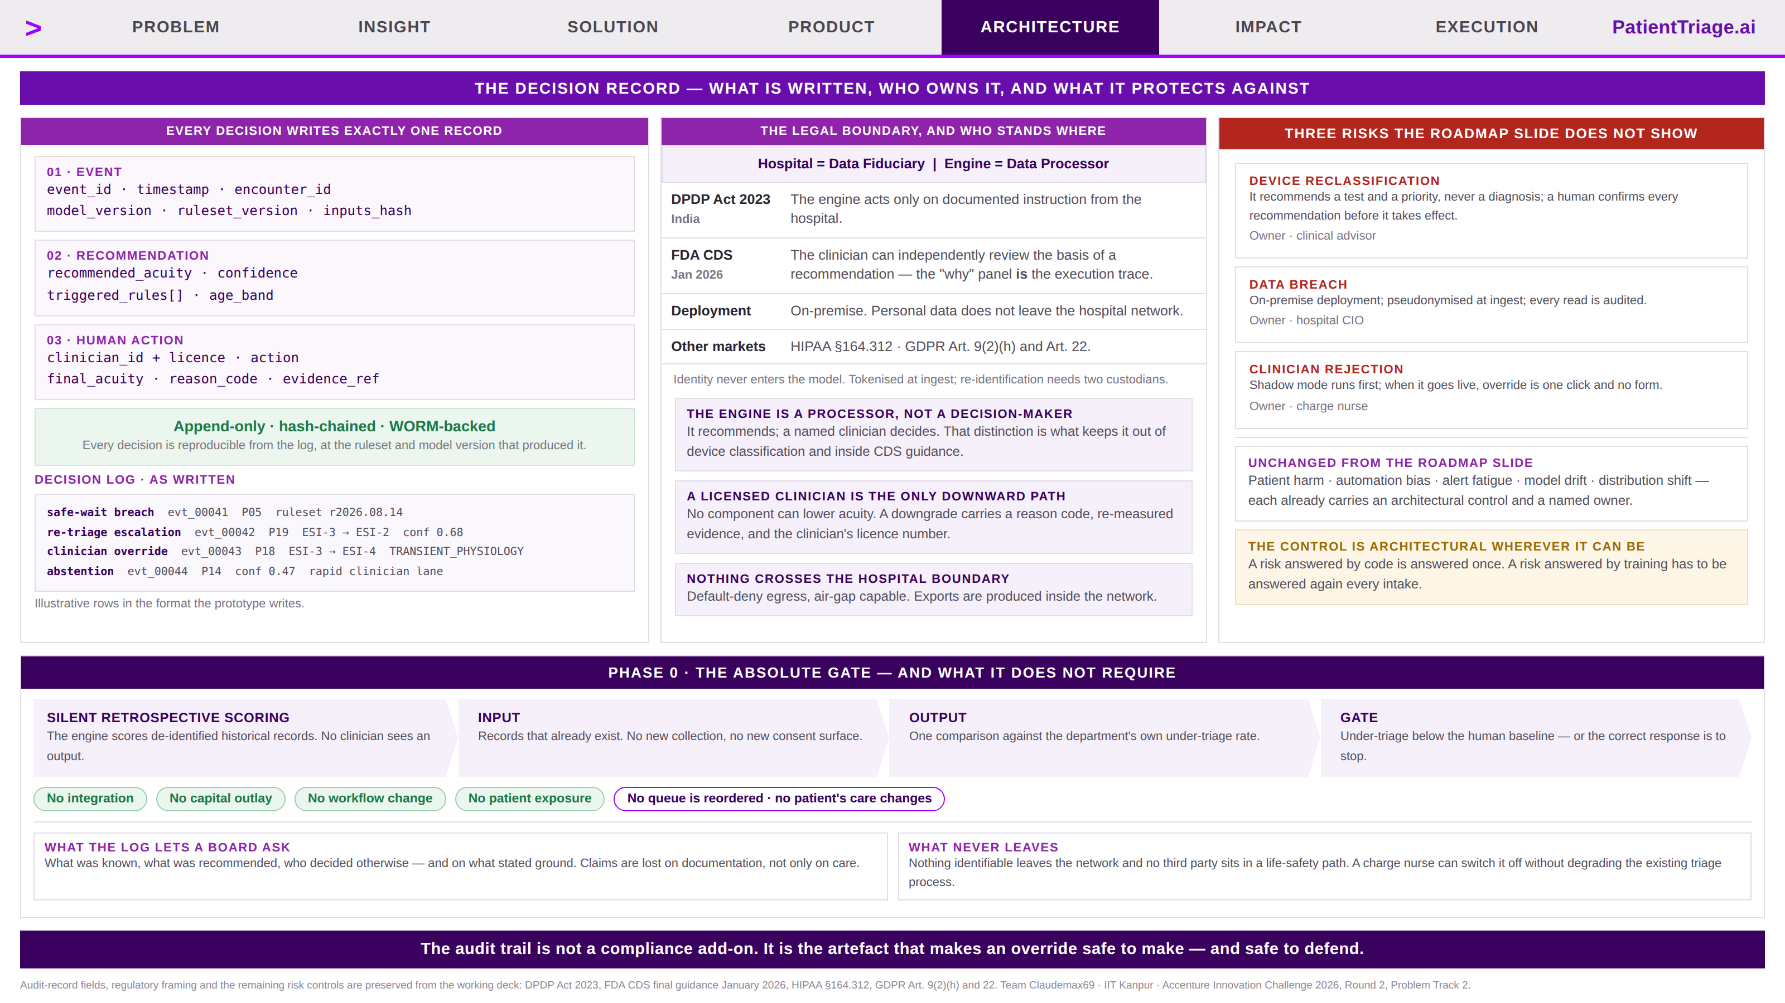
Notes:
ARCHITECTURE · new

Slide 9
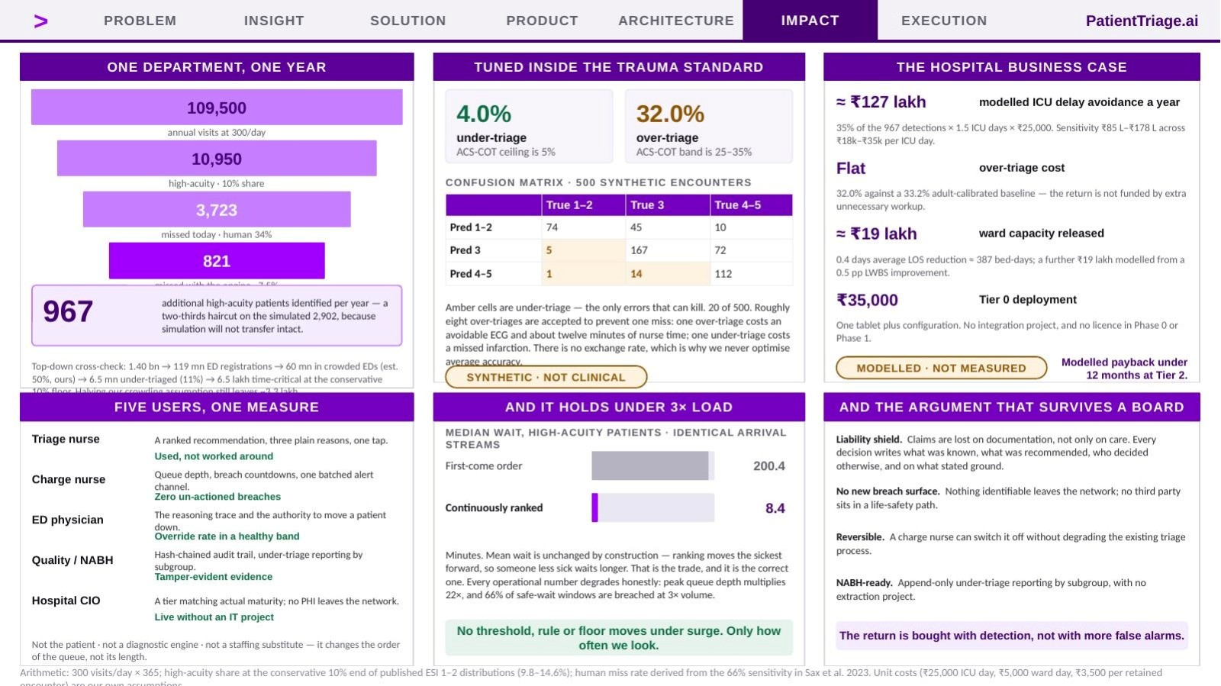
Notes:
IMPACT

Slide 10
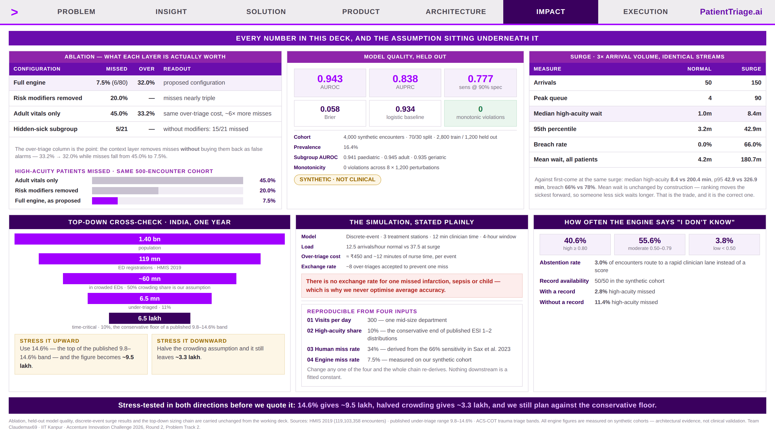
Notes:
IMPACT · new

Slide 11
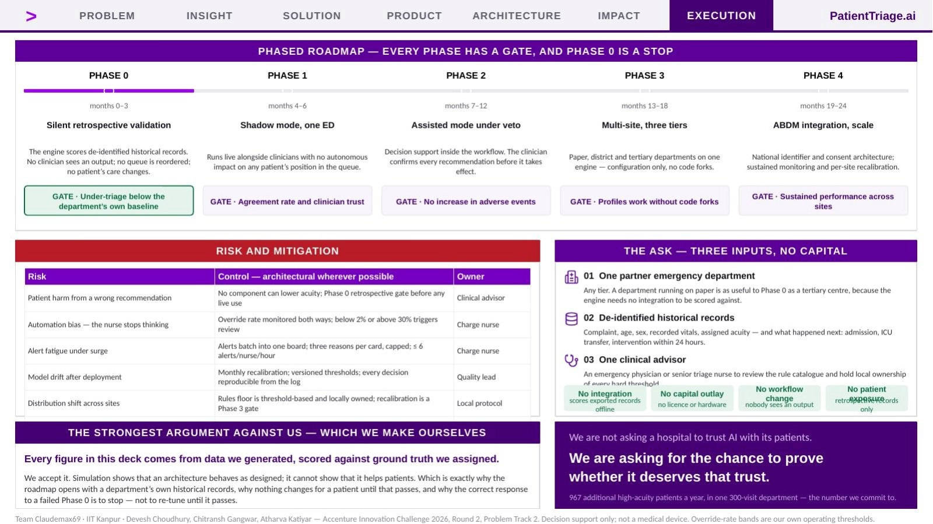
Notes:
EXECUTION

