Slide 1
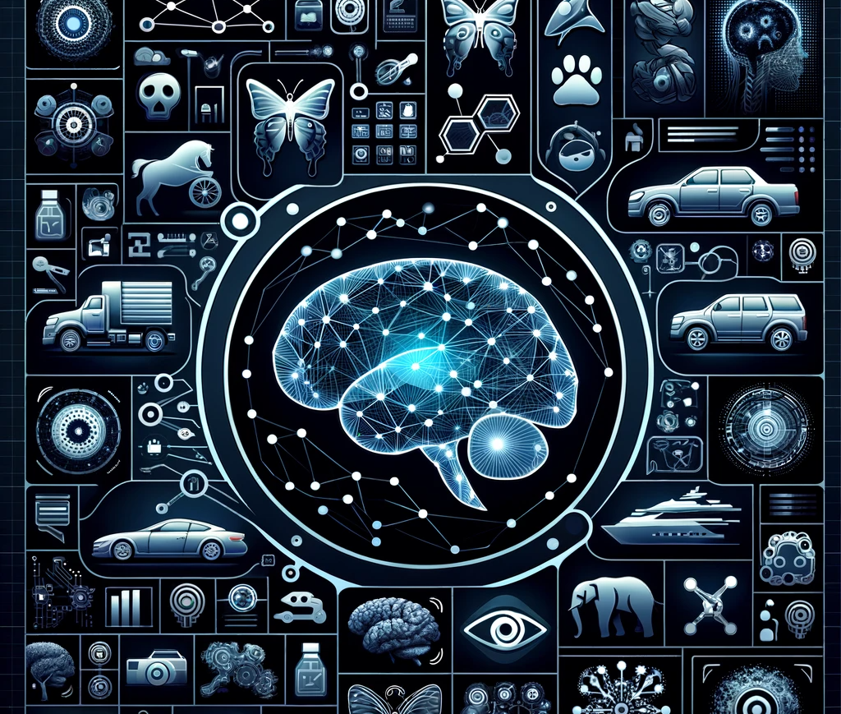
Deep Learning For Image Classification : CIFAR - 10
Devesh Surve
31st Jan 2024
CSYE-7380

Slide 2
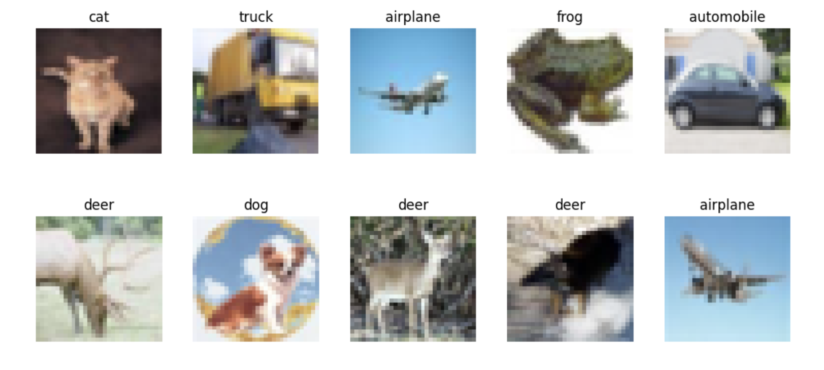
Problem Statement
CIFAR-10 Dataset Overview:
60,000 32x32 color images.
10 classes, with 6,000 images per class.
Diverse categories ( Animals & Vehicles )
Objective
Develop a CNN to classify images into one of the 10 categories.
Challenges in CIFAR-10 Classification:
Small Image Size
Diverse Classes
Class Similarity

Slide 3
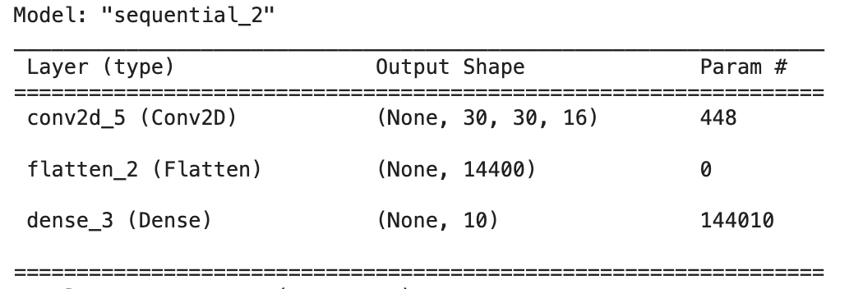
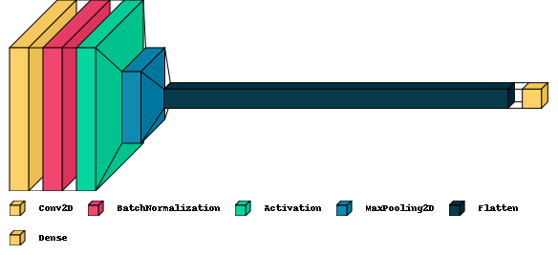
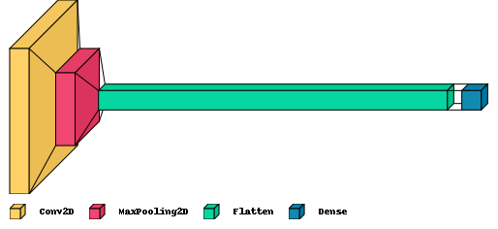
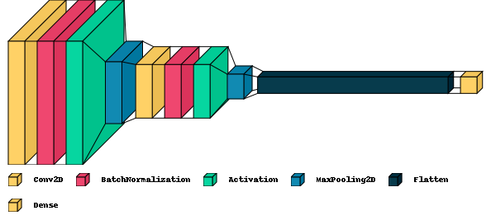
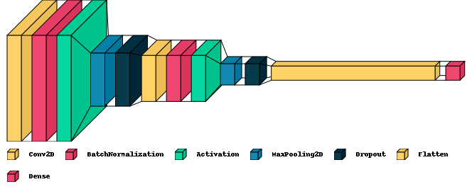
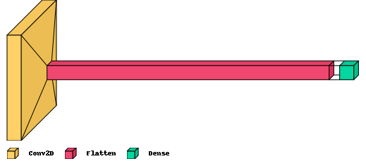
Approach & Learnings - Model Architecture
Next, we iteratively added
Pooling Layer
Batch Normalization
More Convolution Layers
More Pooling Layers
Dropout Layers
Initial Baseline – 3 Layers
Convolution Layer
Flatten
Dense

Slide 4
Approach & Learnings - Model Training & Optimization
Changing Number of Epochs & Batch Size
Tested 5, 10, 15, 20 Epoch Sizes
Tested 32, 64, No Batches
Convolution Layer & Pooling
Increased depth & the number of filters in successive conv layers (e.g., 64, 128)
Pooling Layers – Tested MaxPooling, AveragePooling, GlobalAveragePooling
Dropout Layer & Batch Normalization
Introduced dropout layers for regularization to prevent overfitting
Added batch normalization layers to normalize inputs and accelerate training
Activation Functions & Optimizers
Experimented with ReLU, LeakyReLU for improved performance.
Experimented with Adam, SGD optimizers and different learning rates
Early Stopping & Metrics
Early stopping implemented inorder to prevent overfitting
Tried to optimize metrics like precision, recall and accuracy

Slide 5
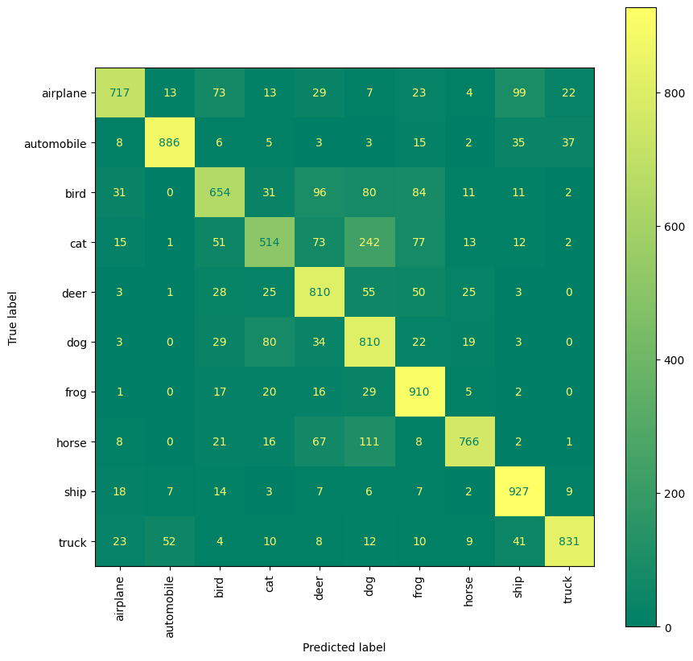
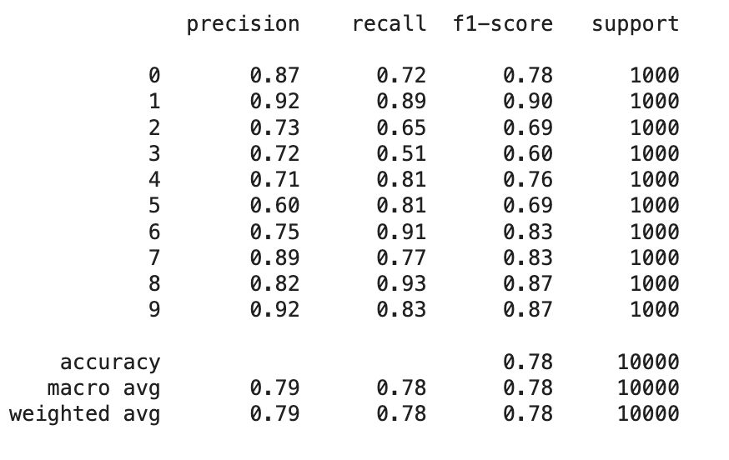
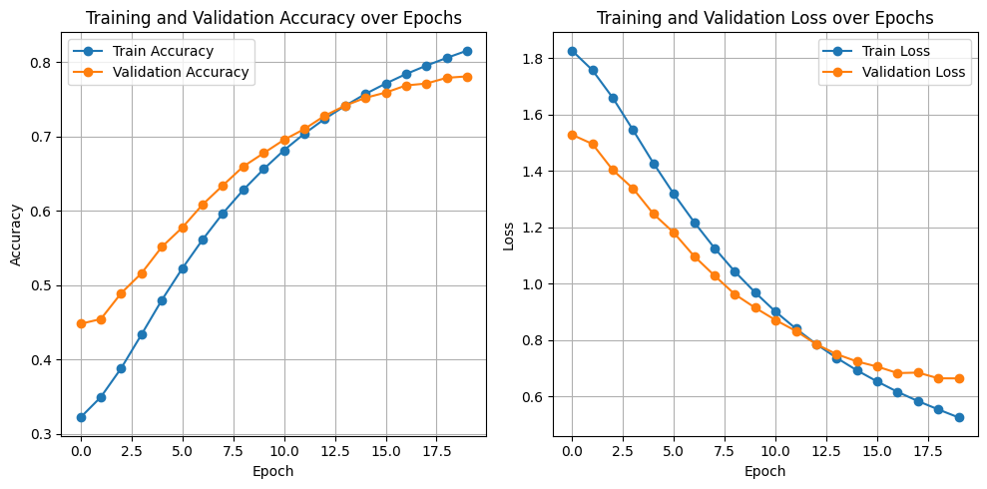
Results
Model Performance Metrics:
80% Accuracy on Test Set
Precision & Recall
Interpretation of Results:
"Strengths: Identify which classes or types of images the model classified with high accuracy."
"Weaknesses: Point out where the model struggled, such as certain classes with lower accuracy or more confusion."
Visualization of Results:
"Confusion Matrix
"Improvement over baseline model:
56% > 59% > 67% > 80%
Accuracy & Loss Graphs:
Show the training and validation accuracy/loss over epochs."

