Slide 1

Revolutionizing NLP with Transformers Assignment 6: A Deep Dive into Encoder-Decoder based Transformer Models
Devesh Surve
21st Feb 2024
ID: 002766974

Slide 2
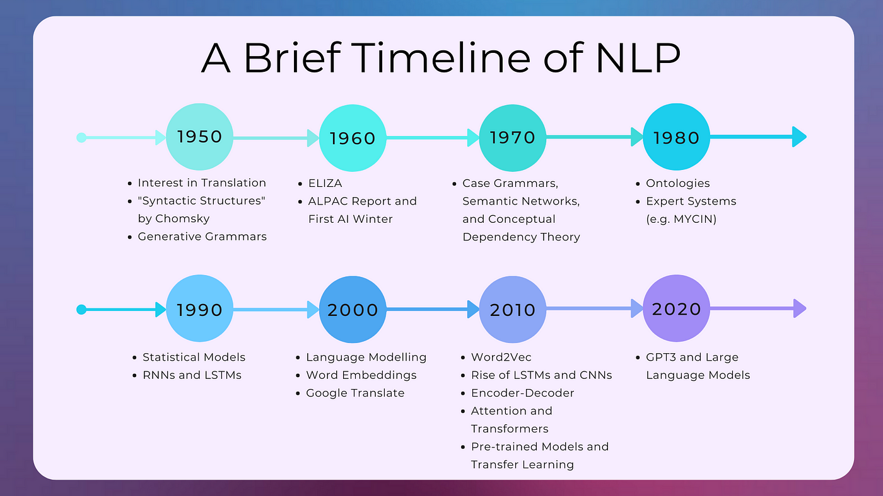
Background
Natural Language Generation (NLG):
A critical subset of Natural Language Processing (NLP).
Focuses on converting data into understandable and relevant natural language.
Key tasks include summarization, translation, and more.
Sequence-to-Sequence Mapping:
Essential in NLG for tasks like summarization and translation.
Involves mapping a sequence of input words to a sequence of target words.
Early Approaches - Deep Neural Networks (DNNs):
Initial attempts used DNNs for sequence tasks.
Faced limitations: DNNs couldn't dynamically adjust to the length of output sequences. For instance, predicting whether a 1000-word article should be summarized into 200 or 100 words was challenging.
Advancement with Recurrent Neural Networks (RNNs):
Introduced hidden states to carry information across input sequences, enabling a representation of the input sequence (X) into a context (C).
Led to RNN-based Encoder-Decoder architectures for improved sequence modeling.
Disadvantages of RNNs:
Vanishing Gradient Problem: Makes it difficult to learn dependencies between distant elements. As loss is propagated backward, the gradient's value diminishes, affecting learning.
Sequential Nature: Processing data in sequence limits parallelization, affecting efficiency on hardware optimized for parallel computations.

Slide 3
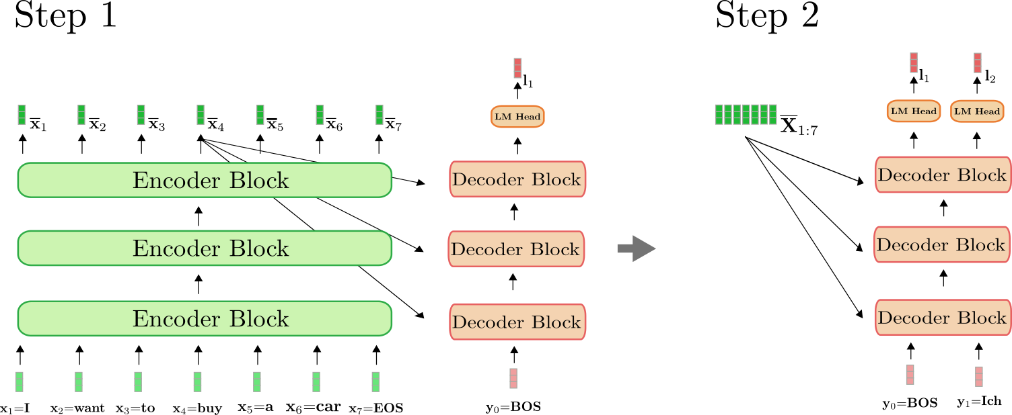
Encoder – Decoder Architecture for Transformers
Introduction to the Transformer Model:
"Attention is All You Need" paper by Vaswani et al.
Model's departure from recurrent structures to stacks of residual attention blocks.
Key Innovation:
Focus on the ability to parallelize processing due to the non-recurrent structure, significantly enhancing efficiency.
How Transformer-based Encoder-Decoder Models Work:
Encoder Overview:
Processes input tokens (X1 to Xn) into a sequence of hidden states.
These states form a "contextualized" representation of the input.
The encoding step is represented by a function
Decoder's Role:
Aims to predict the next word in the sequence.
Utilizes two key approaches:
Modeling the probability of each possible word given the encoded input.
Considering the part of the target sequence generated so far.
Auto-regressive Output Generation:
Details the generation process one word at a time, leveraging the conditional distributions defined by the decoder.
Initial word prediction uses "begin-of-sentence" (BOS) token and the contextualized encodings.
For subsequent words, the decoder efficiently reuses these encodings, combined with all previously generated words, to predict the next word in the sequence.

Slide 4
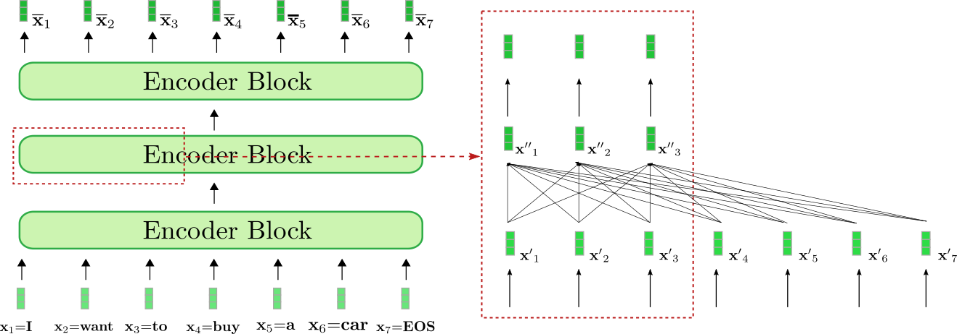
Encoder Architecture Explained
Stacked Encoder Blocks:
Multiple identical layers, each known as an encoder block.
Stacked on top of each other, forming the encoder part of the model.
Residual Connections:
Residual connections around each sub-layer, including self-attention and feed-forward neural networks.
Help in preventing the vanishing gradient problem by allowing gradients to flow through a shortcut.
Self-Attention Mechanism:
Allows the model to consider other words in the input sentence as it processes each word.
Key to understanding the context and relationships between words in a sentence.
Normalization and Feed-Forward Networks:
Each sub-layer output is normalized to stabilize learning.
Feed-forward neural networks follow, further transforming the data within each encoder block.
Encoding the Input Sequence:
The encoder transforms the sequence of input tokens into a sequence of hidden states.
Each token is represented by a vector that captures not only the token's own information but also the context provided by the rest of the tokens in the sequence.

Slide 5
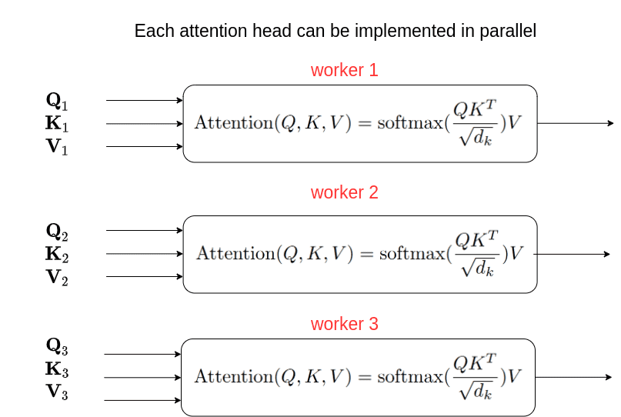
Understanding the Self-Attention Mechanism
Purpose
Processes the input text to understand context and relationships between words.
Self-Attention Overview
Enables the model to weigh the relevance of different words in the input sequence.
Understands context and relationships between words regardless of their position in the input text.
Mathematical Foundation
Input Transformation: Each element of the input sequence is transformed into three vectors:
Queries (Q)
Keys (K)
Values (V)
These transformations are achieved through multiplication with learned weight matrices.
Calculating Self-Attention Scores
The formula used for calculating self-attention scores involves obtaining weights on the values. This operation computes the output as a weighted sum of the values. The weight assigned to each value is determined by the compatibility of the query with the corresponding key.
Output Generation
The self-attention output for each position is a combination of all values, weighted by these attention scores. This allows the model to dynamically focus on different parts of the input sequence.
Resulting Output
Produces a continuous representation of the input text that encapsulates the meanings of individual words and their context within the sentence. This output is then passed to the decoder for further processing.

Slide 6
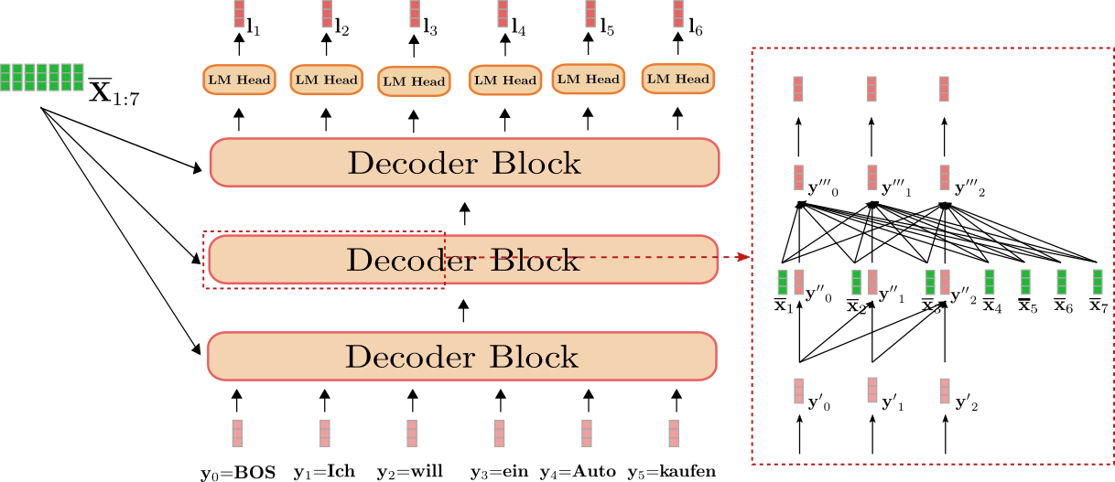
Decoder Architecture Explained
Stacked Decoder Blocks:
Series of identical layers known as decoder blocks.
Stacked atop one another, responsible for generating the output sequence.
Language Model (LM) Head:
Block is connected to an LM Head, a dense layer that helps in predicting the next token in the sequence by converting the decoder's output into logits, which are scores for each token in the vocabulary.
Uni-directional Self-Attention:
Within each decoder block, the uni-directional self-attention layer prevents the model from attending to future positions in the sequence, ensuring that the prediction for a position can depend only on the known outputs at previous positions.
Cross-Attention Mechanism:
Cross-attention layer that attends to the encoder's output, vital for incorporating the context provided by the input sequence into the output sequence generation.
Conditional Probability & Auto-regression:
Output generation is auto-regressive, with each word being predicted based on the encoder's output and the sequence of words already generated, starting with the special "begin-of-sentence" (BOS) token.

