Slide 1

Quantized Visions: Decoding Imagery with VQ-VAE Assignment 5: A Deep Dive into Vector Quantized Variational Autoencoders
Devesh Surve
14th Feb 2024
ID: 002766974

Slide 2
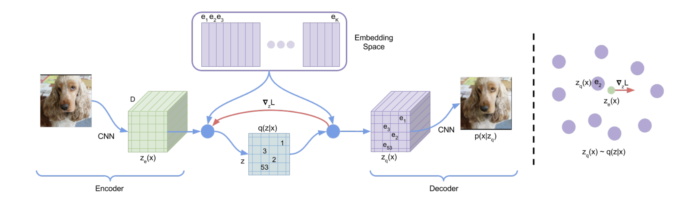
Introduction to VQ-VAE
What are VQ-VAEs:
VQ-VAEs represent a novel approach in autoencoding, introducing a discrete latent space to the traditional continuous autoencoder framework.
Significance in Machine Learning:
VQ-VAEs enable us to learn robust and meaningful representations of data without labeled datasets, which is a major step forward in unsupervised learning.
Comparison to Traditional Autoencoders:
Unlike traditional autoencoders that map inputs to a continuous latent space, VQ-VAEs quantize the space, leading to more efficient representations and preventing common issues like posterior collapse.

Slide 3
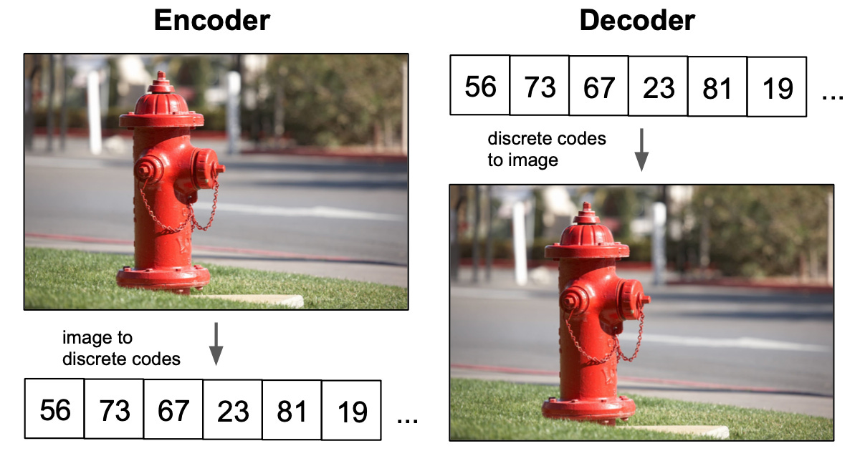
Discrete Latent Space and Vector Quantization
Discrete Latent Variables:
In contrast to traditional autoencoders that represent data in a continuous latent space, VQ-VAEs introduce a discrete latent space, enhancing the model's representational efficiency.
Vector Quantization Explained:
Vector quantization is the process where the continuous outputs of the encoder are mapped onto a finite set of embeddings, turning them into discrete codes.
Benefits of VQ:
By using a discrete latent space, VQ-VAEs offer a more stable and interpretable training process and enable the model to leverage powerful autoregressive decoders effectively.

Slide 4
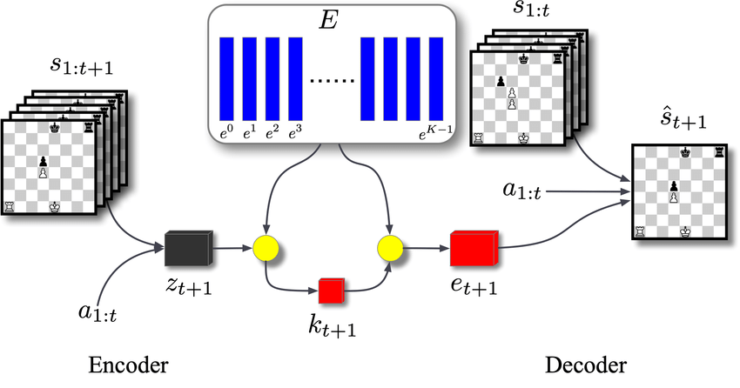
Architectural Deep Dive: Building Blocks of VQ-VAE
Encoder Architecture:
The encoder is the first stage in VQ-VAE, compressing the high-dimensional input into a lower-dimensional latent space.
Quantizer Mechanics:
At the heart of VQ-VAE, the VectorQuantizer layer transforms the continuous latent variables from the encoder into discrete embeddings, using a codebook of learnable parameters.
Decoder Functionality:
The decoder receives the discrete codes and up-samples them back to the original input dimensionality, effectively reconstructing the input data.

Slide 5
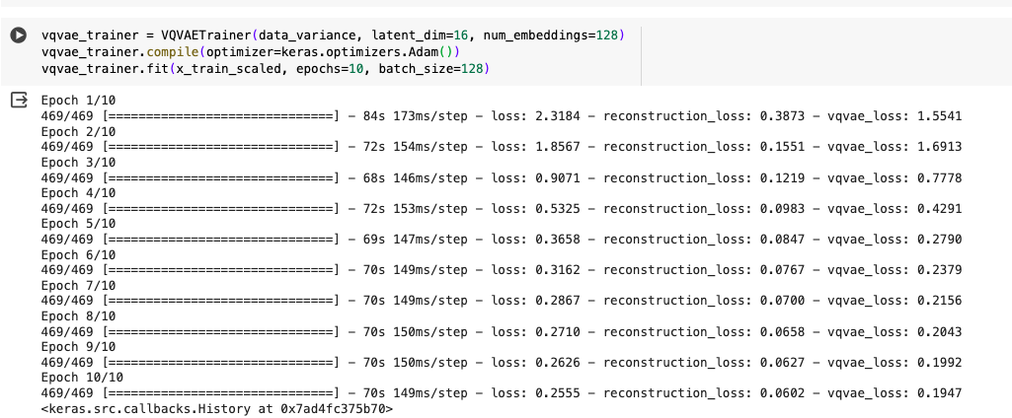
Training the VQ-VAE Model
Reconstruction Loss:
Reconstruction loss measures the fidelity of the output when compared to the input, driving the model to generate accurate reconstructions.
Codebook and Commitment Loss:
Codebook loss encourages the embeddings to approximate the encoder outputs closely, while commitment loss ensures the encoder commits to its chosen embedding, thus stabilizing training.
Training Dynamics:
Balancing these loss components is crucial; it affects the model's ability to learn a diverse and useful set of discrete codes and to reconstruct inputs accurately.

Slide 6
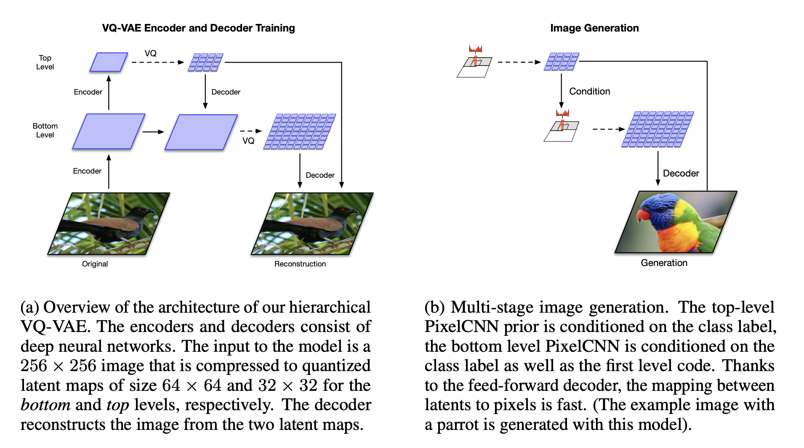
Generative Horizons: PixelCNN & VQ-VAE
PixelCNN Overview:
PixelCNN serves as a powerful generative model, predicting pixels sequentially to capture the underlying data distribution in the latent space.
Learning the Latent Distribution:
By training on the discrete latent codes, PixelCNN learns to generate new codes that can be decoded into novel images, thus enabling VQ-VAE to generate unseen data.
Expanding VQ-VAE's Generative Capacity:
The integration with PixelCNN allows VQ-VAE to not only reconstruct but also to create, by sampling from the learned distribution.

