Slide 1
INVESTMENT ASSIGNMENT SUBMISSION
Name: Devesh Khare

Slide 2
Spark Funds Investment Analysis Assignment
Spark Funds, an asset management company, is looking for investment.
The overall strategy is to invest where others are investing, implying that the 'best' sectors, countries and
investment type where most investors are investing.
Business constrains:
• It wants to invest between 5 to 15 million USD per round of investment
• It wants to invest only in English-speaking countries
Business objective:
To identify the best sectors, countries, and a suitable investment type for making investments.
Goals of data analysis:
• Investment type analysis
• Country analysis
• Sector analysis

Slide 3
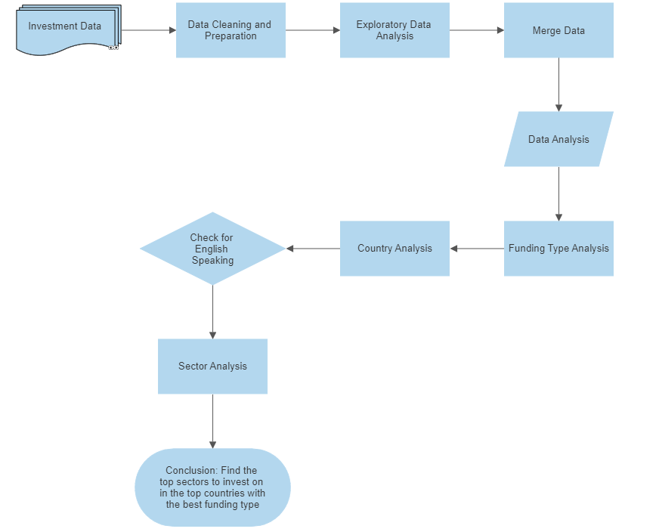
Problem Solving Methodology

Slide 4
Data Cleaning, Collection and Preparation
Data from all three files is imported into panda’s data frames.
The dataframes are then checked for missing values
We find out the percentage of missing values for each column and determine how we deal with it, remove column/ impute with median, impute with mean/ knn imputation based on the type of our data. Median is used here as the data has outliers and for sake of simplicity.
We check the data for outliers using a box plot.
Given data has a lot of outliers and a copy of our data is created and then outliers are removed based on the inter-quartile range concept
The dataframes are then merged to form a master dataframe.
Columns Trivial for our analysis our removed.
Now we proceed to the analysis.
However after a rudimentary analysis it becomes evident that the outliers removed were important to the data and hence we go back to our data of which we had saved a copy earlier and then perform the analysis again/

Slide 5
Data Analysis
Funding Type Analysis:
Here we find out which funding type is most relevant for us: We choose amongst the four venture, seed, private equity and angel. Which of these have maximum number of funding rounds that fall under the 5-15 million range that we desire.
Country-wise Investment Amount Analysis
Here we check the countries which have previously received most fundings for the funding type which we have chosen and they also need to be an English speaking country.
Sector wise Analysis
Here we find out which sectors are the highest funded for every country individually
We then find out the top companies in that sector which have received the highest funding.

Slide 6
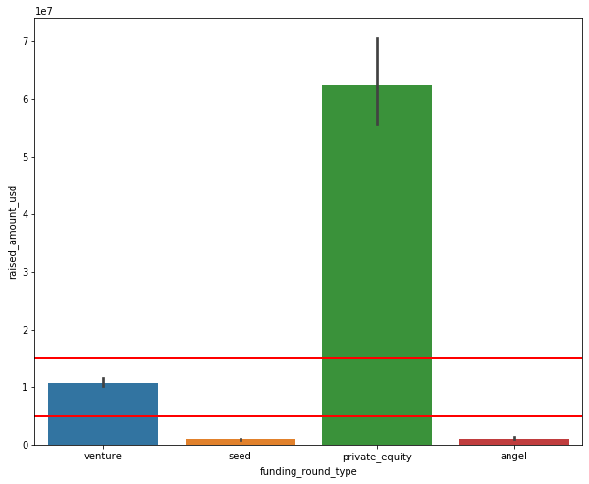
Funding Type Analysis
Plot1

Slide 7
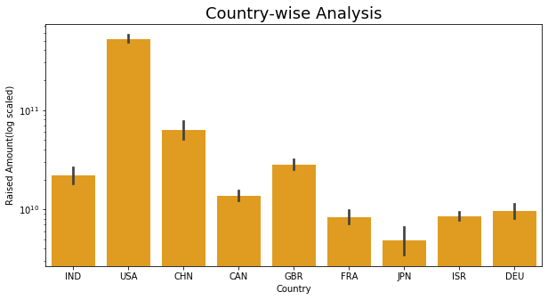
Country-wise Investment Amount Analysis
Plot 2

Slide 8
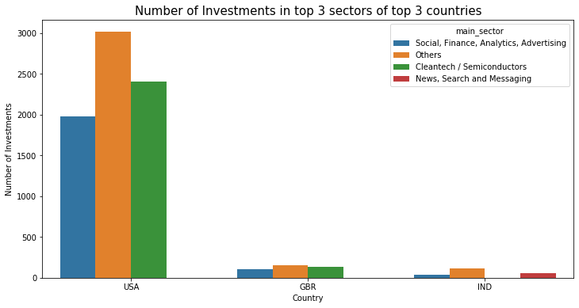
Number of Investments in top 3 sectors of top 3 countries
Plot 3

Slide 9
Results
Sl.no | Observations: | USA | UK | India
1 | Total number of Investments (count) | 12635 | 664 | 342
2 | Total amount of investment (USD) | $ 1,12,56,26,37,512.00 | $ 5,72,69,36,263.00 | $ 3,06,55,43,502.00
3 | Top Sector name (no. of investment-wise) | Others | Others | Others
4 | Second Sector name (no. of investment-wise) | Cleanteach/Semiconductors | Cleanteach/Semiconductors | News, Search and Messaging
5 | Third Sector name (no. of investment-wise) | Social, Finance, Analytics, Advertising | Social, Finance, Analytics, Advertising | Social, Finance, Analytics, Advertising
6 | Number of investments in top sector (3) | 3014 | 149 | 113
7 | Number of investments in second sector (4) | 2408 | 130 | 53
8 | Number of investments in third sector (5) | 1614 | 103 | 34
9 | For point 3 (top sector count-wise), company which received highest investment | Virtustream | Electric Cloud | Firstcry.com
10 | For point 4 (second best sector count-wise), company which received the highest investment | Capella | Sensage | Myntra

Slide 10
Conclusions
Clearly USA is the best Country to invest in followed by UK and India.
Venture is the best Funding Type for our investments ranging between 10-15 million
Best Sectors to invest in USA are Others, Cleanteach/Semiconductors, (Social, Finance, Analytics, Advertising)
Best Sectors to invest in UK are Others, Cleanteach/Semiconductors, (Social, Finance, Analytics, Advertising)
Best Sectors to invest in India are Others, (News, Search and Messaging), (Social, Finance, Analytics, Advertising)
Companies in the USA which received highest funding are: Virtustream and Capella
Companies in the UK which received highest funding are: Electric Cloud and Sensage
Companies in the USA which received highest funding are: Virtustream and Capella
Companies in India which received highest funding are: firstCry.com and Myntra

