Slide 1
Site Minder / Okta SAML
Securing J2EE WEB App on IPN Managed Tomcat JVMs
Proven in Pre IAF (Servlets) ERA > IAF > Struts > EJPM Kit > DSFJ > Spring
Need to Prove in OpenStack, Openstack Powered Cloud Foundry, Azure and AWS clouds
By: Ashok Jangid
YASH TECHNOLOGIES INC

Slide 2
Developer Enablement / Enterprise Architect / IT-Modernization Team
Sub Team “WAS Factory” within DE / EA
Two onsite team members – Ashok Jangid and Bala Pallinti
One offshore team member – Pawan Madanan
WAS Factory is working with Deere groups / Departments
FiHRE (Corporate HR, FIN and Labor)
IT Manufacturing – Factories Back Office Applications development and support
JDSN – Supplier Network Applications
PDC
Many More to join

Slide 3
WAS Factory Team Vision
Objective is to help migrate legacy apps from WAS v7/8 to IPN managed Tomcat servers.
Why not OpenStack / Cloud Foundry / AWS as target hosting solutions?
Previous Groups (FiHRE, IT Mfg, PDC & JDSN) not having capability, budget and resources.
These legacy apps are too far to take advantages of cloud tools / technologies compared to just lift and shift.
Current support teams like Aquent or IBM India may not have cloud capabilities.
What are the IT Modernization Tasks?
Mavenize the app using enterprise artifactory repo https://repository.deere.com
Migrate the source code from SVN (WAS v7/8) to GitHub (Tomcat migrated).
Move passwords and other sensitive data from Java class / Properties files to XL DeployIT Encrypted data dictionary.

Slide 4
WAS Factory Team Vision - Continue
What are the IT Modernization Tasks?
Implement Tomcat Database Connection Pool.
Build and Deployment using Jenkins Pipelines “Jenkinsfile” and XL Deploy maven plugin.
Replace Site Minder Basic Auth / Form based Auth by,
Site Minder SAML Auth [Temporary to keep the WAS/Tomcat migration scope limited as Okta will not provide RACF Groups]
Okta SAML Auth
Why both?
Legacy apps are having logic using RACF Groups derived from SM HTTP headers.
Okta will not provide RACF Groups for the logged in user.
Either replace RACF Groups by AD Groups OR
Call UUC component to get the RACF Groups [Easiest Way, may be other alternatives]
The above two alternatives will need application code changes which are not in scope of WAS to Tomcat migration.
System Property Switch to enable either SM OR Okta SAML, so the app owner team will switch to Okta FINALLY without any change.

Slide 5
Present State – Site Minder Basic Auth / Form based Auth
SM Basic Auth (Popup window) Used for app to app integration.
SM Form Auth (SM Login page) Used for Web app login.
Apps running on WAS and relying on Apache web servers site minder agents for authentication and authorization (RACF Group membership)
After successfully authenticated and authorized, apps are getting current logged in user id and authorized RACF groups from Site Minder HTTP headers.
WAS/Tomcat JVM request form has questions to add SM security including application URL → Policy setup (Mostly RACF Groups)

Slide 6
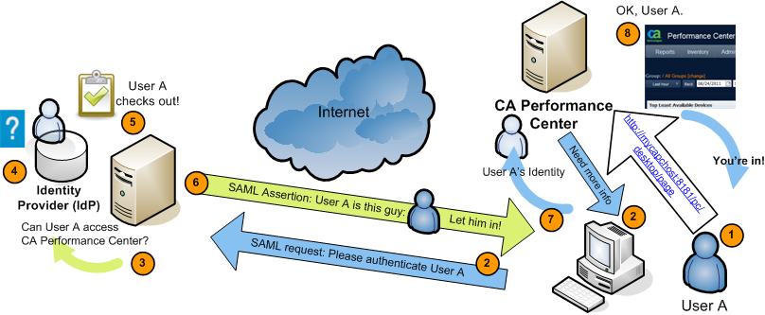
SAML
SAML Authentication Flow

Slide 7
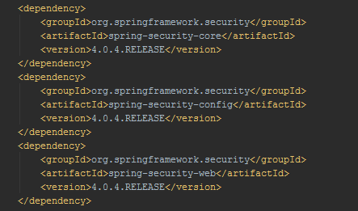

Future State – SSO using Site Minder SAML / Okta SAML
Common Steps for Both SM and Okta
Using Spring Security Framework v4.0.4.RELEASE / Sometimes v3 for Legacy Apps
With SAML Extension

Slide 8
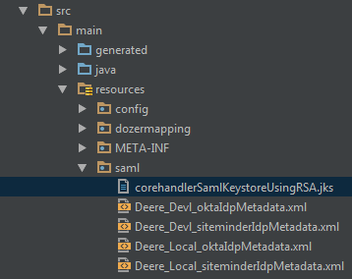
Future State – Common Steps for Both SM and Okta Cont.
Create the Java Keystore encrypted file to store the private and public keys which gets exchanged between your App (SP) and SM/Okta (IDP).
Use JDK Keytool to create the JKS file and put in resources folder.
keytool -genkeypair -alias <<REPLACE_WITH_ALIAS>> -keypass <<REPLACE_WITH_KEYPASS>> -keystore <<LOCAL_FILESYSTEM_PATH>>\samlKeystoreUsingRSA.jks -keyalg "RSA" -sigalg "SHA256withRSA"
Okta supports both DSA and RSA, but Site Minder only supports RSA alogorithm.
Also put the SAML Metadata XML for SM and Okta into this same folder.

Slide 9
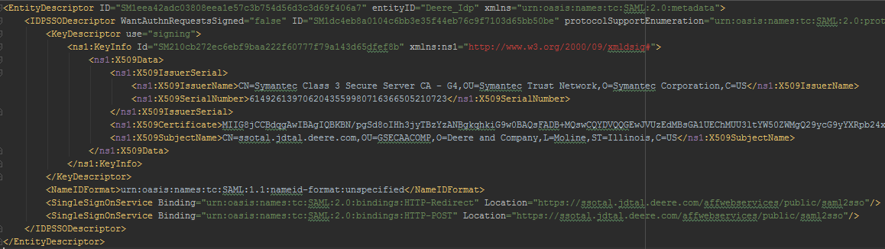
Future State – Common Steps for Both SM and Okta Cont.
SAML Metadata XML File
This metadata XML file has SAML SSO login URL.
SM security team has fixed/static SAML Metadata XML file for each environment to be loaded in your App (SP).

Slide 10
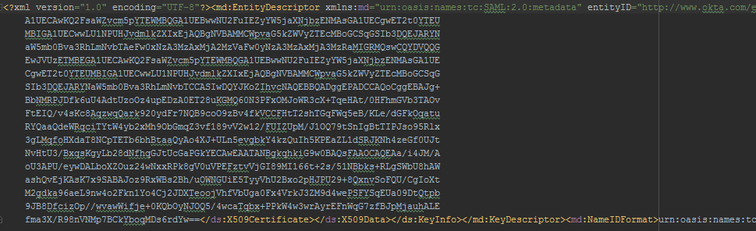
Future State – Common Steps for Both SM and Okta Cont.
SAML Metadata XML File
Okta SAML Metadata file downloaded from the application created within Okta with Admin access.
Team members can create applications within Okta in “Preview” instance https://johndeere.oktapreview.com

Slide 11
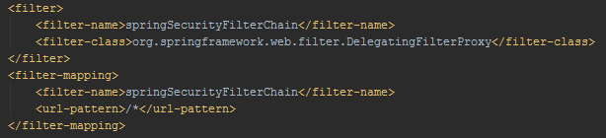
Future State – Common Steps for Both SM and Okta Cont.
Add Servlet Filter in the web.xml
Need to define two beans which will be created at the Tomcat server startup
WebSecurityConfigurerAdapter JAVA class OR security-context.xml XML file.
The URL authorization using Roles/Authority (RACF Groups) configured in this bean.
SAMLUserDetailsService JAVA class → To get the logged in user ID and other SAML attributes enabled like RACF Groups, First Name, Last Name, Email etc…

Slide 12
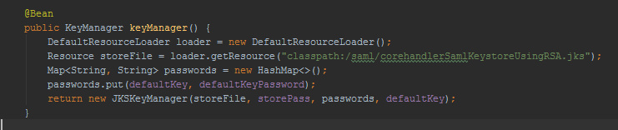
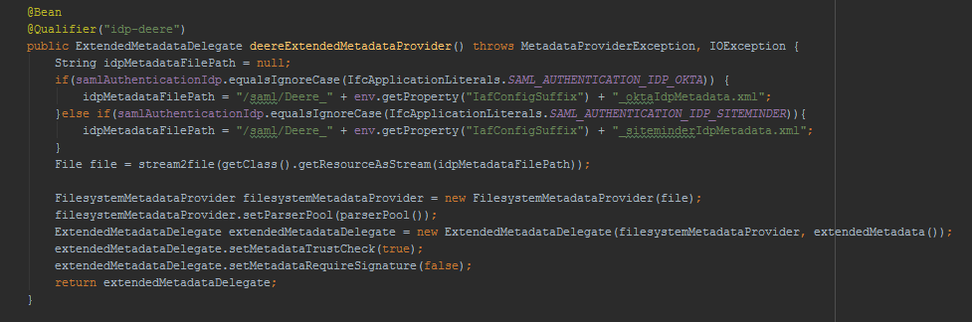
Future State – Common Steps for Both SM and Okta Cont.
WebSecurityConfigurerAdapter OR security-context.xml details.
Load JKS keystore at Tomcat Server Startup
Load SAML Metadata XML at Tomcat Server Startup. Notice the Switch Between Site Minder and Okta.

Slide 13
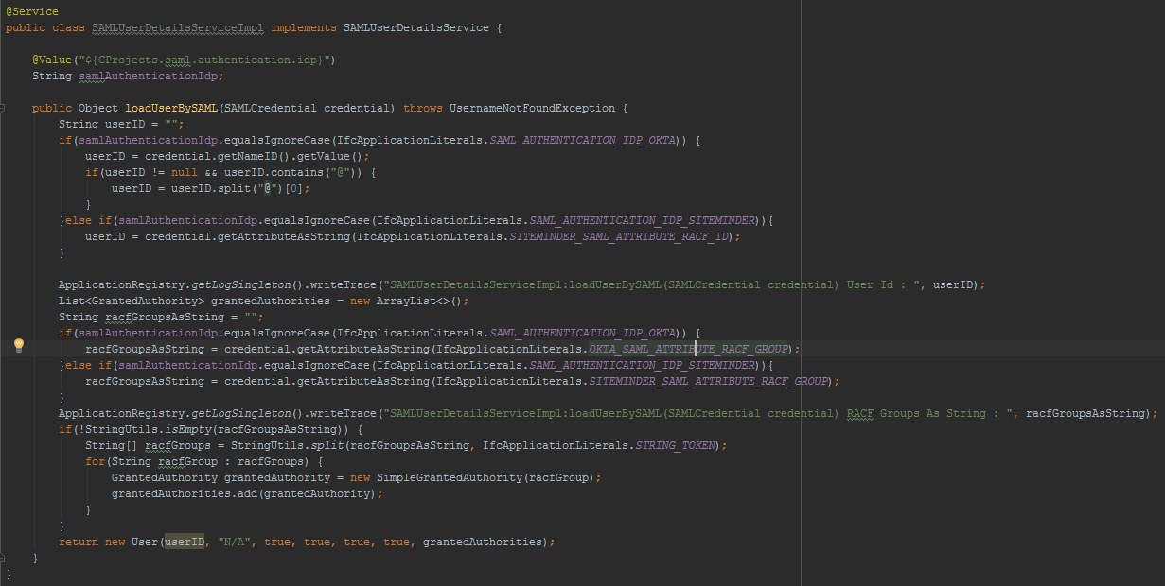
Future State – Common Steps for Both SM and Okta Cont.
SAMLUserDetailsService JAVA class details.
Get the SAML attributes User Id, RACF Groups etc. setup in SM OR Okta.

Slide 14
Future State – Unique Steps for SM and Okta
Site Minder SAML
Generate SAML Metadata XML for Loca, Devl, Qual, Cert and Prod environments after Spring Security SAML implementation in your App (SP).
At this point your app URLs will give request forbidden 403 error as there is no SAML partnership has been setup between SP and IDP.
Need to work with the Site Minder Security team (WebAuthSupport) to setup the SAML partnership.
Okta SAML
Create your own app using Okta Admin access.
While creating the app it will ask for SSO URL, Entity Id and relay state URL (App Base URL).
You can download the metadata after the Okta app creation and put in your app source code.

Slide 15
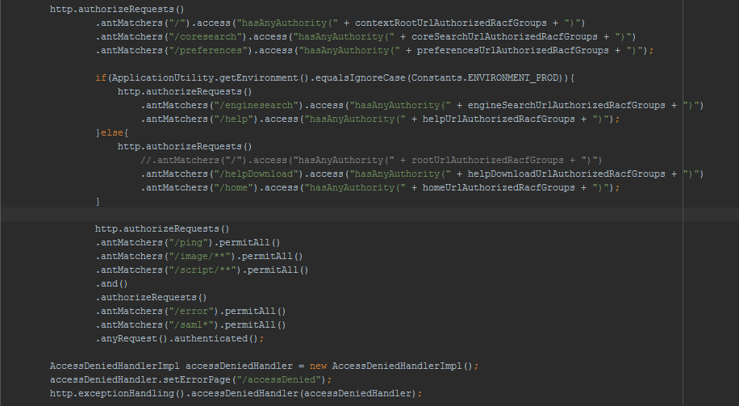
Future State – SM/Okta SAML URL Authorization
To replace the SM URL Policy configuration

Slide 16
Thank You

