Slide 1
Prompt Engineering 101 Guide

Slide 2
What is Prompt Engineering?
Providing instructions to LLM is prompt and if we format our prompt with rules and constraints then we can call as Prompt Engineering.
We should design inputs to guide LLMs to produce:
Accurate
Consistent
Structured
Safe outputs

Slide 3
Standard Prompt Structure for Prompt
1. Role (Who the model is) 2. Task (What to do) 3. Context (Data / background) 4. Constraints (Limits, rules) 5. Output format (Strict structure) 6. Examples (Optional but powerful)
Role- Why it matters
Let’s see a story-> suppose you are computer hardware support executive and when you come to office your manager asks you to go to market and take some orders from clients. Think will you able to do your work properly?
No, you will not able to take orders in professional manner because your role is computer hardware support executive, your mind set is for another role.
Similarly, when we instruct LLM and assign some role , LLM try to work like that professional

Slide 4
Step-by-Step Prompt Engineering Process
1.Define Goal-
Bad: "Explain AI" Good: "Explain AI to a non-technical manager in 5 bullet points“
2. Assign Role
you are technical architect
3. Add Constraints
.Do not exceed 100 words .Avoid technical jargon .Use bullet points
4. Define Output Format
Return JSON: { "risk": "", "score": 0 }

Slide 5
Prompt Engineering
Role
Who You are
Task
Please extract data from this or do some research
Rules
Please do not consider this or avoid this
Output
JSON {Key Value}

Slide 6
Important Prompting Techniques
1. Zero-shot Prompting
This is prompt where we are just asking LLM to do something without providing any other details
Example
Can you explain AI

Slide 7
2. Few Shot Prompt
We can provide some examples while defining prompt.
Classify the user intent into one of: - Refund - Complaint - Inquiry Example: Input: "I want my money back" Output: Refund Input: "This product is not working" Output: Complaint Input: "What is the delivery time?" Output: Inquiry Now classify: Input: "I have not received my order yet" Output:

Slide 8
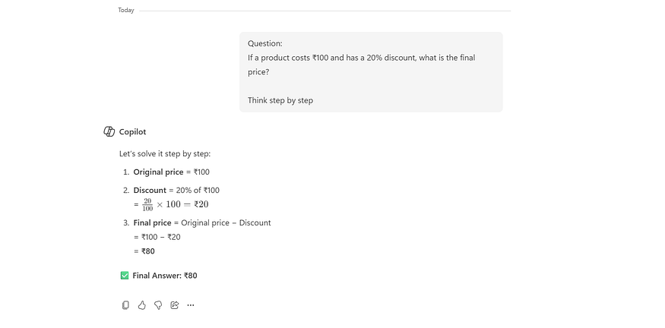
3. Chain-of-Thought (CoT)
This is very useful when we need something like LLM to think and Observe and Plan
Question: If a product costs ₹100 and has a 20% discount, what is the final price? Think step by step.

Slide 9
4. Self-Reflection Prompt
Here we can ask LLM to review and improve answer.
Answer the question: "Explain microservices architecture" Then: Review your answer and improve clarity, correctness, and completeness.

